Slide 2
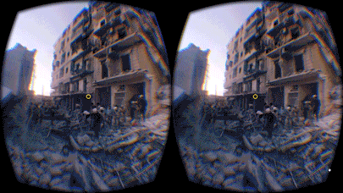
360 Syria:
Digital resources for empathy & activism
Notes:
Slide 1: 360 Syria: Digital Resources for Empathy and Activism
This training will introduce activist groups and other groups to the 360 Syria project undertaken by Amnesty International. It will teach them how to use the virtual reality headsets and the 360syria.com website.
You may include the following:
This training will introduce you to Amnesty International UK’s 360 Syria project.
It will include exploring the virtual reality headsets and the 360syria.com website.
Both these digital resources allow people to have an immersive experience of what life is like on the ground in Syria, through using spherical 360 images of post barrel bomb sites in Aleppo, a northern city in Syria.
Whilst the human rights violations that we see Amnesty campaigning on or the stories we see in the news everyday may move many people to take action, like our dedicated activists around the world, often these people are in the minority.
Apathy and not knowing what to do plays a big part in why the majority of people do not take action for human rights.
Through the 360 and virtual reality experience Amnesty believes that people are more likely to feel empathy about the human rights situation suffered by people in Syria and therefore may even be encouraged to take action.
This training will enable people to engage with the human rights situation in Syria and show people how they can take action for human rights change.

Slide 3
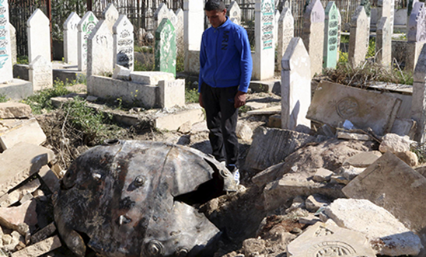
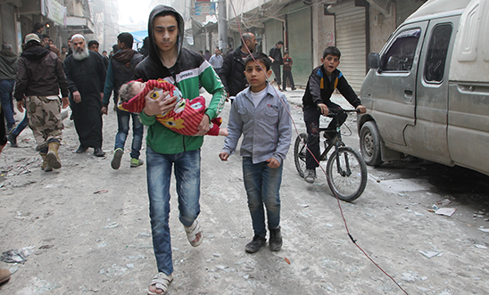
TRAINING OBJECTIVES
Find out what Amnesty International UK is doing on the Syria crisis
Understand the issues surrounding Syria and be able to effectively communicate these to others
Gain skills, awareness and confidence when using digital resources
An unexploded barrel bomb dropped by forces loyal to Syria's President Assad at a cemetery in Aleppo. © Reuters
Civilians fear the Syrian regime’s planes circling above them in Aleppo © Amnesty International
(Photo: Mujahid Abu al-Joud)
Notes:
Slide 2: Training Objectives
This slide will go through the three main training objectives as well as providing a content warning for the issues that may be explored in the session. Trainers are advised to regularly check with the group at different stages of the training to allow participants to opt out or raise concerns about the content that is to follow, e.g. explaining the next stage of the training thoroughly and what participants can expect.
You may include the following:
The objectives of this training will be to:
Find out about Amnesty International UK’s work on the Syria Crisis, including the work we are doing on the ground working with peaceful activists in Syria.
Secondly, we want you to understand the human rights issues surrounding Syria and feel confident in effectively communicating these to others.
And lastly, we hope that you will gain the skills, awareness and confidence to use the virtual reality and 360 Syria digital tools. This will include exploring the virtual reality headsets and the 360syria.com website.
It is important to note that some of the images and stories that will be explored in today’s training will be harrowing and difficult to comprehend. Whilst this is a reality for millions of people around the world caught up in bloody conflicts and wars, we appreciate that the content shared today can cause distress and upset.
Although this response is likely to lead to feelings of empathy, we do not wish for any of you to feel unduly affected by this content, we therefore advise that you exercise careful consideration and feel free and comfortable to excuse yourselves from activities, if you wish.
As we move through the training, effort will be made to inform you of the content in advance and allow you to opt out or ask any questions before moving forward.
In the next part of this training you will be doing an activity exploring a range of different images from everyday scenes to scenes of war and destruction.
Does anyone have any questions before we move on?
(Address any issues to clarify the activity and allow people to opt out if they wish)

Slide 4
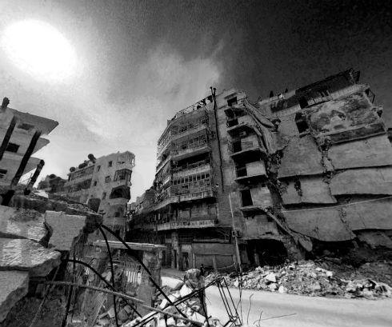
starter activity Scavenger Hunt
Share your image(s) with as many people around the room.
Reflect with others the meaning you assign to images you see.
Do you see images that leave you feeling positive, negative or even neutral?
© Amnesty International UK
Notes:
Slide 3: Starter Activity: Scavenger Activity
This activity will allow people to explore the relationship between imagery and emotions and how it can play a different role to different people. We will explore feelings of positivity, negativity and neutrality in response to the picture cards given out. If you are training a larger group print more than one copy of the picture cards if required. This activity will still work if images are duplicated. Make sure you share a wide range of images, e.g. don’t share just the war and conflict images but allow for a full spectrum of images to be explored. In smaller groups you may give two picture cards each. Lastly, there are several images that you should always use as they make for useful discussion in the reflection session. These are the images that include white helmets, clear blue sky and the airplane.
Activity Objective: To personally reflect on the impact of imagery and how life experiences influence interpretations.
Duration: 15 minutes
Resources: Activity 1 Picture Cards (Print and cut to individual images)
AJ+ White Helmets’ video: https://amp.twimg.com/v/da13a353-ff0e-4fff-ae2c-2066a6b0a8fb
5 minutes to explore each others images
5 minutes to organise themselves in groups in a line (positive, negative and neutral) and look at what images went where.
5 minutes for trainer to reflect on how different images could mean different things to different people.
You may include the following:
Hand each person a picture card and ask them to move around the room and share and discuss their image with as many people as possible in 5 minutes. (5 minutes)
Ask the group to organise themselves in a line across the room on a spectrum, one end for images that are interpreted as positive and the other end for images that are interpreted as negative. People who feel neutral should remain in the middle of the line.
If people have more than one picture card then ask them to select only one image for this part of the activity. Ask the group to hold out the images so that others can see where they have chosen to stand based on the image they have. In particular, look out for the images with the blue sky, aircraft and white helmets.
You may wish to ask a couple of people to explain why they chose to stand in certain places, e.g. blue sky may be positive and bombed scene may be negative.
Now identify where the images of the clear blue sky and airplane are. Ask the group “what is the ideal weather condition for drone strikes to operate?’ Answer: A clear blue sky. So a clear blue sky to people in Syria, Afghanistan or Yemen could derive emotions of fear, pain and negativity.
Likewise, an airplane to some of us may mean the freedom to travel, to enjoy holidays, but to others it may be the vessel used to destroy their communities and homes. It may also symbolise the lack of access for many people to air travel, particularly in light of the refugee crisis. Questions are being asked by people about why people fleeing war don’t just fly to somewhere safe, why are the risking their lives in the sea. This is where human rights education can be so vital.
You may finish with the images of the white helmets. Identify where the white helmet images are and explain that in Syria the White Helmets are a civilian led rescue operation. Many of these people are teachers, students, lawyers, bakers, etc. but in light of no state run rescue services (due to government forces being predominantly responsible for such attacks) they are filling this vital gap and risking their lives.
You may wish to finish with the AJ+ video (link above). Provide a content warning as it is graphic and distressing. This is a video of a child crying over his father's death in Aleppo pleading “Dad, don't leave me.” This child's father was killed while on a White Helmet mission to rescue people from the rubble in Syria.

Slide 5
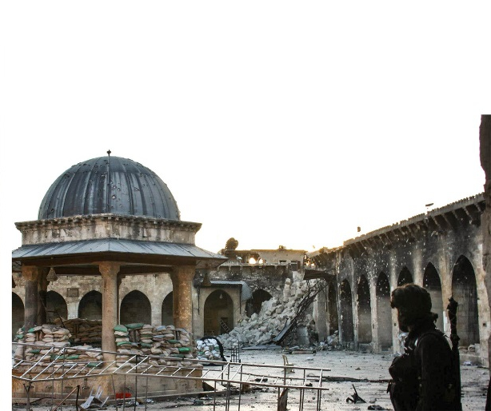
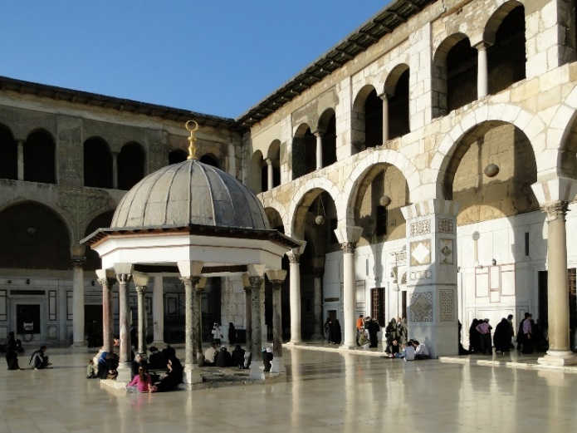
Overview: Syria crisis Aleppo: before and after
Ummayad Mosque’s Dome of the Clock was built in 780. Wikipedia Commons
Ummayad Mosque of Aleppo in 2013, after destruction of the minaret. Wikipedia Commons
Notes:
Slide Four: Overview Syria Crisis
This slide introduces the city of Aleppo, a northern city in Syria, where the 360 images have been taken. It gives an overview of the situation and takes you through images of key places in Aleppo, before the conflict and the state of those places today. You may wish to share the Fact Sheet: Aleppo 360 with the group and allow some time for the group to reflect on the different images and information provided.
Resources: Fact Sheet: Aleppo 360
You may include the following:
All of the images used for the 360 website and virtual reality headset are from Aleppo, a northern city in Syria.
Aleppo is one of the world’s oldest cities and the area is thought to have been inhabited since 5000BCE. The modern day city of Aleppo occupies the same area as its ancient site, the Old City.
The Old City of Aleppo reflected the rich and diverse cultures of its successive occupants. Many periods of history have left their influence in the architectural fabric of the city. The diverse mixture of buildings represented an exceptional reflection of the social, cultural and economic aspects of what was once one of the richest cities in the world.
The great citadel of Aleppo has the grim distinction of being the world’s only ancient fortress that is back in action today as a garrison and artillery battery in the midst of war.
The battles and fighting have caused catastrophic destruction to the Old City of Aleppo. These images show the damage and devastation caused to the Great Ummayad Mosque. Showing the contrast of how they once stood compared to their present harrowing reality.
Aleppo, once Syria’s economic powerhouse, has been devastated by fighting since 2012. The city is now divided between government control in the west and opposition control in the east. Much of Aleppo has been left in ruins as regime forces carry out aerial attacks and rebels retaliate, despite criticism of both sides from humanitarian organisations

Slide 6
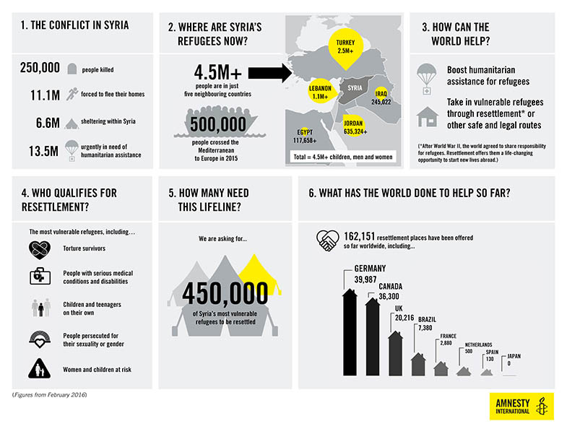
Overview: Syria crisis
Notes:
Slide 5: Overview: Syria Crisis
This will go through the extent of which this conflict has affected the lives of Syrian people, the extent of the refugee crisis and the response so far.
You may include the following:
This infographic is taken from Amnesty research from February 2016.
The human cost of this conflict has been huge with the death toll ranging from 250,000 to 450,000 lives.
It has led to the biggest humanitarian crisis since the second world war with over 11 million Syrians having to flee home. The vast majority are internally displaced and still at significant risk.
Over 4 million have fled Syria as refugees, predominantly seeking refuge in neighbouring countries, like Lebanon, Iraq, Jordan, Egypt and Turkey, who alone host over 2 million Syrian refugees.
In addition, 2015 saw over half a million Syrian refugees cross the Mediterranean into Europe.
Amnesty wants to see a boost in humanitarian assistance for refugees as well as resettlement places for vulnerable refugees and safe and legal routes to refuge.
Some, 450,000 resettlement places are needed but so far only a quarter of those places have been pledged, with the UK pledging to take 20,000 over five years and to date only resettling refugees in the low hundreds.

Slide 7
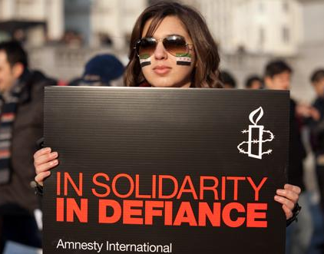
AMNESTY’S WORK ON SYRIA
Solidarity with people peacefully demanding their human rights – Defiance against those trying to stop them.
Transition
Accountability
Humanitarian action
Solidarity and Support
for detained Syrian activists
Refugees & Resettlement
Notes:
Slide 6: Amnesty’s work on Syria
This slide will go through the key areas that Amnesty International UK is focusing on our Crisis campaign. There are five key areas and you will elaborate on what each of them entails.
You may include the following:
We are now going to look at Amnesty International’s work on the Syria crisis.
The Syrian uprising took place in March 2011. Since then Syria and the surrounding region has become the most severe humanitarian and human rights crisis in the world.
Everyday that passes without an effective international response to the crisis compounds the misery of ordinary civilians in Syria.
So we have five key areas that we are focusing on.
The first is Transition, where we are looking to empower, equip and mobilise peaceful Syrian activists who we work with, hoping to lead to the development of an independent civil society, dedicated to human rights.
The second focus of this campaign is Accountability, this is about increasing exposure of human rights violations taking place in Syria, regardless of whether those violations are committed by government forces or non-state actors. This 360 Syria project with the virtual reality headsets as well as the 360syria.com website, play a key role in exposing human rights violations and create opportunities to bring parties to account by showing the full.
The third focus is Humanitarian Action, this is looking at securing durable cross border and cross line aid delivery ensuring that UN security resolutions are effectively implemented, in order to make sure that the aid goes to the necessary places.
Then we have Solidarity and Support for Detained Syrian Activists, where we are building our case work which will demonstrate our solidarity with Syrian activists and call for their release.
Lastly, we have Refugees and Resettlement, where we want to see increased investment in the regional refugee response and ensure that the UK and other countries resettle vulnerable Syrian refugees.

Slide 8
360 Syria: virtual reality
Notes:
Slide 7: 360 Syria: Virtual Reality
This slide will briefly go through how Amnesty International UK has been developing our work on virtual reality in the context of Syria, and how it has been a dynamic and innovative tool for fundraising, campaigning and education.
You may include the following:
Amnesty International UK has been working very closely with Syrian media activists, Lamba Media Production. Following training and providing them with new equipment from Amnesty, they have helped us collect 360 degree photography to document the devastation caused by barrel bombing on cities across Syria.
Their brave work brings us one step closer to holding the perpetrators of these atrocities to account.
The 360 images allow us to be fully immersed in the photograph, as you will see when you get a chance to use them later.
Virtual reality has proved to be a very useful tool for Amnesty. It is a high quality research tool, in countries where we may not be able to have researchers, e.g. in Syria. Therefore acts as a remote research tool. It helps us to raise awareness of the work carried out by peaceful Syrian activists and as a result has given these activists more exposure to key media outlets, including Channel 4 News and New York Times.
We have found it particularly useful in growing the Amnesty movement to deliver higher impact. For example, we found that people were more likely to stop for street fundraisers and also more likely to donate. In fact, we have seen an increase of up to 16% in people signing up to direct debits. This has allowed us to take these images to the public, for them to realise what it is like to be in Syria and therefore empathise with the people in Syria.
Lastly and most importantly, virtual reality increases understand, empathy and action outside of Syria.
We are now going to move on to exploring the virtual reality head sets. The images are hard hitting and may even be upsetting. Please do be aware of this as you part take in the activity. If anyone wishes to sit this out that is also completely fine.

Slide 9
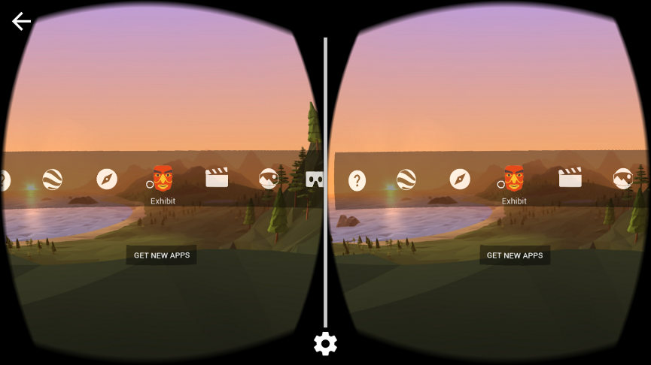
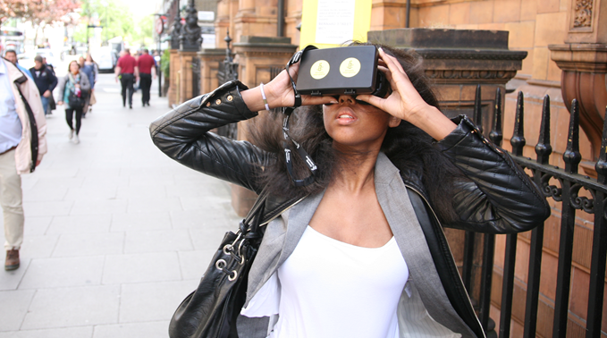
Activity
Explore 360 Syria Virtual reality
Notes:
Slide 8: Activity: Explore 360 Syria Virtual Reality
This activity will allow people to explore the virtual reality headsets and discuss in groups their immediate response to the images and virtual reality as a tool. It is essential that you complete the Office Mix Module on 360 Syria – VR Headset Online Module in advance so that you can explain how you use and set up the images. It is also advised that you set up the headsets ahead of time, with the image ready and leave the device on sleep mode until you need to use the headset for this activity. Remember to keep the devices on airplane mode to saved battery life.
Activity Objective: For participants to immerse themselves in the images and engage with the content, building empathy and knowledge of the Syria crisis.
Duration: 20 minutes
Resources: VR headset, Activity Sheet: A day in the life of...
Preparation: Office Mix Module – 360 Syria VR Headset Online Module.
Part One – https://mix.office.com/watch/1oox51xiewy75
Part Two – https://mix.office.com/watch/d1dzgixmy7vz
Part Three - https://mix.office.com/watch/15a574haeyilw
10 minutes for whole group to explore images
5 minutes to complete ‘Thinking Points’ activity.
5 minutes for groups to feedback on their initial reactions.
You may include the following:
Talk through how to operate the headset. How the case operates, how to turn it on, etc.
Hand out headsets to groups of three to five and allow them all time to explore the images. You can use only one image if you wish or have them look at all three images. Provide them each with the ‘a day in the life of’ activity sheet, so that they can start personally reflecting after viewing and whilst others are using the VR headsets. (10 minutes)
Get the group to share their reflections with other. (5 minutes)
Get some feedback from the group on the activity. Ask them about how they would use the headsets and the images.

Slide 10
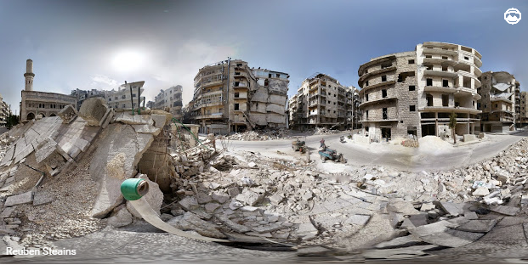
Story behind image 1
Notes:
Slide 9: Story Behind Image 1
This slide will briefly tell the story of the photographer who took this photo and his account of losing his father in a barrel bomb strike.
This is a distressing account so you may wish to provide a content warning or leave out the graphic parts but make sure you keep the integrity and respect for this individual’s personal account.
Preparation: Office Mix Module – 360 Syria VR Headset Online Module.
Part Three - https://mix.office.com/watch/15a574haeyilw
You may include the following:
The first image is the best image to use to engage people. There is a cross road with motorcyclists, surrounded by tall crumbling residential buildings and a neighbourhood mosque with a destroyed minaret. This is clearly a neighbourhood where a community once lived and flourished.
This is an area in Aleppo called Ash-Sha’ar, which is deliberately being targeted by the Syrian government using barrel bombs. Barrel bombs are illegal under international law and have been used to destroy schools, hospitals and residential areas, like this. This area is being deliberately targeted by the government as it was a rebel held area. However, it also housed over 250,000 families but now this number is in the low hundreds because people have been forced to flee or they have been killed.
Every building with the exception of the Mosque are residential buildings. It was a working class area. The people here were small business owners, taxi drivers or factory workers. Before the bombings you would often see children playing, going to school, and people living their ordinary lives.
One of the team who took this photo lost his father in a barrel bomb strike. He told us his account of how he was with his father one day near the mosque. The community was bustling. When government helicopters flew over head, people began to panic, as this was usually an indicator that a barrel bomb would be dropped. Amongst the chaos, he became separated from his father as people rushed to flee. Moments later a barrel bomb was dropped. When he returned to the scene to desperately look for his father, he searched through the rubble and found the charred remains of his father’s body, his limbs and clothing had been blown off.
This is a graphic and harrowing account but he told us that instead of picking up a gun in revenge, he chose to pick up a camera and to make sure the world sees these images. It’s now our duty to show these images and to tell their stories and one day bring those to account.
Ask the group if they would like to share any reflections.

Slide 11
Activity: create a script
Create a script that you can use to engage members of the public.
Group 1
Fundraising stall
Your script should address
Using VR to take people from empathy to action?
How can we use VR images for change?
Objective: Raise money
Group 2
Syria Petition
Your script should address
Using VR to take people from empathy to action?
How can we use VR images for change?
Objective: Petition signatures.
Group 3
Festival/Event
Your script should address
Using VR to take people from empathy to action?
How can we use VR images for change?
Objective: Raise awareness
Notes:
Slide 10: Activity: Create a Script
This activity will allow groups to come up with a script to engage people on the Syria Crisis. This script can be used at festivals, street stalls raising money or a public petition signing in the local town centre. You will have three or four groups using the materials to come up with a script to engage the public for their assigned activity. The script could include the events taking place in Syria, the story behind the images and the role we can play to effect change. Your script should increase empathy, empower and encourage people to take action. Action could be, donating money, signing a petition, taking a solidarity ‘dove’ picture or wanting to be more involved in Amnesty's work.
Activity Objective: To create a compelling script when using the VR headset, to encourage the public to take action.
Duration: 25 minutes
Resources: VR headset, Information Sheet, Fact Sheet: Aleppo 360, Syria Action Sheet, flipchart and marker pens.
10 minutes to research and write 2 minute compelling script
10 minutes to perform their assigned scene
5 minutes to choose most compelling script
You may include the following:
Divide the group into 3 groups. Using the resources, e.g. Information sheet, Action Sheet, Fact Sheet and the images in the headset create a 2 minute scene for each of the scenarios.
Group 1 will create a script for a fundraising stall, group 2 will create a script for a petition signing and group 3 will be creating a script for a festival or event. Each group has its own objectives. Talk through how to operate the headset.
You have 10 minutes to research, plan your scene and write your script and then each group will perform their scenes.
Ask each group to perform their two minute scenes with brief feedback after each performance. (10 minutes)
Ask the groups: Who had the most compelling script? What were the challenges in creating and delivering the script? What improvements would you make to your script?
Who had the best script and performance? (5 minutes).

Slide 12
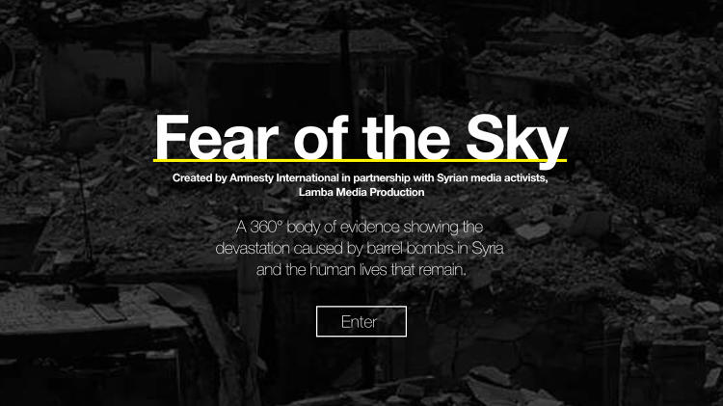
360syria.com
Notes:
Slide 11: 360 Syria: 360Syria.com
This slide will briefly go through how Amnesty International UK has developed the 360syria.com website following on from the virtual reality headsets. Please view the online training before delivering training and explore through the different parts of the website. You may wish to only share parts of the website due to some of the distressing content, e.g. White helmets video, barrel bomb dropping video.
Preparation: Office Mix Module – 360Syria.com - Online Module.
Part One – https://mix.office.com/watch/lor2l00vwc85
Part Two – https://mix.office.com/watch/1kp0ovbzlhdii
Part Three - https://mix.office.com/watch/ynmidmy6qwhn
You may include the following:
In addition to developing the virtual reality headset Amnesty International UK has been working very closely with Lamba Media Production. Following training and providing them with new equipment from Amnesty, they have helped us collect 360 degree photography to document the devastation caused by barrel bombing on cities across Syria.
Their brave work brings us one step closer to holding the perpetrators of these atrocities to account.
The 360 images allow us to be fully immersed in the photograph, and able to view images via the website. The website can be view of desktop, tablet and smart phones as well as Oculus/VR headsets.
Similarly to the virtual reality headsets, you can explore scene of devastation caused by barrel bombs and you can also explore a 360 diagram of a barrel bomb and what it is.
The site is narrated by renowned Syrian activist and blogger, Razan Ghazzawi. This virtual reality platform is part of an enduring body of evidence of human rights abuses and provides a message of hope. Against all the odds, Syrian people – and civil society in particular – are still surviving inside Syria.

Slide 13
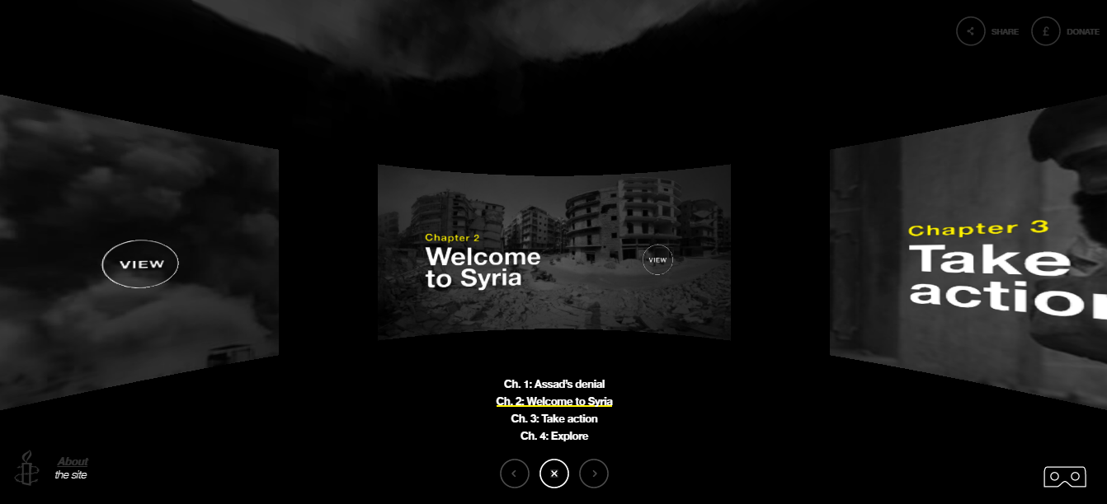
Activity explore 360syria.com
Notes:
Slide 12: Activity: Explore 360Syria.com
This activity will allow people to explore 360syria.com website and discuss in groups their immediate response to the images and 360 as a tool. It is essential that you complete the Office Mix Module – 360Syria.com - Online Module in advance so that you can explain how you use the website. It is also advised that you set up the website in advance to make sure that the wifi and internet connection work and support the format of the 360 website.
Activity Objective: For participants to immerse themselves in the images and engage with the content, building empathy and knowledge of the Syria crisis.
Duration: 20 minutes
Resources: 360syria.com on PC, tablets, phones or in Ocular VR headsets, headphones Activity Sheet: Thinking Points
Preparation: Office Mix Module – 360Syria.com - Online Module.
Part One – https://mix.office.com/watch/lor2l00vwc85
Part Two – https://mix.office.com/watch/1kp0ovbzlhdii
Part Three - https://mix.office.com/watch/ynmidmy6qwhn
10 minutes for whole group to explore images
5 minutes to complete ‘Thinking Points’ activity.
5 minutes for groups to feedback on their initial reactions.
You may include the following:
Talk through how to operate the website. How to navigate through pages, etc.
Can use laptops, tablets and smartphones and working in groups of three to five and allow them all time to explore the images. Provide them each with the ‘Thinking Points’ activity sheet, so that they can start personally reflecting whilst exploring the website. (10 minutes)
Get the group to share their reflections with each other. (5 minutes)
Get some feedback from the group on the their thoughts about the website and what they thought about using it with other audiences. (5 minutes)

Slide 14
What next?
What can you’re group do next?
Plan an event or activity with the virtual reality headsets.
Fundraise, Educate and Campaign!
© Amnesty International UK
Notes:
Slide 13: What next?
This slide is to finish off reflecting on the positive actions the group can do to take what they’ve learnt forward.
You may include the following:
Now that we are at the end of the session, it is important to think about how you will all take this work forward. What can you do next to raise awareness, understanding and empathy for the situation in Syria?
How can each of you make a difference?
Commit yourselves to an action or activity in the next six months to take this work forward. It would be a fundraiser, a street stall, or an event but commit to action and think about how this message can reach more people!

