Slide 1


Slide 2
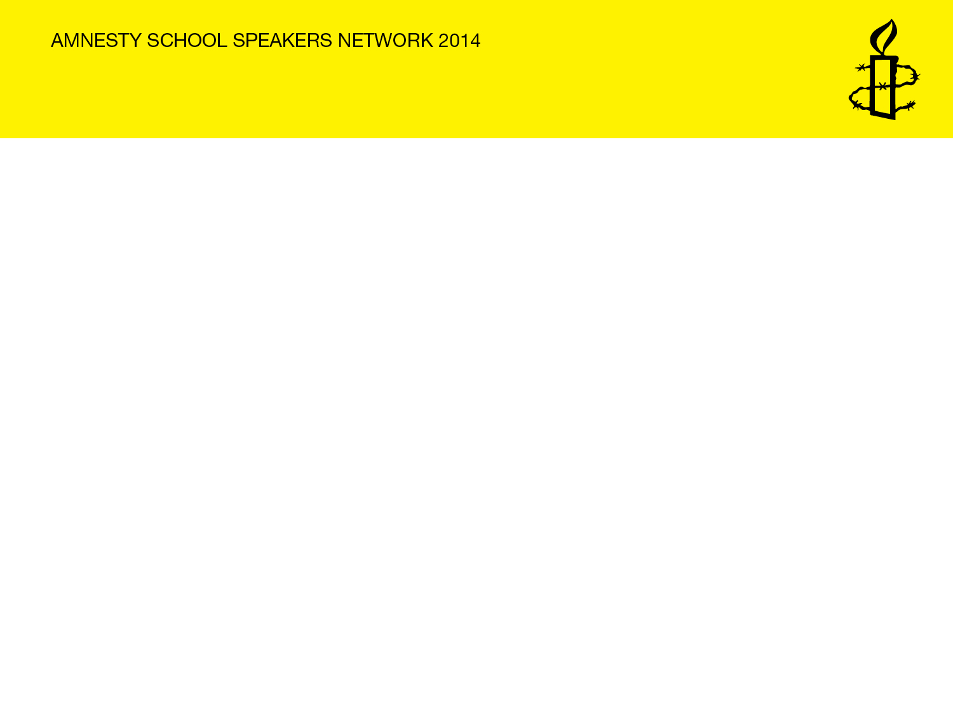
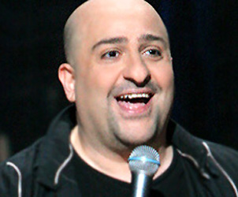
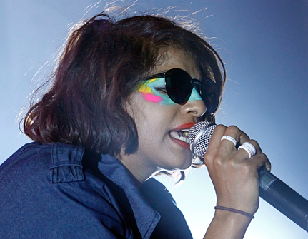
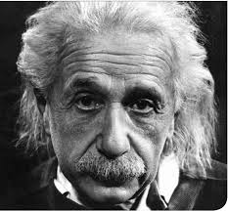
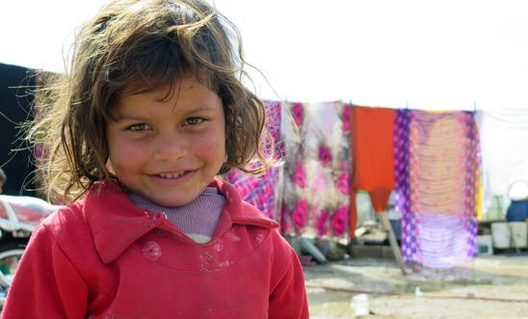


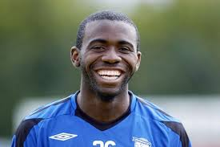
Who are these people?
And what links them?
Notes:
Albert Einstein – physicist. Left Germany permanently after rise of Nazis. As he was Jewish, he could no longer hold any position in a university and his books were among those burnt.
Omid Djalil – comedian whose parents left Iran because of their Bah’ai faith.
MIA – singer who’s family fled from the civil war in Sri Lanka. Her father’s activism had forced the family into hiding.
The Tiger who Came to Tea by Judith Kerr who as a child had to flee Nazi Germany because of her Jewish origins. (She told her story in When Hitler Stole Pink Rabbit).
Fabrice Muamba – footballer who had to leave the Democratic Republic of Congo with his parents because of his father’s political views.
Marks and Spencer - Michael Marks fled Russia at end of the 19th century because of persecution of Jews.
Syrian child in a refugee camp in Lebanon - a reminder that all human beings should have the right to refuge when fleeing persecution or war.

Slide 3
Refugees throughout history
Over the last 400 years many waves of refugees fled to our country to escape persecution and war overseas.
Who came?
From where ?
Why?
Notes:
Some examples:
Huguenots (French protestants fleeing religious persecution in 17th and 18th centuries).
Jews especially late 19th century after pogroms in Russia and Poland.
Asians expelled from Uganda by Idi Amin in 1970s.
Somalis fleeing civil war in 1980s and 1990s.

Slide 4
Words and meanings
What do these words mean?
Refugee
Asylum seeker
Persecution
Notes:
Ask for suggestions.

Slide 5
A Refugee
A Refugee
is somebody who leaves their country and seeks safety in another country who has a good reason to fear being badly treated just because of what they look like, what they think, what they believe or where they are from.
Geneva Convention
(1951 UN Convention relating to the Status of Refugees)

Slide 6
An Asylum seeker
An Asylum seeker
Is somebody who wants to find safety in another country and who has asked the Government of that country to allow him in as a refugee.

Slide 7
Persecution
Persecution
To subject a person to prolonged ill-treatment because of who they are or what they think.
Notes:
You might like to ask what persecution would mean in a school context.

Slide 8
HANDS UP
Most refugees are
A) People from rich countries who have fled to poor countries?
B) People from rich countries who have fled to other rich countries?
C) People from poor countries who have fled to rich countries?
D) People from poor countries who have fled to other poor countries ?
Notes:
A myth-busting exercise – ask for show of hands for each possible answer.
Correct answer is D.

Slide 9
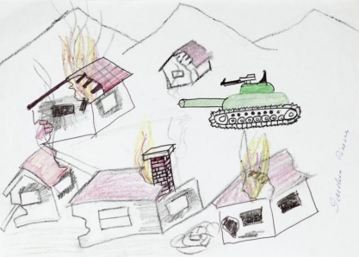
Pictures by refugee children based on their experiences

Slide 10
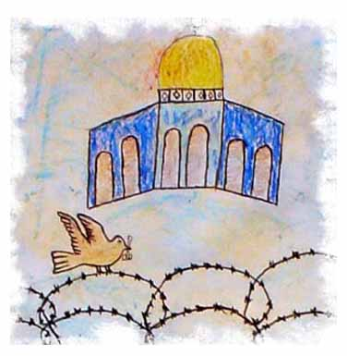

Slide 11
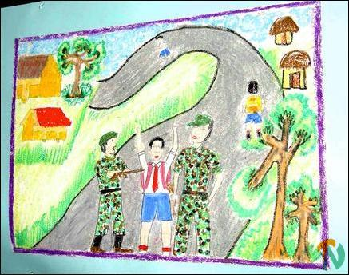

Slide 12
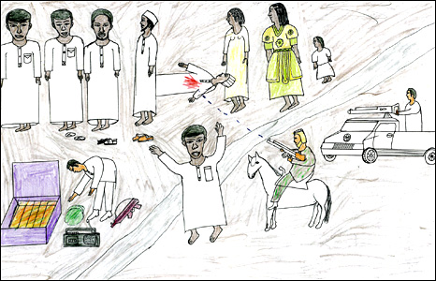

Slide 13
Which countries have most of the world’s refugees fled from?
Notes:
Ask for suggestions based on current news stories

Slide 14
The main countries from which refugees have fled up to mid 2013
1. Afghanistan – 2.5 million
2. Syria - 1.9 million
3. Somalia – 1.1 million
4. Sudan - 632,000
5. Democratic Republic of Congo – 490,000

Slide 15
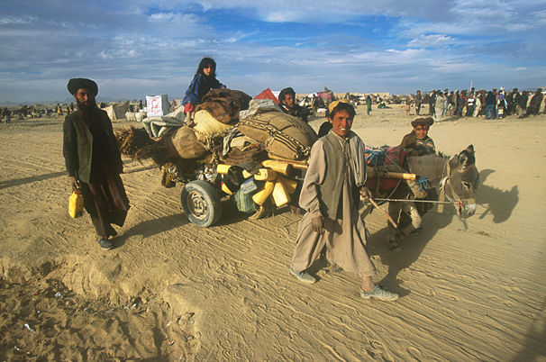
Afghan refugees in Pakistan

Slide 16
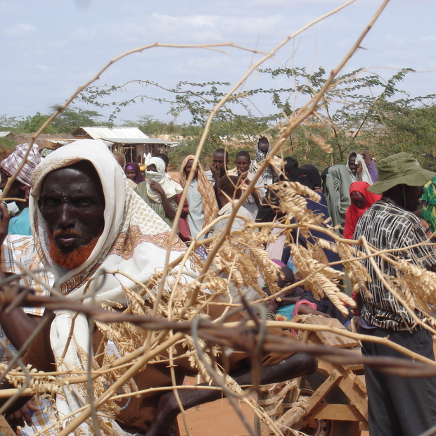
Somali refugees in a camp in Kenya

Slide 17
To which countries did most of the world’s refugees flee?

Slide 18
Countries receiving the largest numbers of refugees by mid 2013 included
Pakistan 1.6m
Iran 862,800
Jordan 613,100
Lebanon 577,200
Kenya 550,00
Turkey 512,000

Slide 19
HANDS UP
How many people in this country are refugees or asylum seekers???
A 1 in 5
B 1 in 50
C 1 in 500
Notes:
C is correct answer.
Ask why people think the proportion is higher (media coverage etc).

Slide 20
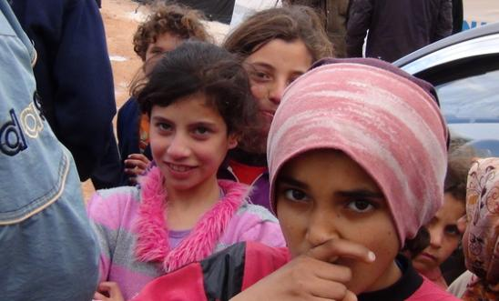
Crisis in Syria
By the end of 2013 2 million Syrians had left their country
5,000 are fleeing every day
52% are 17 or younger
Notes:
Since March 2011 when the first peaceful protests were forcibly put down, what started as a peaceful cry for freedom has descended into an internal armed conflict - with devastating results and over 100,000 men, women and children killed.

Slide 21
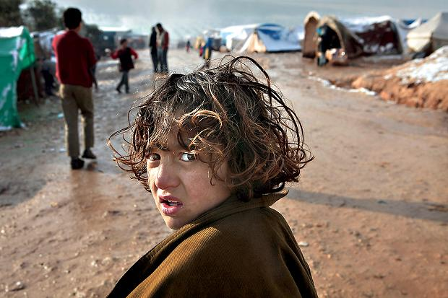
Syrian refugee camp across the Turkish border
Notes:
What do students think it is like to live in a refugee camp?

Slide 22
Mohammed’s story
“When the boat sank, I could not find my friends. I was asking: where are they? Then I found Omar, but another friend was nowhere to be found. I tried to help others, but could not. Omar and I helped each other, but it was difficult to swim for hours. In the water, everyone was looking for family and friends.”
Mohammed, 21, a Syrian refugee, describing his experience on 11 October 2013 when the boat he was on sank 70 miles off Lampedusa
Notes:
Some refugees try to reach Europe to escape but there are increasing numbers of shipwrecks in the Mediterranean. According to UNHCR, between August 2012 and March 2014, 188 people drowned or went missing.

Slide 23
Notes:
Amnesty International works to protect and defend human rights wherever they are under threat including the right to seek refuge from persecution in another country (Universal Declaration of Human Rights Article 14).

