Slide 1
At our Street Collection in Tavistock, the volunteers were asked about Amnesty and its work… how they became interested in Amnesty, what it means to them and a whole lot more!
Jeremy, the Plymouth Chair, spoke of how a holiday in Colombia triggered things off for him…
32 secs.

Slide 2
Contacts and details for the Plymouth Group
Jim – a long-standing member – spoke of how the local Amnesty Groups operate.
49 secs.

Slide 3
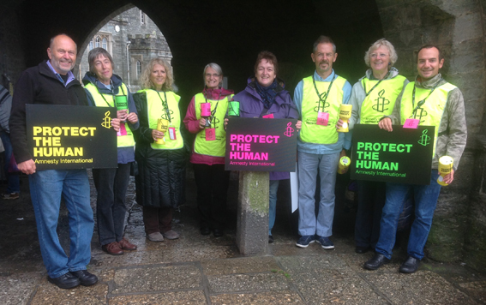
The Tavistock Street Collection Team!
Hilary was keen to stress the importance of raising the profile of the Plymouth Group.
31 secs.

Slide 4
The Plymouth Group meets every first Wednesday at The Quaker House on Mutley Plain in Plymouth at 7.00 pm.
David was keen to stress that some people don’t always understand exactly what Amnesty are about…
45 secs.

Slide 5
… and finally, four heartfelt thoughts from our volunteers on the day.
Pru
Gail
15 secs.
18 secs.
Viv
Angela
13 secs.
8 secs.

