Slide 1
Torture, medicine and the state
Julian sheather
British Medical association

Slide 2

BMA involvement in human rights
ARM 1984 – working party investigating doctors’ involvement in torture
1986 – The Torture Report
ARM 1989 – new working party developed
1992 – Medicine Betrayed
2001 – The Medical Profession and Human Rights
2007 – The Right to Health – a toolkit for doctors
2014 – Joint working with Amnesty on physician involvement in torture

Slide 3
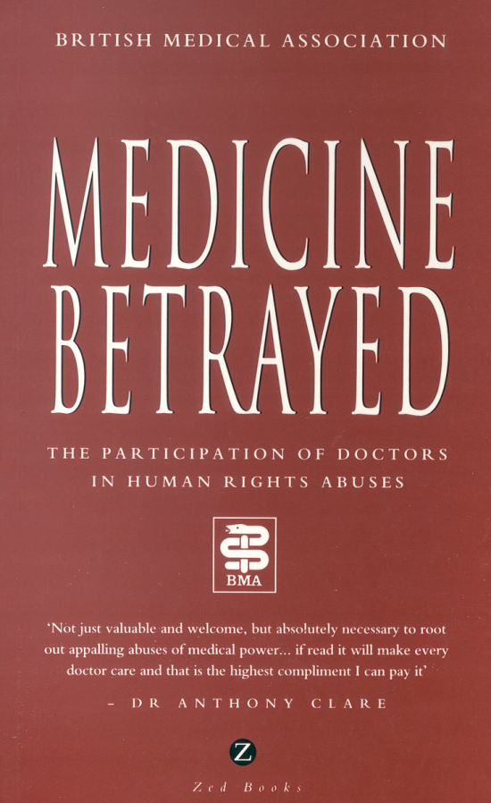
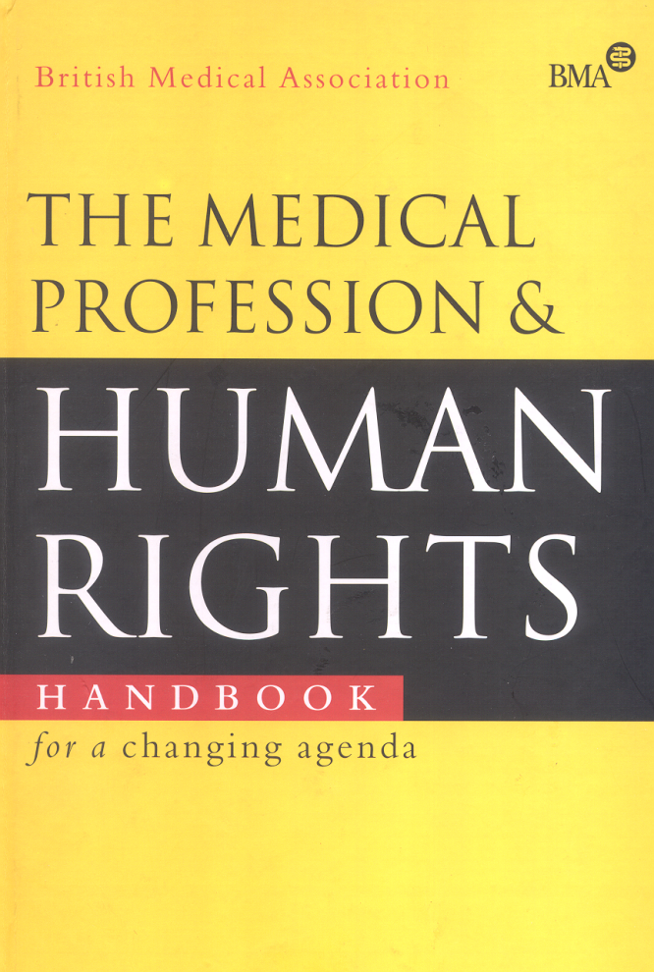
The BMA’s commitment to human rights

Slide 4
The Universal Declaration of Human Rights
Article 5.
No one shall be subjected to torture or to cruel, inhuman or degrading treatment or punishment.
It is ‘non-derogable’. It applies to all people at all times in all places. It cannot be negotiated away, nor sidestepped through pressure of circumstance.

Slide 5
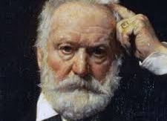
“Torture has ceased to exist”
Victor Hugo 1874

Slide 6
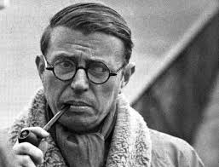
Jean-Paul Sartre 1958
“If nothing can protect a nation against itself, neither its traditions nor its loyalties nor its laws…then its behaviour is no more than a matter of opportunity and occasion. Anybody, at any time, may equally find himself victim or executioner.”

Slide 7
Torture in 2014
“Over the past five years, Amnesty International has reported on torture and other ill treatment in 141 countries and from every world region. While in some of these countries Amnesty International has only documented isolated and exceptional cases, in
others torture is systemic.”
                SALIL Shetty, secetary general Amnesty international

Slide 8
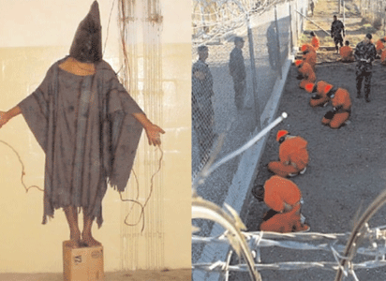
Guantanamo Bay
The Guardian
Gitmo hunger strikes are a cry for help. Why is the US fighting back with secret torture?
Force-feeding at Guantánamo shames America – not just in the bad old days of George W Bush, but today, in 2014. And you deserve to hear the truth, loud and clear…A bioethicist, a torture physician and a psychiatrist who is also a retired Brigadier General would testify that force-feeding as currently practiced at Guantánamo Bay is punitive – that it is a transparent effort by prison authorities to break detainees’ will and stop them from hunger-striking. What force-feeding emphatically is not, these experts will say, is proper medical care. It is a gross violation of medical ethics.
30 Sept 2014

Slide 9
Doctors in the UK
Global mobility means that doctors may see people with torture sequelae
Doctors may be called upon to write reports for asylum seekers who claim to have been tortured

Slide 10
Why does torture take place?
A culture of impunity
In search of information
To intimidate and to terrorise
As a form of punishment
State-sponsored violence against particular groups, often vulnerable and marginalised

Slide 11
Medicine and torture
“The physician shall not countenance, condone or participate in the practice of torture or other forms of cruel, inhuman or degrading procedures, whatever the offense of which the victim of such procedures is suspected, accused or guilty, and whatever the victim's beliefs or motives, and in all situations, including armed conflict and civil strife.”
World Medical Association Declaration of Tokyo

Slide 12
Medical involvement in torture
Doctors as witnesses of torture
Therapeutic involvement with victims
Forensic involvement with identifying and recording sequelae
Complicity, intentional or otherwise
Participation in the design of torture methods and the identification of medical vulnerabilities
Active participation in torture

Slide 13
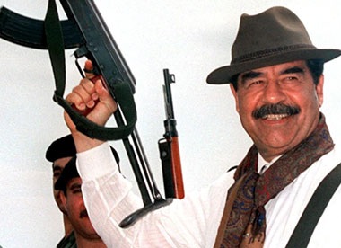
Forced medical involvement in judicial amputations and executions
“In Iraq… several hundred doctors who tried to carry out a protest strike in 1994 against judicial amputations were threatened with imprisonment. In September 1994, some doctors were arrested; the Director of the Al-Basra hospital and another doctor at the Saddam Hospital were executed for refusing to carry out what they deemed to be unacceptable practices.”
The Medical Profession and Human Rights

Slide 14
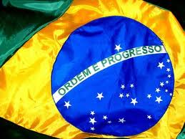
The misuse of medical skills
“In 1972 Jao Alves Gondim Neto, a twenty –five year old student, said that … ‘while he was at the barracks of the 23rd Riflemen’s Battalion he was visited by the medical officer …who…not only refused to medicate him, but also advised the torturers what part of his body could be hit without leaving a trace.”
The Medical Profession and Human Rights

Slide 15
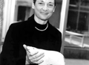
Dr Wendy Orr – District Surgeon Eastern Cape South Africa 1985
“I was confronted on an almost daily basis with some sort of violation of the rights of my patients or some challenge to my own perspective on moral and ethical practice. I can articulate that now, but at the time I just felt uncomfortable, that things were not OK. I also felt unsure of my own discomfort – no one else I worked with seemed to have a problem, we had never talked about these issues at medical school, there seemed to be no place I could go to discuss my concerns.”

Slide 16
What lies behind the problem?
Doctors working in institutional settings can be subject to dual or conflicting loyalties
Alongside their ordinary therapeutic obligations to their patients, forensic and prison physicians owe obligations either to the criminal justice system or to the regime
The single biggest problem is the ability of state institutions to compromise or corrupt the proper purposes of medicine

Slide 17
For good or ill?
There is a universal non-negotiable prohibition on all forms of torture or inhuman or degrading treatment, but:
  Does solitary confinement amount to abuse and what role should doctors have in monitoring or assessing the fitness of patients?
  Where someone has been abused or tortured and is unconscious, what role should doctors have in bringing them round if they may be tortured again?

Slide 18
Force feeding
What therapeutic role can there be in force feeding?
BMA is clear that a voluntary, informed refusal of treatment must be respected.
What impact does the environment have?
How free and informed are decisions in these contexts?
What should the role of the doctor be?

Slide 19
Where next?
Understanding, protecting and maintaining clinical independence
Gaining clarity about the distinction between therapeutic and non-therapeutic interventions
Training physicians in the identification and recording of torture sequelae
Encouraging and supporting doctors to speak out
Providing safe alternative reporting processes where they cannot

