Slide 2
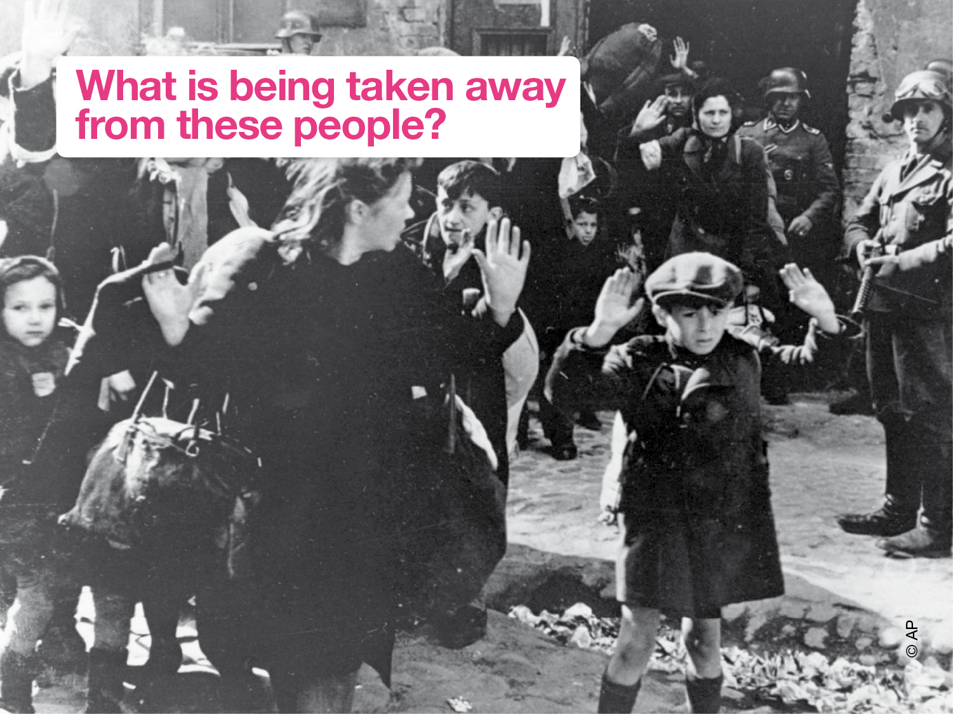
Notes:
Show images of the holocaust – ask for suggestions of what has been taken away from people in these pictures?

Slide 6
Notes:
Explain that after the holocaust world leaders came together to work out how to stop future atrocities.
They drew up a list of all the rights that people are entitled to, by just being human. Everyone should have these rights. No one should take them away.
The United Nations was set up following two world wars at the beginning of the 20th Century. Its purpose is to bring all nations of the world together to work for peace and development. The ideas behind the UN are developed in the Universal Declaration of Human Rights, which the UN agreed in1948. The introduction to this Declaration recognises:
People’s outrage at “barbarous acts” such as those of World War 2;
People’s aspiration to live in a world “in which human beings shall enjoy freedom of speech and
belief and freedom from fear and want”;
The dignity of every human being and the importance of human rights;
The UN’s promise to promote respect for human rights and freedoms among all people.

Slide 7
Notes:
The Amnesty Candle: you could inform / ask students the following:
• Amnesty exists to ensure everyone enjoys all the rights laid out in the UDHR and to put an end to human rights abuses everywhere in the world.
• You may have noticed the candle symbol on the slides you have seen so far. This is Amnesty International’s symbol. What do you think it means? [Prompts: Why would you use a candle? What could the barbed wire represent?] [Answer: The candle represents light and hope in the dark, and the barbed wire represents prison and persecution.]
• Amnesty’s motto comes from an ancient Chinese proverb: ‘It is better to light a single candle than to curse the darkness.’ What do you think that could mean? [Answer: Even when it seems there are many problems to be solved, it is better to do something than just to complain about it.]

