Slide 1
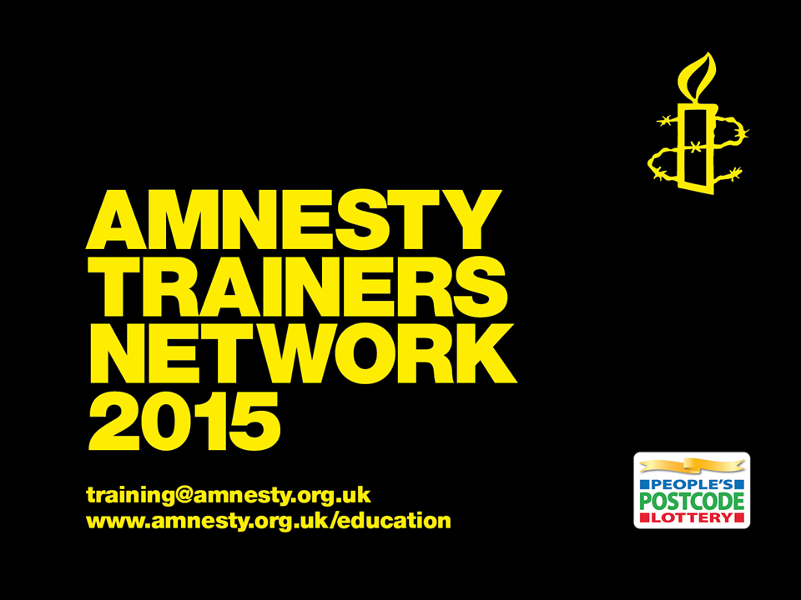

Slide 2
My Body, My Rights (MBMR)
Training Objectives
Understand the MBMR global campaign for Sexual and Reproductive Rights (SRR).
Gain knowledge and skills to campaign for SRR as human rights
Understand AIUK campaign priorities.
Effectively communicate AI’s Abortion Policy
Notes:
Slide 1 – My Body, My Rights (MBMR)
This slide outlines the training objectives for activists on the My Body, My Rights campaign.
You may include the following:
1. Introduce the My Body, My Rights campaign as our global campaign and go through the following objectives:
Understand the MBMR global campaign for Sexual and Reproductive Rights (SRR).
Gain knowledge and skills to campaign for SRR as human rights
Understand AIUK campaign priorities.
Effectively communicate AI’s Abortion Policy
2. Explain that this will be achieved in a number of ways including, exploring case studies, extracting information from key Amnesty reports and a selection of engaging activities to explore the campaign in more depth.

Slide 3
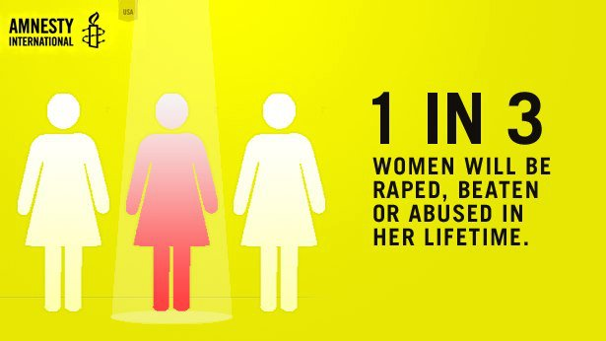
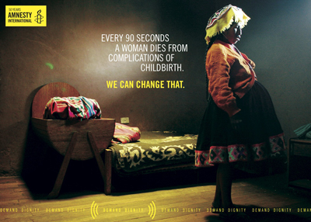
Content Warning
Notes:
Slide 2: Content Warning
This slide is an important part of setting the scene for this training. With the sensitive nature of the subject matter and the increased likelihood of our audiences may have encountered personal trauma regarding some of the content, it is important to forewarn
Content warning for the following;
Sexual Assault
Rape
Abortion
Child abuse
Discrimination
Forced sterilisation
Pre and post natal medical complications
Forced marriage
FGM
Miscarriage
You may include the following:
For activists; The nature of the work we do at Amnesty means that we often deal with issues which are upsetting or distressing. When working on MBMR it is important to remember that many of the issues we address will have happened to people participating directly in our work. For example, one in three women in England and Wales will have had an abortion in her lifetime and 1 in 3 women will have been raped, beaten or abused in her lifetime.
This means that whether you realise or not, you are likely to work with people who have had some direct experience of the issues we are discussing. Please remember this when participating in and facilitating discussions and take care with language to ensure that you or other participants do not perpetuate negative and damaging stereotypes (e.g. women who have abortions are promiscuous and uncaring) or demonise others.
Activists and or those that they engage with may also have strongly held religious beliefs. You may want to reaffirm that Amnesty upholds the human rights to freedom of religious belief, thought and conscience. We also uphold the right to live without discrimination, intimidation or violence and in this area of human rights, these rights sometimes come into conflict (e.g. protests outside abortion clinics, homophobic abuse).
We want activists and those they engage with on this campaign to feel comfortable in expressing their views but sensitive to others views and life experiences. We don’t want to worry participants about saying the wrong thing or inadvertently offending people as this might close down discussion, so encourage participation in discussions.

Slide 4
Campaign Objectives
To ensure everyone has access to their sexual and reproductive rights.
To stop criminalisation of sexuality and reproduction by governments.
To make tangible changes in key
campaign countries.
Notes:
Slide 3: Campaign Objectives
My Body My Rights is Amnesty International's global campaign to help ensure that everyone has access to their sexual and reproductive rights and to stop criminalization of sexuality and reproduction by governments.
You may include the following:
My Body My Rights is Amnesty International's global campaign to help ensure that everyone has access to their sexual and reproductive rights and to stop criminalization of sexuality and reproduction by governments.
We want to frame SRR in terms of human rights because regularly they are talked about just in terms of religious belief, morality, shame or guilt. Some of the arguments against campaigning for lesbian and gay rights, for transgender rights, against FGM or for access to abortion and contraception take a cultural relativist approach; “But this is their culture”, “We can’t impose “Western” human rights”.
This approach ignores the human rights defenders on the ground battling hard and in dangerous contexts. And it ignores that human rights are fundamental and innate. We still have some way to go for people to see sexual and reproductive rights as human rights so it is important that Amnesty International is part of this debate.
“Winning” sexual and reproductive rights is not just about changes in law and policy, it is about winning hearts and minds. Those who campaign on gays rights or for reproductive justice welcome Amnesty into this realm because we bring with us detailed research on human rights impacts, the cool analysis of international human rights law and we work with human rights defenders and organisations on the ground in our key target countries.

Slide 5
Activity: Understanding Terms
*Gender *Sex *Discrimination
*Sexuality *Gender Identity *Rape
*Sexual Orientation *Sexual Violence
*LGBTI *Stigma *Consensual Sex
What do these terms mean to you?
Notes:
Slide 4: Activity 1 – Understanding Terms
Sexual and reproductive rights cover a wide variety of issues – many of which the activists and participants may be unaware of.
Explain to the audience that the training session will refer to these terms and it is important to explore their definitions and how they relate the SRR.
There will be a hand-out glossary of terms.
Session objective: To explore and understand the breadth of terms associated with the MBMR campaign.
Length of session: 20 mins
Resources: Flipchart and marker pens, Glossary of terms (to give out after feedback.)
1. In pairs come up with definitions for two terms per pair. 10 minutes
2. Feedback on each term and provide the glossary of terms sheet for groups. 10 minutes

Slide 6
Activity: Sexual & Reproductive Rights?
Sexual and reproductive rights are human rights that belong to us all.
What do you think our sexual and reproductive rights are?
Notes:
Slide 5: Activity 2 – Sexual and Reproductive Rights?
Session objective: To personally reflect on what SRR mean.
Length of session: 10 minutes
Resources: none
Ask the audience what they think sexual and reproductive rights are?
Take a few answers and reflect on the contributions.
You may get the following answers:
Make decisions about our own health, body, sexual life, and identity without fear of coercion or criminalisation
Seek and receive information about sexuality and reproduction and access related health services and contraception
Decide whether and when to have children, and how many to have
Choose your intimate partner and whether and when to marry
Decide what type of family to create
Access family planning; contraception; safe and accessible post-abortion care; access to abortion in cases of rape, sexual assault or incest, and pregnancy that poses a risk to the life or to physical or mental health; and, where legal, access to safe abortion services
Live free from discrimination, coercion and violence, including rape and other sexual violence, female genital mutilation, forced pregnancy, forced abortion, forced sterilization and forced marriage.
4. Go into the next slide to elaborate on the answer.

Slide 7
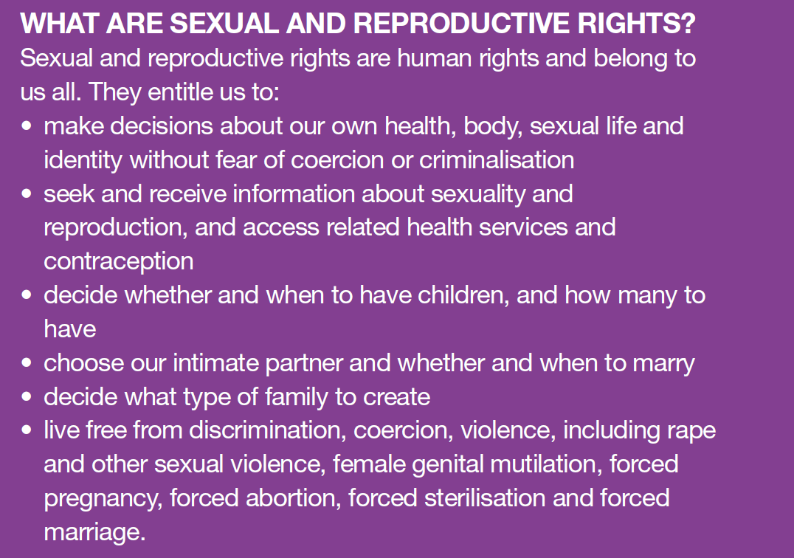
Sexual & Reproductive Rights
Notes:
Slide 6: Sexual & Reproductive Rights
This slide lays out how SRR are human rights and presents the main calls of our campaign, which are reference in our country work.
You may include the following:
Our campaign is calling for SRR to be seen as human rights. We are campaigning for the following:
Non-discrimination: everyone is equal regardless of their sex, sexuality, gender identity or marital status. Religion or culture are not justifications for discrimination.
Abortion must be decriminalised. Women and girls and health workers must not face jail for accessing or providing abortion services.
Affordable, confidential and quality health services, including access to contraception, is not a luxury – it’s a human right.
Education and information on sex and relationships must be based on scientific evidence and should be available to everyone.
We all have the right to live free from all forms of violence, including rape.
We have the right to have a say in the laws, policies and programmes that affect our bodies and our lives.
If we are denied any of the above, we have the rights to report it, have it investigated and be confident that justice will be served.

Slide 8
Campaign Overview
Criminalisation of abortion
Discriminatory laws, particularly regarding gender based violence
Access to sexual reproductive health services, including access to information.
Notes:
Slide 7: Campaign Overview
This slide gives activists an overview of the MBMR campaign. This campaign breaks down into three issues and highlights the issues in our campaign countries. These issues include Criminalisation of abortion (Ireland and El Salvador), Discriminatory laws, particularly regarding gender based violence (Maghreb- Morocco-Western Sahara, Algeria and Tunisia) and Access to sexual reproductive health services, including access to information (Burkina Faso).
You may include the following:
All over the world, people are coerced, criminalised and discriminated against, simply for making choices about their bodies and their lives. That is why Amnesty International has launched My Body My Rights, a global campaign to defend sexual and reproductive rights for all.
Sexuality and childbearing are sensitive issues and many people find them difficult to talk about in public. They are deeply personal experiences, yet families and communities, states and religious bodies, often seek to control people’s sexual and reproductive lives – and the lives of women in particular.
The freedom to make decisions about your own health, body, sexual life and identity is a fundamental human right. Such decisions are important and may be difficult, so to reach them people may need support, information and health services. But the power to decide must remain with the person most directly concerned.
Around the world, sexual and reproductive rights are denied and violated. This campaign traces and exposes the connections between denial of these rights and violence against women.
Sexual and reproductive rights are inter-related and interdependent, but the My Body My Rights campaign focusses on access to abortion and contraception. These rights are the most controversial and most contested. This is the issue where gender equality is suffering the greatest backlash and where human rights defenders are facing some of the biggest threats.
This campaign breaks down into three issues and highlights the issues in our campaign countries. These issues include Criminalisation of abortion (Ireland and El Salvador), Discriminatory laws, particularly regarding gender based violence (Maghreb- Morocco-Western Sahara, Algeria and Tunisia) and Access to sexual reproductive health services, including access to information (Burkina Faso).
We will call for the decriminalisation of abortion around the world but will be focussing on Northern Ireland as well as the Republic of Ireland and El Salvador.
Public debate about abortion is often carried out in strident, emotional tones which do little to encourage wider participation. Amnesty International, our members and supporters, will be part of that discussion and will help shed more light than heat on the subject, and encourage reasoned discussion.
If we claim our own rights over our own bodies and in turn respect others rights over their bodies, then this will multiply from an individual to a global level. Then governments will have to step up and start protecting our human right to make decisions about our bodies and our lives.
Remember, it’s your body and your rights.

Slide 9
Campaign Overview
Important Facts and Stats:
Notes:
Slide 8: Campaign Overview
This slide illustrates some of the shocking statistics about sexual and reproductive health across the world and why it is important to respect, protect and fulfil sexual and reproductive rights. Because they are fundamental to our rights to life, health, privacy, access to education and information and our rights to live free from violence, torture, and inhuman and degrading treatment.
You may include the following:
The state of sexual and reproductive health across the world, especially of women, is dire.
Millions of adolescent girls give birth every year, usually as a result to coerced sex and unwanted pregnancies.
In addition, 40% of women of childrearing age live in countries where abortion is banned, restricted or not accessible.
Access to contraception could save the lives of 215, 000 women who die every year due to poor maternal health.
These are just a few of the facts and stats that shine a light on the state of sexual reproductive health

Slide 10
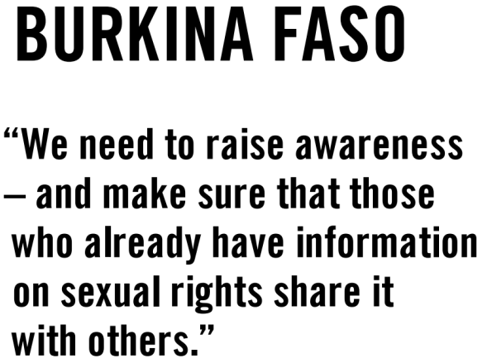
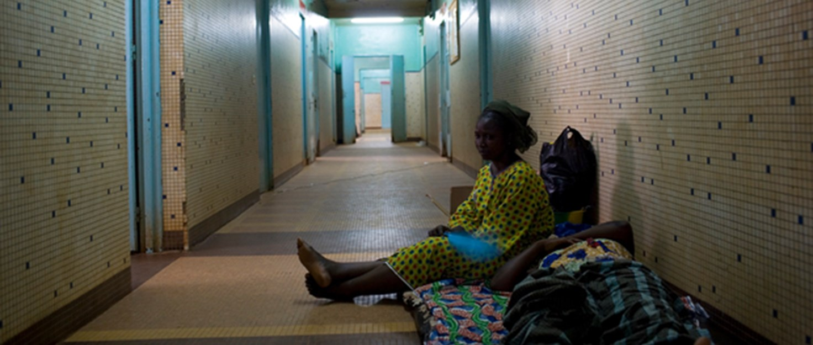
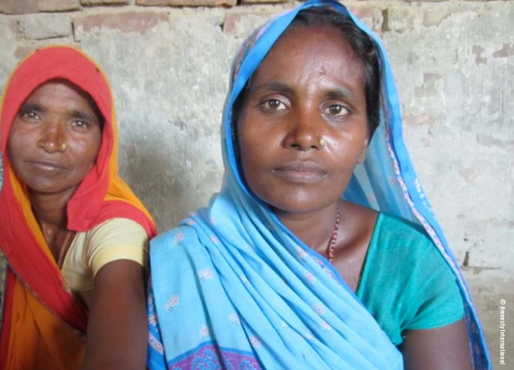
Campaign Countries
Notes:
Slide 9: Campaign Countries
The following few slides go through our key campaign countries and the issues that this campaign is trying to address in each of these countries.
This slide looks at Burkina Faso and Nepal.
You may include the following:
This campaign is working on issues in a handful of key countries in order to make tangible changes in this key campaign countries.
Burkina Faso: We are launching an action on Burkina Faso in July in the run-up to their elections in September 2015.
It includes specific asks on SRR and access to education. We will be handing this petition over to the new government when it is formed.
At the beginning of 2016 we will have the release of a report on access to contraception in BF, specifically looking at the issue of women needing the consent of their husbands to access contraception and the violation to their rights that this creates.
We will also have a high profile fundraising campaign on for our human rights education work in Burkina Faso and Sierra Leone around the same time.
Our campaign in Nepal highlights the widespread and systematic discrimination of women and girls because of their gender.
This discrimination threatens their health and results in high rates of uterine prolapse – a painful and debilitating condition in which the pelvic muscles weaken and the uterus descends into the vagina.
There are many causes, including carrying heavy loads during or just after pregnancy, having children at a very young age, and having several children in quick succession, but all are linked to women’s lack of control over their bodies, health and lives.
Our Nepal campaign launched the My Body My Rights campaign back at the beginning of 2014.
We are currently working with groups on the ground around the implementation of a national uterine prolapse strategy.

Slide 11
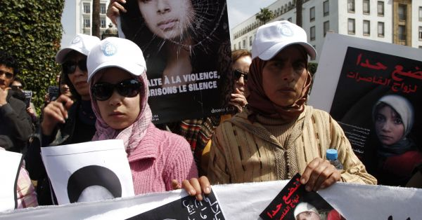
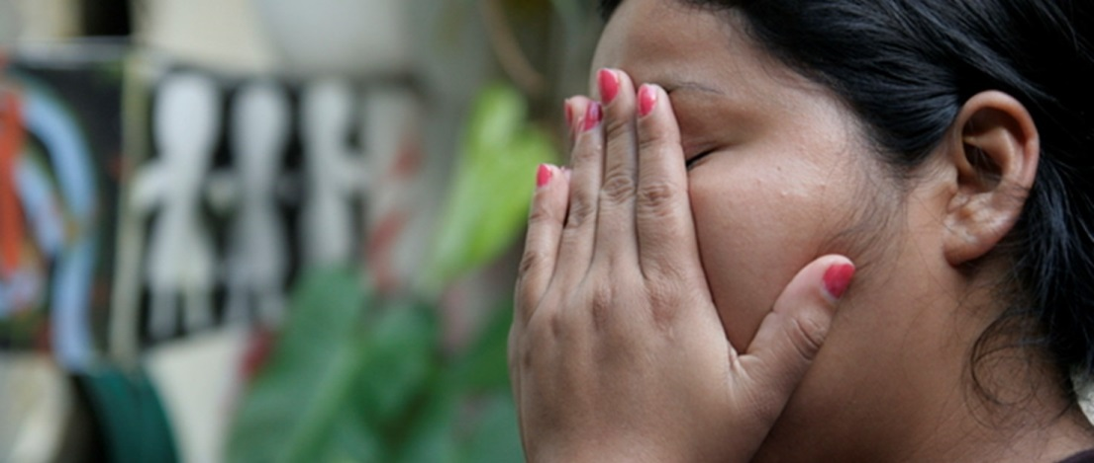
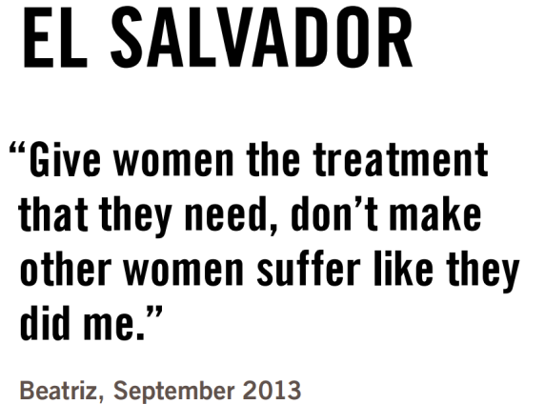
Campaign Countries
Notes:
Slide 10: Campaign Countries
The following slide goes through our remaining key campaign countries and the issues that this campaign is trying to address in each of these countries.
This slide focuses on the Al Maghreb region, including, Tunisia, Morocco and Algeria; Ireland and El Salvador.
You may include the following:
You may include the following:
Our campaign in the Maghreb covers Tunisia, Morocco and Algeria.
In the Maghreb, legislation on rape places the emphasis on morality rather than on the attack against the personal and bodily integrity of the victim. For instance, the discriminatory provisions in the Penal Codes in Algeria (Article 326) and Tunisia (Article 227) allow rapists to escape prosecution if they marry their victim.
In March 2012 in Morocco the suicide of Amina Filali, a 16- year-old girl coerced into marrying the man she said had raped her, led to a public outcry.
Amina Filali swallowed rat poison, having reportedly been mistreated by the man she had been forced to marry and his family, with whom she lived.
The legislation in these countries fails to protect and affirm the rights of women and girls and provide them with access to health services and judicial remedies.
Thankfully, Morocco repealed Article 475 in 2014 but there are still discriminatory provisions relating to rape and Algeria and Tunisia are yet to follow suit.
We have had a huge response to our action on discriminatory rape laws in North Africa.
We handed over the global petition to politicians in Tunisia, Morocco and Algeria. There was a very positive response in Tunisia where the ministers committed to a comprehensive new draft law on violence against women.
But less positive progress in Morocco and Algeria. We will be returning to this campaign later in 2015.
Our campaign in Ireland was launched by a report on the impact of Ireland’s abortion laws in June 2015.
The report found that every day, between 10 and 12 women and girls living in Ireland travel to England for an abortion.
The majority of the women are aged between 20 and 34. Their reasons for terminating their pregnancies vary; however, their reason for travelling is the same.
They cannot access safe and legal abortion services in Ireland, as it is a criminal offence except where the pregnancy poses a “real and substantial” risk to their life.
We are encouraging huge activity amongst our activists on this campaign with a petition hand-over planned for the start of 2016 – around the time of the Irish elections.
We are particularly looking to engage the Irish diaspora in the UK and get them involved in the campaign.
We also started work on Northern Ireland in October 2014 with a report launch later in Feb 2015 on the barriers to accessing a safe abortion.
We are currently waiting for the Justice Dept to put down legislation allowing access to abortion in cases of fatal foetal abnormality (where the foetus will not survive) and are expecting actions in September. More on this section of the campaign.
Our campaign in El Salvador was launched with a report in September 2014.
El Salvador has a total ban on abortion ban and has led to the arrest and imprisonment of women who have suffered miscarriages—some have been jailed for 50 years because of their miscarriage.
El Salvador’s abortion law results from a systemic denial of the human rights of girls and women. It doesn’t matter if you’re pregnant as a result of rape, whether you’re a child, or whether the pregnancy is a risk to your life: the government demands women and girls to give birth.
Our global petition addressing the oppressive abortion laws was handed over in May 2015 with a delegation including women’s organisations and one of the women Amnesty activists campaigned for through a successful Urgent Action. We will be returning to this campaign in later 2015.

Slide 12
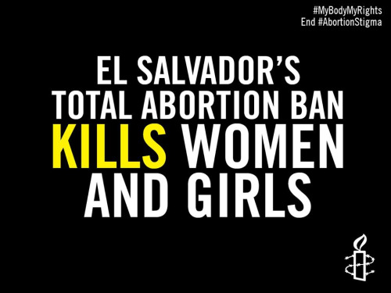
Video: El Salvador & Abortion Law
Notes:
Slide 11: Video: El Salvador & Abortion Law
At this point in your presentation you can show the following animation video addressing 30 year prison sentence for having a miscarriage
Length of time: 1min 35secs
Link to Video: https://www.youtube.com/watch?list=UU9s5KvO_EPGoZNlaHdf8Szw&v=rzyjyhL5wPQ

Slide 13
Campaign Timeline
9th June: launch of the Ireland report and campaign
Women to Blame exhibition in London then Belfast
August: Student media summit
Sept: Fresher’s Week packs
28th Sept: Int Day of Action for the Decriminalisation of Abortion
September/October: big push on My Body My Rights and all current country projects. Women to Blame exhibition in Glasgow then Liverpool.
November: start of the 16 Days, Write for Rights (will have a MBMR case)
8th March: International Women’s Day
Notes:
Slide 12: Campaign Timeline
This slide give the campaign timeline and what events activists could get involved in.
You may include the following:
Here are some of the key dates for events and activities you could do to campaign for the realisation of sexual and reproductive rights.
The launch of our Ireland report and campaign took place on 9th June. We will have opportunities to heavily campaign on this issue leaving to the end of the campaign in 2016.
In order to highlight the barriers to accessing full sexual and reproductive rights in Ireland, the 'Women to Blame' exhibition, a pictorial of the social and political struggle of women in Ireland to obtain reproductive rights was exhibited in London at Amnesty UK’s Human Rights Action Centre and will be exhibited in Belfast next followed by Glasgow and Liverpool in September/October 2015.
Amnesty student activists will be focussing on the My Body, My Rights campaign. In August we will have our Student media summit followed in September with University Fresher’s Week packs highlighting this campaign.
In September/October, there will be a big push on My Body My Rights and all current country projects, to gain maximum momentum to achieve tangible changes in the key countries.
Further dates for planned activities for groups and activists to get in involved with include,
the International Day of Action for the Decriminalisation of Abortion on 28th September,
the start of our annual 16 Day, Write for Rights letter writing campaign in November, which will feature a My Body, My Rights Campaign,
and International Women’s Day on 8th March 2016.

Slide 14
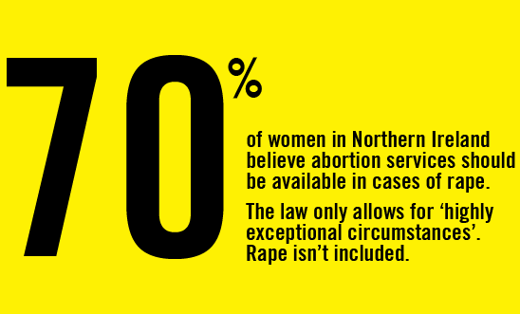
AIUK Campaign Priorities
Notes:
Slide 13: AIUK Campaign Priorities
The next couple of slides look at the Amnesty UK’s key focus for this campaign. AIUK will be concentrating it’s efforts on highlighting and working towards changes in legislation in both Ireland and Northern Ireland. The slides will include background on the Northern Irish situation, including findings from an Amnesty commissioned research and poll.
You may include the following:
Amnesty International UK will be concentrating particularly on the issues in Ireland and Northern Ireland for this campaign. This is where we would like our activists to focus their campaigning activity. Amnesty will be looking to work with Irish diaspora groups based in the UK as well as medical professionals to highlight the issues around accessing an abortion in this region.
Women from both Ireland and Northern Ireland travel to England to access abortion services.
Ireland imposes criminal sanctions for abortion, which carries a maximum life sentence. Access safe and legal abortion services in Ireland are banned except where the pregnancy poses a “real and substantial” risk to life.
In Northern Ireland a new poll finds 7 in 10 people in Northern Ireland back abortion law reform.
That is the clear result from new independent opinion polling that was published in October 2014.
The poll findings coincide with the launch of a new campaign by Amnesty International to change laws; policy and practice on access to abortion in Northern Ireland and bring it into line with international human rights standards.
The research, commissioned by Amnesty International, carried out by market research company Millward Brown Ulster, shows that;
69% of people think the law in Northern Ireland should make access to abortion available where the pregnancy is the result of rape
68% of people think the law in Northern Ireland should make access to abortion available where the pregnancy is the result of incest
60% of people think the law in Northern Ireland should make access to abortion available where the foetus has a fatal abnormality.
This poll shows that Northern Ireland’s abortion laws are out of line with international human rights standards and out of line with public opinion.

Slide 15
AIUK Campaign Priorities
Northern Ireland
Notes:
Slide 14: AIUK Campaign Priorities
The next couple of slides look at the Amnesty UK’s key focus for this campaign. AIUK will be concentrating it’s efforts on highlighting and working towards changes in legislation in both Ireland and Northern Ireland. The slides will include background on the Northern Irish situation, including findings from an Amnesty commissioned research and poll.
You may include the following:
With no pathway into the NHS in Northern Ireland, each year between 1000 and 2000 women and girls have little option but to consider travel elsewhere – sometimes accompanied by a partner, supportive family member or friend – to access abortion services.
Grainne Teggart, Northern Ireland Campaigner at Amnesty International UK, said: 'It is shocking that in 2014 it is still not possible for a woman in Northern Ireland to have an abortion where the pregnancy is a result of her being raped or where there is a fatal foetal abnormality.
'Women, finding themselves in the most distressing of circumstances, should not also face the threat of imprisonment for making deeply personal choices about their pregnancies.
Amnesty’s campaign and poll come as the Department of Justice reviews laws on access to abortion in Northern Ireland, where the procedure is largely governed by the 1861 Offences Against the Person Act. This makes it a criminal offence for a woman to have an unlawful abortion, or for any other person to carry out an unlawful abortion.
The Northern Ireland Department of Justice is currently consulting on reforming the law to provide access to abortion in cases of fatal foetal abnormality, rape and other criminal sexual activity. The public consultation on abortion legislation will close in January 2016.
Amnesty’s ‘My Body My Rights’ campaign will focus on changing laws, policy and practice on access to abortion in Northern Ireland.

Slide 16
Activity: Campaigning on NI Abortion
In groups prepare your campaigning activity.
What activity would you plan?
What key facts would you use to support the campaign?
Reference the Amnesty poll, NI Report and case studies.
Notes:
Slide 15: Activity 3: Campaigning on NI Abortion
This activity will allow activists more in-depth engagement on the general issues in the MBMR campaign as well as the issues particularly relevant to Northern Ireland. It will also give the opportunity to plan activities for future campaigning on this issue.
Session objective: To explore campaigning ideas in the context of Northern Ireland.
To come up with ideas that the public can engage in.
Length of session: 40 mins
Resources: Policy Primer, NI Report Fact sheets, case studies, poll, flipchart and marker pens
1. In groups of 5, use the materials to plan a/some campaigning activities. Ready to present to the group. 25 minutes
2. Feedback presentations from each group. 15 minutes

Slide 17
AI’s Abortion Policy
Amnesty International seeks to ensure that women have access to safe, legal termination of pregnancy in cases of
Rape,
Incest or
When a woman or girl’s life or health is at risk
Notes:
Slide 18: AI’s Abortion Policy
This slide gives an overview to Amnesty’s Abortion Policy and explains how it has developed our Sexual Reproductive Rights Policy.
You will explain to activists and other audiences how the policy was developed and its scope.
You may include the following:
After a two year consultation, Amnesty took a position on abortion as part of its new sexual and reproductive rights policy.
Amnesty International’s position is in line with the minimum required by international human rights law and links directly to our women’s human rights work, campaigning against violence against women and campaigning against torture, inhuman and degrading treatment.
Our policy position seeks to eliminate unsafe abortions and other violations of women’s rights.
It seeks to repeal all laws which permit the imprisonment or imposition of any other criminal sanction on women for seeking or having an abortion.
In addition, Amnesty deems it a grave violation of women’s rights by obstructing or limiting access to medical services for complications arising from abortion, regardless of the legal status of abortion. This violated a woman’s right to life and health and is a form of cruel, inhuman and degrading treatment.
Amnesty International’s policy on abortion has the following components:
We call on states to decriminalise abortion in all circumstances, so that no woman is subject to penalties of any kind for having or seeking an abortion.
We also oppose the criminalisation of health care providers and others if they are arrested, detained, charged, prosecuted, convicted, or subject to penalties solely for providing or attempting to provide abortion services.
We call for states to provide access to quality services for management of complications arising from abortion, regardless of the legality of the abortion.
We call on states to ensure timely access to legal, safe, and accessible abortion in cases of an unwanted pregnancy as a result of rape, sexual assault or incest, or if the pregnancy poses a risk to the life or risk to the health of the woman or girl.
AI takes no position on whether a woman should have an abortion under any of these circumstances but they must be available to prevent grave violations that could result if they were denied this option.
Furthermore, we call on states to provide women and men with full information on sexual and reproductive health.

Slide 18
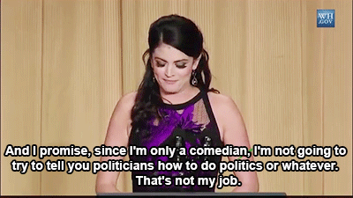
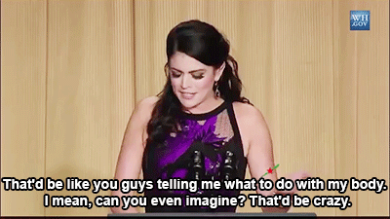
Activity: Dealing with difficult situations
In pairs take a scenario and discuss
how you would overcome the challenge?
Notes:
Slide 17: Activity 4: Dealing with Difficult Situations
This activity will allow activists to prepare for difficult situations that could be faced by Amnesty activists in campaigning for sexual and reproductive rights. Use the “Activity Sheet MBMR Dealing with difficult situations”.
Session objective: To prepare for a wide spectrum of difficult questions around the MBMR campaign.
To engage and familiarise activists with the Q&A created for activists on dealing with a range of questions on this campaign.
To create a confident and well informed activist base in order to campaign effectively for sexual and reproductive rights.
Length of session: 30 mins
Resources: MBMR Q&A for Activists, Policy Primer, case studies, poll, flipchart and marker pens
1. In pairs take a scenario and discuss how you would overcome the challenge? Ready to present to the group. 15 minutes
2. Feedback presentations from each pair. What did you find the most challenging? Did you feel confident to deal with the challenge? 15 minutes
Scenarios include:
“Why do you campaign to kill babies?”
An anti-choice advocate begins debating with you at your Amnesty MBMR stall.
“Abortion under all circumstances is wrong and sinful”
You’re delivering an ‘Intro to AI’ to a local faith group.
“What’s sex got to do with human rights?”
“Why is Amnesty calling for abortion to be a human right? What about the human rights of the baby?”
“Why does Amnesty have a policy on abortion?”
“How do you know that back street abortions are a result of lack of access to a safe abortion?”
“Does Amnesty support abortion on the basis of disability if so, what about the rights of disabled people?”
“Isn’t there a contradiction between Amnesty International campaigning against the death penalty and being pro-abortion? “

Slide 19
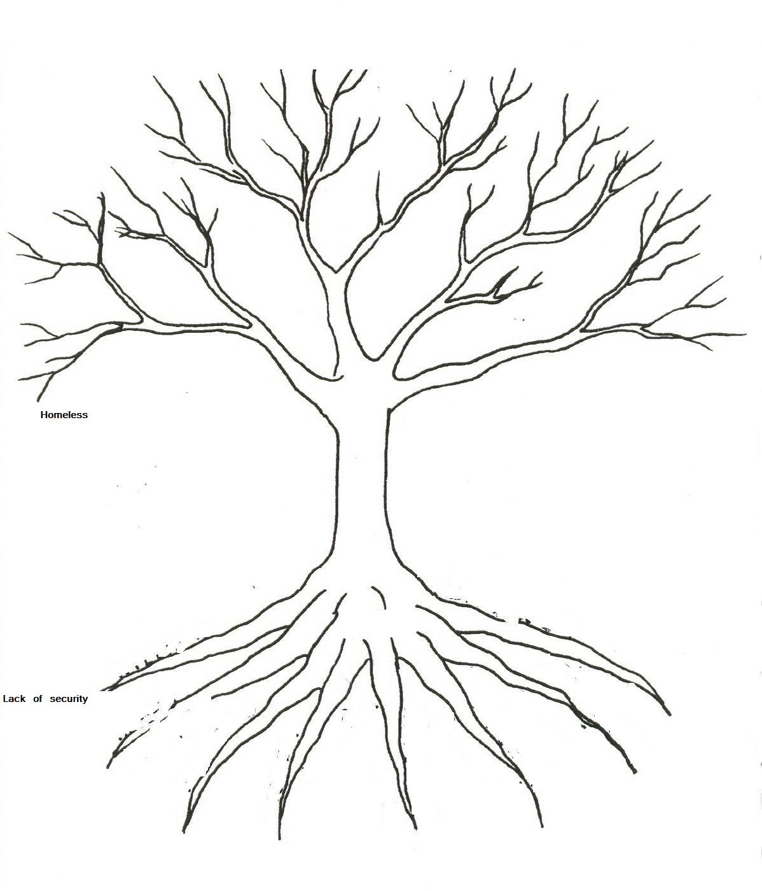
Activity: Problem Tree
Lack of access to contraception and safe abortion
Effects
Lack of accessible, affordable and adequate maternal health education
Criminal sanctions for seeking abortion/having a miscarriage
Forced and child marriage
Problem
Forced abortion or sterilisation
Denying rape survivors access to a safe abortion
Restrictions on sexual and reproductive health education
Causes
Notes:
Slide 20: Activity 5: Problem Tree
This activity will allow activists to fully engage with some of the issues that we are trying to address in this campaign. The Problem Tree will allows groups to explore an issue and work through the causes and effects of this problem and later explore what solutions there are in addressing this issue.
Session objective: To work through and focus on one of the human rights issues posed in this campaign.
To explore specific campaign issues in detail and work our solutions that can inform their campaigning.
Length of session: 40 minutes
Resources: Policy Primer, case studies, flipchart and marker pens
Create a problem tree (as shown on the slide). Select one of the issues around the tree to focus on.
In small groups, explore the issue you’ve selected by writing the causes of the problem at the root of the tree and the effects and the branches. 15 minutes.
Then explore the possible solutions to the causes and effects of your problem. Try and be as specific as possibly on how you could overcome the problem. 15 minutes.
Feedback to the wider group and share any lessons learnt or ideas you’ve come across that may help with your campaigning activities. 10 minutes.

Slide 20
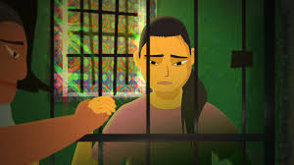
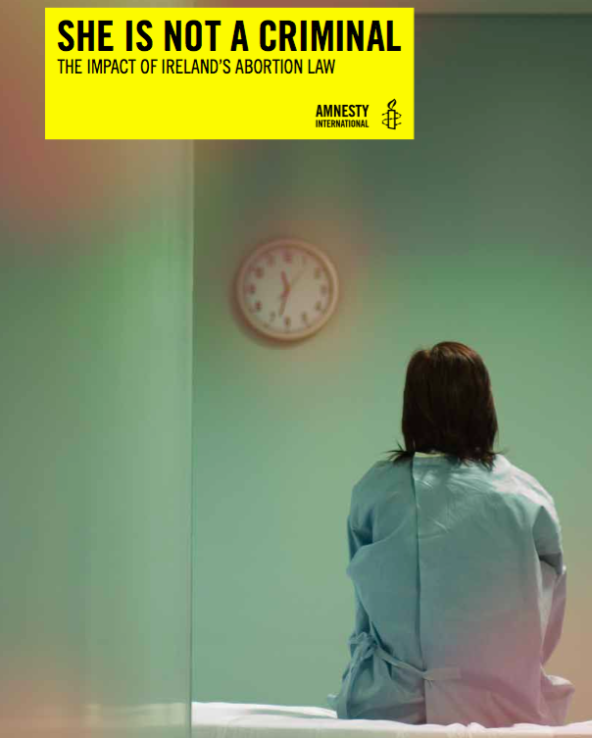
What does success look like?
Notes:
Slide 21: What does success look like?
This slide looks at successes we are trying to achieve with this campaign, which can only be possible through the effective campaigning of Amnesty activists across the UK and across the globe.
You may include the following:
The success of this campaign can only be possible through the effective campaigning of Amnesty activists across the UK and across the globe.
We want to see the following human rights changes by the end of this campaign:
The release of a number of women in El Salvador who are being held on pregnancy-related charges. (Image: Top Left)
Human rights education work on FGM and early and forced marriage in Burkina Faso and Sierra Leone are funded for the next 3 years.
The new Irish Government commit to looking at the law relating to abortion in Ireland in 2016. (Image: Right from Ireland report to decriminalise)
A comprehensive law on violence against women is introduced in Tunisia and changes are made to the rape laws in Algeria and Morocco.
Bills restricting access to contraception in Iran are not passed. (Image: Bottom Left– Billboard to encourage procreation)
Debates around abortion in the UK regularly reference human rights and international standards.
Northern Ireland has access to abortion in the cases of fatal foetal abnormality and rape and incest.

