Slide 1
Lumi/ Zoom Instructions

Slide 2
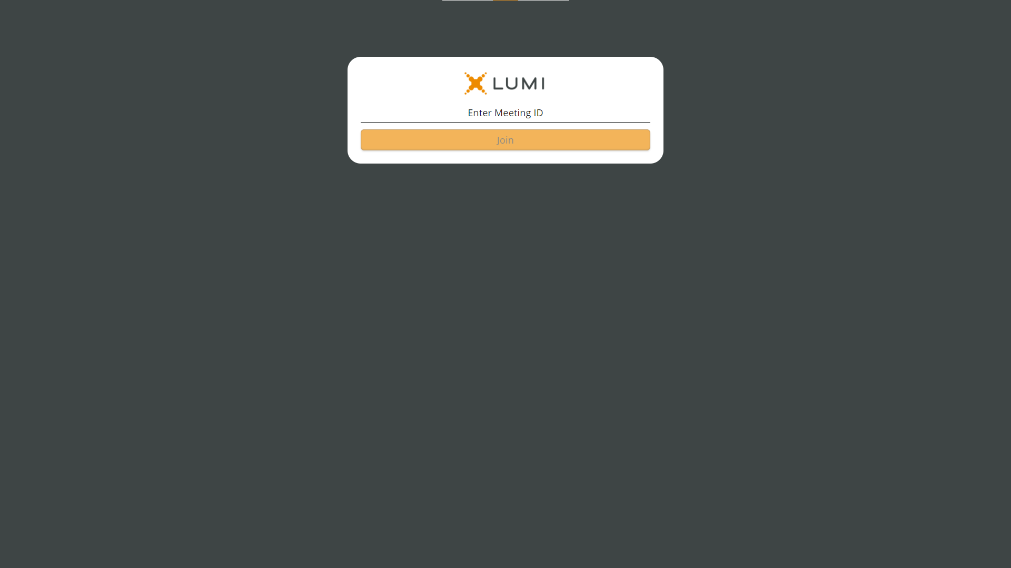
Enter the Meeting ID & click Join

Slide 3
Enter your VRN & PIN

Slide 4
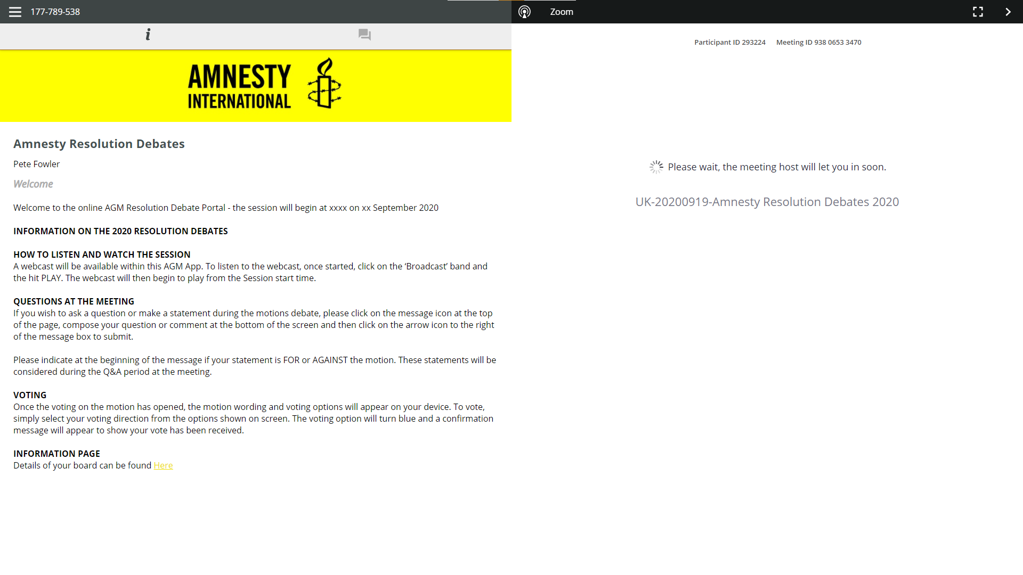
You will automatically be added into the Zoom call
(When let in by the host)

Slide 5
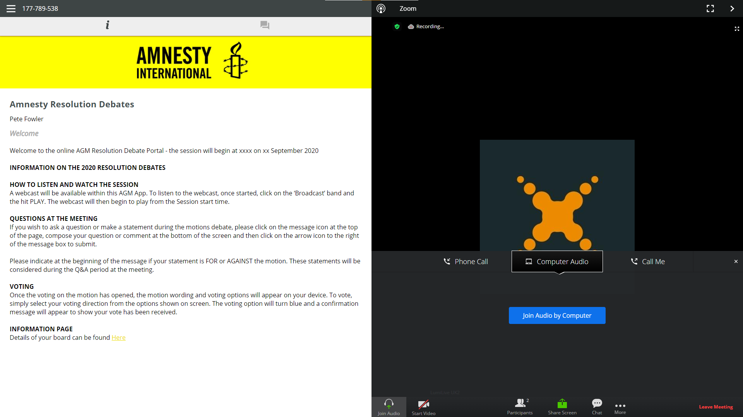
On entry select “Join Audio by Computer”

Slide 6
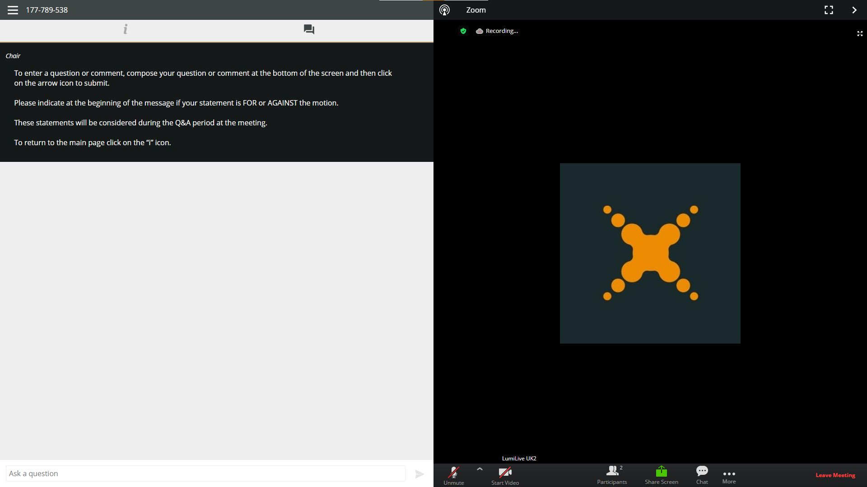
You can continue to send messages from the Lumi platform while on the Zoom call

