Slide 1


Slide 2



Source: Inja
Notes:
Also available at: https://vimeo.com/237401668

Slide 3


Slide 4
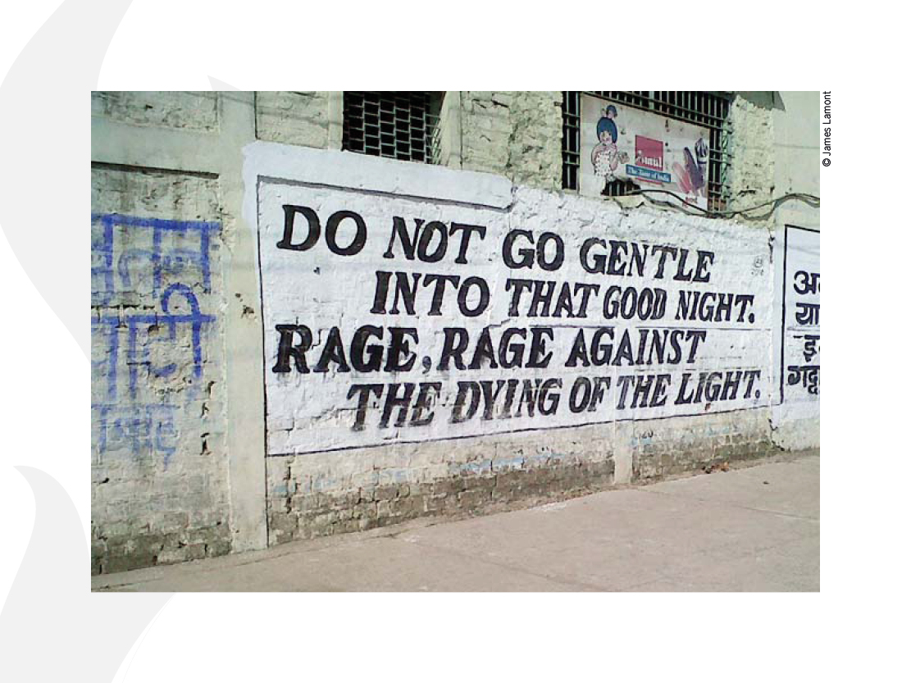

Slide 5


Slide 6


Slide 7
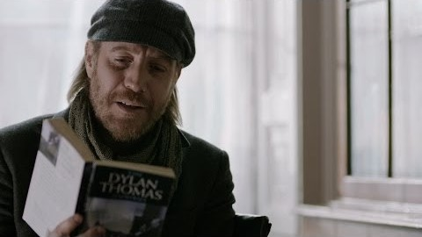
BBC Cymru Wales
YouTube Video clip
‘Do not go gentle into that good night:
Dylan Thomas Season’
Notes:
Also available on YouTube here: https://www.youtube.com/watch?v=zbHjyMJsCqA

Slide 8
Just imagine …

