Slide 1
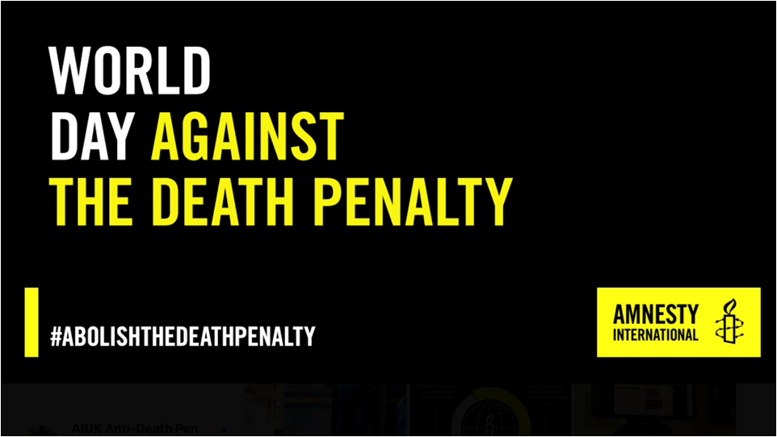

Slide 2

Agenda
Introduction
World Day Against the Death Penalty – 2024
  Our aim
  What we want you to do
  Resources
  Social media presence
  Follow up
  Q&A
Short break
Film screening – The Penalty
Courtesy https://en.wikipedia.org/wiki/en:GNU_Free_Documentation_License
Notes:
Slide 2: Content warning
Before the full presentation begins, it is worth providing a content warning as the nature of the topic may be upsetting or distressing.
Content warning for the following:
Death
Executions (including methods of execution and descriptions of executions)
Imprisonment
Inhumane conditions (including descriptions of death row cells and regimes)
Torture (includes references to torture being used to obtain confessions and “botched” executions)
You may include the following:
The nature of the work we do at Amnesty means that we often deal with issues which are upsetting or distressing. As you can see from the statistics the number of executions that were recorded by Amnesty and death sentences handed. Behind each death sentence is a story of human suffering.
If at any time a member of the audience does find any of the content distressing or it makes them uncomfortable, do check whether it would be possible to explain that section in a different way. It may be possible for audience members to remove themselves for upsetting sections and then return.
The content of this presentation will include details about death, methods and descriptions of executions and other violations of human rights including, torture and inhumane treatment.
The presentation will also include the types of crimes that could lead to being sentenced to death in different countries, which you may also find alarming.

Slide 3

WDADP 2024 campaign – The Aim
To engage every US death penalty state governor
To be a persistent advocate for abolition
To counterbalance the pro-DP echo chamber
To nudge all of them towards the abolitionist viewpoint

Slide 4
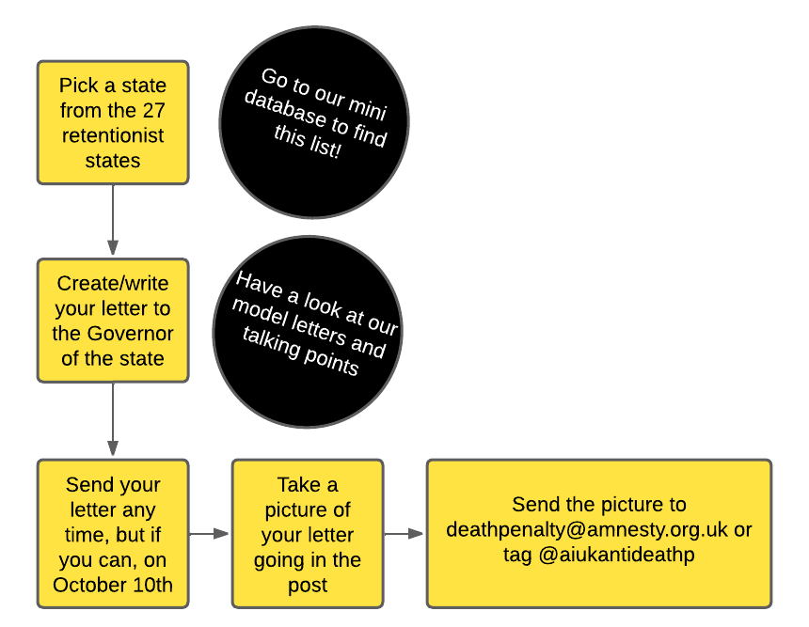
What we want you to do
‘Adopt’ a state
Write your letter
Take a picture
Send your picture to us
Send your letter

Slide 5
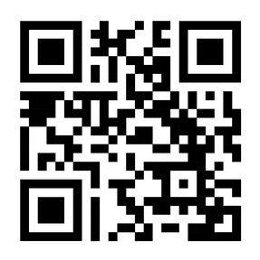
Resources
US state mini-database
Model letters
Get them here: https://www.amnesty.org.uk/resources/anti-death-penalty-project-usa-special-world-day?

Slide 6
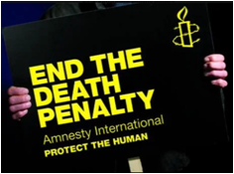
Using social media
Suggested messages for World Day Against the Death Penalty
“Today is World Day Against the Death Penalty. We must recognise that the #deathpenalty is the ultimate cruel, inhuman & degrading punishment.”
“ The #deathpenalty is irreversible & mistakes happen. Execution is the ultimate, irrevocable punishment: the risk of executing an innocent person cannot be eliminated & such mistakes cannot be unmade.”
“The #deathpenalty is often used within unfair justice systems. The countries executing the most people are often the same countries about which @Amnesty has serious concerns regarding fairness of their judicial systems”

Slide 7
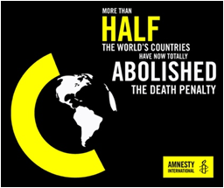
Using social media
Add the hashtag #WorldDayAgainstTheDeathPenalty
Copy in the governor of the US state if you’ve chosen one
Please follow us and tag us into any messages you make - we can repost to amplify the message further.
Twitter/X - @AIUKAntiDeathP
Facebook – search Amnesty Death Penalty Project
Instagram – Anti Death Penalty Project
Remember, most platforms allow you to schedule messages in advance, which I find very helpful, so I don’t forget!

Slide 8




Using social media
You can add a photo to make it more visual.
Amnesty have a few eye-catching ones or you can take on at a group meeting or by yourself. Amnesty have placards you can order or make your own.

Slide 9
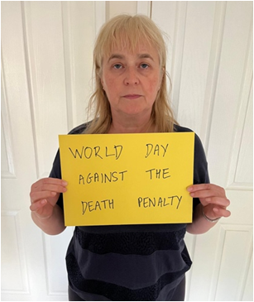
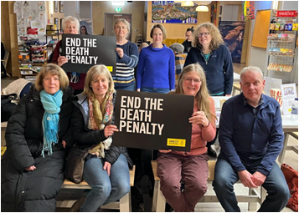
Using social media

Slide 10
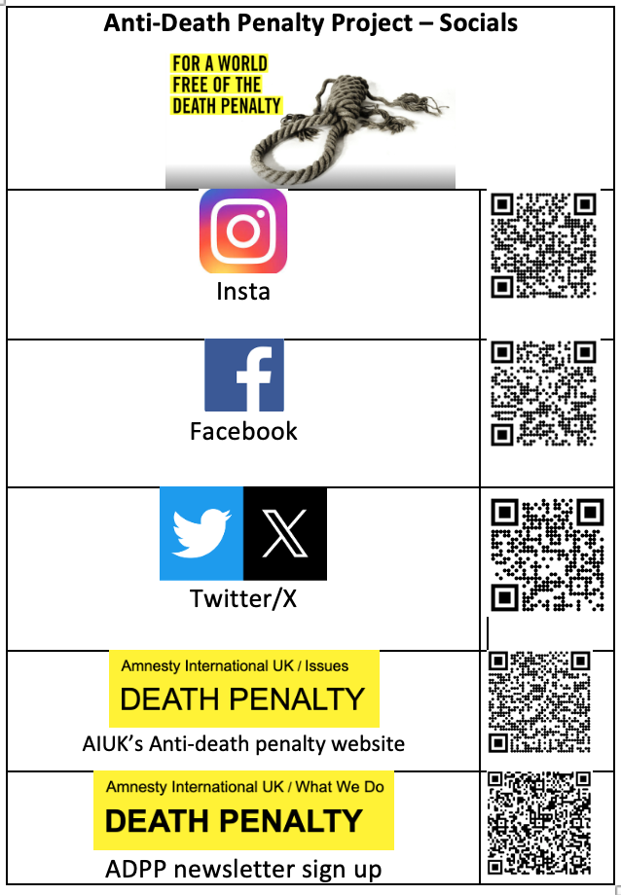
Using social media

Slide 11
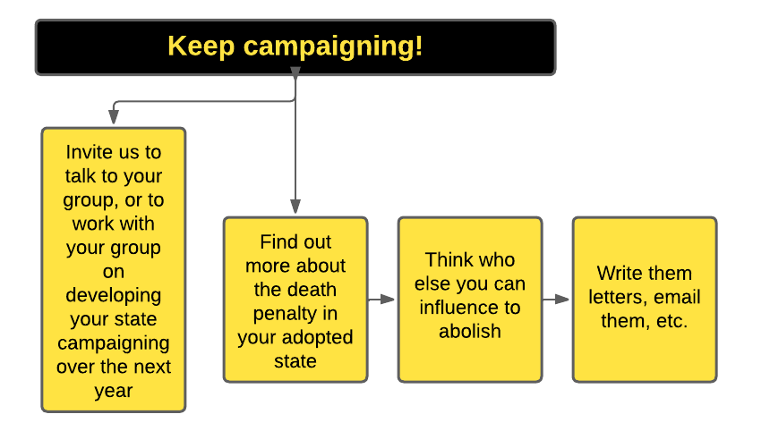
Following up
Here’s a way of involving others
Notes:
Slide 1: The Death Penalty
This presentations on the death penalty is for adult audiences to bring about awareness on the global state of the death penalty in 2017. It will take the audience through Amnesty’s 2016 report on death sentences and executions, cases and Amnesty’s long term commitment to abolishing the death penalty across the world.
The 2017 report on the death penalty can be found here: https://www.amnesty.org/en/documents/act50/5740/2017/en/
You may include the following:
Amnesty International is one of the leading organisations to report on the use of the death penalty across the world.
This presentation will take you through Amnesty’s 2017 report on death sentences and executions, death penalty cases and the impact of Amnesty’s work in this area.
Amnesty’s opposition to the death penalty began as far back as 1965, when it sponsored a UN resolution to suspend and abolish the death penalty for peacetime political offences.
In 1968 Amnesty announced its opposition to the death penalty for political prisoners.
Calls for a total abolition of the death penalty began in 1977, the same year Amnesty was awarded the Nobel Peace Prize.
Amnesty has called on all governments to “bring about the immediate and total abolition of the death penalty”.
Amnesty activists continue to campaign for total abolition of the death penalty in countries across the world.

Slide 12
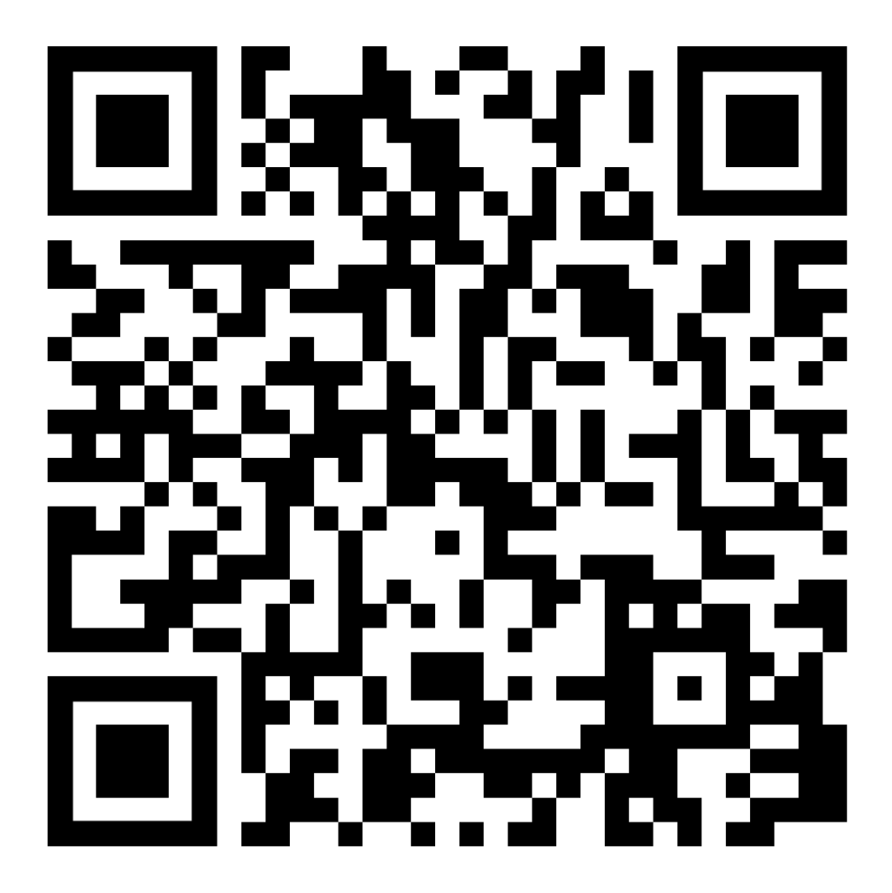
Contacting ADPP
You can contact us at:
  deathpenalty@amnesty.org.uk

Slide 13
Questions?
Notes:
2019 saw the downward trend continuing (unbroken since 2015)
For both executions and death sentences
No country abolished the death penalty in 2019 but there were further positive signs
New Hampshire abolished the DP
California established a moratorium on executions
Kazakhstan, Russian Fed, Tajikistan, Malaysia and Gambia continued to observe moratoriums
Barbados removed mandatory DP from its constitution

Slide 14

Next
Short break & refreshments
Film – The Penalty

