Slide 1
Manchester Amnesty International
Review of 2021-22

Slide 2
UAE
Mohamed al-Roken and Ahmed Mansoor
Postcards to embassy to mark Ahmed’s fourth year in prison
Appeal rota continues
Meeting at FCDO
  As result of lobbying MPs and Andy Burnham
Interview for Mancunian Matters
Talk by Kathryn

Slide 3
Human Rights in the UK
Talk by Anne
Government Immigration Consultation
Faiths and Beliefs letter
Week of Action (October)
  Mini Demo
  Meeting with Jeff Smith
  Letter and ad in MEN
Writing to MPs
Future of the HRA consultation
Coverage in Mancunian Matters and About Manchester

Slide 4
Anti Racism
AIUK problems
Group meeting concentrating on antiracism
Set up sub-group
  Self educating
Letters to MPs re racism in GMP
Messages of support to
  Didsbury Mosque
  Manchester Reform Synagogue
Been at rallies/demos/meetings

Slide 5
Refugee Rights
Collaboration with National Football Museum
  Panel Discussion
  Digital Exhibition
Couple of speakers
  Migrant Destitution Fund
  Quentin Duflos
Took part in Hong Kong Spirit event
  Speakers at our January meeting
Demo outside Polish consulate

Slide 6
Individuals at Risk
Write for Rights
  December Meeting
  Stall at Whalley Range event
    797 actions taken
Weekly Actions
Restarting Letter Writing Drop ins

Slide 7
Craftivism
Banner for Pride
Gift for Bev Craig

Slide 8
Ripples of Hope Feast
12 activist groups got to know each other

Slide 9
Syria Online Fundraiser
AIUK and Rethink Rebuild speakers
Very informative
Raffle raised £735
Thanks to Simona and Umbareen

Slide 10
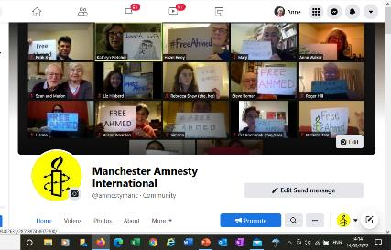
Social Media
Facebook - Anne Walker is Admin
  Page (Manchester Amnesty International)
    https://www.facebook.com/amnestymanc
    To promote the group
    Only admins can post
  Group (Manchester Amnesty)
    For discussion
    All can post
Twitter – Steve Lindsay is Admin
  @amnestymanc
Instagram – Ola Bocheneck is Admin
  amnestymanc

Slide 11
Thanks to all who took part

