Slide 1
RUNG PANUSAYA
THAILAND
FACING A LIFE SENTENCE FOR PEACEFUL PROTESTS

Slide 2
FREEDOM OF EXPRESSION: WORD CLOUD
How do you like to express yourself?
‹#›
Notes:
Ask participants to write down on the sticky notes the ways in which they commonly express themselves. Examples could be “sharing selfies”, “writing poems” or “dancing”. If you cannot use the sticky notes, participants can contribute orally.
Once the slide is covered with notes, ask participants why they express themselves in these ways?
What does it enable you to do?
Why is it important to you?

Slide 3
FREEDOM OF EXPRESSION: WORD CLOUD
What would be the consequences if you were not allowed to express yourself in these ways anymore?
Would it have a big impact on your daily activities and friendships?
How would it make you feel?
Would you be upset? Why? Or why not?
‹#›
Notes:
Pick a few individuals and ask them what they had written on their sticky notes. Then ask them the questions on the slide.
Option: If you use break out rooms put participants in pair or small groups for 10min to discuss the questions
Explain to participants that many people around the world cannot express themselves freely and that some people live with the threat or reality of being thrown into prison simply because they speak their minds or express themselves in various ways.

Slide 4
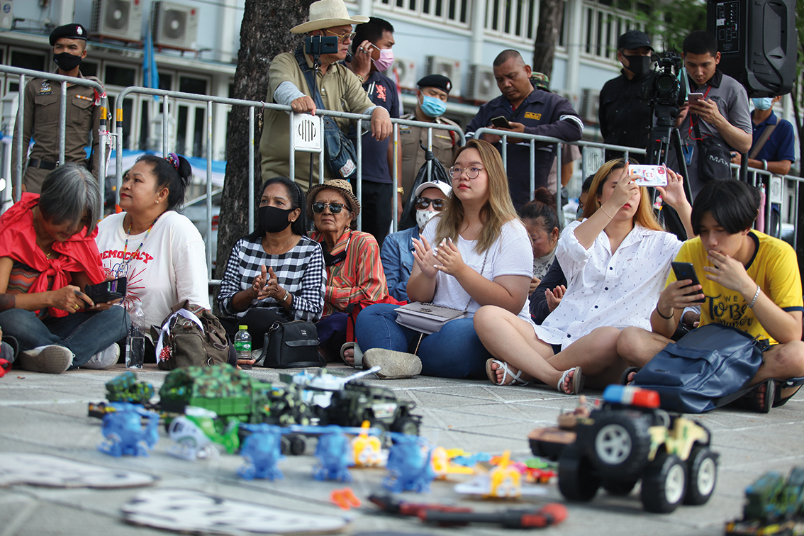
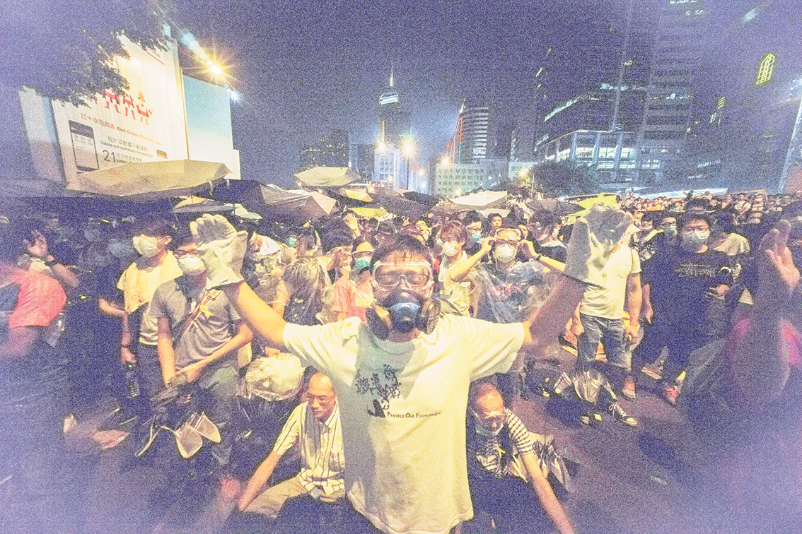
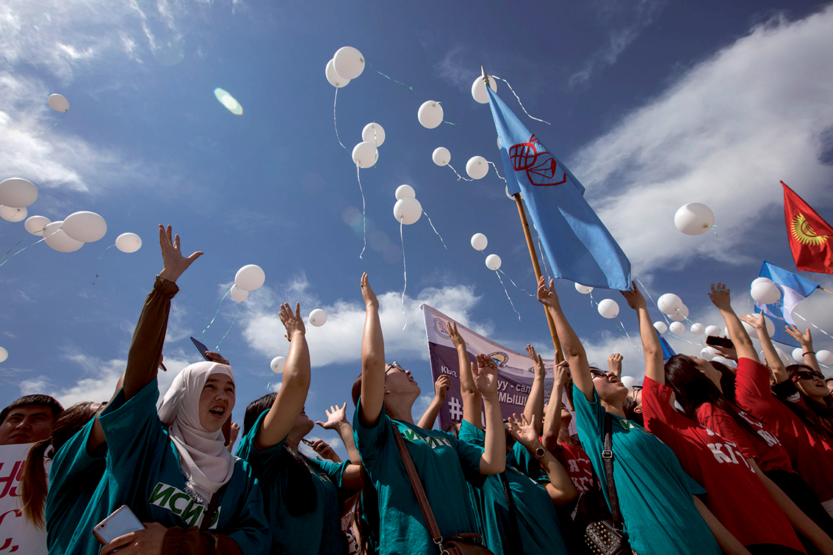
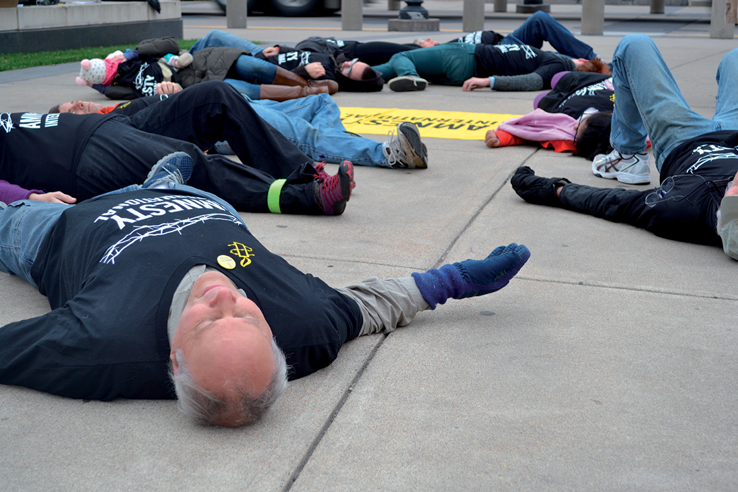
EXPLORING THE RIGHT TO PROTEST
1
2
3
4
‹#›
Notes:
Get the participants to examine the images and ask the following questions
What do the pictures have in common?
Where do you think the pictures are located?
What are the people in the pictures doing? Why?

Slide 5
EXPLORING THE RIGHT TO PROTEST
What would you do if you wanted to change society?
>
‹#›
Notes:
Participants can write down their responses on the slide or you can take down their ideas.

Slide 6
EXPLORING THE RIGHT TO PROTEST
1
A peaceful protest in Thailand in 2021, calling for justice and a better society.
© Kan Sangtong
‹#›
Notes:
Read out the captions for each picture.

Slide 7
EXPLORING THE RIGHT TO PROTEST
2
In 2014, tens of thousands of people took to the streets of Hong Kong, China, to call for democratic reforms in the city. The 79-day protest occupied key districts of central Hong Kong and became known as the Umbrella Movement. The umbrellas, used by the protesters to deflect pepper spray and tear gas, has given the everyday item iconic status, symbolizing resistance and the underlying social grievances.
© Leung Ching Yau Alex

Slide 8
EXPLORING THE RIGHT TO PROTEST
3
More than 1,000 people, including schoolchildren, protested against bride kidnapping in Kyrgyzstan on 6 June 2018, after a 20-year-old woman was murdered in a police station by her kidnapper.
© DMITRY MOTINOV/AFP/Getty Images

Slide 9
EXPLORING THE RIGHT TO PROTEST
This is one of a series of photographs of actions and events taking place in the USA as part of Amnesty International USA’s Game of Drones bus tour. This brings Amnesty USA’s campaigns and grassroots organizing around a secret drone programme into cities across the USA, building a mobile organizing space that directly incorporates local activists. This photograph shows University of Minnesota students taking action to urge the US government to end extrajudicial executions. Drone strike victims and their families have little chance of securing justice.
© Amnesty International / Flor Montero
4

Slide 10
EXPLORING THE RIGHT TO PROTEST
Why do you think people protested in the ways they did?
>
What do the protesters across all the cases have in common?
>
‹#›
Notes:
Participants can write down their responses on the slide or you can take down their ideas.

Slide 11
FREEDOM OF EXPRESSION AND PEACEFUL ASSEMBLY
The right to freedom of expression
Freedom of expression is the right of every individual to hold opinions without interference and to seek, receive and impart information and ideas through any media, regardless of frontiers. Freedom of expression protects your right to hold your own opinions and to express them freely without government interference. This includes the right to express views through public protests or through written materials, media broadcasts and works of art.
‹#›
Notes:
Explain that we will explore the definition of the rights to freedom of expression and peaceful assembly. The full definition is on the slide.

Slide 12
FREEDOM OF EXPRESSION AND PEACEFUL ASSEMBLY
The right to freedom of peaceful assembly
Freedom of peaceful assembly is the right of people to come together in a public place for a common expressive purpose.
The right to peaceful assembly means that someone can gather together with others peacefully without fear of being arrested or harassed by the police.
In fact, the authorities have a positive duty to facilitate peaceful assemblies.
‹#›
Notes:
Read the full definition:
Freedom of peaceful assembly is the right of people to come together in a public place for a common expressive purpose, such as for meetings, strikes, processions, rallies and sit-ins. The right to peaceful assembly means that someone can gather together with others peacefully without fear of being arrested or harassed by the police. In fact, the authorities have a positive duty to facilitate peaceful assemblies, so the police may be required to take special measures to ensure the safety of both the people assembling and the general public.

Slide 13
FREEDOM OF EXPRESSION AND PEACEFUL ASSEMBLY
The rights to freedom of expression and peaceful assembly are enshrined in international human rights law, including in the Universal Declaration of Human Rights (UDHR) and the International Covenant on Civil and Political Rights (ICCPR), as well as many national legal systems.
‹#›
Notes:
The rights to freedom of expression and peaceful assembly are enshrined in international human rights law.
Ask the participants if they can think of a situation where these rights might be restricted?

Slide 14
FREEDOM OF EXPRESSION AND PEACEFUL ASSEMBLY
Peaceful assembly in the time of Covid-19
The right to freedom of peaceful assembly is not an unlimited right. Sometimes governments have a duty to protect other people’s rights or certain public interests, such as public health.
However, as a rule, there should be no blanket bans on assemblies. Each assembly should be assessed, and restrictions must be imposed only to the extent necessary and proportionate to achieve a legitimate end.
In response to the Covid-19 pandemic:
Any restriction of assemblies must be based on the objective to protect public health.
The restriction must be effective in achieving the objective to protect public health.
Restrictions must be time-limited and regularly reviewed as to their necessity and proportionality.
If less restrictive measures are available to achieve the same objective, they should be used instead.
Complete prohibition of a specific assembly must remain the last resort.
‹#›
Notes:
Explain to participants that although we have the right to freedom of peaceful assembly, it is not an unlimited right. Sometimes governments have a duty to protect other people’s rights or certain public interests which requires some restrictions to assemblies. However, the circumstances in which the authorities can restrict freedom of peaceful assembly are very narrow and must be considered as exceptional rather than the norm.
Public health is one public interest. However, as a rule, there should be no blanket bans on assemblies. Each assembly should be assessed, and restrictions must be imposed only to the extent necessary and proportionate to achieve a legitimate end.

Slide 15
RUNG’S
STORY
Asked to describe herself, Panusaya “Rung” Sithijirawattanakul says she’s “humble and quiet”. The student and amateur violinist was once shy, but today she’s a leading voice in Thailand’s youth democracy movement.
Rung – which means “rainbow” in Thai – became politically active while studying sociology and anthropology at university in the capital, Bangkok. She bravely took part in protests for social and political change throughout 2020. By August, she had become a protest leader. Watched by thousands, Rung called for equality, freedom of expression and – what is a highly sensitive topic in Thailand – the reform of the monarchy. This unprecedented act propelled her onto the national stage and the authorities branded her a troublemaker.
‹#›
Notes:
Read out Rung’s story on this and the following slide. You can also choose to share a video of Rung speaking (7 mins) www.youtube.com/watch?v=InNt_grIJFo

Slide 16
RUNG’S
STORY
Rung continued to lead protests for constitutional and social reform. Accused of provoking unrest, she was arrested in March under a lèse-majesté law that outlaws criticism of the monarchy. She was imprisoned for 60 days during which she was diagnosed with Covid-19. The authorities denied her bail six times. In defiance, she went on a 38-day hunger strike and was released on 30 April 2021.
Rung faces dozens of charges against her and, if found guilty, life imprisonment. “Once you step into the prison; you will no longer feel that your humanity is still intact,” she says.
‹#›

Slide 17
RUNG’S STORY
-REACTION
Why is Rung protesting?
What are her demands?
Who is she protesting for?
>>
>>
‹#›
Notes:
Get the participants to react to Rung’s story by answering the questions on the following 3 slides. You could split participants into 4 groups and get them to answer the question(s) by writing their answers each slides..

Slide 18
RUNG’S STORY
-REACTION
What do you think gives Rung the strength and courage to continue?
What are the difficulties she is facing?
>>
>>
‹#›
Notes:
Get the participants to react to Rung’s story by answering the questions on this and the following slide. You could split participants into groups and get them to answer each question by writing their answers on the slide. Alternatively, you can pick participants to answer and write their answers on the slides.

Slide 19
RUNG’S STORY
-REACTION
Why is it important that Rung can freely express herself?
>>
‹#›

Slide 20
RUNG’S STORY
-REACTION
What inspires you about her story?
>>
‹#›

Slide 21
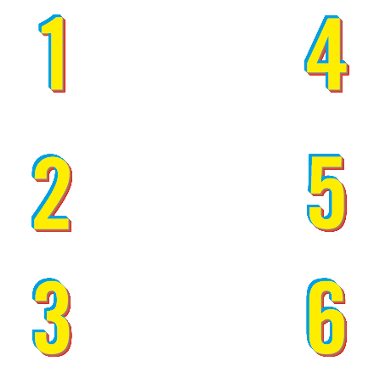
HOW DOES WRITE FOR RIGHTS WORK?
WHY DO WE NEED
TO TAKE ACTION?
People in more than 170 countries and territories take part in all kinds of events
Writing millions of letters, emails, tweets and petitions
Supporting people who’ve been harassed, threatened and unjustly jailed
Putting pressure
on governments, leaders and decision-makers
Showing love and support for the people and their families
And making change happen – releasing activists, securing justice for those whose rights have been wronged and protecting people who stand up for change
In country after country, people’s freedom to speak out against injustice, to live on their ancestral lands, to not be discriminated against – is under threat.
Our letters, words and actions will put pressure on authorities to take immediate ​ action, so that those who abuse will be brought to justice. And those unjustly imprisoned will taste freedom ​once again.
‹#›
Notes:
Now introduce Amnesty’s Write for Rights campaign. Explain that Amnesty is encouraging people to demand justice for Rung. You could give examples from last year’s campaign (see toolkit) demonstrating how successful writing letters and taking other actions can be.

Slide 22
HOW TO WRITE
FOR RIGHTS
1. LISTEN TO THE STORIES
2. WRITE YOUR LETTERS TO:
-The government we are trying to persuade to help the person or people featured in each case
-The person or people we want to help, or someone they are close to
3. TAG YOUR LETTERS SO AMNESTY CAN FIND ​THEM ON SOCIAL
-Take a photo of your letter
-Post in on your social media channels, tagging it with the unique event hashtag
-Make sure the posts are public so we can find it
4. AMNESTY WILL DELIVER YOUR LETTERS
Amnesty will then collect all actions and give them to the governments, the people we’re trying to help, or their families
‹#›
Notes:
Explain how to write for rights using the slide. You could also show participants the video of Bernardo which can be found here: www.amnesty.org/w4r-videos.

Slide 23
WRITE A LETTER,
CHANGE A LIFE
You can write to the Prime Minister of Thailand, Prayut Chan-O-Cha, at the following address:
The Office of the Permanent Secretary,
Government House,
1 Nakhon Pathom Road,
Dusit,
Bangkok 10300
Thailand
Salutation: Dear Prime Minister
Email address: sarabun@opm.go.th
Fax number: +66 2 282 5131
Social media: @prayutofficial
Use the following guidelines to write a more personal letter:
Tell the Prime Minister something about themselves.
Tell him what shocks them about Rung’s story. She is a student peaceful protester and a human rights defender who just wants a better life for people in Thailand.
Urge him to immediately drop all criminal proceedings against Panusaya “Rung” Sithijirawattanaku and others charged solely for peacefully exercising their rights to freedom of peaceful assembly and expression.
You can use the template letters in the letter writing toolkit which you can download on the Write for Rights web page at www.amnesty.org/writeforrights
W4R 2021 ACTIVITY: PEACEFUL PROTEST
‹#›
Notes:
Explain that Amnesty is encouraging people to write letters to authorities and show solidarity for Rung. If there isn’t enough time for participants to take action by writing letters, participants can also take action online. Share the link https://www.amnesty.org/en/get-involved/write-for-rights/ in the chat.
Please note If sending physical letters, please use a courier company, otherwise send communications over email or social media.
Tip: You could play some music for the group while they complete this activity

Slide 24
SHOW
SOLIDARITY
Rung in Thai means rainbow, a symbol we can use to show our support to her. In addition, she loves cats so would appreciate any such detail in her solidarity cards and messages. If using social media use suggested hashtags: #RungIsMyRainbow #W4R21
Digital messages via Rung’s social media:
Facebook: www.facebook.com/panusaya.sithijirawattanakul
Twitter: @PanusayaS
Instagram: @overttherainbow
Letters can be sent to:
Amnesty International Thailand
139/21, Soi Lat Phrao 5,
Chom Phon,
Chatuchak,
Bangkok 10900,
Thailand
W4R 2021 ACTIVITY: PEACEFUL PROTEST
‹#›
Notes:
You could have people hold their messages of solidarity and take a screenshot of the screen for a joint solidarity photo. Share on social media with #W4R20.

Slide 25
LEARN MORE
You can learn more about Rung and freedom of expression through our online game, Rights Arcade, available in English. Search for “Rights Arcade” in the Google Play Store or IOS App Store.
W4R 2021 ACTIVITY: PEACEFUL PROTEST
‹#›
Notes:
If you want to set a homework exercise, you can get participants to download the Rights Arcade app and learn more about Rung and Freedom of expression.

