Slide 1
UK Human Rights Act
A bit of history
How it works
Cases it’s helped
Image problem
Future changes?
1

Slide 2
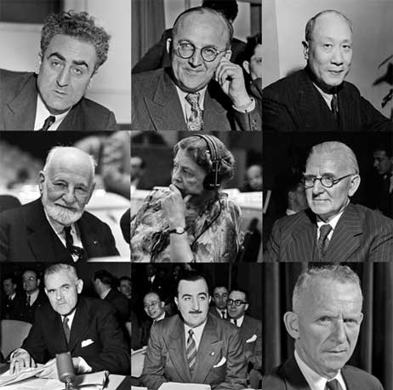
Universal Declaration of
Human Rights -10 Dec 1948
Common standards for all peoples and nations
Not legally binding
UN Human Rights Council
  Periodic Reviews
2
Notes:
Original drafting panel: China, Lebanon, USSR, France, UK (Charles Duke, President TUC), Australia, Chile, Canada, US (Chair – Eleanor Roosevelt)
Last UK review by Human Rights Council 2015. Found issues in Northern Ireland, racism. Stop and search +. Myanmar due in next round.

Slide 3

European Convention of Human Rights
Came into force 1953
Drafting committee
  Sir David Maxwell Fyfe
    Conservative MP
    Prosecutor at Nuremburg
Political Rights + Education
Covers all countries in Council of Europe
3

Slide 4
Council of Europe
1949
10 founding members, inc UK
Now 47 members
  Iceland, Turkey, Russia
European Court of Human Rights (ECtHR)
  Strasbourg
Any citizen of member countries can bring an action to ECtHR
4
Notes:
Having a formal court makes this a strong convention.

Slide 5
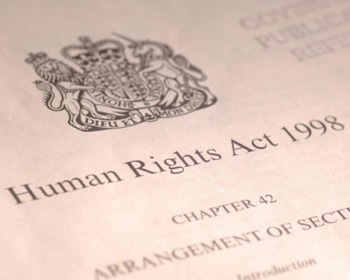
The Human Rights Act 1998
Passed in 1998, came into force in 2000
‘Brings rights back home’
Instead of taking case to ECtHR, could take case to UK courts
5
Notes:
5

Slide 6
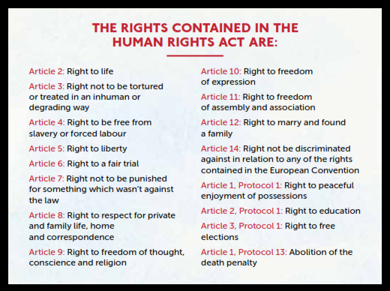
Which Rights?
6
Notes:
The HRA protects these 15 rights, and enshrines the prohibition on the death penalty.
They mirror the key ones in the European Convention on Human Rights, and are about fairness, dignity and justice. These rights also exist in the Universal Declaration of Human Rights and the International Covenants that protect human rights.
No economic and social rights with the exception of education

Slide 7
Who does the HRA apply to?
Places obligations on the state
  to respect the rights of individuals
All public bodies must act compatibly with the rights in the HRA
  Schools
  Hospitals
  Local councils
The courts are required to interpret laws in a way which is compatible with the rights contained in the HRA.
  If this is not possible, they can make a ‘declaration of incompatibility’ and Parliament can decide how to amend the law
When a new Bill is introduced to Parliament, the Minister responsible must make a statement that it is compatible with the Human Rights Act
7
Notes:
7

Slide 8

How it works
Council of Europe
European Court of Human Rights (ECtHR)
Strasbourg
Make a ruling
Parliament HAS to do it!
UK Parliament
UK Human Rights Act (HRA) 1998
UK Courts can review decisions/actions & legislation
Can decide what to do
I feel my rights have been violated
(European Convention on Human Rights)
8
Notes:
8

Slide 9
Who is protected by the HRA
Applies to anyone within the jurisdiction of the UK, including foreign nationals
Limited protections for people outside jurisdiction unless UK involvement
Important rights for victims of crime, obligations on state to prevent/investigate.
9
Notes:
9

Slide 10
Abolishes the Death Penalty
Last execution 1964
Abolished for murder in 1965 (NI 1973)
Remained for:
  Fire/explosion in a naval dockyard, ship or warehouse until 1971
  Espionage until 1981
  Piracy with violence until 1998
  Treason until 1998
  Some military offences until 1998
HRA
10

Slide 11
Who does it help?
Upheld older couple’s right to live together
Improved level of care for lady with multiple sclerosis
Helped a woman get information on Covid in a form she could access
11
Notes:
Details of elderly couples case – see https://www.bihr.org.uk/FAQs/older-couple-separated-in-care-home
Details of lady with MS – see https://savetheact.uk/people-like-you/ Jan Sutton
Details on blind lady getting access to health info – see https://www.bbc.co.uk/news/uk-england-leicestershire-56445596
11

Slide 12
Hillsborough (1989)
Initial inquest - Accidental death
Second inquest - Major errors by police and ambulance service
Human Rights Act
  Right to life - If someone dies at hands of state or because of state failings, must be investigated
“I don’t think we would have got the verdicts in April of this year if it hadn’t been for the Human Rights Act . . . I think it’s probably one of the most important pieces of legislation that governs rights for UK citizens” – Becky Shah, who lost her mum, Inger.
12
Notes:
For more details see https://savetheact.uk/hillsborough/

Slide 13
Northern Ireland Agreement
1998
States that the UK must bring ECHRs into Northern Ireland's law
  Corner stone of agreement
  Public institutions accountable
“The Human rights Act means there is a route for Troubles victims to make sure that the government investigates their cases. If the Human rights Act wasn’t there, I don’t know how justice would be served” – Alan McBride, who lost his wife, Sharon, in an IRA bombing in Belfast in 1993.
13
Notes:
For more details see https://savetheact.uk/peace-northern-ireland/

Slide 14



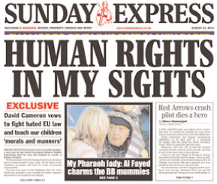
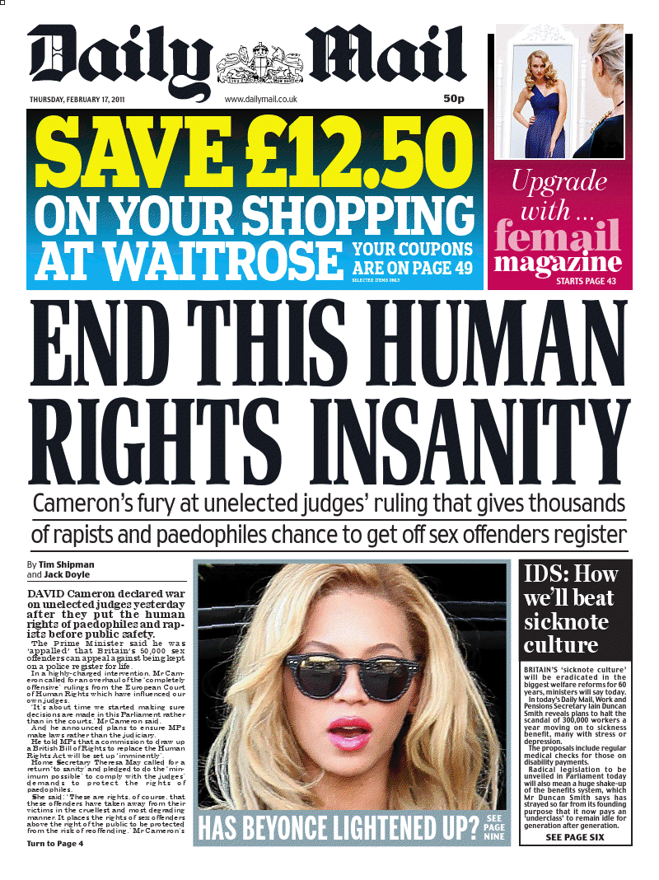

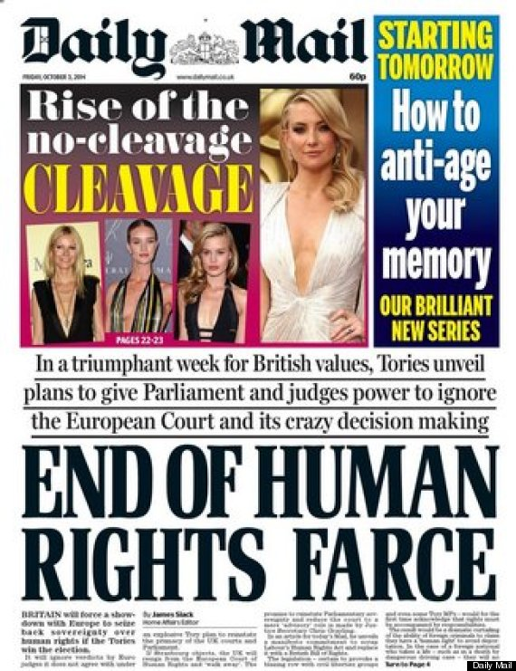
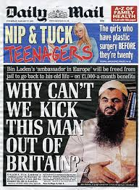
Bad press
Image problem
14
Notes:
Huge amount of myth and misconception. Trivial or Europe dictating to us
14

Slide 15

Serial killer, Denis Nilsen, 60, received hardcore gay porn in jail thanks to human rights laws. He argued “it was his right to information and freedom of expression” in 2002. The prison service agreed to allow that right to Nilsen, convicted of killing six young men in 1983
13 May 2006
Government Review of the Implementation of the Human Rights Act June 2006
Dennis Nilsen’s application was refused by the single judge at the permission stage. He did not establish that there was any arguable case that a breach of his human rights had occurred, nor that the prison’s rules were discriminatory. He also failed to receive any greater access to such materials as a result. The failure of his application at the first hurdle was not widely reported, nor his further failure on renewal.
15
Notes:
https://en.wikipedia.org/wiki/Dennis_Nilsen
Nilsen repeatedly sought legal avenues to challenge real and perceived abuses of prison rules by prison officers—regularly petitioning the Home Office and, later, the European Court of Human Rights with complaints. As a result, he was an unpopular inmate with successive governors at the various prisons in which he was incarcerated.^{[149]} In October 2001, Nilson brought a judicial review against the prison service, citing that the gay softcore pornography magazines Vulcan and Him, to which he subscribed regularly, had some images and articles of a more explicit nature removed before the magazine reached him.^{[156][157]} The legal case he brought against the prison service was dismissed because he could not establish that any breach of his human rights had occurred.^{[158]}
15

Slide 16
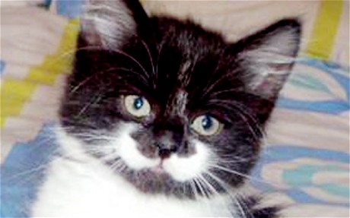
Catgate
Catgate
16
Notes:
In 2011, it was reported (Sun, Sunday Telegraph, Daily Mail, Theresa May) that a Bolivian man had been spared deportation under Article 8 (right to family life) because he had a pet cat.
In fact, it was his long term relationship with a British women that made the deportation disproportionate. The reference to the cat was a joke by the immigration judge.

Slide 17
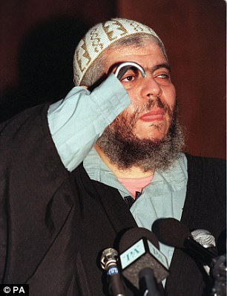
Abu Hamza
Sentenced to 7 years in UK 2006
US ask for extradition
UK courts give permission
Blocked by ECtHR
  Sought assurances that would not be treated inhumanely
Eventually agreed 2012
Currently in jail in US.
17
Notes:
https://en.wikipedia.org/wiki/Abu_Hamza_al-Masri
On 8 July 2010, the ECtHR temporarily blocked Hamza's extradition to the United States to face terrorism charges until the court was satisfied that he would not be treated inhumanely.^{[52]} The court based its judgement on ECHR, which applies to British law. It is an absolute prohibition for a signatory to the ECHR to remove anyone to a place where they would be subject to inhumane or degrading treatment.^{[53]} In past cases, the ECtHR has prevented the UK from deporting suspected foreign terrorists to places where they might be tortured. In Hamza's case, this has been extended to refusing extradition to a country where he might be jailed for life, and where the prison regime is judged too harsh. The court said there should be further legal argument on whether life without parole would be a breach of human rights. The court asked for fresh submissions on whether Hamza, and other prisoners awaiting extradition, would face inhumane treatment in the US if they were sent there to stand trial.^{[54]}
On 24 September 2012, the court agreed Hamza could be extradited to the US to face terrorism charges.^{[55]}

Slide 18
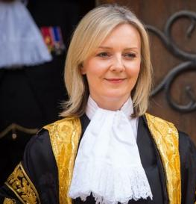
Conservative Manifesto pledge
“ We will scrap Labour’s Human Rights Act and introduce a British Bill of rights which will restore common sense to the application of human rights in the UK”
“We are committed to that. That is a manifesto commitment, I’m looking very closely at the details but we have a manifesto commitment to deliver that.”
Notes:
Pledge in manifesto for 2015& 2017 elections. Statement by Liz Truss immediately after Brexit referendum.

Slide 19
2019 Conservative Manifesto
Only contained reference to ‘updating’ Human Rights Act
Independent Human Rights Act Review
  Launched Dec 2020
  Report this summer
  Chaired by a judge – Sir Peter Gross
19

Slide 20
Review
The Review will consider how the Human Rights Act is working in practice and whether any change is needed.
  Report expected in June
  AIUK has responded
Concern that courts making policy
Relationship between ECtHR and UK courts
“We are committed to remaining a signatory to the European Convention on Human Rights”.
20
Notes:
See https://www.gov.uk/guidance/independent-human-rights-act-review

Slide 21
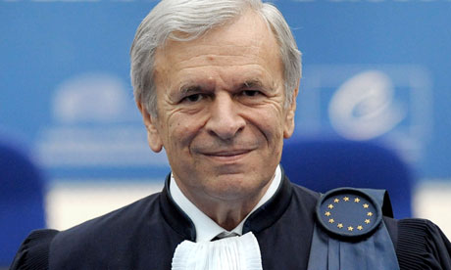
My problem is in understanding why it’s desirable to introduce a new Bill of Rights into law. The Human Rights Act is an extremely skilful piece of legislation which does strike exactly the right balance
Sir Nicolas Bratza, President , ECtHR.
Guardian 22/10/12
21

Slide 22
AIUK Response
https://www.amnesty.org.uk/resources/aiuk-submission-independent-human-rights-act-review-ihrar
Finally, we would reiterate our movement’s concern that what happens with regards to human rights in the UK has consequences internationally. As is widely reported, there is a growing threat to rights protections and the rule of law in many countries around the world, with independent judiciaries and lawful restraints on government action being presented as in some way illegitimate affronts to the will of the people. It is imperative that the UK not be seen to be condoning or participating in these developments.

Slide 23
What’s next
Open letter from faiths and beliefs to PM
Series of online Roadshows organized by consultation panel
Report is published – expected in June
AIUK Week of Action – planned for October
Previous actions by Manchester Amnesty
  Motion passed by City Council
  Petition at stalls
  Street theatre
Subgroup – email anne.walker9@ntlworld.com to volunteer

Slide 24
Other UK legislative concerns
Overseas Operations Bill
Immigration and Asylum Bill
Police, Crime, Sentencing and Courts Bill
22

