Slide 1
Amnesty Student Training: Building Alliances & Partnerships

Slide 2
Ground rules
Mute when not speaking.
Respect each other.
Speak slowly and clearly.
Identify yourself.
Ask for clarification.
Zero tolerance.
Provide feedback.
Notes:
Mute. Make sure you mute yourself whilst the workshop facilitator is talking, you’ll be asked to unmute when we begin the discussion part of this session.
Respect each other. Please be respectful and mindful with the questions e.g., their lived experience may make speaking on this topic difficult.
Speak slowly and clearly. When participating in workshops, please try not to talk over another speaker. If there are multiple participants, people tend to talk at the same time – making conversations extremely difficult to understand. Try to speak one at a time so that we can follow your point in its entirety.
Identify yourself. So we can get to know each other, before you start to speak, please state your name and university. Only if you feel comfortable – this is not a requirement.
No one-on-one side conversations. All discussion is meant for everyone.
Ask for clarification. If there is something that you don’t understand, please ask for clarification. If you don’t understand the issue or solution, then there are probably others who also don’t understand.
Zero tolerance. If you display repeatedly hateful actions you will be removed from the platform.
Provide feedback. After this session there will be an opportunity to feedback. This only takes a few moments so please use this opportunity.

Slide 3
Learning Outcomes
Understand why we build alliances and partnerships
Understand self interest and what motivates allies and partners
Understand how to build common interests with those from different backgrounds
Identify allies and partners we can work with
Notes:
How to understand self-Interests of Individuals
How to build common Interests with those from different backgrounds
Being part of / broadening someone else's interests
Building Allies and diverse teams

Slide 4
What is an ally/partner?
Allies and partners may share a common goal or objective.
Allies and partners are people you will work with on specific aspects of your work, but wont be able to join with completely and universally.
Notes:
We all work with people every day, building relationships, getting and offering help, joining together on tasks.
But with allies and partners, we’re talking about a specific group of people – or at least, a specific approach to building relationships with people.
Allys and partners may share a common goal or objective – but not both.
So – Amnesty working with UK black pride, for example, will be a partnership. We may see them as allies to the broad Human Rights Cause, and they may see us as allies to the needs of queer communities – but the purposes, priorities and direction of our organisations are distinct.

Slide 5
What motivates people to act?
Empathy/ Emotional Connection
Moral Obligation
Self Interest
Notes:
There’s a huge amount of research, debate and discussion on this.
Shout out: What motivates individuals to act?
Self-interest, empathy/emotional connection, moral obligation
We are going to be a bit unsophisticated here, and look at these three headings, while recognising the complexity of the debate does extend somewhat beyond them. These headings, though, are a good compromise, where almost everyone will agree they are relevant to human motivation.
All 3 of these elements will be a factor when you’re working with individuals. We all know that engagement through emotional connection and moral obligation is a strong avenue that we use in getting people to take part in our campaigns. But, working with organisations or groups, self-interest is going to be the key factor.
Shoutout: Why?
Organisations have organisational priorities. Moral obligation and emotional connection are built into them – but in forming an organisation, these are turned into an organisational strategy that already encompasses them.
An organisation like WWF will inevitably attract staff and supporters who feel emotional connection to wildlife, and a moral obligation to support wildlife. However, the organisation will put it’s time, money and effort into wildlife protection that has the most chance of success, or the biggest effect. In forming WWF, in defining the scope of their organisation, they have already addressed emotional and moral motivators. How they choose what part of that scope to act on will be strategic.

Slide 6
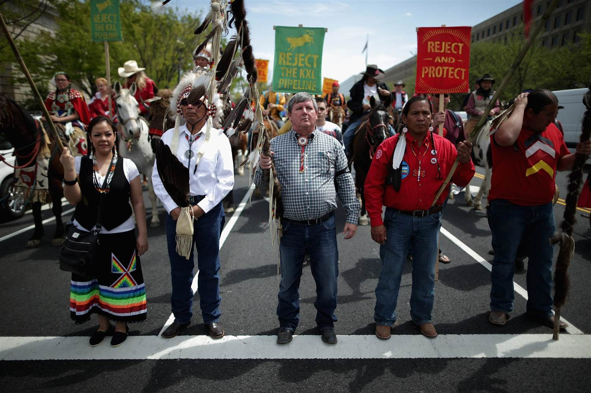
Unlikely allies…
Notes:
The campaign against the keystone pipeline was a huge, multi-year campaign to stop the multinational corporation Transcanada building an extension to their existing pipeline network, which transports crude oil into the US for processing. To do so, they will need to cross – meaning dig, lay pipe and otherwise decimate – vast tracks of wilderness – even aside from the threat to the climate implicit in it’s completion.
The campaign ran for years before the Obama administration ceded to their demands and rejected permission for the extension. The Trump administration has subsequently reversed that refusal, and the campaign continues.
For our purposes, we’re interested at looking at the unlikely partnerships the coalition constructed in opposition to the project.
Shout-out: What groups of people would you look to engage in this project?
Scientists, climate activists, politicians, hikers and ramblers, indigenous peoples, ranchers.
Bringing together Nebraska’s ranchers and indigenous peoples to campaign for a shared goal, based on a common wish to protect the land over which they have had stewardship for generations – was an enormous task given that each contests the stewardship of the other, and the two groups have had such a longstanding animosity that whole genres of film and literature have sprung from it. Self interest in use of Water TERFS/Church This partnership is, hopefully, less to the liking of Amnesty activists, but it remains a sharp example of strange bed fellows.
In recent years, so called “TERFs” (Trans-exclusionary radical feminists) have found increasing common group – and public support – elements of the Catholic church. And vice versa.
“It has been a tremendous plus to have radical feminists speaking out so strongly about the reality of sexual difference and against the new tyranny of gender,” says the director of the Catholics Women’s Forum,
Mary Kate Fain, who founded 4W, an online space that publishes articles on (their words) radical feminism, identifies the catholic church as a key ally.
Interestingly, this partnership increasingly stretches beyond the foundational common purpose of dismissing diverse gender identities – with the groups now working together on ‘cancel culture’, citing freedom of speech as going ‘hand in hand’ with freedom of religion. You can build a partnership with anyone, if that partnership benefits both parties

Slide 7
Finding common ground
Who will benefit from the change you’re trying to make/ be harmed by the thing you’re trying to stop?
Think about:
Shared objectives
Material gain
Media exposure
Power
Notes:
When we build partnerships, we always go back to the same organisations or groups. In the case of Amnesty, that’s often other NGOs. If we want to build a partnership on queer rights – we go to Stonewall, or Mermaids, or Gendered Intelligence. If we want to build a partnership on refugee rights, we go to Oxfam, and the Refugee Council, and Actionaid.
And that’s completely fine – and those organisations should definitely be ones we work with on those issues.
The key is not to limit yourself to those partners.
Who will benefit from your work on this issue? That might be other NGOs with the same objective, but remember we’re interested in Self-Interest here.
Shoutout:
Why do Starbucks sponsor pride?
Why do Tesco work with Friends of the Earth on making their stores environmentally friendly?
A more complicated one…
Why do UKIP politicians so often take photo ops in a pub with a pint?
An unlikely partnership for Amnesty is Football Welcomes (hand over to Elaine)

Slide 8
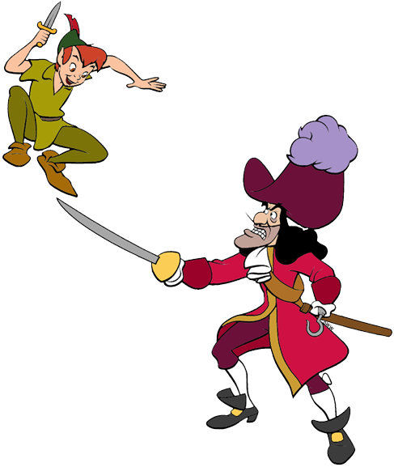
Frenemies
Notes:
Take 5 minutes and think of an issue that could occur that could unite these old enemies. We’re looking for each of you to come up with an issue for every pair.

Slide 9
Break

Slide 10
Your work
In breakout groups;
Think of something you’re working on – a specific campaign or issue – and come up with the most unlikely group or organisation you can think of that also stands to gain from you achieving your aim.
Who is it?
What is their self interest?

Slide 11
How to approach allies
So – you’ve dropped an email to the unlikely partner asking them if they’d like a meeting on working in partnership on a given issue.
What do you think will be important in developing and managing these relationships?
What are the pitfalls you’ll need to avoid?

Slide 12
Trust matters
Don’t over-promise
Don’t divert from agreed positions
Don’t expect your partner’s position to change on other things
Be clear about what you can contribute
Build a concrete plan, and stick to it
Do be clear your position won’t change on other things

Slide 13
Recap
Identify groups/people with an interest in you achieving your specific goal
Don’t be afraid if you don’t see them as natural allies
Identify what you have to offer.
Identify what you need
Be clear on objectives, expectations and offer. Build trust.

