Slide 1
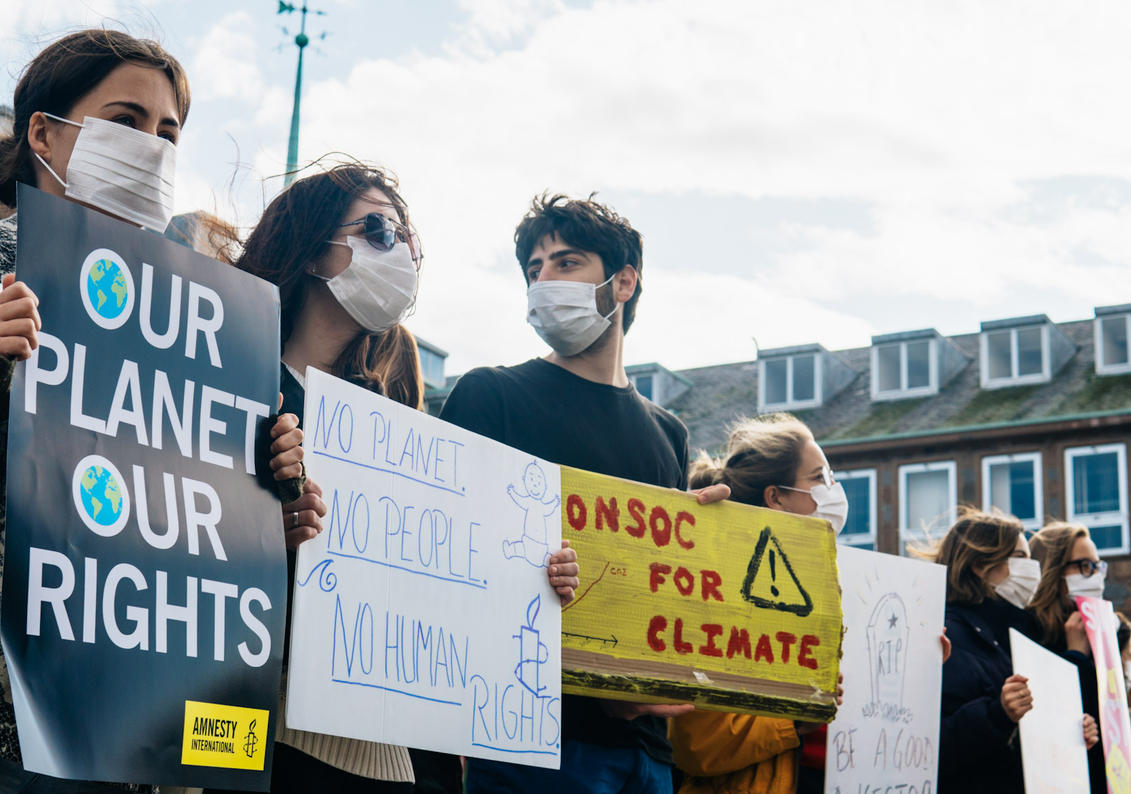
Beyond Protest: An Introduction to Organising on Campus

Slide 2
Ground rules
Mute when not speaking.
Respect each other.
Speak slowly and clearly.
Identify yourself.
Ask for clarification.
Zero tolerance.
Provide feedback.
Notes:
Mute. Make sure you mute yourself whilst the workshop facilitator is talking, you’ll be asked to unmute when we begin the discussion part of this session.
Respect each other. Please be respectful and mindful with the questions e.g., their lived experience may make speaking on this topic difficult.
Speak slowly and clearly. When participating in workshops, please try not to talk over another speaker. If there are multiple participants, people tend to talk at the same time – making conversations extremely difficult to understand. Try to speak one at a time so that we can follow your point in its entirety.
Identify yourself. So we can get to know each other, before you start to speak, please state your name and university. Only if you feel comfortable – this is not a requirement.
No one-on-one side conversations. All discussion is meant for everyone.
Ask for clarification. If there is something that you don’t understand, please ask for clarification. If you don’t understand the issue or solution, then there are probably others who also don’t understand.
Zero tolerance. If you display repeatedly hateful actions you will be removed from the platform.
Provide feedback. After this session there will be an opportunity to feedback. This only takes a few moments so please use this opportunity.

Slide 3
Ice breaker
In breakout rooms come up with 3 things you have in common in 3 minutes.

Slide 4
Learning Outcomes
Begin to understand what Community Organising is and why it is important
Explore how Community Organising can make our groups more relevant, diverse and inclusive
Understand who is in your community and how you can reach them

Slide 5
What is Community Organising?
In the chat box write what comes to your mind when you think of the word community
In the chat box write what comes to your mind when you think of the word organising

Slide 6
What is Community Organising?
Community organising is the work of bringing people together to take action around their common concerns and overcome social injustice.
It’s about returning power to people. Community organisers reach out and listen, connect and motivate people to build their collective power.
Notes:
Other key points:
It’s proactive not reactive – in that you are addressing the root causes and not just the outcomes of them.
Organising is about authentic relationship building, changing the world from how it is to how it should be according to the community,

Slide 7
Core components of Community Organising
Building authentic relationships with all parts of a diverse community
Building power by leadership training and bringing people together
Listening to people and addressing the relevant issues they bring up
Identifying those in power to change the situation
Taking action to engage those in power as one cohesive unit

Slide 8
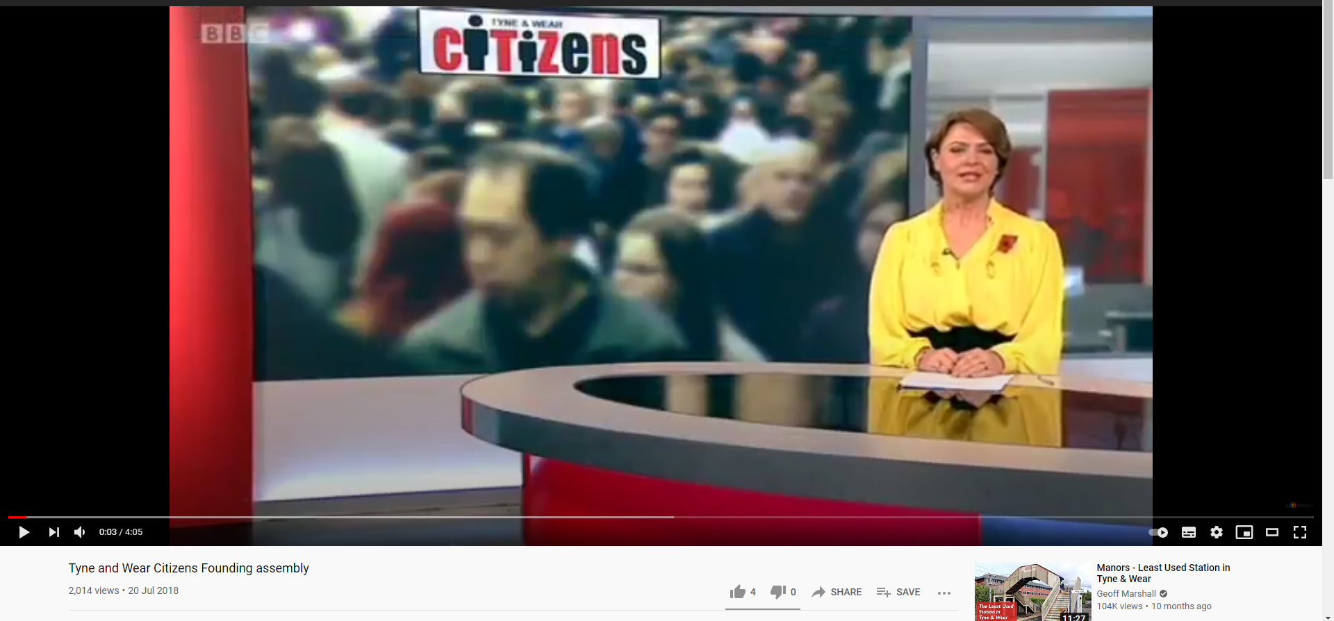

Slide 9
Does your student group/your campaigns reflect what you saw in the video?
Notes:
Traditionally Amnesty has mobilised it’s supporters – telling them what issues to work on and how to take action. This may be called top down.
We want to move to a bottom up approach, where human rights issues are tackled on a local as well and global issue

Slide 10
Diversity through organising
“As organisers we need to actively expand our universe of people, we can’t just call an ‘open-meeting’ and expect people to attend” - Jane McAlevey
“Diversity doesn’t mean anything if it’s not at the table that’s making decisions.” - Bilal Hussain
In your breakout groups reflect on these two quotes (10 mins)
Discuss whether your student groups, the meetings and events you organise or attend, are reflective of your community, both on campus and wider
Who’s missing from your meetings and why?
Notes:
Break into rooms of 5 and reflect on these two quotes.
Discuss whether your student groups, the meetings and events you attend are reflective of your community, both on campus and wider

Slide 11
Diversity through organising
When you’re working with not for people – which is what CO does – you’re naturally more relevant and diverse not just in demographics but in method.
Amnesty UK, and human rights themselves, will be more relevant when we’re engaging in new conversations and working on issues that matter to us locally and not just globally
Any questions before the break?
Notes:
A lack of diversity in certain events and groups can leave people with the impression that Amnesty is a white, liberal, secular, middle class, middle aged movement
Engaging in new conversations, working on issues that matter to us locally and not just globally which is why we need CO.
When you’re working with, not for, people – which is what CO does – you’re naturally more relevant and diverse not just in demographic but in method.
You’re pulling from a wider base of people and skills.

Slide 12
10 minute break

Slide 13
Community mapping: First steps to building a network in your community

Slide 14
Do you know who is in your community?
POLL: Scale of 1 to 10, how well do you know the community where your university is based
1- Not at all
10 – I know it very well
Community organising is all about building power in our community through relationships
But if we don’t know who is in our wider community, we can’t build relationships with them.
Notes:
Many of us are part of an activist community on campus. But this means the same people come to meetings and show up to events.

Slide 15
Community mapping is the first step in Community Organising
Community Mapping is a simple tool to identify the people, groups and organisations in your community.
There’s no right or wrong way to map your community – be as creative as you like.
Use your own expertise and knowledge of the area, but also use tools like Google and online maps.
Be positive and confident - you often know more people than
you think you do.

Slide 16
Community mapping spheres
Your Town/City
Your University
Civil
Society

Slide 17
Group Exercise
Open the document and copy it into Word
Choose one group leader who makes notes to reports back the main/most interesting findings to share with everyone in the main meeting.
Write down who you know in your communities
Who/what did you write down that could be useful to others
What unusual suspects did you come up with
How would you recommend approaching people/organisations that you do not hold relationship with?
Come back into the main room and group leader feeds back.
Notes:
TIP: Open Google Maps or grab a physical map, zoom in on your community/town/city/region, and have a look at what organisations/businesses are around you!
TIP: Think outside the box – who and what are unusual suspects
that could help you?

Slide 18
Next steps
Take the community mapping exercise back to your groups, and complete it together.
Arrange a (virtual) meeting with two people/groups you have identified in your mapping.
Come to the next session on 13th March to learn about power and building relationships.
Complete our feedback survey

