Slide 1
Understanding the
Amnesty movement

Slide 2
WHAT WE’LL COVER
A brief history of Amnesty International
An overview of how Amnesty works and the issues we work on
The structure of Amnesty International and where your student group fits in
How Amnesty fundraises
A chance for you to ask any questions
Notes:
This presentation will give you an overview of the history of Amnesty International and the issues that Amnesty International works on. We’ll go into detail on how Amnesty is structured at a global and domestic level, and how student groups can take part in the democratic decision-making processes of the organisation.
We’ll also cover how Amnesty fundraises, and the support offered to student groups.

Slide 3
Quick Quiz
What year was Amnesty International formed
A)1951 B) 1961 C) 1971
How many supporters does Amnesty have globally
A) 1 million B) 5 Million C) 7 Million
How many times has Amnesty won the Noble Peace Prize
A) Once B) Twice) C) Never
How many research reports has Amnesty written since 1961
A)15,000 B) 10,000 C)17,000
How many countries does Amnesty International have an office in?
A)90 B) 80 C)74
Notes:
Use this quiz as an icebreaker for the group
Quick Quiz Answers:
Q) What Year was Amnesty International form?
A) B- 1961, in London, UK
Q) How many times has Amnesty won the Nobel Peace Prise?
A- Once in 1977 for its work on the protection of the rights of prisoners of conscience
Q) How many supporters does Amnesty have Globally?
C- Amnesty is a global movement of more than 7 million people
Q) How many research reports has Amnesty written since 1961?
C- 17 093 to be exact. This does not include press releases or urgent action calls
Q) How many countries does Amnesty International have an office in?
A) B- 80 countries but we have members and activists from over 150 countries and territories

Slide 4
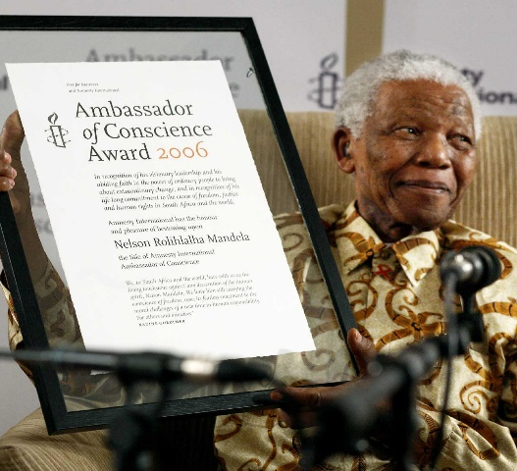
Brief History of Amnesty
1961-2
1969
1972
1977
1980
1993
2014
2020
Amnesty International is founded as a permanent international movement in defence of
freedom of
opinion
Milestone 2000 Prisoners of conscience released
Launches first
campaign against torture resulting in UN declaration on torture in 1975
Amnesty awarded the Nobel Peace Prize in recognition of all Amnesty supporters
Amnesty launces first campaign against the death penalty. Published the ground breaking study When the State kills in 1982
Amnesty campaigns for an International Criminal Court to bring those responsible for genocides and war crimes to justice. The ICC is established
in 2002.
Arms Trade Treaty comes into force to stop the flow of weapons fuelling atrocities around the world.
Amnesty is the world's largest human rights movement, with more than 7 million supporters in more than 150 countries
Notes:
Amnesty began in 1961 when British lawyer Peter Benenson was outraged by the imprisonment of two Portuguese students raising a toast to freedom. He wrote an article called the forgotten prisoner in The Observer newspaper and launched a campaign that provoked an incredible response. Reprinted in newspapers across the world, his call to action sparked the idea that people everywhere can unite in solidarity for justice and freedom. Amnesty International was born.
This inspiring moment didn’t just give birth to an extraordinary movement, it was the start of an extraordinary social change. Amnesty grew from a collection of western countries focused on the release of prisoners of conscience to a truly international organisation that focused and campaigned on a range of human rights abuses such as torture, the death penalty and the trade of arms, some of which are highlighted on the timeline. Since 1961, Amnesty International has grown to become the world’s largest human rights organisation which in 2020 has 8 million supports worldwide in more than 150 counties.

Slide 5
What do we do?
Notes:
Amnesty International is unique in that we conduct research, lobby governments and businesses, and build campaigning power through our movement of activists. Many organisations do only one or two of these things.
Amnesty will only work on an issue that we have a global policy position on, and that we have researched or independently verified. Policy is approved at a global level through our democratic structures, something we’ll cover later in this presentation.
Since its founding, Amnesty has written and published 17,000 reports and carried out 3,300 research missions
Of the back of this research, Amnesty develops global campaigns. All Amnesty entities take part in at least one global campaign, but they also run their own regional or country specific campaigns. For example in the UK, Amnesty has campaigned to save the Human Rights Act, and this year the Student Action Network are taking part in Let’s Talk About Yes – a Europe wide campaign on sexual consent. Amnesty’s student groups are free to campaign on any human rights issue that Amnesty works on

Slide 6
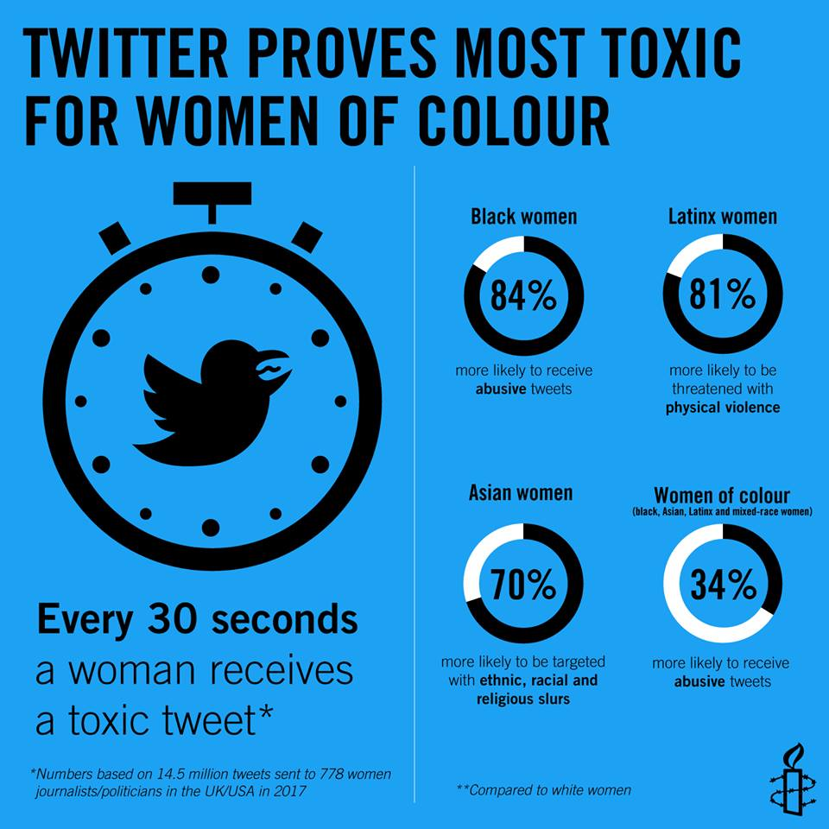
TOXic Twitter Report
Our report, #ToxicTwitter was the result of interviews with more than 80 women, including politicians, journalists, and regular users across the UK and USA.
Amnesty exposed how Twitter is failing to respect women’s rights.
I think Twitter is the worst of the social media platforms, just because of the quickened and masked flow [of abuse] that happens. Jessica Valenti, US journalist and writer
Notes:
Amnesty’s Toxic Twitter campaign is a good example of how they combined research, campaigning and political lobbying.
In 2018 Amnesty launched their Toxic Twitter report which interview over 80 women in the UK and US, as well as using online data analysis.
They found that every 30 seconds a woman on Twitter receives an abusive tweet, and women of colour are up to 84% more likely to receive abuse on twitter than white women. In addition to the report, Amnesty UK identified that ahead of the 2017 GE Dianne abbot received more abuse online than all other MPs combined.

Slide 7
TOXic Twitter Campaigning and Advocacy
Twitter were initially unresponsive to Amnesty’s campaign, stating that the release of information of the number of reports of abuse on the platform would be ‘uninformative and potentially misleading’
Thousands of activists sent action cards, including as part of Write for Rights, to Twitter’s headquarters.
During Jack Dorsey’s Congressional Hearing in the US about Transparency and Accountability on Twitter, Congresswoman Diana DeGette used her time to raise the Toxic Twitter report.
This pressure resulted in Twitter CEO Jack Dorsey agreeing to meet with Kumi Naidoo, our then Secretary General.
Notes:
Off the back of their report Amnesty launched the Toxic Twitter campaign. Amnesty has a long history of writing physical letters – it’s how the organisation started in 1961. They wanted to use this to their advantage when targeting twitter. They identified that Twitter aren’t used to receiving large amounts of posts – most of their communication is online.
Amnesty knew that if Amnesty supporters and activists globally sent action cards to their headquarters, they would be forced to take notice. In 2018 action cards and materials were included Freshers Packs, and student groups across the country signed thousands of action cards.
The campaign was also included as a key action in Write for Rights, alongside a solidarity action with Seyi Akiwowo who founded Glitch UK.

Slide 8
TOXic Twitter Campaign Wins
As a result of this meeting Jack Dorsey committed to ;
Introduce a dashboard (as per our suggestion) where people could track and appeal reports of abuse,
Consider providing more context for decisions,
Increase transparency,
Invest in public awareness re: how users can protect themselves on Twitter, report abuse, etc.
Take steps to remove the burden of reporting from victims.
Twitter also created a Director of Human Rights role, and updated their Transparency Report to include a section on how they enforce their rules
Notes:
In September, during Jack Dorsey’s Congressional Hearing in the US about Transparency and Accountability on Twitter, Congresswoman Diana DeGette used her time to raise the Toxic Twitter report, get it on record that Jack Dorsey is aware of the report, questioned Jack about whether he has met with Amnesty personally to discuss their concerns and also highlighted Amnesty’s key recommendations.
In his response to the Congresswoman, Jack Dorsey publicly committed to publishing the Content Moderation Transparency Report which had previously only been disused privately with Amnesty
As a result of this pressure, Jack Dorsey CEO agreed to meet Amnesty’s then Secretary General Kumi Naidoo. As a result of this meeting Twitter agreed to;
• Introducing a dashboard (as per Amnesty’s recommendation) where people could track and appeal reports of abuse
• Consider providing more context for decisions
• Increase transparency;
• Invest in public awareness re: how users can protect themselves on Twitter, report abuse, etc.
• Take steps to remove the burden of reporting from victims.
Just prior to the meeting Twitter had already created a Director of Human Rights role and released an updated Transparency Report in which it included for the first time a section on 'Twitter Rules Enforcement'.
This is a really good example of how Amnesty were able to carry out a piece of independent research, use this to mobilise thousands of activists and supporters globally, which built pressure on a global organisation to change their practices.

Slide 9
The Issues We Work on
Notes:
When Amnesty International began their work focused on releasing political prisoners, or prisoners of conscious. As the organisation has grown, these areas of work have expanded to include a host of personal, political, social and economic rights.
Arms Control was a huge focus for Amnesty throughout the 90s and 00s, as they campaigned for the introduction of a Global Arms Trade Treaty. 2014 saw the UN ratify a global Arms Trade Treaty which was a huge win for the campaign and followed years of student campaigning on the issue. Now the focus has shifted to the use of technology in the military, including the development of autonomous weapons as part of the Stop Killer Robots Campaign.
Amnesty has been working on the death penalty since 1982 when Amnesty released their ground-breaking research When States Kill. Amnesty activists have been campaigning on this issue ever since, and now 109 states have banned the use of the death penalty. There’s still a lot of work to be done, with over 650 people executed around the world in 2019. In the UK, the activist led Anti Death Penalty Network coordinates this work.
Sexual and reproductive rights have been an extremely popular topic with Amnesty’s student groups. In 2018 Amnesty student groups around the UK campaigned in solidarity with women and pregnant people in Northern Ireland campaigning for the right to safe and legal abortions. 2019 saw a huge win for this campaign, as abortion was decriminalised in Northern Ireland alongside the legalisation of gay marriage. The Queens Belfast Student Group played a huge role in this campaign and their campaign gained media coverage across the UK. In 2020 the Student Action Network Committee launched their Let’s Talk About Yes campaign, which aims to create a Yes Culture on campus around sexual consent.

Slide 10
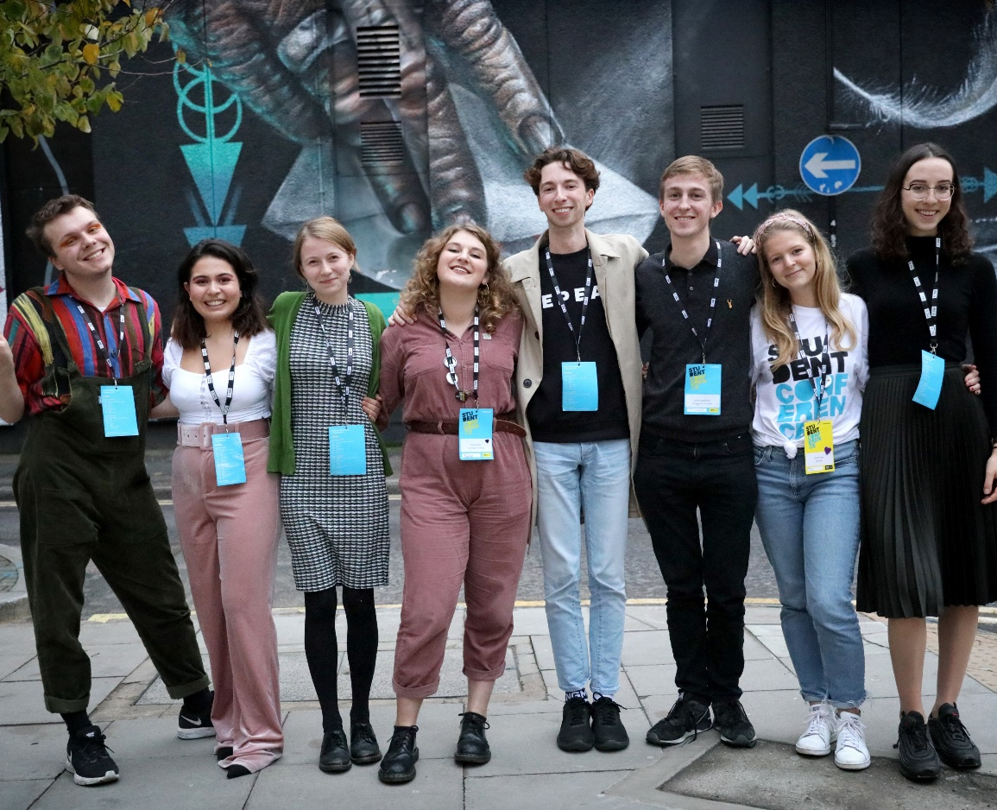
THE AMNESTY STUDENT NETWORK
60 student groups across the UK – the largest student campaigning network in the UK
Elect a committee of 8 students who represent and lead the network – the Student Action Network Committee.
Notes:
The Amnesty Student Network, which our group is a part of, is one of the largest student campaigning network in the UK and is the second largest Amnesty student network in the world after the USA. There are currently 60 student groups in universities across the UK.
Being one of the largest student campaigning network in the UK, we campaign on a variety of issues important to students such as climate change, women’s healthcare access, LGBT+ rights and many other human rights abuses.
Amnesty Student groups are supported and represented by the Student Action Network Committee, most commonly referred to as the STAN Committee, which is a group of 8 student activists who are elected by the student groups. The STAN Committee act as a point of contact between Amnesty International UK and the student groups with each STAN Committee member being given a region to represent.
The Student Action Network has been critical for the success of many campaigns, including organising a student day of action for the #ItsTime campaign where STAN organised a UK and Ireland wide day of protesting for abortion access in Northern Ireland. The STAN committee were also focused using climate strikes to encourage universities to declare a climate emergency which have been widely successful.
This academic year (2020-21) the main student campaigns that the STAN committee are working on are:
Let’s Talk About Yes – making universities more accountable for sexual harassment on campus
Stop Killer Robots – preventing UK universities contributing to research on autonomous weapon systems
Black Lives Matter – Ending systemic racism in the UK and across the world

Slide 11
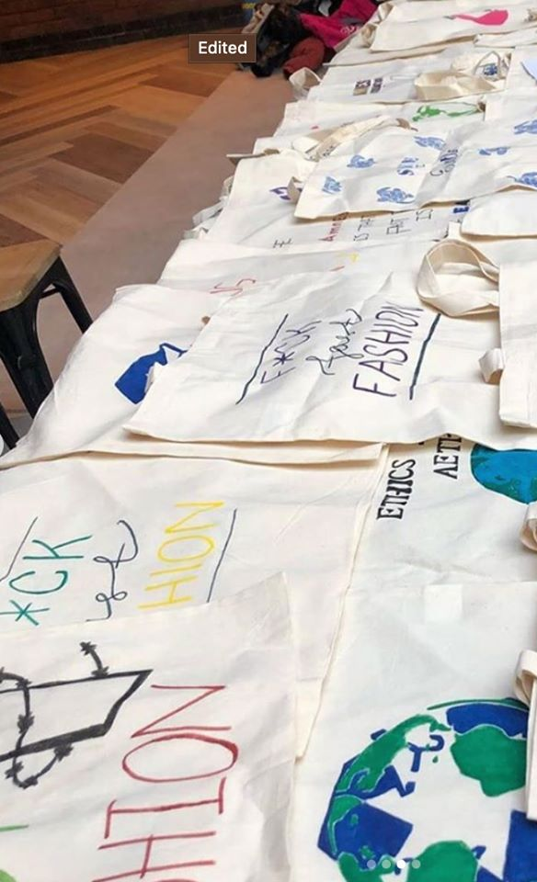
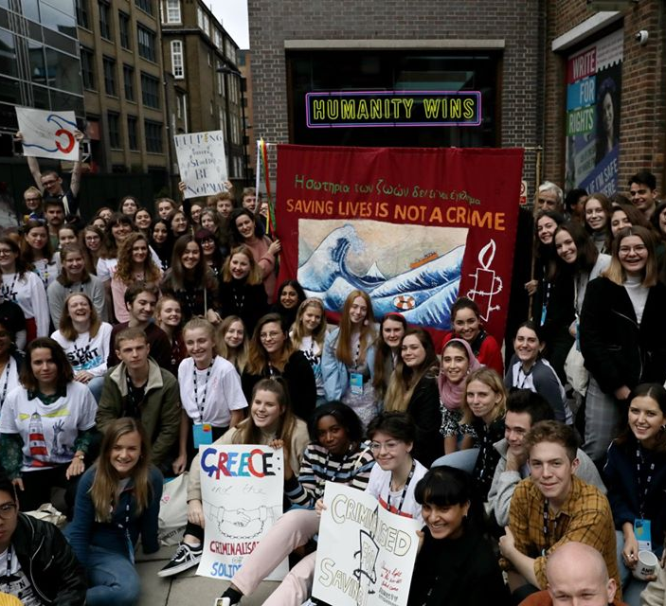
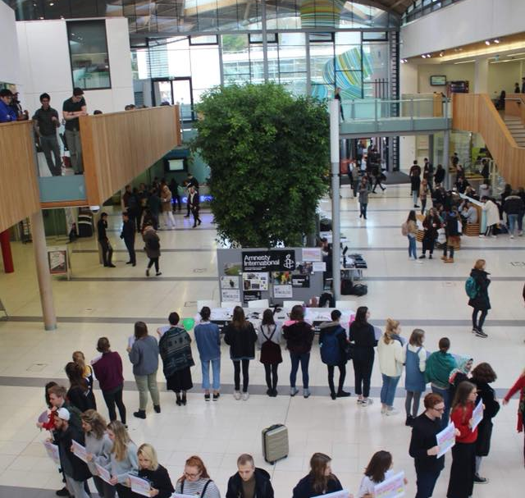
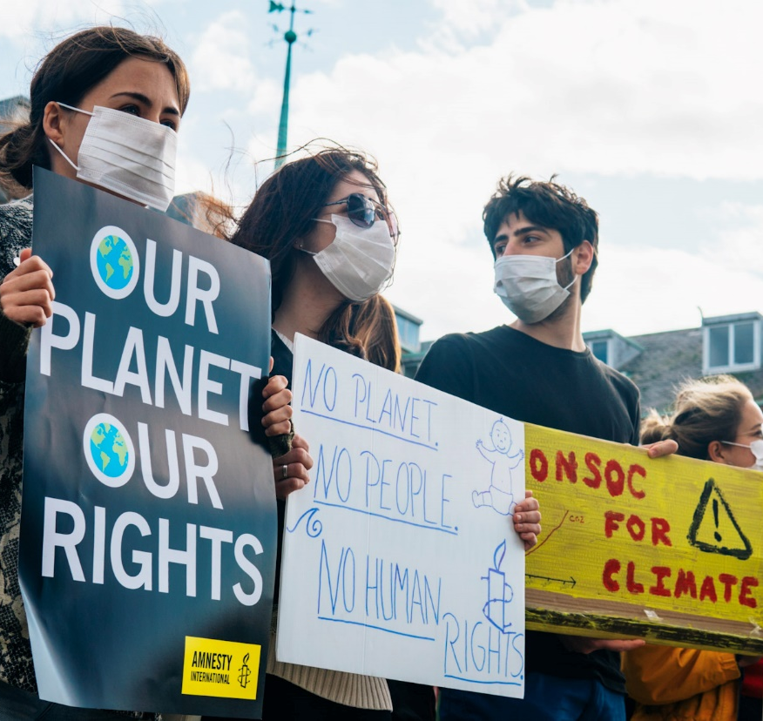
Notes:
This slide shows some examples of Amnesty student group campaigning. On this slide you can see students at our 2019 student conference, a solidarity stunt for abortion rights in Northern Ireland, amnesty students representing at pride, and the Aberdeen University student groups climate strike.

Slide 12
Global Structure of Amnesty international
Amnesty UK Section
International Board
Global Assembly
Amnesty UK board
Annual General Meeting
International Secretariat
Thematic Networks
Children Human rights, Rainbow Feminist
Groups
(Student, Youth, local)
All Sections
Amnesty UK
Individual
members
Notes:
This slide shows the different levels of decision making at Amnesty International. Amnesty is an international democratic organisation and all members including students can impact on decision making within the organisation. At the bottom right side of the diagram are the different types of membership in Amnesty UK. These include individual members and groups such as student groups. Every year, all aspects of Amnesty UK’s membership meet at the Annual General Meeting. Here decisions about policy for the UK section are made and voted on by members. If a motion passes it moves to the Amnesty UK board, who are the most senior members in the UK section.
The Amnesty UK board have many responsibilities but two of the most important are to make sure the UK section follows through on motions passed at the AGM and secondly to represent the UK section at the Global Assembly. The Global Assembly convenes all the sections from across the world to discuss strategies, policies, vote on International Board members, and share ideas and knowledge to guide the international movement. A Section is a country office that has a democratic say in the Amnesty movement at the Global Assembly.
The International board is made up of nine people and provides proposals for the international financial assessment system, global governance procedures, global standards and the Strategic Goals of the organisation. They provide annual reports on the movement and appoint Amnesty’s Secretary General, who is the figurehead of Amnesty International. The Secretary General is the chief executive officer for the International Secretariat which carries out the majority of our research and global campaign work. This research and global campaign work are given to the Sections as the diagram shows.

Slide 13
How do UK Student groups make decisions at amnesty UK?
Submit motions to
Student groups
Annual General Meeting
Support student
groups
If motion passes
Amnesty UK Staff
Amnesty UK board
Notes:
In the UK section, decisions are made at the Annual General Meeting (AGM). If a motion is successfully passed by the membership, it is given to the Amnesty UK board to oversee its implementation, but it is the Amnesty staff who often carry out the work. The most useful analogy for this relationship is to think of the Amnesty UK board as MPs and the staff as civil servants who do the work to make sure Amnesty’s activists and members are properly resourced.

Slide 14
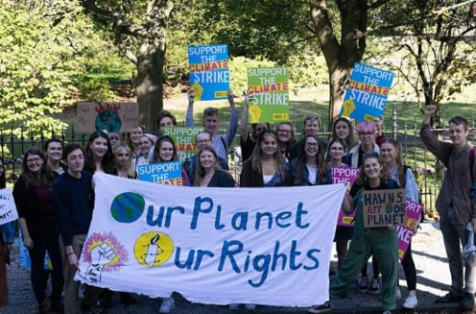
How does this work in practice?
Edinburgh University Amnesty International Society
International Secretariat creates policy on Climate Change and Human Rights
Edinburgh University Group and Climate Action
2016 Annual General
Meeting
Votes for: 1851 (74.01%)
Amnesty UK board propose motion at
2017 Global Assembly
Votes against 650 (25.99%)
Notes:
Edinburgh University are a great example of how Student groups have a direct impact on the decision making at Amnesty. In 2016, Edinburgh University Amnesty group brought a motion to the AGM, calling on the UK section to bring forward a motion to the 2017 Global Assembly instructing the development of research and policy on the human rights impact of climate change. Edinburgh university student group presented their motion at the 2016 AGM and it passed by 74%. This meant that the Amnesty UK board could take the issue to the Global Assembly where it is again passed.
As a result the International Secretariat conducted research on human rights issues related to the effects of the climate emergency, as the Edinburgh University group had asked for. By 2019, Amnesty members such as Student groups could work and campaign on climate change and in the presentation is a picture of the Edinburgh university group at a climate strike in 2019. As proven by Edinburgh University, Student groups are able to directly impact on the research and campaigning work of Amnesty at a global level.

Slide 15
Amnesty UK groups
Regional Reps
Student Action Network Committee
Youth Advisory Group
Student Conference
Local Group
Youth Group
Youth Group
Local Group
Local Group
Local Group
Student Group
Student Group
Youth Group
Youth Group
Local Group
Local Group
Local Group
Student Group
Student Group
Youth Group
Youth Group
Notes:
As mentioned earlier in the presentation, within the UK section there are three different types of groups. The one you are probably most familiar with are the student groups. Student groups meet up at the annual Student Conference where student workshops take place and the Student Action Network (StAN) committee is elected.
There are also youth groups, which are mainly secondary school groups. They are represented by the Youth Advisory Group. To get onto the Youth Advisory Group (YAG) you have to apply and candidates are chosen. YAG meet 4 times a year and feed into Amnesty UKs work.
For members not in education there are local groups. Each region has its own representative who helps facilitate events and communication between local groups within a region. Most regions have all three group types and there is an encouragement of all three groups to work together on campaigns and many regions have strong cooperation between the different types of groups.

Slide 16
Trade Union
Trade Union
Amnesty UK Networks
Trade Union Network (TUNC)
CC
CC
Country Coordinator Forum
Trade Union
Trade Union
Trade Union
CC
CC
Thematic Network’s
Anti Death Penalty Project
Asylum Justice Project
Children’s Human Rights Network
Rainbow Network
Amnesty Feminists
Notes:
As well a local, student and youth groups, Amnesty UK has a number of activist networks. TUNC is our network of trade unions who we partner with to defend workers rights and the rights of trade union members around the world.
Country coordinators are individual activists who each specialise in a specific country of region. They’re a great resource for student groups and are keen to support campaigns on campus as much as possible.
There are also the thematic networks, focusing on children’s rights, women’s rights and LGBTI rights. These networks are a great way for students to stay involved with Amnesty after they graduate. They each have a committee similar to the student network. Finally there are the Asylum justice project and Anti Death Penalty Project who bring together activists to work on these specific issues.
All students are welcome to join these networks, and you can find out more about them on the Amnesty website.

Slide 17
Where does Amnesty UK’s money come from – the CHARITABLE TrUST?
Notes:
Amnesty International UK is split into two distinct but relate entities: the charitable trust and the section. The trust is a registered charity and the section isn’t. This allows Amnesty to benefit from charitable status but still carry out certain kinds of work that aren’t considered charitable by the Charity Commission.
This chart is the income for the Trust.
What immediately stands out are the biggest sections: donations from individuals and legacies (money left to Amnesty International UK in wills.) Amnesty also gains significant income from ‘Gift Aid’ which is a form of tax relief people can claim on charitable contributions – so, again from individuals who support Amnesty International UK. Amnesty gets very little money from grant making bodies and even less from government (they only get donations from government for human rights education.)
This helps enables Amnesty to remain impartial and accountable only to their members through the democratic systems we have in place to determine out campaigning priorities.
Often people and groups are put off fundraising because of the mistaken belief that their contribution doesn’t matter. It does! Small individual donations make up the vast majority of Amnesty’s income, and without them Amnesty wouldn’t be able to carry out its vital human rights work.

Slide 18
How is it spent – the charitable Trust?
Notes:
Money paid from your group goes to Amnesty International UK. Some of that money is passed on to our International Secretariat (IS). The IS is our global research HQ and carries out the bulk of our research upon which all of our campaigns and actions are based. 53% of our net income is sent to the IS.
The money that isn’t passed on to the IS is used by Amnesty UK. How Amnesty spends money is decided on a day to day basis by Amnesty staff but staff are responsible to the Board and to Amnesty’s members who agree are campaign priorities.
This chart gives you a rough breakdown of how the trust spends its money. As you can see, the bulk is spent on human rights research and campaigns. We also spend some money raising funds and ensuring Amnesty UK’s financial stability.

Slide 19
Where does Amnesty UK’s money come from – the section?
Notes:
Income for the Section (the part of Amnesty International UK that is NOT a registered charity) is even more likely to come from individual contributions, usually in the form of membership payments. This is where your affiliation fees go and any individual membership costs.
Again, the other forms of money are also almost all in the form of individual contributions the exception being ‘conferencing’ which comes from using the Amnesty UK office to host conferences from other non-profits.
The Section also gets money from the Charitable Trust in the form of a grant, but that has been left off this chart so we don’t double count income.

Slide 20
How is it spent – the Section?
Notes:
The Section funds a lot of our human rights campaigning work in the UK, including everything that isn't considered ‘charitable’ (like work lobbying the UK government on certain issues.) It also pays many of our ‘support costs’, such as those associated with maintaining the movement’s democracy (organising the AGM etc…)

Slide 21
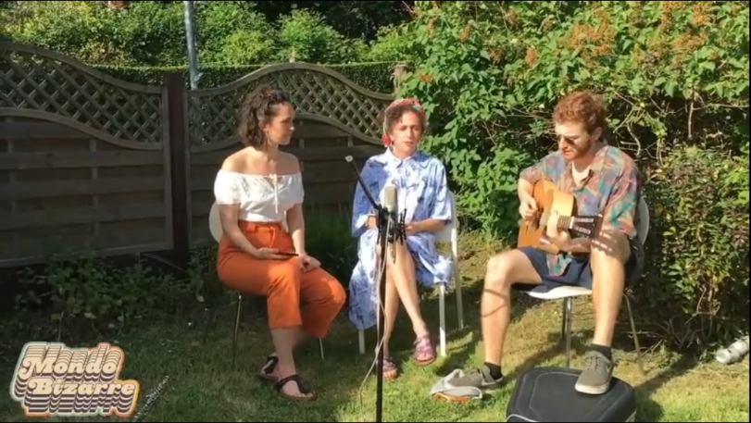
University of leeds – jamnesty
The University of Leeds group puts on regular live music events – ‘Jamnesty’
They work with a local venue and recruit student and local acts
Nearly £1300 from two events!
They organised a virtual event during lockdown.
Submissions were made from acts and Amnesty groups and were pulled together into a video that was streamed.
Donations came through Just Giving and were split between Amnesty UK and Refuge. Raised over £1000!
Notes:
Here are a couple of examples of student groups raising money for Amnesty.
Jamnesty, a live music fundraising event, has been a staple for student groups for decades. The University of Leeds amnesty group have traditionally organised regular Jamnestys, working with local venues, and recruiting student and local acts. Money is raised via ticket sales and donated to Amnesty. In 2019 they raised over £1300 from two events.
Sadly their physical event earlier this year was cancelled due to COVID19, so instead they organised a virtual Jamnesty. Submissions were made from acts and Amnesty groups and were pulled together into a video that was streamed. Donations came through Just Giving and were split between Amnesty UK and Refuge – in total they raised £1000

Slide 22
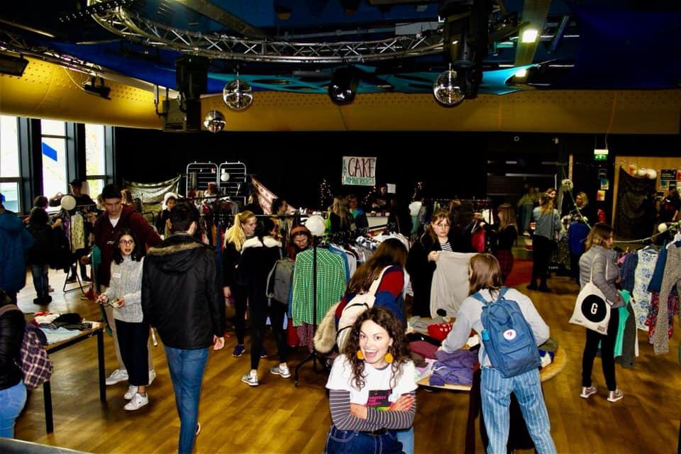
University of Exeter – clothes swap
The University of Exeter Group organise a regular clothes swap
You’ll need: a large open space, clothes rails and people to bring clothes
Advertise well in advance and play music, serve refreshments etc…
People swap clothes for tokens when they arrive and pay a fee. They exchange tokens for other clothes.
Cheap to organise and environmentally friendly
Notes:
A more recent addition to Amnesty student groups fundraising efforts are clothes swaps, such as the ones organised by the Exeter student group. They’re cheap to organise and environmentally friendly. People swap clothes for tokens when they arrive and pay a fee. All you need is a large open spaces and some clothes rails.

Slide 23
SUPPORTING THE STUDENT NETWORK
Training
Amnesty UK organise an annual training event Action for Change, as well as online webinars throughout the year.
Conferences and Events
The National Conference and AGM is being held virtually in the Autumn – as will the Amnesty Student Conference.
Freshers
Amnesty UK provide a Freshers Pack to all student groups in September full of materials to use throughout the year.
The Network
The Student Action Network committee organise regular calls throughout term stay connected with each other and plan campaigns.
Notes:
Finally, I just wanted to cover how Amnesty supports student groups like ours. They offer training through the year including an annual training day, Action for Change, although most training is currently being delivered online.
They also provide Freshers Pack at the start of the year, which is full of materials on the student networks priority campaigns as well as general information on Amnesty.
Note: After this presentation would be a good time to share resources if you haven’t already with your group.
Amnesty organises multiple conferences and events.
The National Conference and AGM usually takes place in Spring, and as discussed earlier is where student groups and individual members can have their say in the organisation. Due to Coronavirus restrictions 2020 the AGM takes place in October as a closed meeting (members are not able to attend), and voting takes place in advance.
The Student Conference is the highlight of the student calendar bringing 200 students together for a weekend of workshops and talks. In 2020 this will take place online in November.
The Student Action Network Committee also organise regular calls for student groups on their priority campaigns.

Slide 24
Any questions?

