Slide 1

Egypt’s crackdown on human rights defenders
Debora Singer
Amnesty International UK
Country Coordinator - Egypt
Notes:
One year exactly since Ibrahim Ezz El-Din was arrested, disappeared and detained.
Introduce to new IAR and putting into context of Egypt’s crackdown on HRDs.
and then discuss how to campaign on these issues

Slide 2
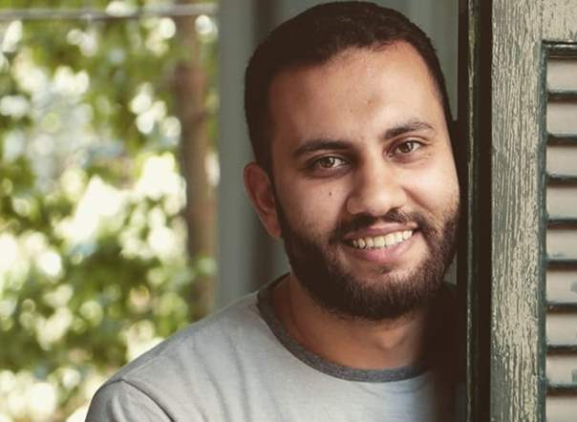
Notes:
Ibrahim Ezz El-Din new IAR …26 year old architectural planning engineer and who works on the right to housing and forced evictions in Egypt. Researcher at the Egyptian Commission for Rights and Freedoms (ECRF) campaigning for investigation re Guilio.
Taken from streets of Cairo in June 2019 Mother and lawyer asked police but got no info re where he was.

Slide 3
Egypt:
Permanent State of Exception:
Abuses by the
Supreme State Security Prosecution
Amnesty International, November 2019
Notes:
Everything that happened to Ibrahim is typical of the cases in Egypt.
Covered in Amnesty’s report … systematic
Majority of cases subject to enforced disappearances by the National Security Agency (intelligence service)

Slide 4
Notes:
Ibrahim reappeared at SSSP on 26th November, 167 days disappeared, nearly 6 months
Investigated and charged with contributing to the objectives of a terrorist group and publication of false information undermining national security. (Assigned to case 488/2019 relates to anti government protest in March 2019.) Very typical charges: membership of terrorist or other illegal group eg Muslim Brotherhood, aiming to harm public order or security.
No evidence presented against him. With lawyer. Lawyer not allowed to examine NSA investigation case file against him. Prosecutors base accusations against suspects mainly on NSA investigation case files, although Egypt’s highest court ruled that, on their own, they do not constitute “evidence”.
NSA claimed his date of arrest was very recent.
Ezz appeared weak having lost much weight. Told prosecutor tortured to get info about ECRF and its work.
Since then the prosecutor has been extending his detention every 15 days, and then 45 days pending investigation.

Slide 5
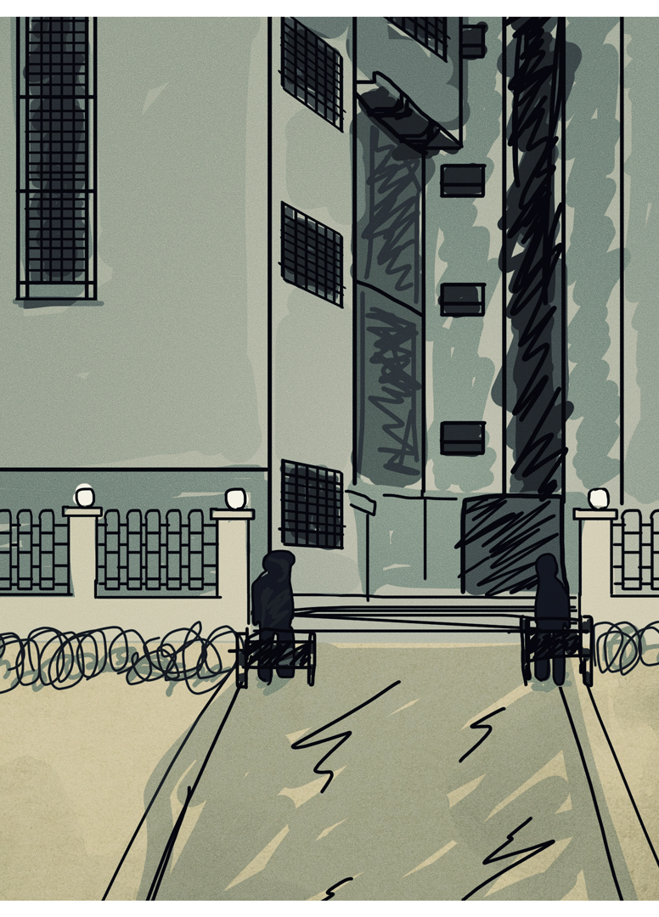
Supreme State Security Prosecution methods
Enforced disappearance
Pre-trial detention
Torture
Investigations without evidence
Arbitrary detention
Unfair trial
Notes:
SSSP established 1953. Responsible for investigating and prosecuting activities that could constitute threats to state security.
Not independent. Public prosecutor appointed by Sisi and he approves appointment of all other prosecutors.
Works in tandem with NSA specialised police agency.
Since Sisi came to power in 2013, SSSP has extended definition of terrorism to include peaceful critics of government
SSSP functioning as tool of repression by misusing new counter-terrorism legislation and treating government critics as enemies of the state
HRDs, lawyers, journalists detained for participating in protests or social media statements or for political or human rights activities
over past six years
Worst case: In Sept 2019 protests across Egypt for Sisi to resign (Ali Mohamed alleged Sisi wasting public money on luxury properties) Crackdown 4,000 arrested, most into pre-trial detention and charged over terrorism.

Slide 6
Notes:
Particularly worried now for all prisoners due to Covid – unsanitary conditions, poor health care.
Ibrahim has chronic allergies leading to respiratory difficulties so particularly at risk.
Plus, probably due to torture and medical neglect, got depressed and attempted suicide twice in February. Denied psychiatric services requested by lawyer
Asking for immediate release, in meantime, provide access to lawyers, health care, families
Will be undertaking an action at end of session…

Slide 7
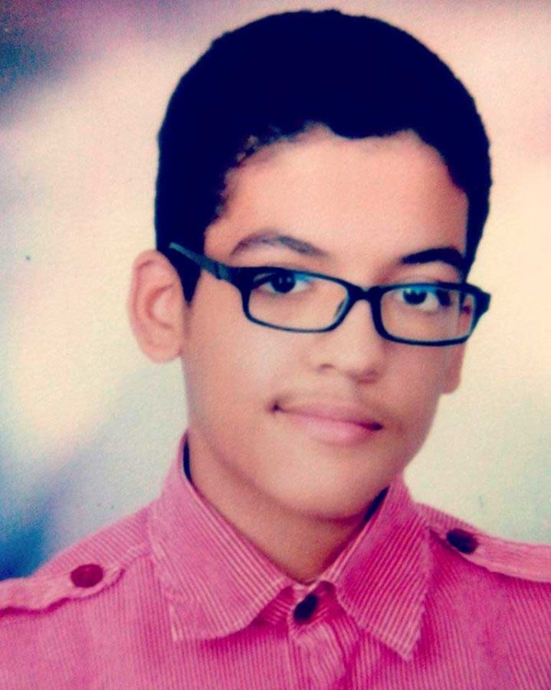
Notes:
Meanwhile other IARs UK groups working for
Aser Mohamed
In October 2019, a criminal court sentenced Aser to 10 years imprisonment after finding him guilty of membership in the banned Muslim Brotherhood group and attacking a hotel in January 2016. He was 14 years old at the time of his arrest.
Aser’s lawyer filed a cassation request to the criminal court end of 2019 and is still waiting for the court to set a hearing date. The process usually takes 12 to 18 months.
Chronic allergy – respiratory problems. Aser’s family is concerned about his health and wellbeing as they did not receive any letters from him since the suspension of prison visits . They also have no confirmation on whether he was able to receive the supplies and letters they sent him
Call to quash his conviction, immediately release him and launch investigations into his enforced disappearance and torture allegations.
We call on them to also ensure that - pending his release – he is provided with means to communicate with his family and lawyers and ask them to take measures to protect the health of all prisoners amid the COVID-19 pandemic.

Slide 8
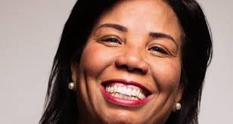
Notes:
Azza Soleiman
Keeping her out of detention by AI activity
HR lawyer focus on women’s rights
In late 2016, Azza was arrested and interrogated. She now faces charges of
slandering Egypt’s image by claiming that women in the country face rape, as well as tax evasion,
operating a civil society organisation without proper registration
receiving foreign finances to harm national interests (case 173, a politically motivated court case).
Azza is on bail
banned from travel
her assets have been frozen.
She faces up to life in prison as a result of case 173.
Amnesty is calling for all charges against Azza to be immediately and unconditionally dropped, and the travel ban and asset freeze issued against her to be revoked.

Slide 9
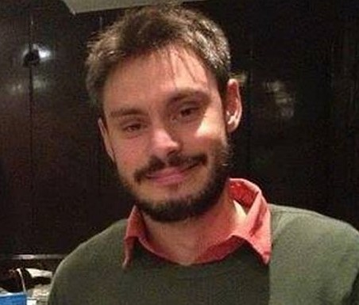
Notes:
Giulio Regeni
Victim of this regime
Italian PhD student at Cambridge University doing research in Cairo
Found tortured and murdered January 2016

Slide 10
Supreme State Security Prosecution methods
Enforced disappearance
Pre-trial detention
Torture
Investigations without evidence
Arbitrary detention
Unfair trial
Notes:
So in summary, huge hr violations for human rights defenders, critics of government, under counter-terrorism legislation
Egyptian authorities deny hr abuses, deny that IARs are HRDs
AI spreading fake news and supporting terrorist groups
So what can we do about this?

Slide 11
Egypt campaign goals
Individuals At Risk
Release Ibrahim Ezz El-Din and Aser Mohamed
Provide access to lawyers, health care, families
The Supreme State Security Prosecution
Reform SSSP and cease its human rights abuses
Investigate and ensure accountability for human rights abuses
Notes:
Theory of change: goals, targets, influencing tree, activities, resources
Combines IARs with systemic abuses by SSSP
Case files for IARs see goals include the SSSP ceasing abuses and the cases being investigated to ensure accountability
Two layers: individual and systemic

Slide 12
Campaign targets
President
Public Prosecutor
Deputy Assistant Minister of Foreign Affairs for Human Rights
Notes:
Who has the power to make these changes?
These are the targets for our IARs and for the Egypt campaign in general

Slide 13
Influencing tree
Notes:
How can we reach our targets?

Slide 14
Notes:
So know what to ask for
and who to ask
and how to reach them

Slide 15
Activities?
Resources needed?

Slide 16
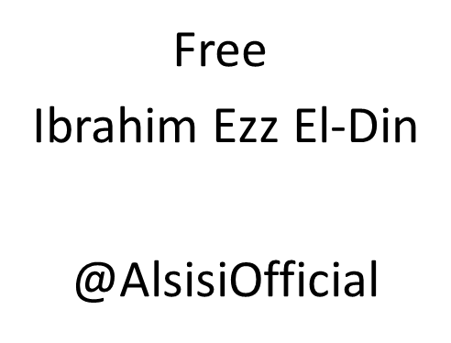
Notes:
Action

