Slide 1
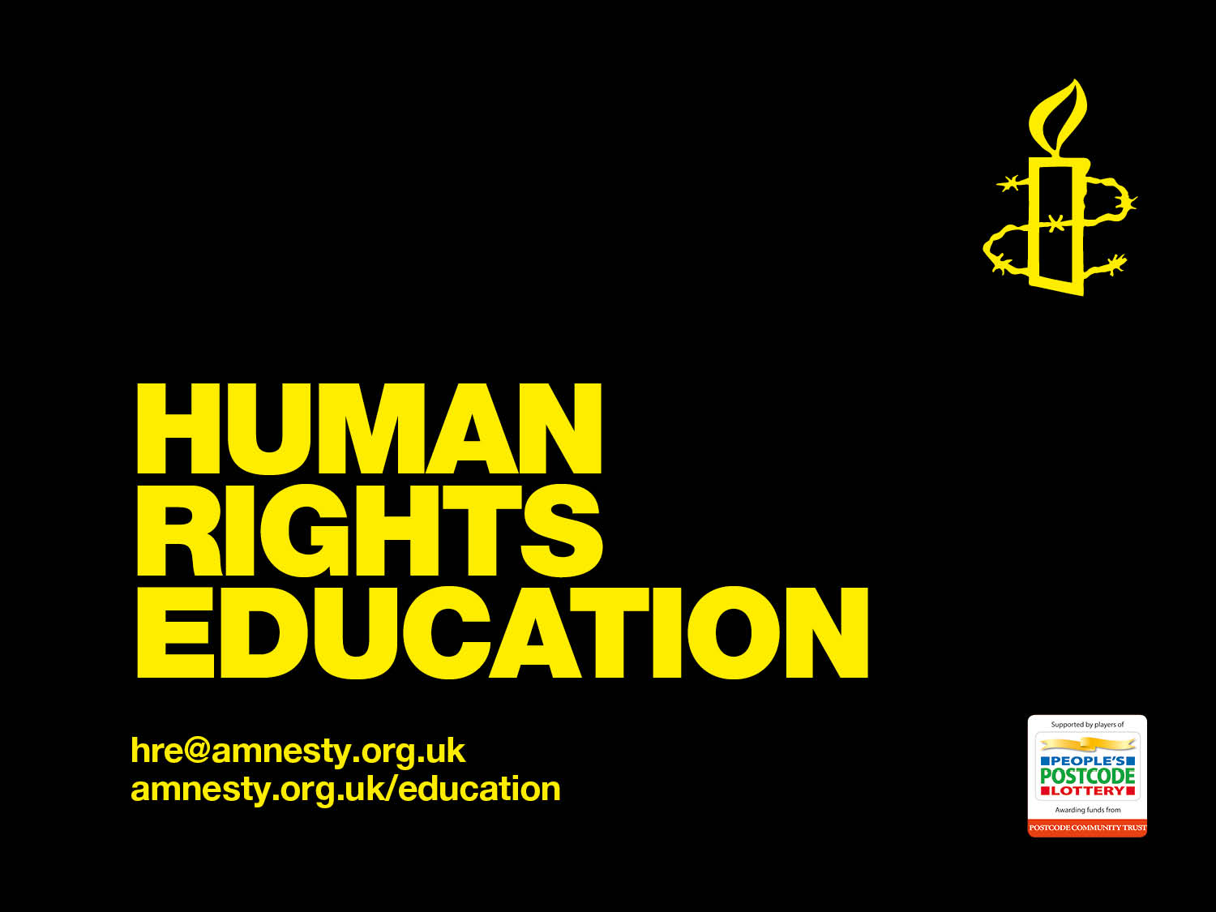

Slide 2
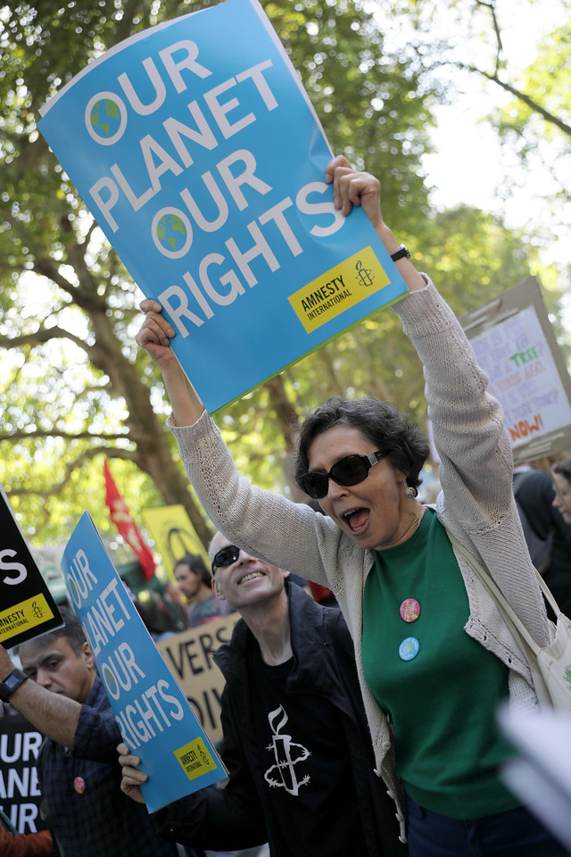
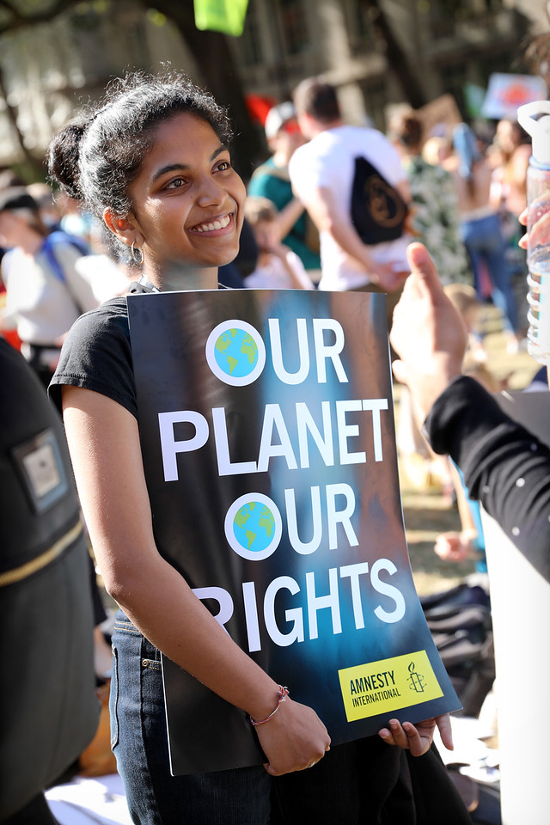
Climate Change and Human Rights
Notes:
Climate Change and Human Rights
Millions of people are already suffering from the catastrophic effects of extreme disasters exacerbated by climate change – from prolonged drought in sub-Saharan Africa to devastating tropical storms sweeping across Southeast Asia, Southern Africa, the Caribbean and the Pacific.
In August 2018, young people started taking to the streets to hold governments and business accountable for the impacts. They have shown true leadership in demanding changes that require the participation and support of all sectors of society.

Slide 3
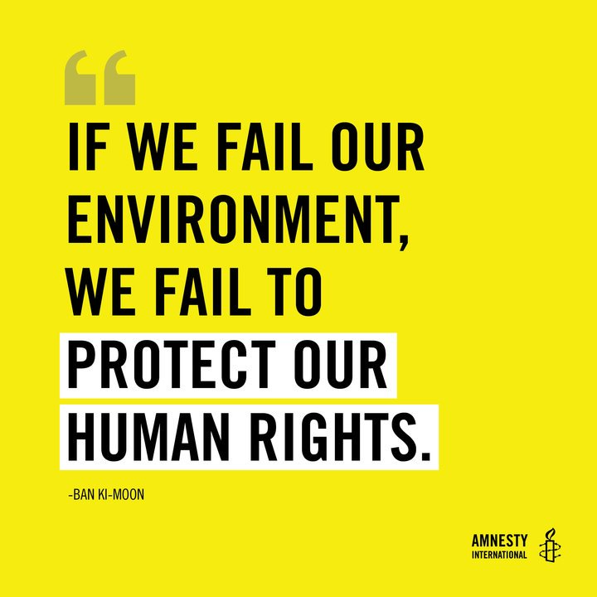
Notes:
What is climate change?
Videos: https://www.youtube.com/watch?v=ztWHqUFJRTs – Ted-Ed - Climate change: Earth's giant game of Tetris - Joss Fong – 2m48s
https://www.youtube.com/watch?v=E2j0pu_tM2Q - World Meteorological Organization – WMO – 0m59s
The planet’s climate has constantly been changing over geological time, with significant fluctuations of global average temperatures.
However, this current period of warming has happened more rapidly than any past events.
It has become clear that humanity has caused most of the last century’s warming.
We are doing this through burning fossil fuels, agriculture and land-use and other activities that drive climate change.
This rapid rise is a problem because it’s changing our climate at a rate that is too fast for living things to adapt to.
These rising temperatures lead to extreme weather events, rising sea levels, shifting wildlife populations and habitats, as well as other impacts.
The effects of climate change are already being felt now, but they will get worse.
Global warming has reached approximately 1°C above pre-industrial levels so far.

Slide 4
Notes:
Effects of Climate Change
The effects of climate change are already being felt now, but they will get worse. Global warming has reached approximately 1°C above pre-industrial levels. Every half degree (or even less) of global warming counts.
It is important to remember that no one list of the effects of climate change can be exhaustive. It is very likely that heatwaves will occur more often and last longer, and that extreme precipitation events will become more intense and frequent in many regions. The oceans will continue to warm and acidify, and global mean sea level will continue to rise. All of this will have, and is already starting to have, a devastating impact on human life.

Slide 5
How it affects us?
UK Climate Change Risk Assessment 2017 - Urgent priorities for the UK – Committee on Climate Change
Notes:
How it affects us?
https://www.youtube.com/watch?v=SDxmlvGiV9k&feature=youtu.be&t=87 - UK Climate Change Risk Assessment 2017 - Urgent priorities for the UK – Committee on Climate Change
Video Script:
Action is needed to tackle six key risks:
The increasing chance of more severe and widespread flooding.
Risks to public health from higher temperatures, including in overheating homes.
A risk of shortages in public water supplies, and scarce water for farming.
A threat to nature including loss of native species.
Food price spikes and potential disruption to UK and global food production.
And risks from new and emerging pests and diseases affecting people, animals and plants.
The longer action is delayed to reduce greenhouse gas emissions, and adapt to the changes, the higher the costs and risks will be.
Climate change is happening now.
This new UK risk assessment identifies where more effort is necessary, and urgent, to address these risks.
It’s time to act.

Slide 6
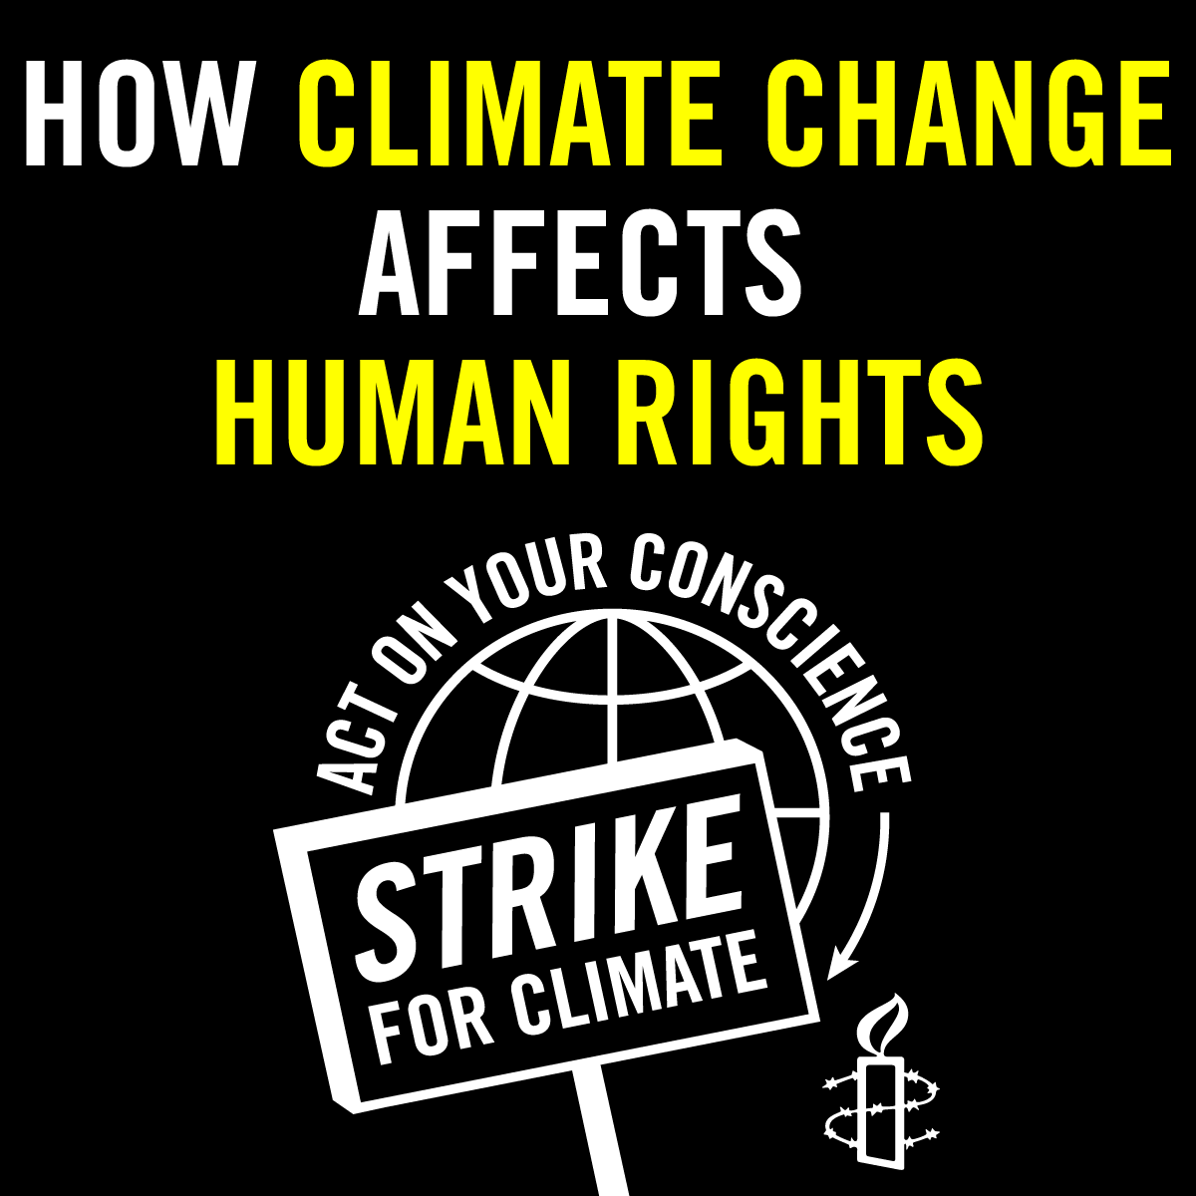
Notes:
WHY IS CLIMATE CHANGE A HUMAN RIGHTS ISSUE?
[Video: https://www.instagram.com/p/B2MUW6OB_vE/]
Climate change is causing devastation across the world, which makes it an urgent human rights issue. In particular,
It will compound and magnify existing inequalities.
It is likely to affect certain groups more than others – for example, those communities who depend on agricultural or coastal livelihoods, as well as other disadvantaged groups who are subject to discrimination, such as women, elderly people, children and youth, people living in poverty and indigenous communities.
Its effects will continue to grow and worsen over time, creating ruin for current and future generations.
In addition to threatening our very existence, climate change is having harmful impacts on our rights to life, health, food, water, housing and livelihoods. Climate change directly effects these human rights and will continue to do so.

Slide 7
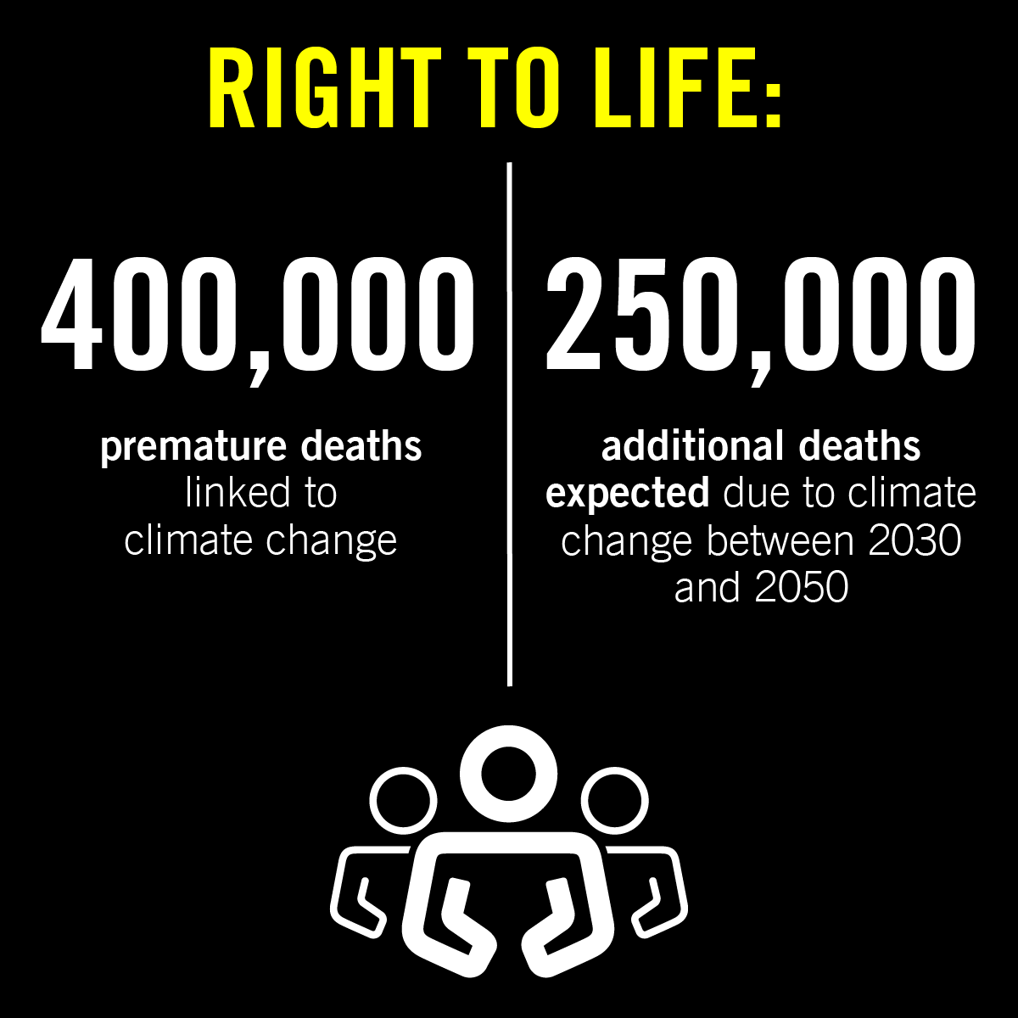
Notes:
Right to life
We all have the right to life, and to live in freedom and safety. But climate change threatens the safety of billions of people on this planet. The most obvious example is through extreme weather-related events, such as storms, floods and wildfires. Typhoon Yolanda in the Philippines claimed the lives of nearly 10,000 people in 2013. Heat stress is among the most deadly impacts. The summer heatwave in Europe in 2003 resulted in the deaths of 35,000 people. However, there are many other less visible ways that climate change threatens lives. The World Health Organization predicts that climate change will cause 250,000 deaths per year between 2030 and 2050, due to malaria, malnutrition, diarrhoea and heat stress.

Slide 8
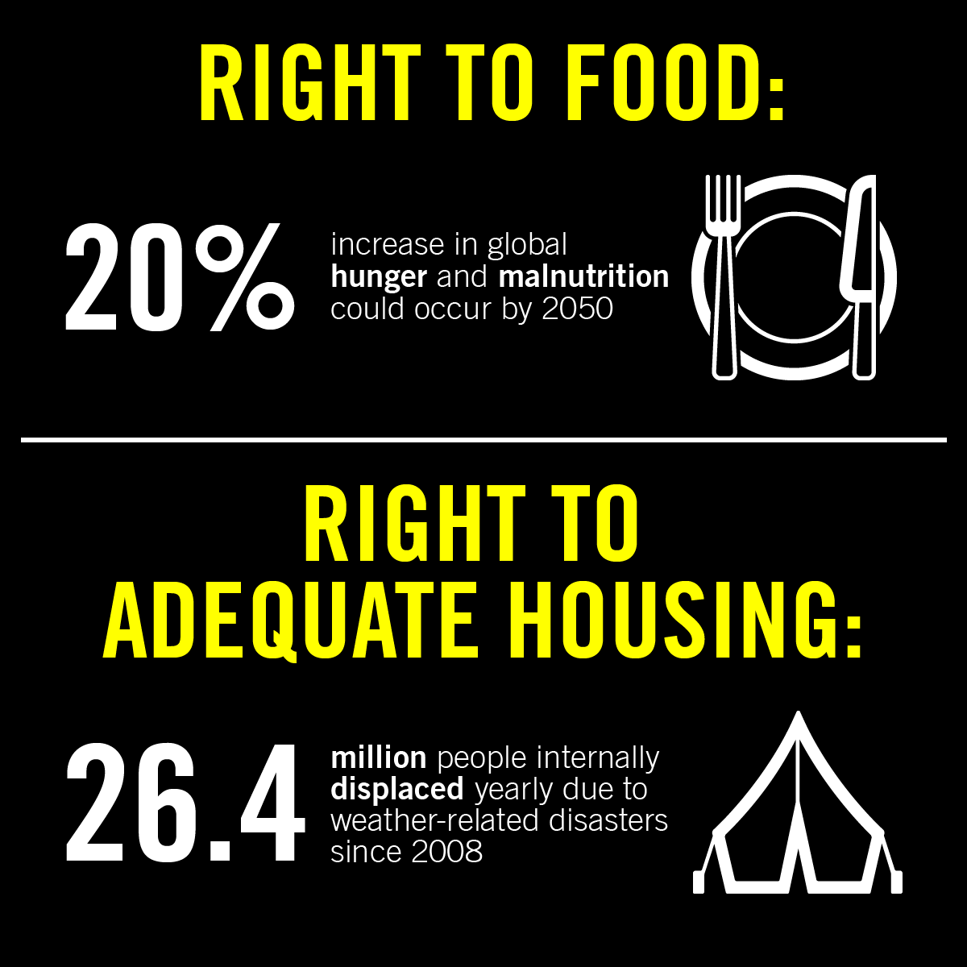
Notes:
Right to housing
We all have a right to an adequate standard of living for ourselves and our families, including adequate housing. However, climate change threatens our right to housing in a variety of ways. Extreme weather events like floods and wildfires are already destroying people’s homes, leaving them displaced. Drought, erosion and flooding can also over time change the environment whilst sea-level rises threaten the homes of millions of people around the world in low-lying territories.

Slide 9
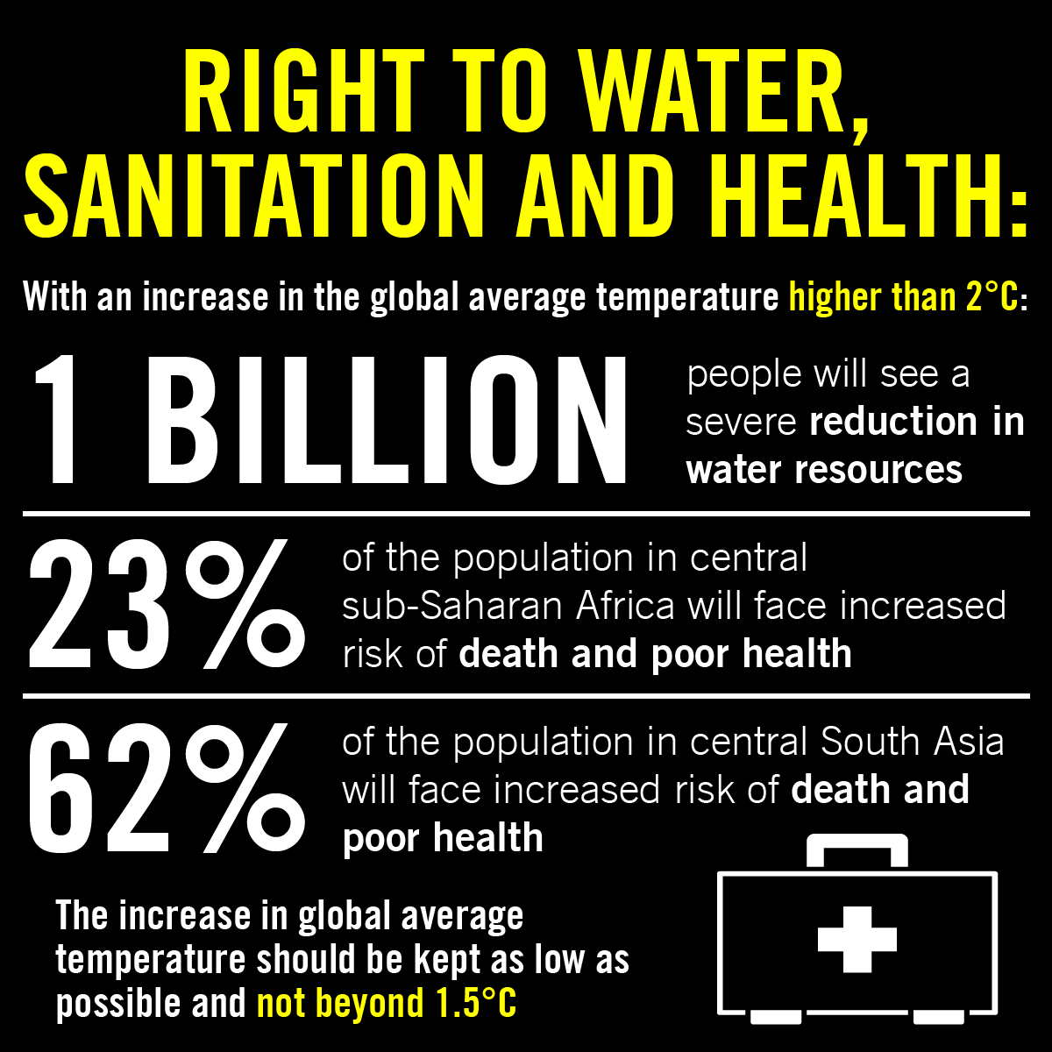
Notes:
Rights to water and to sanitation
We all have the right to safe water for personal and domestic use and to sanitation that ensures we stay healthy. But a combination of factors such as melting snow and ice, reduced rainfall, higher temperatures and rising sea levels show that climate change is affecting and will continue to affect the quality and quantity of water resources. Already more than one billion people do not have access to clean water, and climate change will make this worse. Extreme weather events such as cyclones and floods affect water and sanitation infrastructure, leaving behind contaminated water and thus contributing to the spread of water-borne diseases. Sewage systems, especially in urban areas, will also be affected.
Right to health
We all have the right to enjoy the highest attainable standard of physical and mental health. According to the IPCC, the major health impacts of climate change will include greater risk of injury, disease and death due to more intense heatwaves and fires; increased risk of under-nutrition as a result of diminished food production in poor regions; and increased risks of food- and water-borne diseases, and vector-borne diseases. Children exposed to traumatic events such as natural disasters, exacerbated by climate change, can suffer from post-traumatic stress disorders. The health impacts of climate change demand an urgent response, with unmitigated warming threatening to undermine health systems and core global health objectives.

Slide 10
Notes:
WHO IS RESPONSIBLE FOR STOPPING CLIMATE CHANGE?
[Video link: https://www.instagram.com/p/B2WM-M_F767/]
States and corporations are responsible for stopping climate change.
States are obliged to take steps to tackle climate change as fast and as humanely as possible. In their efforts to address climate change, they must not resort to measures that directly or indirectly violate human rights. For example, they shouldn’t create conservation areas or renewable energy projects on the lands of Indigenous peoples without consulting them and getting their consent.
Businesses must remedy human rights abuses they cause or to which they contribute, which extends to human rights harms resulting from climate change. Research shows that just 100 fossil fuel-producing companies are responsible for 71% of global greenhouse gas emissions since 1988.

Slide 11
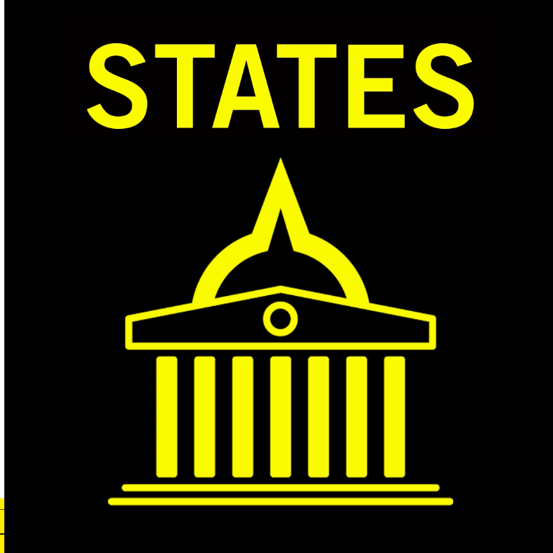
Notes:
States
States have the obligation to mitigate the harmful effects of climate change by taking the most ambitious measures possible to prevent or reduce greenhouse emissions within the shortest possible time-frame. While wealthy states need to lead the way, both internally and through international cooperation, all countries must take all reasonable steps to reduce emissions to the full extent of their abilities.
States must also take all necessary steps to help everyone within their jurisdiction to adapt to the foreseeable and unavoidable effects of climate change, thus minimizing the impact of climate change on their human rights. This is true irrespective of whether the state is responsible for those effects, because states have an obligation to protect people from harms caused by third parties.
States must take steps to tackle climate change as fast and as humanely as possible. In their efforts to address climate change, they must not resort to measures that directly or indirectly violate human rights. For example, conservation areas or renewable energy projects must not be created on the lands of Indigenous peoples without consulting them and getting their consent.
In all measures, states should respect the right to information and participation for all affected people, as well as their right to access effective remedies for human rights abuses.
However, the current pledges made by governments to mitigate climate change are completely inadequate, as they would lead to a catastrophic 3°C increase in average global temperatures over pre-industrial levels by 2100. People in countries including France, the Netherlands and Switzerland are taking their governments to court for their failure to establish sufficient climate mitigation targets and measures.

Slide 12
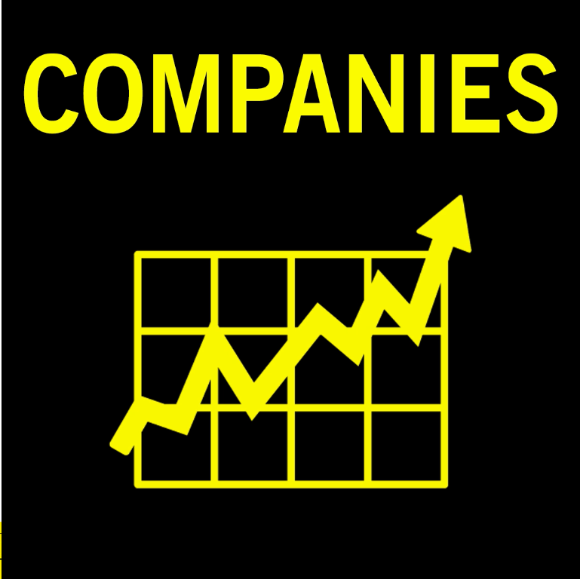
Notes:
Corporations
Businesses also have a responsibility to respect human rights. To meet this responsibility, companies must assess the potential effects of their activities on human rights and put in place measures to prevent negative impacts. They must make such findings and any prevention measures public. Companies must also take measures to remedy human rights abuses they cause or to which they contribute, either by themselves or in cooperation with other actors. Such responsibilities extend to human rights harms resulting from climate change.
Corporations, and particularly fossil fuel companies, must also immediately put measures in place to minimize greenhouse emissions – including by shifting their portfolio towards renewable energy – and make relevant information about their emissions and mitigation efforts public. These efforts must extend to all the major subsidiaries, affiliates and entities in their supply chain.

Slide 13
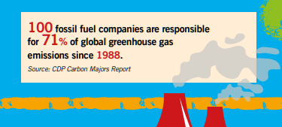
Companies
Notes:
Companies
Fossil fuel companies have been historically among the most responsible for climate change – and this continues today. Research shows that just 100 fossil fuel-producing companies are responsible for 71% of global greenhouse gas emissions since 1988.
There is growing evidence that major fossil fuel companies have known for decades about the harmful effects of burning fossil fuels and have attempted to suppress that information and block efforts to tackle climate change.

Slide 14
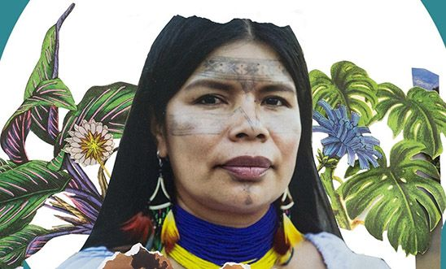
Who is impacted the most by climate change?
Developing Nations
Poorer Communities of Colour
Women and Girls
Future Generations
Indigenous Peoples
Patricia Gualinga (pictured above), an Indigenous leader of the Kichwa people of the Sarayaku community, in Ecuador
© Caroline Bennett, Amazon Watch
Notes:
Who is impacted the most by climate change?
[Action and further reading on Patricia (pictured) and other women risking their lives to save the planet - https://www.amnesty.org.uk/blogs/ether/women-saving-planet]
Climate change is and will continue to harm all of us unless governments take action. However, its effects are likely to be much more pronounced for certain groups – for example, those communities dependent on agricultural or coastal livelihoods – as well as those who are generally already vulnerable, disadvantaged and subject to discrimination.
These are some of the ways climate change can and is exacerbating inequalities:
Between developed and developing nations:
At a national level, those in low-lying, small island states and less developed countries will be and already are among those worst affected. People in the Marshall Islands already regularly experience the devastating flooding and storms that destroy their homes and livelihoods. The 2018 heatwave in the northern hemisphere made headlines across Europe and North America, but some of the worst effects were also felt in places like Pakistan, where more than 60 people died – mostly labourers already working in intense heat – as temperatures soared above 44°C.
Between different ethnicities and classes:
The effects of climate change and fossil fuel-related pollution also run along ethnicity and class lines. In North America, it is largely poorer communities of colour who are forced to breathe toxic air because their neighbourhoods are more likely to be situated next to power plants and refineries. They experience markedly higher rates of respiratory illnesses and cancers, and African Americans are three times more likely to die of airborne pollution than the overall US population.
Between genders:
Women and girls are disproportionately affected by climate change, reflecting the fact that they are more likely in many countries to be marginalized and disadvantaged. This means that they are more vulnerable to the impacts of climate-related events as they are less able to protect themselves against it and will find it harder to recover.
Between generations:
Future generations will experience the worsening effects unless action is taken now by governments. However, children and young people are already suffering due to their specific metabolism, physiology and developmental needs. This means, for example, that the forced displacement experienced by communities impacting a whole range of rights – from water, sanitation and food to adequate housing, health, education and development – is likely to be particularly harmful to children.
Between communities:
Indigenous peoples are among the communities most impacted by climate change. They often live in marginal lands and fragile ecosystems which are particularly sensitive to alterations in the physical environment. They maintain a close connection with nature and their traditional lands on which their livelihoods and cultural identity depend.

Slide 15
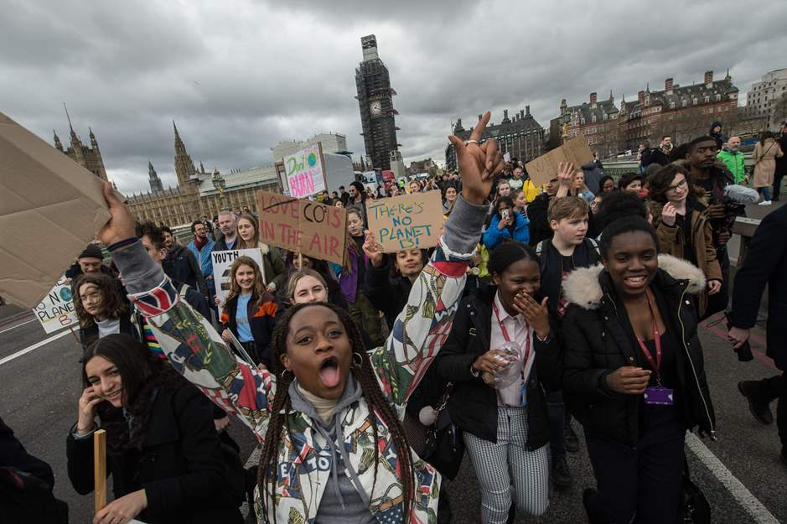
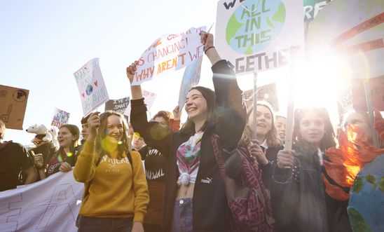
Climate change deepens inequality
Less Industrially Developed Countries
Poor and Marginalised Communities
The Gender Gap
Young People and Future Generations
Notes:
The climate crisis deepens inequality
The climate crisis deepens inequality by disproportionately affecting people already marginalised by poverty and discrimination – those who are least responsible for it:
Less industrially developed countries: low lying, small island states, like the Marshall Islands, are already experiencing devastating flooding and storms, destroying their homes and livelihoods. While temperatures have risen to deadly levels across Europe, the worst effects have been felt in places like Pakistan, where more than 60 people died in 2018, as temperatures soared above 44°C.
Poor and marginalised communities: those hardest hit in North America have been residents of poor communities of colour. Low-income communities are more likely to be located near power plants and refineries, forcing inhabitants to breathe toxic air, putting them at higher risk for respiratory illnesses and cancers. Because African Americans are more likely to reside in these communities they are three times more likely to die of airborne pollution than the general US population. Indigenous communities are also more likely to be located on land that is extremely sensitive to physical changes, making the possibility of displacement increasingly likely.
The gender gap: in many countries in the world women and girls are more likely to be marginalised and disadvantaged. They have less stability and security in employment, and are more like to face food and housing insecurity. Indigenous women in Ecuador have faced a series of attacks and death threats for protecting their communities in the Amazon. Ecuadorian authorities have failed to provide protection.
Young people and future generations: children and young people are already suffering from changes in their metabolism and physiology. They will face worsening conditions over time if governments do not act now.
Signpost to: https://www.amnesty.org.uk/climate/five-women-colour-fighting-climate-change-worldwide

Slide 16
Young People and Future Generations
Notes:
Young People and Future Generations
Video: https://www.youtube.com/watch?v=rasCsQd4g8Q
More videos:
https://www.youtube.com/watch?v=wMk2qh0-uzs
https://www.youtube.com/watch?v=e0-XI41t6EM
https://www.youtube.com/watch?time_continue=7&v=7UyDmHuMv08
Millions of people are already suffering from the catastrophic effects of extreme disasters exacerbated by climate change – from prolonged drought in sub-Saharan Africa to devastating tropical storms sweeping across Southeast Asia, the Caribbean and the Pacific.
While we largely understand climate change through the impacts it will have on our natural world, it is the devastation that it is causing and will continue to cause for humanity that makes it an urgent human rights issue. It will compound and magnify existing inequalities. And its effects will continue to grow and worsen over time, creating ruin for current and future generations.
This is why the failure of governments to act on climate change in the face of overwhelming scientific evidence may well be the biggest inter-generational human rights violation in history.
Future generations will experience the worsening effects unless action is taken now by governments. However, children and young people are already suffering due to their specific metabolism, physiology and developmental needs. This means, for example, that the forced displacement experienced by communities impacting a whole range of rights – from water, sanitation and food to adequate housing, health, education and development – is likely to be particularly harmful to children.

Slide 17
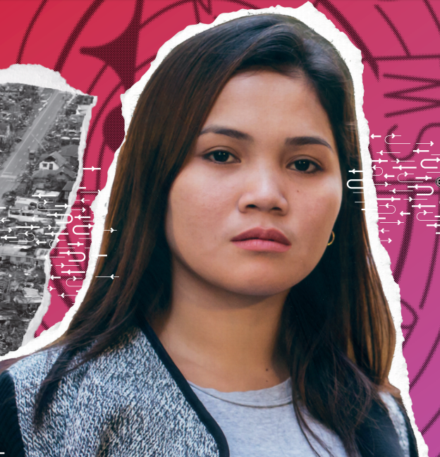
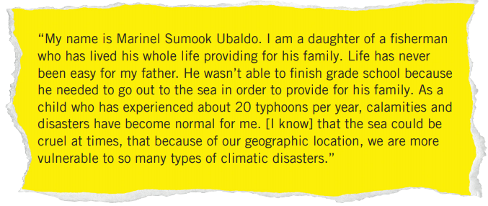
Marinel Sumook Ubaldo
Notes:
Activity: Marinel Sumook Ubaldo
Marinel is 22 years old and from the Philippines. When she was 16 years old Typhoon Yolanda, one of the deadliest typhoons on record, destroyed her village in Eastern Samar and over 6,000 people died in the Philippines alone, while millions lost their homes.
Ask the participants to discuss the following questions, in small groups and draw conclusions together:
What do you think Marinel’s childhood was like?
Do you think Marinel felt safe where she grew up? Why or why not?
[Marinel has written a letter directly to the participants. Read the letter aloud or hand it out for them to read alone or in small groups.]
Part 1
“My name is Marinel Sumook Ubaldo. I am a daughter of a fisherman who has lived his whole life providing for his family. Life has never been easy for my father. He wasn’t able to finish grade school because he needed to go out to the sea in order to provide for his family. As a child who has experienced about 20 typhoons per year, calamities and disasters have become normal for me. [I know] that the sea could be cruel at times, that because of our geographic location, we are more vulnerable to so many types of climatic disasters.”

Slide 18
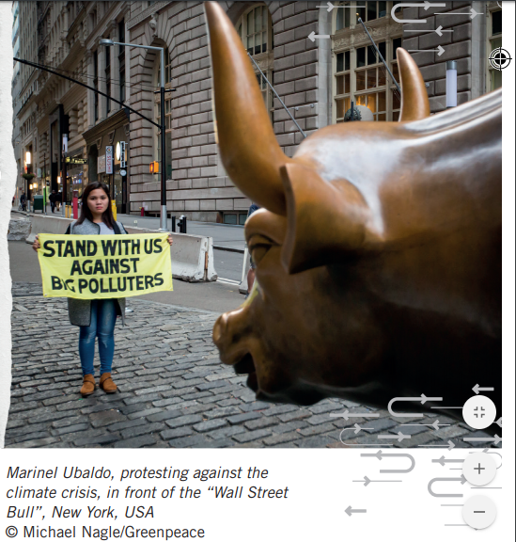
Marinel Sumook Ubaldo
Notes:
Marinel Sumook Ubaldo
“Climate change is not anymore a battle that we will face in the future, but a battle that we need to face today, in the present. If we are not afraid to speak up and share our story, then we will be able to tell the world how the Philippines has been suffering from the effects of a phenomenon that we didn’t cause. Some of the countries that have historically contributed to climate change the most are still not fully feeling its effects and that’s why it’s so important for them to hear our stories so they can realize that it is affecting real people today. As youth, we have the energy and the power to speak up and to represent those who do not have the courage to stand up for themselves. Sharing has been the key to healing for me. Climate change is not just an issue of adaptation and mitigation, but also an issue of human rights. During climatic disasters, we are being deprived of the basic rights that we should be able to enjoy. The future of all of us depends on YOUR decision NOW, so please join me and make a difference.”
Activity: Ask participants to brainstorm and plan additional ways they can take action on climate change and support Marinel’s fight for people affected most by it.

Slide 19
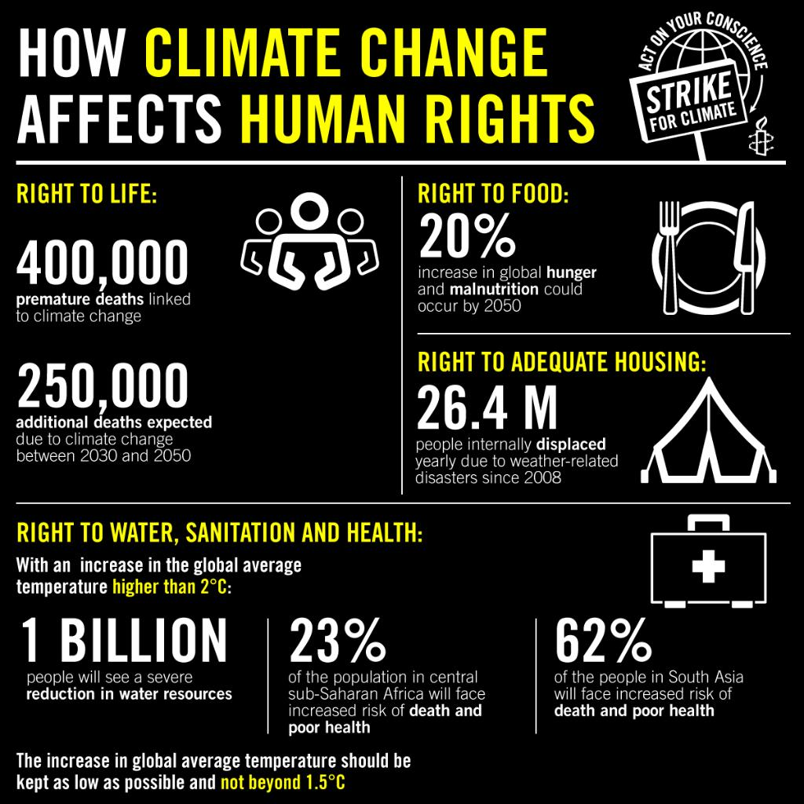
Notes:
Summary

Slide 20
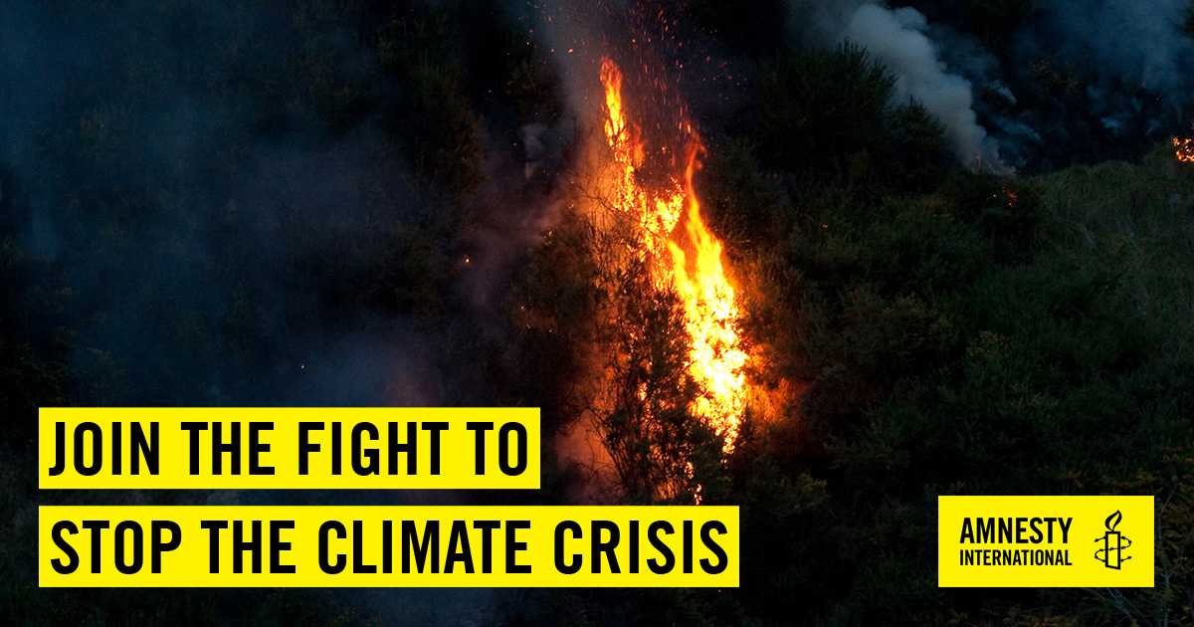
Notes:
Amnesty is calling for governments to:
Do everything they can to help stop the global temperature rising by more than 1.5°C.
Reduce their greenhouse gas emissions to zero by 2050 at the latest. Richer countries should do this faster. By 2030, global emissions must be half as much as they were in 2010.
Stop using fossil fuels (coal, oil and gas) as quickly as possible.
Make sure that climate action is done in a way that does not violate anyone’s human rights, and reduces rather than increases inequality
Make sure everyone, particularly those affected by climate change or the transition to a fossil-free economy, is properly informed about what is happening and is able to participate in decisions about their futures.
Work together to fairly share the burden of climate change – richer countries must help others.

Slide 21
