Slide 1
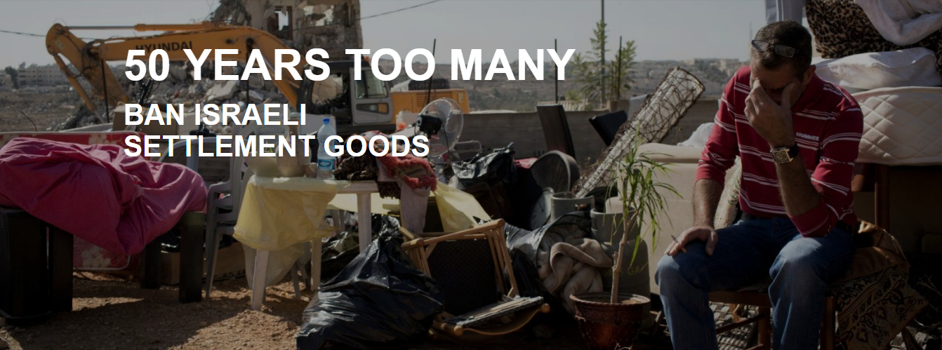
Notes:
Ban Israeli Settlement Goods
Welcome and introduce yourself.
Explain what you’ll be covering and the length of your session.

Slide 2
Training Objectives
Understand the impact of settlements and over 50 years of violations.
Get an overview of the campaign
Create an open, safe and explorative space to tackle challenges head on
Take action!
Notes:
Training Objectives
Resource: Guide to Respectful Conversations
Notes for the Trainer: Use the Guide to Respectful Conversation to set the tone of the session. Establish ground rules. You may want to explain that the subject of Israel and Palestine is a contested one. Whilst there are a huge array of positions in understanding this issue, it is important to understand that Amnesty International bases its position in international human rights law and on commissioning its own research.
The objectives of the training session are to:
Understand the impact of settlements and over 50 years of violations.
Get an overview of the campaign
Create an open, safe and explorative space to tackle challenges head on
Take action!

Slide 3
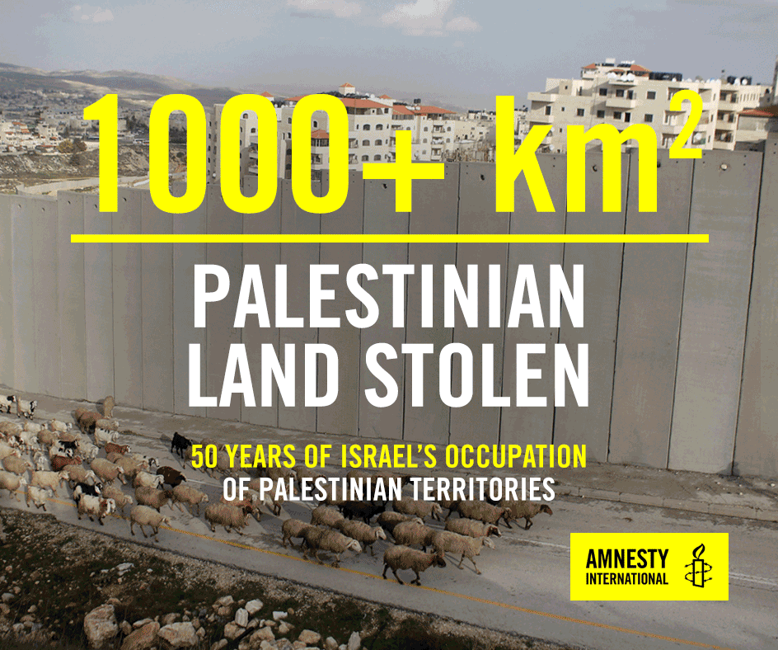
50 Years Too Many
Notes:
50 Years Too Many
GIF Slide
This session will illustrate the impact of over 50 years of violations on individuals and communities.
It will give some background to the issue and how settlements have grown over the years.

Slide 4
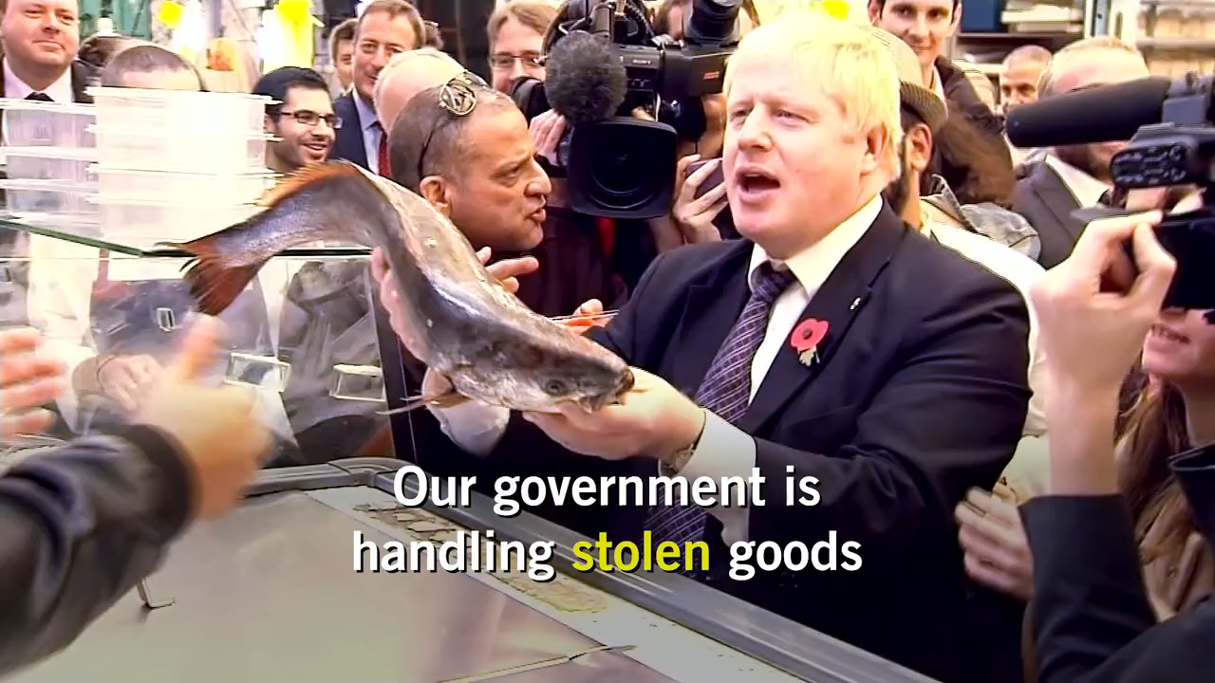
50 Years Too Many
Notes:
50 Years Too Many
Video
Play Amnesty International’s 1 minute video on illegal Israeli Settlements.
https://vimeo.com/254877081
Password: amnesty

Slide 5
Starter Activity
Teen
Violent protestor
Activist
Hooligan
Freedom Fighter
Terrorist
Child
Notes:
Starter Activity
1. Ask: Which of these words are interchangeable depending on your perspective?
2. Listen: https to Imtiaz Dharker’s poem The Right Word
http://poetrystation.org.uk/poems/the-right-word (1 min 20 secs)
© Imtiaz Dharker
Imtiaz Dharker reads her poem The right word from ‘The terrorist at my table’
Filmed at the English and Media Centre
Drawings by Imtiaz Dharker - © Imtiaz Dharker
3. Ask: What do you think of the poem?
Ask: What do you think it is saying about identity?
Ask: What do you think it is saying about language?
4. Explain: The language we use about Israel and the Occupied Palestinian Territories is incredibly important. It is a complex situation that can be portrayed very differently in different sources.
For those in the room who are fairly new to this area we hope the training will help clarify some of the key terms and human rights issues in Palestine, with a particular focus on the breaking of international law in the case of settlements.
For those in this room who have a long history of campaigning on this topic, and knowledge of the subject, we hope throughout the training you can reflect on how you can campaign around this issue in an accessible and clear way based in international law.
5. Looking back at the words on the slides. These are words that have all been used to describe one person – Ahed Tamimi.

Slide 6
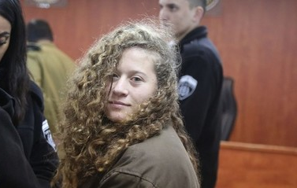
AHED TAMIMI
Notes:
Ahed Tamimi
Looking back at the words on the previous slide. These are words that have all been used to describe one person – Ahed Tamimi.
Explain: Ahed Tamimi is a young Palestinian from the village of Nabi Saleh in the West Bank.

Slide 7
Name: Ahed Tamimi
DOB: 31 January 2001
Age: 17
Occupation: Student
Languages: Arabic
Place of birth: Palestine
Place of residence:
Nabi Saleh, Palestine
Notes:
50 Years Too Many
Explain: Click through the basic information on who Ahed Tamimi is.
17-year-old Palestinian activist Ahed Tamimi has been called the ‘Rosa Parks of Palestine’. For years, she and her family have bravely stood up against the Israeli occupation.
On 15 December, Ahed Tamimi and her family were protesting Trump’s decision to recognize Jerusalem as the capital of Israel. In a horrifying turn of events, Ahed’s 14-year-old cousin, Mohammed, was shot in the head at close range by an Israeli soldier. He required intensive surgery, where part of his skull was removed, in order to dislodge the rubber bullet.
Later that day, Ahed also came face to face with Israeli soldiers, when they entered the yard of her family’s house. A video, which has since gone viral, shows the unarmed teenage girl slapping, shoving and kicking two armed Israeli soldiers who are wearing protective gear. It was clear she posed no actual threat to them – as they lightly swatted her advances away.

Slide 8
AHED TAMIMI
8 months in prison
5,000 Shekels fine
3 year
suspended sentence
Notes:
Ahed Tamimi
Explain:
Click through: Ahed, who was 16 at the time, was swiftly arrested and detained by Israeli authorities and sentenced to 8 months in prison. Ahed was also given a 5,000 Shekels fine (around £1,000) and a 3 year suspended sentence.
This sentence was clearly disproportionate to her actions and a blatant attempt to intimidate anyone who dares challenge the human rights abuses that Palestinians experience under Israel’s brutal occupation.
To make matters worse, her trial happened behind closed doors, which was clearly against Ahed's interests. We believe this was a blatant attempt by the Israeli authorities to reduce the amount of media attention and international outcry her case was receiving.

Slide 9
Charged with
incitement
Aggravated assault
Obstructing Israeli soldiers
Notes:
Ahed Tamimi
Click through: At her trial, Ahed was accused and charged with incitement, aggravated assault, obstructing Israeli soldiers and 10 other charges.
Ahed was in HaSharon prison, an Israeli prison but she was only one of approximately 350 Palestinian children held in Israeli prisons and detention centres.
Hundreds of Palestinian children are prosecuted every year through Israeli juvenile military courts. Those arrested are systematically denied their rights and subjected to ill-treatment including threats, blindfolding, harsh interrogations, and in some cases physical violence.

Slide 10
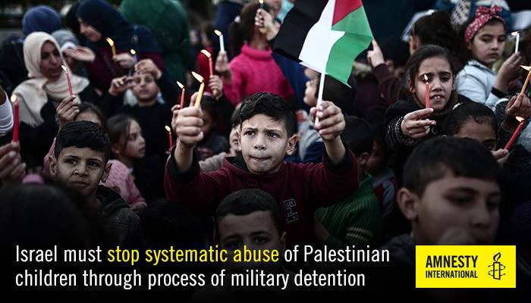
Ahed Released but…
Notes:
Ahed Released but…
Resource: https://www.amnesty.org.uk/ahed-tamimi-palestinian-teen-released-israeli-prison
Twitter Video: Ahed released from prison (1 min)
https://twitter.com/amnesty/status/1023669250807001096?ref_src=twsrc%5Etfw%7Ctwcamp%5Etweetembed%7Ctwterm%5E1023669250807001096&ref_url=https%3A%2F%2Fwww.amnesty.org.uk%2Fahed-tamimi-palestinian-teen-released-israeli-prison
Amnesty International put global pressure on Israeli Prime Minister Benjamin Netanyahu and called on him to:
Immediately release, 16-year-old Palestinian activist Ahed Tamimi, who was sentenced to eight months in prison.
Ensure that Palestinian children are not subjected to detention or imprisonment except in cases where it is demonstrably necessary and proportionate as a last resort for the shortest appropriate period of time.
Ahed celebrated her 17th birthday in prison.
On 30th July 2018, Ahed was released from prison 21 days short of her 8 month sentence.
Ahed Tamimi was imprisoned in a blatant attempt by the Israeli authorities to intimidate those who dare to challenge the ongoing brutal repression by occupying forces.
In detention, Ahed endured aggressive interrogations, sometimes at night, and threats made against her family.
Her imprisonment shows that the Israeli authorities have no regard whatsoever for the rights of Palestinian children.
Israel must stop systematic abuse of Palestinian children.

Slide 11
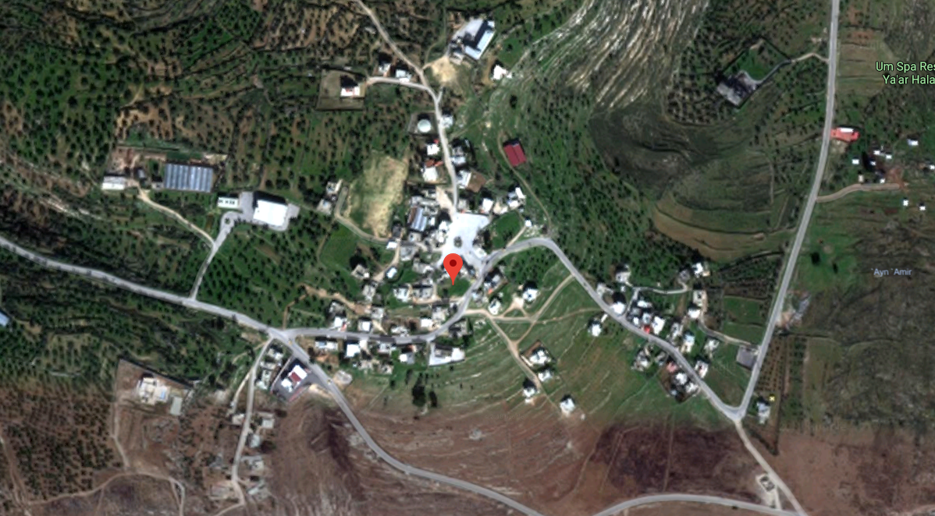
Nabi Saleh
Notes:
Nabi Saleh
As of April 2018, we know of 20 residents of Nabi Saleh village, including seven children, who are currently held in Israeli prisons and detention centres.
Various residents of Nabi Saleh, including Ahed Tamimi, are supported by Amnesty International in relation to the numerous human rights violations they have and do face by the Israeli authorities and the Israeli army.
Nabi Saleh is a village of about 550 people. Most of the inhabitants are the extended Tamimi family; besides them, there are a few refugee families who moved to Nabi Saleh after Israel forced them to flee their homes in 1948.
The village takes its name from a holy site in its centre, which is part of a traditional Sufi pilgrimage route. The village covers around 284 hectares, including farmland.

Slide 12
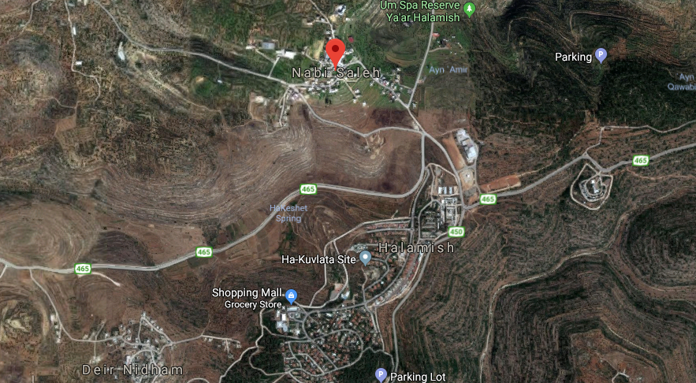
Nabi Saleh
Notes:
Nabi Saleh
Halamish (also called Neve Tzuf) is an illegal Israeli settlement established in 1977 on lands that belong to the villages of Nabi Saleh and Dier Nitham. A few years after its establishment the settlement had around 400 residents; it has since grown to contain around 1,600. There is a military base in the settlement, where the army trains religious recruits and also frequently detains Palestinians, including demonstrators from Nabi Saleh.
Weekly demonstrations developed in late 2009 out of protests by residents of the villages of Nabi Saleh and Dier Nitham when settlers from Halamish began a takeover of the Al-Qaws spring, which is situated in land between the two villages, owned and cultivated by Palestinians.
In early 2009 settlers turned the spring into a tourist site and began to build structures in the area, illegally. In the process they destroyed Palestinian property including olive trees which the villagers partly depend upon for their livelihood. On 17 December 2009 the Israeli authorities banned Palestinians, including landowners, from access to the spring and the land around it, while allowing settlers to continue to build and have free access.
This prompted the villagers to begin regular demonstrations to demand access to the spring. Palestinians are still prevented from accessing the spring and the military authorities have continued using excessive force to stop the Palestinian demonstrations and harass the residents.

Slide 13
Notes:
Ahed Tamimi
Optional Video:
https://www.youtube.com/watch?v=AIN4KQzBUgE
Institute of Middle East Understanding Video:
2:10
Ahed Tamimi: A Teen in Search of Freedom
Note to trainer: This is not an Amnesty video and was produce before Ahed’s release. However, it gives a good overview of Ahed’s experience of living under occupation and the impact it has had on her and her family.

Slide 14
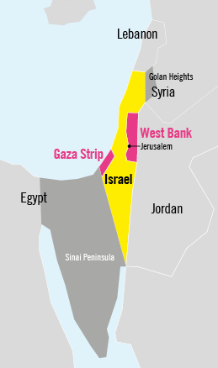
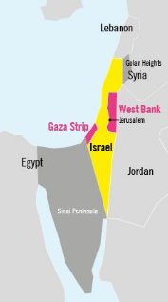
How the Occupation Began?
The 1967 ‘Six-Day War’ resulted in Israel occupying
Sinai Peninsula
The Gaza Strip
The West Bank
All of Jerusalem
The Golan Heights
Notes:
How the Occupation Began?
In the simplest of terms, the Israel-Palestine conflict is about land and who gets to control it and live in it.
Over 50 years ago, the 1967 6 day war took place between Israel and its neighbouring Arab states.
It was fought from 5 to 10 June 1967 and resulted in Israel capturing and occupying the Sinai Peninsula, the Gaza Strip, all of Jerusalem, the Golan Heights and most of the West Bank.

Slide 15
Beginning of Illegal Settlements
Israel began building settlements in the OPT
This was and is illegal under international law
All settlers were evacuated from Sinai in 1989 and Gaza in 2005
But settlements in the West Bank and East Jerusalem continue to expand.
Notes:
Beginning of Illegal Settlements
Israel then took a controversial step that was designed to reinforce its own security, but has instead created a barrier to peace and caused profound suffering to its victims.
They began building illegal settlements on Palestinian land.
This was and is illegal under international law
All settlers were evacuated from Sinai in 1989 and Gaza in 2005
But settlements in the West Bank and East Jerusalem continue to expand.

Slide 16
What are Illegal Settlements?
More than 1,000km² of Palestinian land has been stolen.
1,000km² is about the size of Manchester and Glasgow combined.
50,000 Palestinian homes and structures have been demolished.
Over half a million Israelis have settled in Occupied Palestinian Territories.
Notes:
What are illegal settlements?
Video
https://www.youtube.com/watch?time_continue=16&v=zWzJU68KgVA
IMEU Video: What are Israeli settlements? – 1 min 39 secs
Note to trainer: This is not an Amnesty video but it explains the development and impact of illegal settlements.
Settlements are Israeli colonies that have been unlawfully established by Israel in the in the Occupied Palestinian Territories (OPT). So-called “settlement outposts” are settlements which in theory have been established by individuals without the authorization of the Israeli government but which in practice have the backing of senior government and army officials.
All settlement activity – whether or not it is considered legal under Israeli law – constitutes a flagrant violation of international humanitarian law and, according to the Rome Statute of the International Criminal Court, constitutes a war crime.
Settlements are not just small villages but can be large areas of land, which merge into ‘settlement blocs’. There are more than 600,000 Jewish Israeli settlers living on occupied Palestinian land.
More than 100,000 hectares of Palestinian land have been appropriated by Israel since 1967. More than 1,000km² of Palestinian land has been stolen to build illegal Israeli settlements.
1,000km² is about the size of Manchester and Glasgow combined.
50,000 Palestinian homes and structures have been demolished to make way for over half a million Israelis to settle in Occupied Palestinian Territories.
It isn’t just the scale of land but the quality of the land being taken that has adversely impacted Palestinians in the West Bank. Often the most fertile land and water springs are targeted and stolen to create settlements. As we saw with Ahed’s village, Nabi Saleh.

Slide 17
The Growth of Settlements
By 1970 this grew to
1200 settlers in the West Bank by 1970
8600 in East Jerusalem by 1970
Smaller numbers in Sinai, Gaza and the Golan.
2017 it stands at
621,000 settlers including 200,000 in East Jerusalem
Notes:
The Growth of Settlements
In just over 50 years the scale of land stolen for settlements has growth phenomenally.
In 1970, 1200 settlers in the West Bank and 8600 in East Jerusalem
In 1980, this grew to 17,400 settlers in the West Bank
By 2004, 234,500 settlers in the West Bank
The latest figures from 2017 shows 621,000 settlers including 200,000 in East Jerusalem

Slide 18
Why are Settlements Illegal?
“The occupying power shall not deport or transfer parts of its own population into the territories it occupies.”
Article 49, Geneva Convention IV (1949)
Notes:
Why are Settlements Illegal?
Israel’s policy of settling its civilian nationals in the West Bank, and until 2005 in Gaza, contravenes two fundamental principles of customary international humanitarian law: the temporary nature of occupation and the prohibition on transferring civilians into occupied territory.
Under Article 49, Geneva Convention IV (1949), it states: “The occupying power shall not deport or transfer parts of its own population into the territories it occupies.”
Article 49 is applicable to Israel’s occupation of the West Bank including East Jerusalem and the Gaza Strip.
Also Article 55 of the Hague Regulations forbids the occupying State from changing the character and nature of state property, except for security needs and for the benefit of the local population.
Israel’s building of civilian settlements in the West Bank, and until 2005 in Gaza, does not meet these two exceptional criteria.
The settlements do not benefit the Palestinians, quite the contrary. Nor do they serve the legitimate security needs of the Occupying power.
Under the Statute of the International Criminal Court, the establishment of settlements in occupied territories is a war crime.

Slide 19
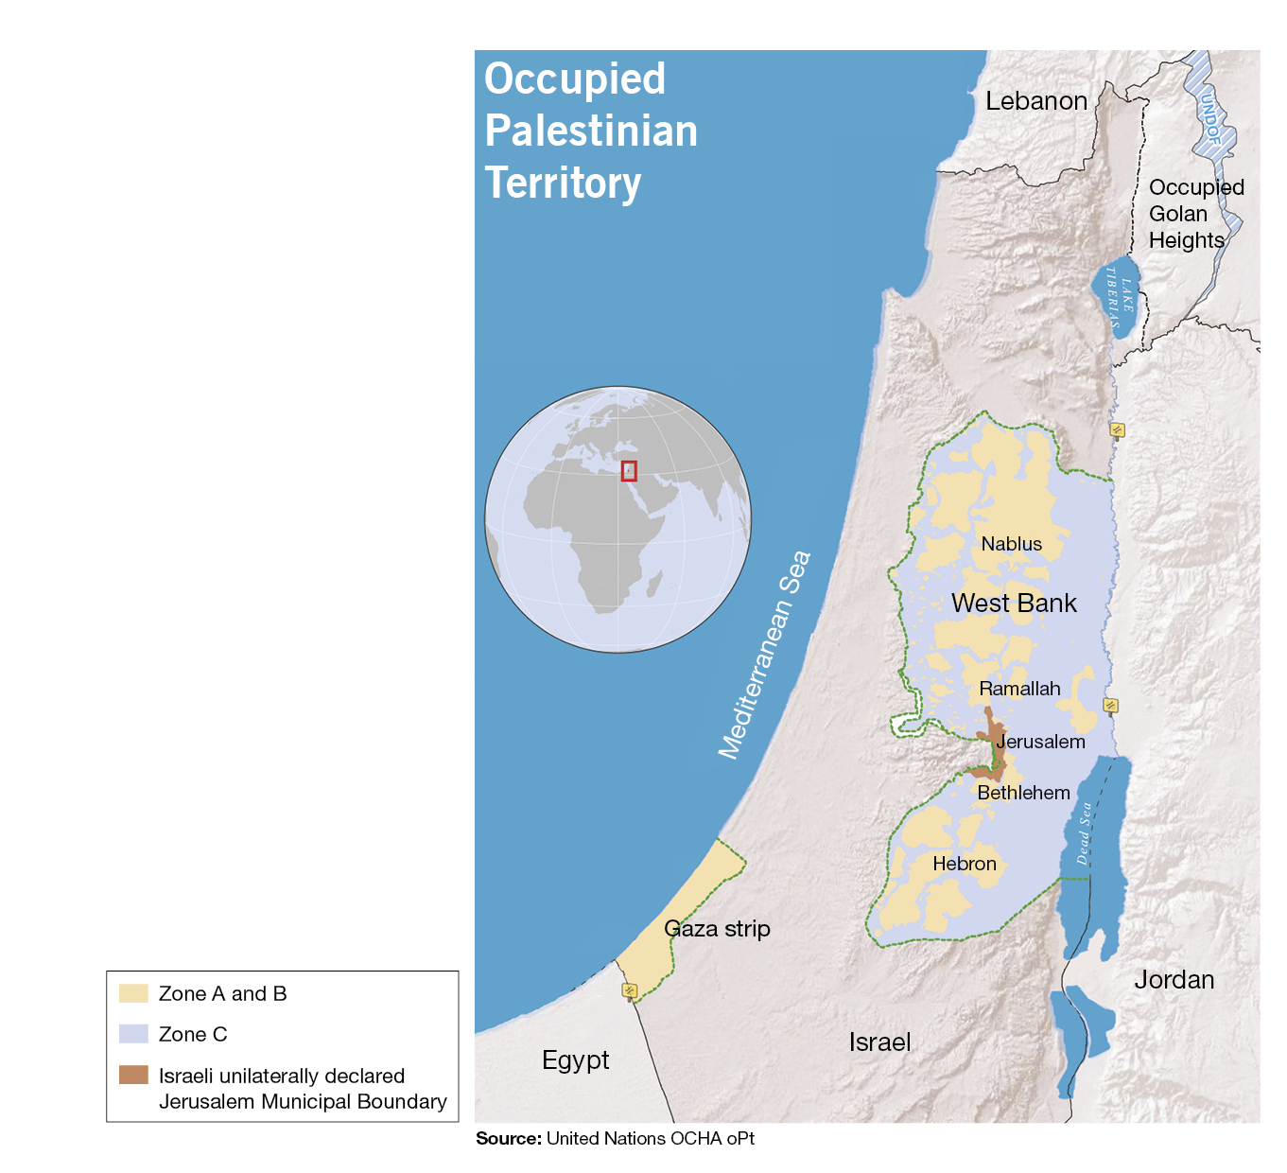
Stolen Land
“A flagrant violation of international law” UN
Settler enterprises are subsidised making farming, textiles and cosmetics very profitable
Palestinians suffer, not just economically but suffer physical attacks from settlers when tending to
their land.
Notes:
Stolen Land
The United Nations has described the creation and expansion of settlement as “a flagrant violation of international law”.
The international consensus on the illegality of settlements has been repeatedly affirmed by various international bodies. The settlements have been condemned in Security Council and other UN resolutions as illegal.
The UN High Commissioner for Human Rights, the Special Rapporteur on the Occupied Territories, and the Special Rapporteur on Housing, and the Commission on Human Rights have all reiterated the illegality of Israeli settlements in the Occupied Territories.
The international community has consistently called on Israel to stop building and expanding settlements in the Occupied Territories and, as early as 1980, the UN Security Council, in its resolution 465 called on Israel "to dismantle the existing settlements and in particular to cease, on an urgent basis, the establishment, construction and planning of settlements in the Arab territories occupied since 1967, including Jerusalem...".
Settler enterprises are subsidised making farming, textiles and cosmetics very profitable
Palestinians suffer, not just economically but suffer physical attacks from settlers when tending to
their land.

Slide 20
Who lives in the ‘Settlements’?
Settlers are Jewish Israeli Citizens
Its illegal under international law to move citizens from your country onto land that you occupy
Palestinians are often violently attacked by the Israeli military and settlers
Notes:
Who lives in the ‘Settlements’?
The people living in settlements are Jewish Israeli citizens. They generally live in walled/fenced and gated communities and Palestinians from the occupied territories are not allowed to live in them.
For the last 50 years, Israel has been forcing thousands of Palestinians off their land, occupying and illegally using it to create settlements that exclusively house Jewish Israeli settlers.
Settlements have displaced entire Palestinian communities. Their homes and livelihoods, have been destroyed, they’ve had restrictions enforced on their movement, access to their own water, land and other natural resources.
The communities have also been violently attacked by the Israeli military and settlers.
There are also hundreds of Israeli military closures across the West Bank, such as checkpoints, roadblocks, and settler-only roads, as well as an overall permit regime, which make simple daily tasks for Palestinians who are trying to get to work, school or hospital a constant struggle.
The very existence of settlements in the Occupied Palestinian Territories violates international humanitarian law and constitutes a war crime.
Settlements and the Israeli settlement policy are inherently discriminatory and result in grave human rights violations against Palestinians.
Settlements constitute a grave violation of the right to be free from discrimination, as well as a violation of other human rights.
The policy of settlement of Israeli civilians in the Occupied Territories has been carried out in a manner that is inherently discriminatory and detrimental to the ability of Palestinians in the West Bank and Gaza to enjoy fundamental rights.
For settlers to live comfortably, and enjoy full freedom of movement, Palestinians’ human rights are routinely violated in myriad of ways.

Slide 21
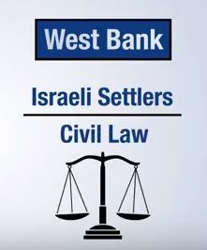
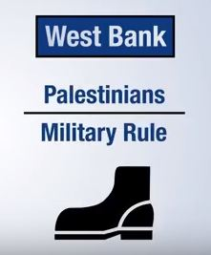
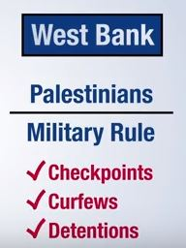
The Impact of the Settlements?
Source: AJ+
Notes:
The Impact of the Settlements?
AJ+ Video – Settlements Explained (2014) – 3 mins
https://www.youtube.com/watch?v=1sib5HbdEV4
Note to trainer: This is not an Amnesty video but it explains the impact of illegal settlements in law and in reality.
By building illegal settlements, Israel is thwarting any future peace process or peace deal.
The total number of settlers continues to grow.
Some Israeli settlers move to settlements with the religious conviction that it is their right to live there.
However, the Israeli government heavily incentivises settlements by offering lower tax rates, subsidised housing and easier loans.
The Israeli army is heavily deployed to protect settlements and settlers.
The physical presence of settlement towns, their infrastructure and the land taken by military to protect settlements, including military bases and security zones have broken up the West Bank into many disconnected areas, often cutting off access to water and farm lands in the Occupied Palestinian Territories.
In addition, whilst settlers in the West Bank bound under Israeli civil law, Palestinians fall under Israeli military law.
This means Palestinians are subjected to checkpoints, curfews and military detention, including the detention of children.
This is the impact of the settlements and living under military occupation.

Slide 22

What are Settlements Goods?
Settlement goods are products made on the land Israel stole from the Palestinians, or using the resources from those areas.
All settlement goods are tainted by human rights abuse. The trade must end.
Notes:
What are Settlement Goods?
As well as illegally building settlement homes and infrastructure on Palestinian land, Israeli and international businesses in settlements have established a thriving economy to sustain their presence and expansion.
This “settlement enterprise” relies on unlawfully appropriated Palestinian resources, including land, water and minerals, to produce goods that are exported and sold for private profit.
Hundreds of millions of dollars’ worth of settlement goods are exported internationally each year.
Settlement goods are products made on the land Israel stole from the Palestinians, or using the resources from those areas.
All settlement goods are tainted by human rights abuse. The trade must end

Slide 23
What are Settlements Goods?
Common exports from Israeli settlements
  fruit and vegetables,
  eggs,
  poultry,
  cosmetics,
  honey,
  olive oil,
  wine,
  spring water,
  textile products
  and toys.
Notes:
What are Settlement Goods?
1. Common exports from Israeli settlements
fruit and vegetables,
eggs,
poultry,
cosmetics,
honey,
olive oil,
wine,
spring water,
textile products
and toys.
2. Settlement products have been exported to many countries including the UK, USA, Denmark, France, Belgium and Germany among others.
3. Governments around the world have condemned settlements over the years. However, the settlements continue to expand so it’s clear that their condemnation is no longer enough. They must take firmer action.

Slide 24
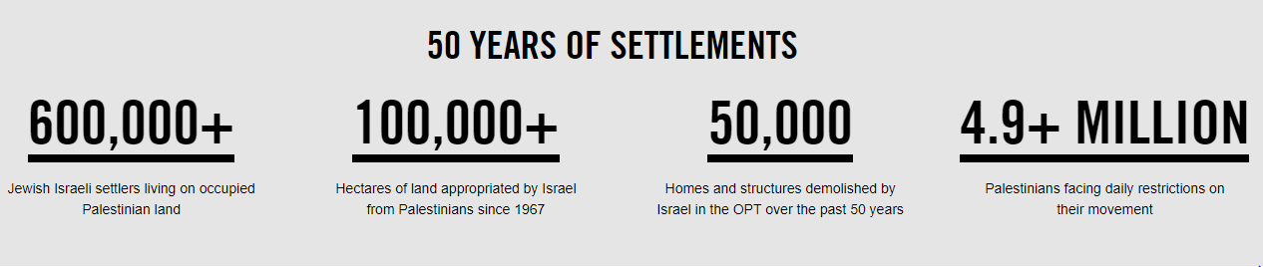
50 Years of Violations
Notes:
50 Years of Violations
For over 50 years, Israel has been forcing thousands of Palestinians off their land, occupying and illegally using it to create settlements that exclusively house Jewish Israeli settlers.
Israel’s policy of constructing and expanding illegal settlements on occupied Palestinian land is one of the main driving forces behind the mass human rights violations resulting from the occupation.
Despite multiple UN resolutions, Israel has continued to appropriate Palestinian land and support at least 600,000 settlers living in the occupied West Bank, including East Jerusalem. Until 2005, more than 9,000 Israeli settlers were illegally residing in Gaza.

Slide 25
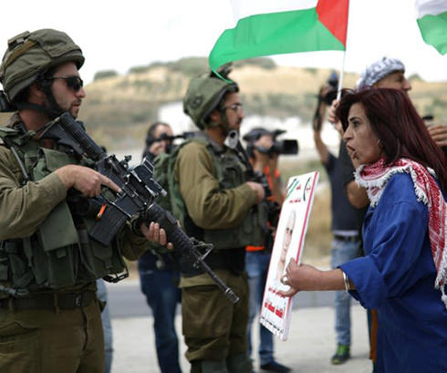
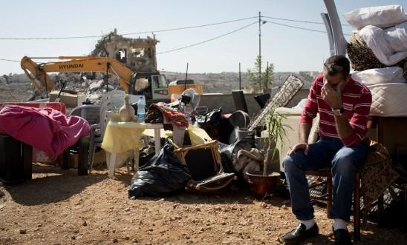
50 Years of Violations
Notes:
50 Years of Violations
Over the past 50 years, Israel has demolished tens of thousands of Palestinian properties and displaced large swathes of the population to build homes and infrastructure to illegally settle its own population in the occupied territories.
It has also diverted Palestinian natural resources such as water and agricultural land for settlement use.
The hundreds of Israeli military closures across the West Bank such as checkpoints, roadblocks and settler-only roads, as well as the overall permit regime, make simple daily tasks for Palestinians who are trying to get to work, school or hospital a constant struggle.
Israel claims the winding 700-km fence/wall is there to prevent armed attacks on Israel by Palestinians. But that does not explain why 85% of it is built on Palestinian land, including land deep inside the West Bank. What the fence/wall does is cut off Palestinian communities from each other and rip families apart.
It also deprives Palestinians from accessing essential services and separates farmers from their land and other resources, crippling the Palestinian economy.
Inherently discriminatory and unjust laws also prevent many people from being able to marry, or travel within the occupied territories or into Israel to visit or live with their loved ones. These arbitrary restrictions are discriminatory and unlawful and must be lifted immediately.

Slide 26
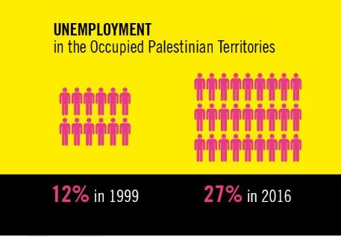
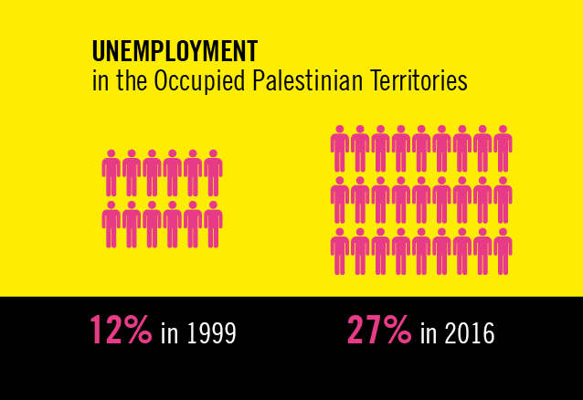
50 Years of Violations
Notes:
50 Years of Violations
Palestinian unemployment has more than doubled from 199 to 2016.
There is significant economic damage to the Palestinian economy caused by the settlements themselves. The Palestinian economy has been stunted by years of restrictions imposed on Palestinians resulting from the expansion of settlements and the settlement trade.
The IMF, UN and World Trade Organization have all identified the Israeli occupation, settlements and their related policies as a main obstacle to the economic development of the OPT.
If Israel lifted restrictions on access to and use of natural resources, imposed to support settlements, it would greatly boost the OPT economy and reduce poverty and unemployment.

Slide 27
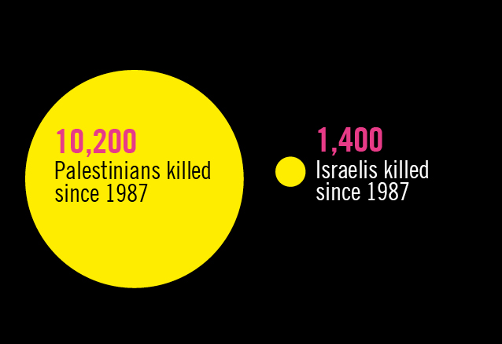
50 Years of Unlawful Killings
Notes:
50 Years of Unlawful Killings
Israeli forces have a long record of using excessive and often lethal force against Palestinian men, women, and children, including to retaliate against protesters and stifle dissent.
Thousands have been killed and many more injured. The authorities’ failure to conduct thorough, impartial and independent investigations to break the cycle of impunity has enabled these violations to continue over half a century.
Since 1987, more than 10,200 Palestinians have been killed, often in circumstances suggesting that the killings were unlawful and may amount to war crimes.
In the same period, over 1,400 Israelis have been killed by Palestinians. Of these, hundreds have been civilians killed by Palestinian armed groups in attacks that constitute crimes under international law.

Slide 28
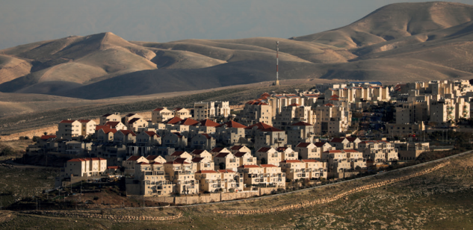
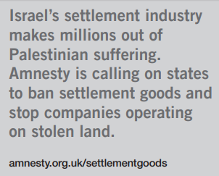
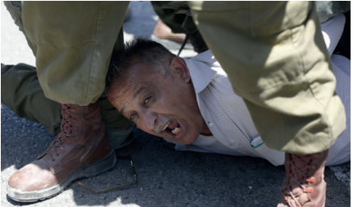
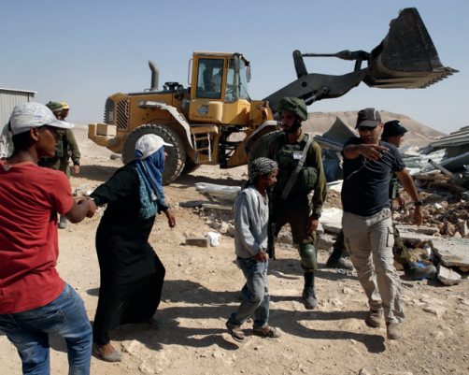
Our Campaign
Notes:
Our Campaign
Amnesty International has been documenting and campaigning against human rights violations, committed by both the government and non-state actors, in Israel and the Occupied Palestinian Territories since 1968, on a wide range of issues including, freedom of movement, arbitrary arrests and detentions, torture, unlawful killings, excessive use of force, freedoms of expression, association and assembly, forced evictions and house demolitions, impunity, violence against women and girls, refugees and asylum-seekers and conscientious objectors.
In 2017, to mark the 50th anniversary of Israel’s occupation of the West Bank, including East Jerusalem, and the Gaza Strip, we launched a campaign calling on states across the world to prohibit settlement goods from entering their markets and to prevent their companies from operating in settlements or trading in settlement goods.

Slide 29
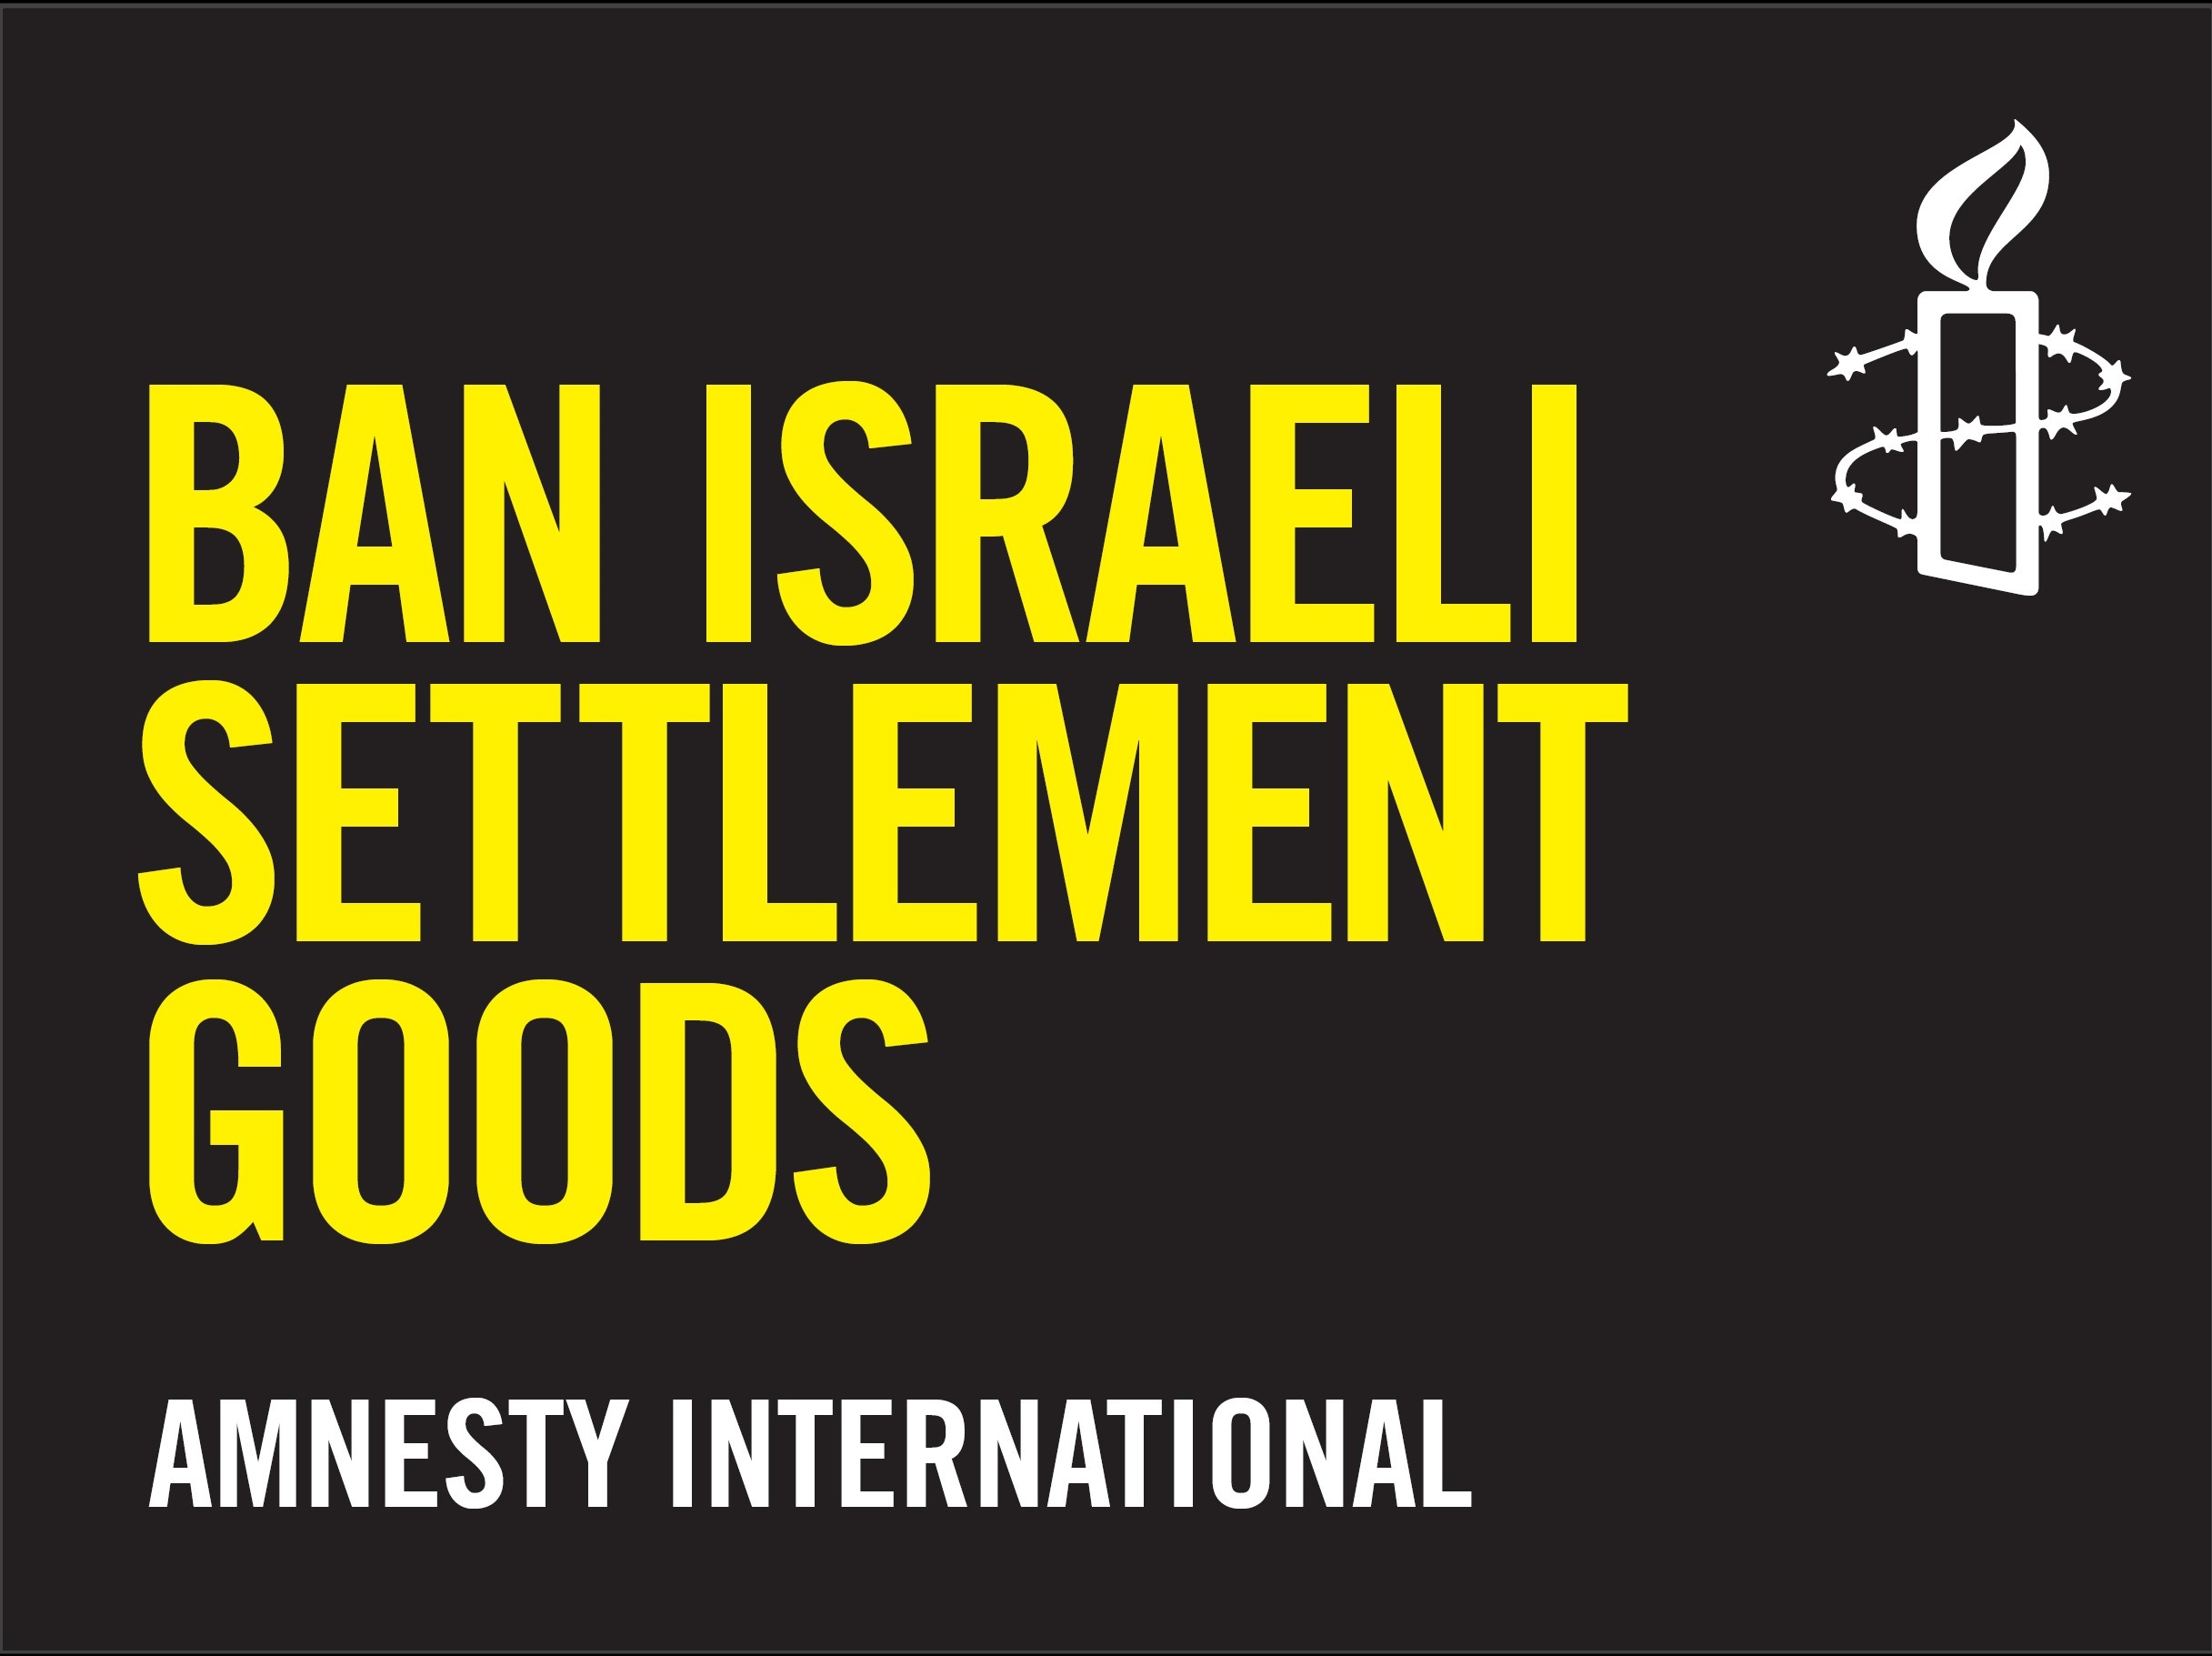
Notes:
Ban Israeli Settlement Goods
Amnesty International calls on Israel to dismantle all settlements and relocate its settlers outside the Occupied Palestinian Territories.
In our campaign launched on 5 June 2017 to mark 50 years since Israel’s occupation of the West Bank and Gaza, we introduced two new calls:
We are calling on governments across the world to stop economically supporting settlements by banning products from settlements in their countries.
We are also calling on governments worldwide to prevent their companies from operating in settlements or trading in settlement goods.
Profits from hundreds of millions of dollars’ worth of settlement products exported internationally help sustain the inherently discriminatory policy of settlements.
In addition the settlement economy relies on unlawfully appropriated Palestinian natural resources, such as water, fertile land, stone quarries and minerals seized for settlement use; resources for which Israel also limits Palestinians’ access.
We want to change the narrative in Parliament to be more supportive of punitive action over occupation and human rights abuses, to do this we need the public to show that they support this, for businesses to support this, and for businesses to stop operating in settlements

Slide 30
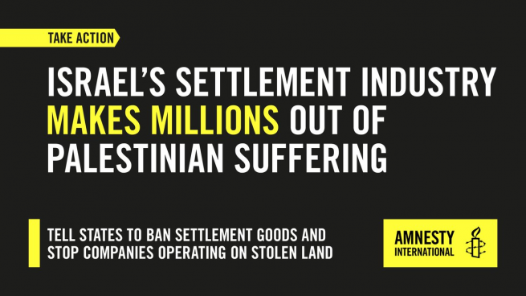
Notes:
Boycott or Ban
Note to Trainer: Boycott, Divestment and Sanctions - we do not call for boycotts but support the right to boycott. We focus on international law, states and businesses as actors. Our calls and message is that states should not be trading with illegal settlements as this breaches their duties under international law, likewise businesses should not be operating in the illegal settlements as they are breaching their duties under international law. Boycotts are a legitimate campaigning tactic, and individuals are free to choose whether or not to boycott and who/what to boycott. However Amnesty is not calling on its members to boycott goods.
A boycott of goods is a call for people to refuse to buy products.
A ban is call for the government to ensure such products are not allowed into the country.
As a human rights organisation Amnesty International’s focus is ensuring that governments uphold their obligations under international law and aren’t fuelling violations themselves.
That’s why our call is directed at states; asking them to stop financially sustaining Israel’s illegal settlement policy.
We strongly believe this is the most strategic and effective route to ensure an end to mass violations against Palestinians in the OPT.
Whether or not to take part in a consumer boycott is a choice for individuals. Historically, Amnesty International has never supported or opposed consumer boycotts. We do, however, defend people’s right to participate in, and advocate for boycotts. And we have campaigned on behalf of those who have been punished for doing so.
But the burden should not be on the consumer. In theory, if there are no settlement products on the market, there would be no need for a consumer boycott of settlement products.

Slide 31
Planning your Campaign Message
!
Why ban Israeli goods?
Why is Amnesty calling for an Israeli boycott?
Notes:
Activity: Planning your Campaign Message
Objective: For groups to effectively and confidently communicate and campaign on banning Israeli Settlement Goods.
Resources: These slides, FAQs and campaign briefings.
Activity: 30 mins
15 mins – In two groups, using the resources, come up with a brief campaign message.
Assign each group a question: Why ban Israeli goods? Why is Amnesty calling for an Israeli boycott?
5 mins – Feedback
10 mins – Wider group discussion
Note to Trainer:
Why ban Israeli goods? Message should include and clarify that this is not a ban on Israeli goods but goods produced or operating in illegal settlement. The message should include what settlements are, the impact of the settlements, why they are illegal and why governments must act now.
What is Amnesty calling for an Israeli boycott? Message should include the difference between a boycott and a ban. Clarification on why Amnesty is targeting States to ban imports from settlements. The message should include what settlements are, the impact of the settlements, why they are illegal and why governments must act now.

Slide 32
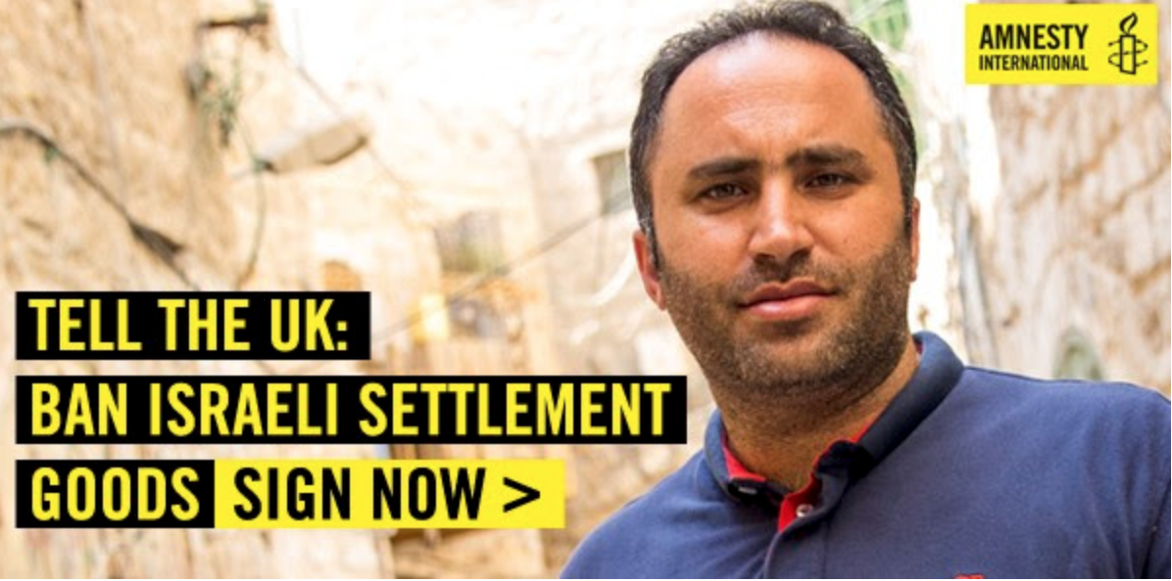
Palestinian Human
Rights Defenders
Notes:
Palestinian Human Rights Defenders
Palestinians living in the Occupied Palestinian Territories cannot get to work or school, or see their friends and family without feeling the disruptive effect of Israel’s military rule. It even restricts their ability to farm their land, attend a protest, or access essential services such as electricity and clean water.
Prominent Palestinian human rights defenders Issa Amro (pictured above) and Farid al-Atrash, have been peacefully standing against the force of Israel’s military rule, demanding the end to Israel’s settlements in the city of Hebron and other places in the occupied West Bank.
But because they have stood up to Israel, they are being punished and are facing criminal charges. face prison sentences for their peaceful campaigning against illegal Israeli settlements in the city of Hebron in the occupied West Bank.
They were arrested after a non-violent demonstration on 26 February 2016, during which Israeli forces threw sound bombs and fired tear gas at protesters.
Farid, a lawyer, and Issa, coordinator of the Youth Against Settlements group, now face trials in an Israeli military court on politically motivated charges, including participating in an illegal demonstration and attacking soldiers. They deny all the charges.
Video footage corroborates Farid’s account that he was peacefully standing in front of Israeli soldiers and holding a poster when he was pushed, dragged and then violently arrested. He also told Amnesty he was shot in the foot.
Issa alleges he was beaten by the Israeli police twice while in custody. He has also been threatened and harassed by the Israeli army, police and settlers.

Slide 33
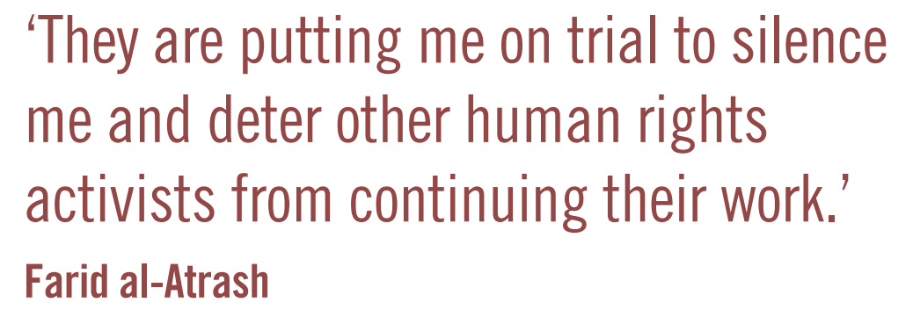
Notes:
Palestinian Human Rights Defenders
Palestinians need to be able to stand up for their rights - and the world needs to know what is happening to them. None of this can happen without activists like Issa and Farid.
We need to show Israel that we stand with peaceful protesters so that they stop prosecuting Issa and Farid and allow them to continue their important work.

Slide 34

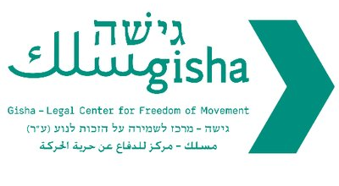


Israeli Human Rights NGOs
Notes:
Israeli Human Rights NGOs
In addition to Palestinian NGOs and human rights defenders like Issa and Farid. There are a number of Israeli human rights organisations that work on the rights and freedoms of the Palestinian people.
This includes Breaking the Silence, a non profit organisation made up of veteran combatants who have served in the Israeli military since the start of the second intifada and have taken it upon themselves to expose the public to the reality of everyday life in the Occupied Palestinian Territories.
B’Tselem – The Israeli Information Center for Human Rights in the Occupied Territories which strives to end Israel’s occupation, by recognizing that this is the only way to achieve a future that ensures human rights, democracy, liberty and equality to all people, Palestinian and Israeli alike.
Gisha, an Israeli not-for-profit organization, founded in 2005, whose goal is to protect the freedom of movement of Palestinians, especially Gaza residents. Gisha promotes rights guaranteed by international and Israeli law.
In recent years these organisations as well as Amnesty International Israel have been targeted by Israeli government campaigns to undermine their work, and faced smears, stigmatization and threats.

Slide 35
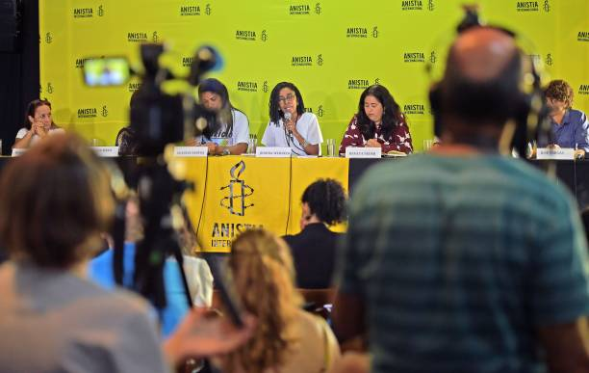
Amnesty Press Conference
Notes:
Activity: Amnesty Press Conference
Objective: To deal with difficult situations and effectively answer tricky questions around this campaign.
Resources: These slides, FAQs, campaign briefing and the Guide to Respectful Conversations
Note to Trainer: Go over the Guide to Respectful Conversations. Set ground rules of rights respecting values and behaviour as well as an open and safe space to explore difficult questions.
Activity: 30 to 45 mins
Work in groups of 3 to 4
5 mins – Brainstorm difficult questions that may come up in this campaign.
Possible questions could include:
Why is Amnesty International targeting Israel?
What about ‘worse’ human rights violations in other countries?
Won’t banning settlement goods harm Palestinian employment prospects?
Isn’t it anti-Semitic of Amnesty to target Israeli?
Why are you focusing on Palestinian human rights when we have people suffering in our own country? What about them?
10 mins - Prepare one or two answers but prepare for possible follow up or curve ball questions.
5 mins - Press Conference for each group (3 groups – 15 mins)
Roles: One group will holding the press conference. The rest will play journalists.
Room Setup: You may say up a panel table for the press conference as shown in the image above.
Ask a ‘journalist’ to start by asking the question the group has prepared for.
Following the answer allow the rest of the group (journalists) to ask follow up questions.
10 mins - Feedback and reflection. How did groups feel doing the activity and what did they learn that they can use in their campaigning for this campaign>

Slide 36
Notes:
Ban Israeli Settlement Goods
Start your campaign to ban Israeli Settlement good by taking action: https://www.amnesty.org.uk/actions/ban-trade-israels-illegal-settlements
Start having conversations in your community about the impact of settlements and how goods and products from settlements fuel human rights violations.
Take action and share the stories of Palestinian human rights defenders like Issa, Farid and Ahed.
https://www.amnesty.org.uk/drop-charges-against-palestine-human-rights-defenders-Israel
https://www.amnesty.org.uk/press-releases/israel-ahed-tamimis-release-welcomed-other-palestinian-children-languish-jail

Slide 37
