Slide 1


Slide 2


It is better to light a candle than to curse the darkness
Notes:
I am XXX. I am a volunteer speaker for Amnesty International. I will be with you for AMOUNT OF TIME.
Amnesty International is a human rights organisation.
This is our symbol, the Amnesty International candle. The candle represents hope and the barbed wire represents prison.
Amnesty stands up for human rights, and represents hope, even in the darkest of times.

Slide 3
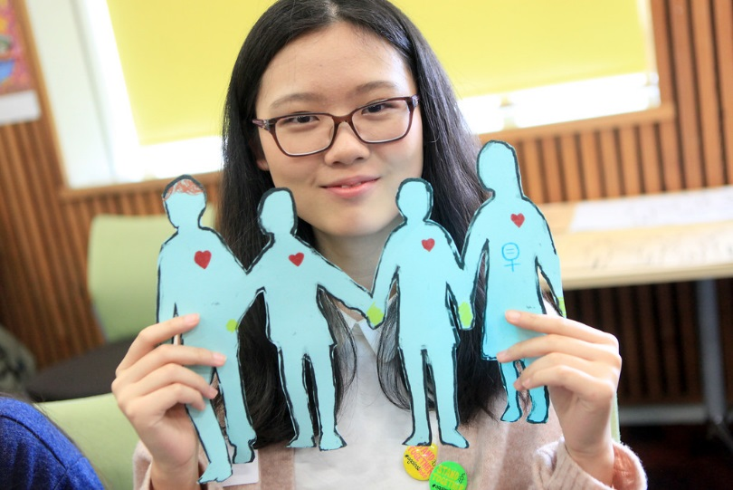
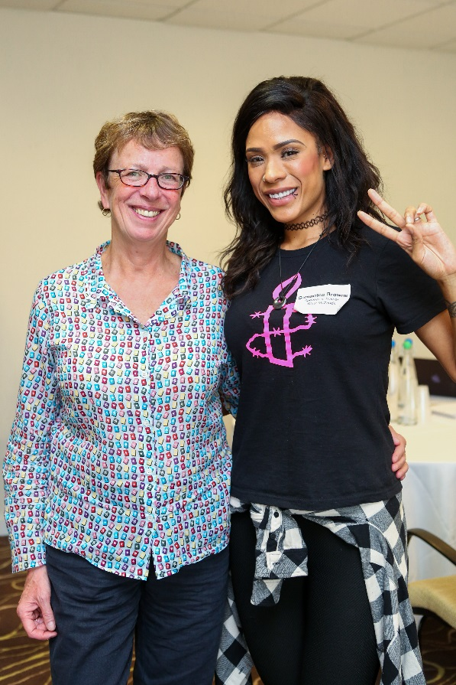
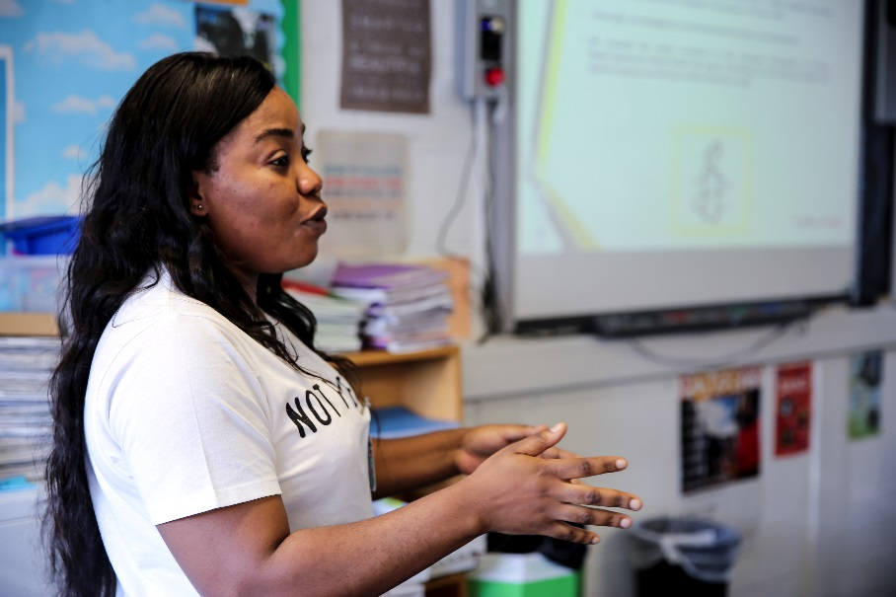
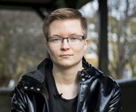
We are ordinary people
from across the world standing up for human rights
Notes:
We take action to protect human rights, we celebrate human rights, and we educate people so they know their rights, value their rights and can defend their rights and the rights of others.
Today we’re talking about children’s rights.

Slide 4
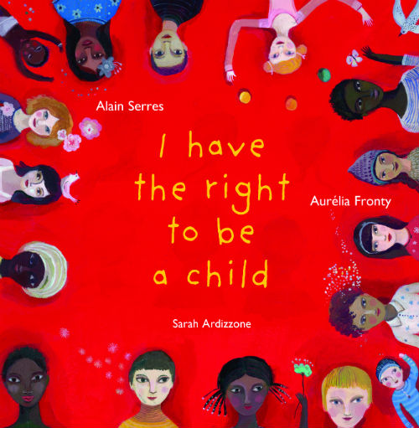
Children’s Rights
Notes:
I have been invited to NAME OF SCHOOL by NAME OF TEACHER because they know that, as a child, you do have rights. And they understand that, as a child, you have a right to learn about your rights!
That’s what we are going to do today: Learn about children’s rights, and learn about Amnesty International.

Slide 5

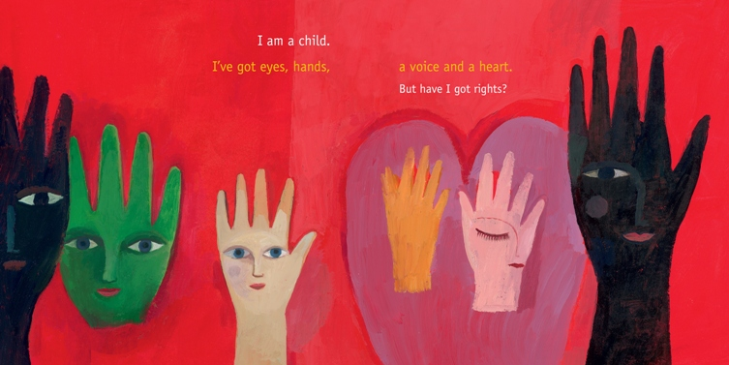
'I HAVE THE RIGHT TO BE A CHILD'
Notes:
ACTIVITY: Ask someone in the class to read the text "I am a child. I've got eyes, hands, a voice and a heart. But have I got rights?
Ask the children what they think. Nod head for yes, shake head for no.
You can ask the teacher to choose someone to read if you prefer

Slide 6
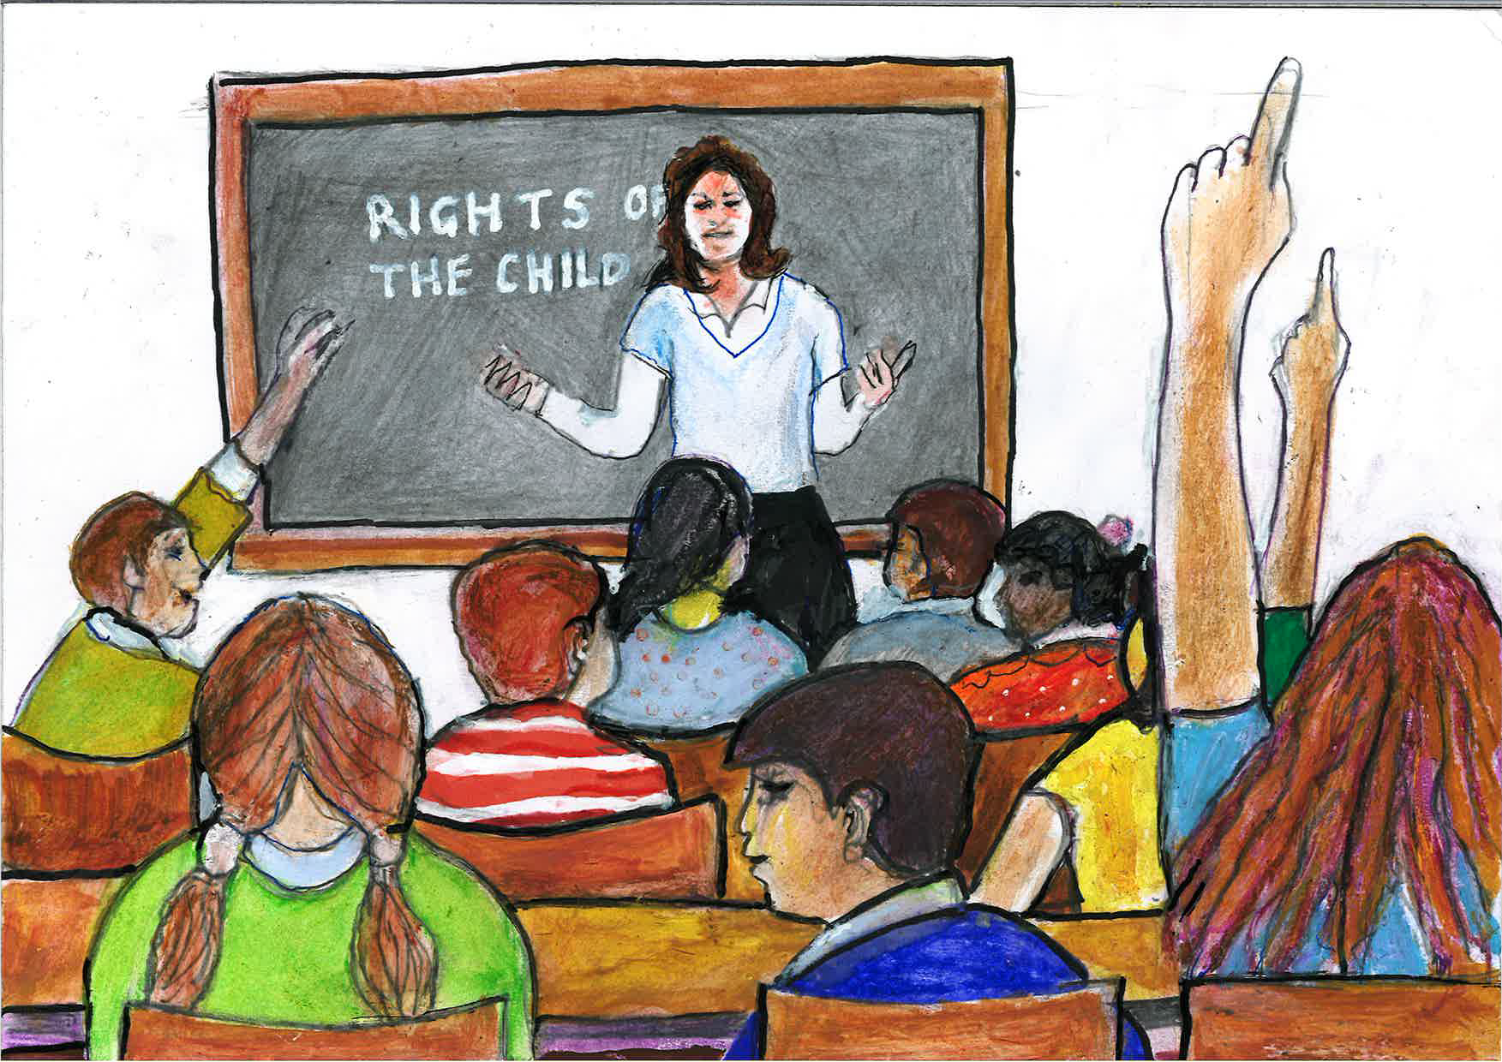
Who is a child?
Notes:
Q. Who is 'a child'?
A. A child is every human being under the age of 18

Slide 7
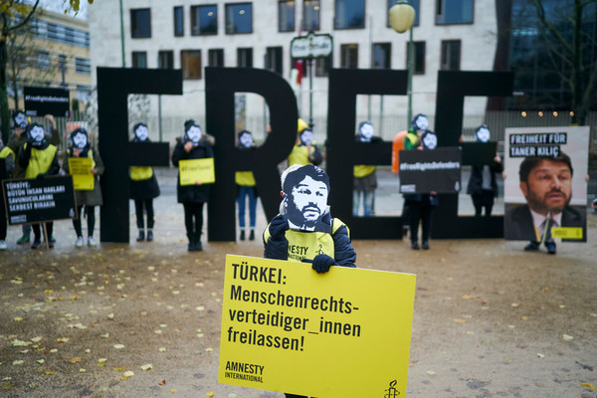
What are rights?
Copyright: Henning Schacht
Notes:
Q. What are 'rights'?
A. Human rights are freedoms that belong to all of us. The moral guarantees and basic standards that we need to be safe, to be happy, to grow and achieve our best. All human beings have human rights.

Slide 8
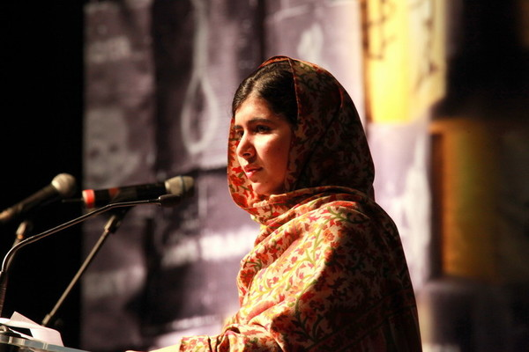
So…what are children’s rights?
Notes:
Q. So what are children's rights?
Children's rights are special rights, that belong to anyone under 18. Children have the same rights as adults but they also have additional rights.
Q. Why do you think children have additional rights?
Children have additional rights because childhood is an important time when you need different things and different protections from those of adults. A time when children grow, learn and develop.
Q. What do you think these rights are? What do you think they should be?
A. You can briefly talk about a few rights that are on the CRC. (Will be developed later in the activities).

Slide 9
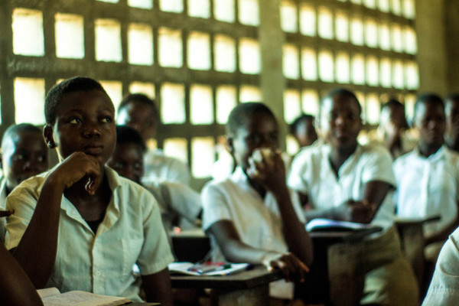
Do children have the right to…?
Notes:
Q. Do children have the right to food? To play? To a name? To an education? To protection from violence? To have a say in decisions made about them?
Answer to all of these is YES.
You could include other examples that are not rights: to own fashionable clothes, to have a mobile phone, to have a pet.

Slide 10
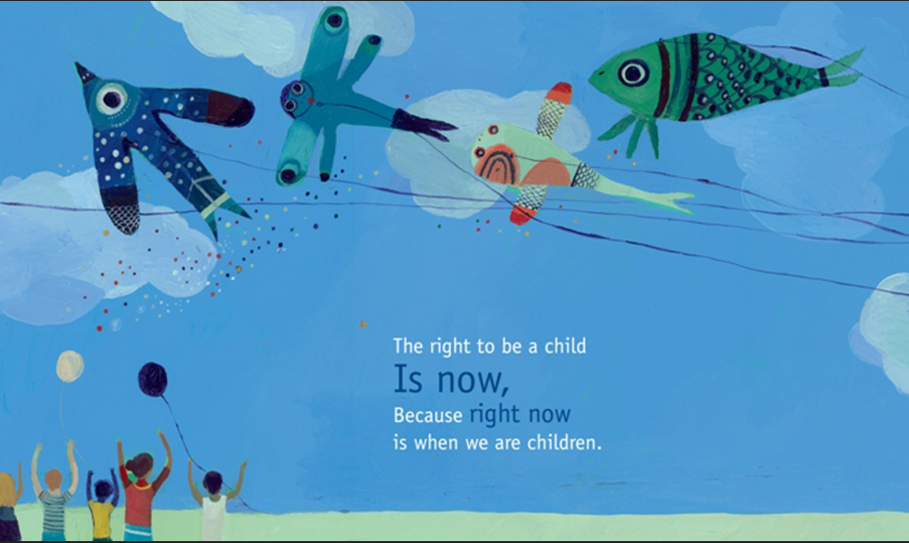
Notes:
Choose from activities 1, 2 and 3.

Slide 11
Notes:
Additional – take action
Brief of case:
Where in the world?
Show on a map if possible
Who is at risk? Why?
Give their name, personal details (family, age, etc), explain what happened
Which of their rights are being abused?
Ask the class
What is the action that Amnesty is taking?
Give examples of actions by other Amnesty supporters across the country/world

