Slide 1


Slide 2
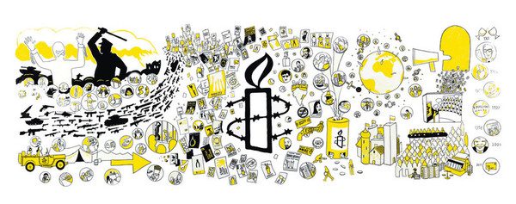
HUMAN RIGHTS AND AMNESTY INTERNATIONAL
[Enter Name of Trainer]
Notes:
Human Rights and Amnesty International.
Introduce yourself and your role at Amnesty International
Share a little about yourself: why/how you got involved with Amnesty, a story or case that stands out for you.
Explain what you’re presenting today.
If you plan to run a Q&A after the presentation, It’s OK not to know the answer
If the group have questions you don’t know the answer to, that is OK. You could: ask the group what they think, make a note of the questions and find out the answers after the session and email them to your group contact, or, leave the questions with the group for them to find out the answers and email them to you via your contact.

Slide 3


TITLE
Text
Notes:
Film: What do we want?
Starting with a short film is a good way of getting everyone’s attention.
Length: 1 minute 32 seconds.

Slide 4
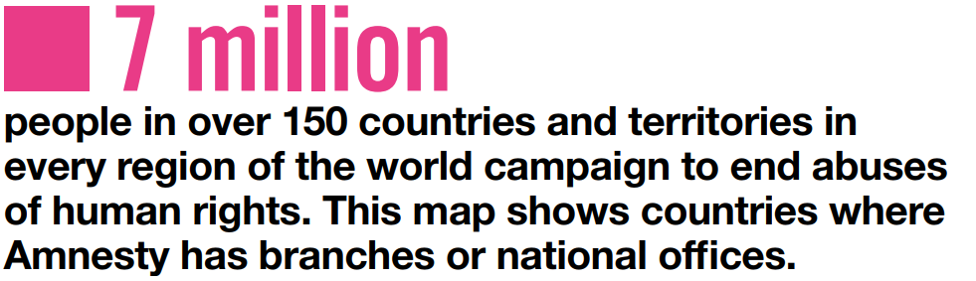
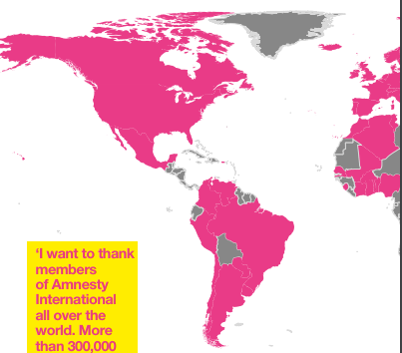
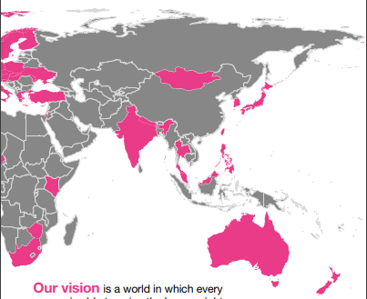
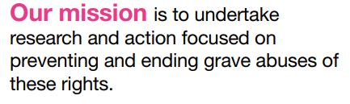
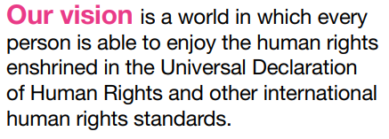
Notes:
Our Vision and Mission
1. Amnesty International is one of the world’s biggest human rights organisations.
2. We have 7 million people in over 150 countries who share our vision to have a world where every person is able to enjoy their human rights.
3. The map here shows where Amnesty has branches and national offices. We have a presence in Europe, North America, South America, Africa, Asia and Australasia.
4. Our presence and support enables us to fulfil our mission of undertaking research and action, which can help prevent and end grave human rights violations.

Slide 5
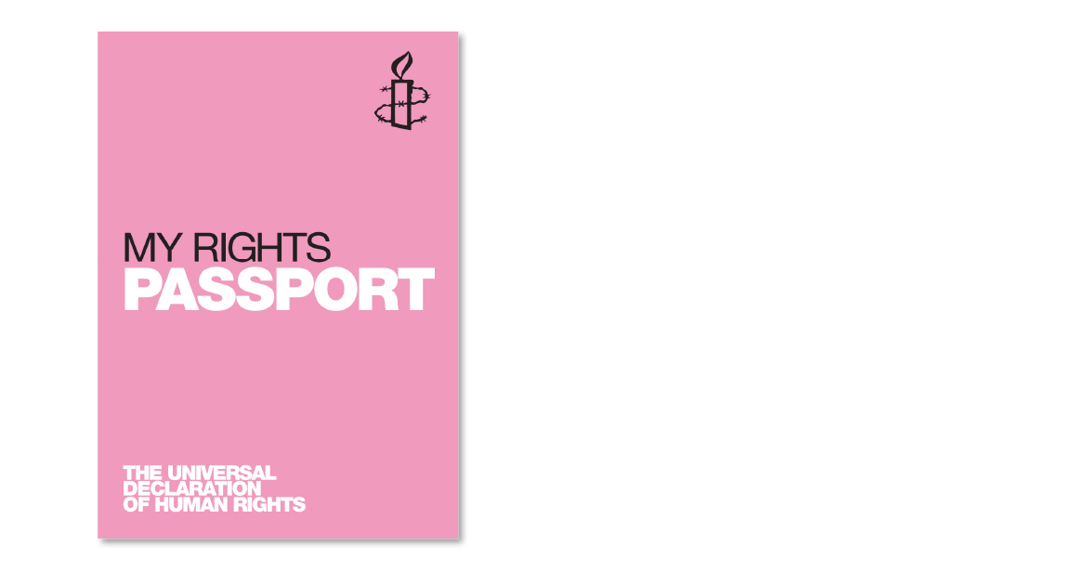
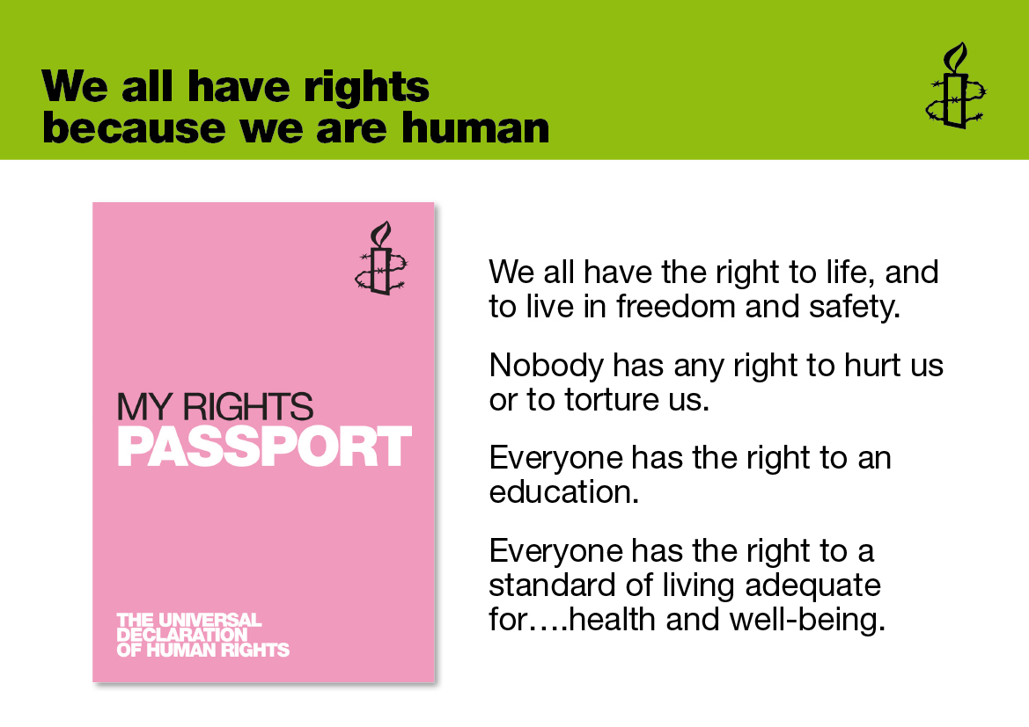

We all have rights
Notes:
We all have rights
This slide gives a brief introduction to the Universal Declaration of Human Rights, which was adopted by the UN General Assembly on 10th December 1948.
You may wish to have copies of the My Rights Passports (as seen in the picture), available to distribute to the audience. These can be ordered for free from Amnesty’s mailing house by calling 01788 545 553 and quoting the product code ED112.
Ask the audience if they have heard of The Universal Declaration of Human Rights (UDHR)? What do they know about it?
Following the traumatic events of the Second World War, there was a need to ensure that rights like the ones listed on the slide were universally respected.
This task was undertaken under the guidance of Eleanor Roosevelt with representatives from the 50 member states of the United Nations. Together they developed a list of 30 rights and freedoms that belong to all of us.
These 30 articles became The Universal Declaration of Human Rights (UDHR) which was adopted by United Nations General Assembly at the Palais de Chaillot, Paris, on 10th December 1948. This day is celebrated every year as Human Rights day.
At the time of adoption, the declaration was not binding under International law but was an expression of shared global norms and values. From 1948 to 1966, the UN Human Rights Commission’s main task was to create a body of international human rights law based on the Declaration. They produced two major documents: the International Covenant on Civil and Political Rights (ICCPR) and the International Covenant on Economic, Social and Cultural Rights (ICESCR). Both became international law in 1976.
The aim of the UDHR is to ensure that all people, whatever their race, religion, gender or any other difference, live in freedom and dignity.
Unfortunately, despite the Universal Declaration, human rights are abused every day in all corners of the globe. Thousands of people across the world are denied a fair trial and many are imprisoned purely because of what they think or believe. Civilians are still targeted in times of war: children are forced to become soldiers and women and girls are raped. Torture still happens. Millions of people still live in poverty; living on less than 1 dollar a day.

Slide 6
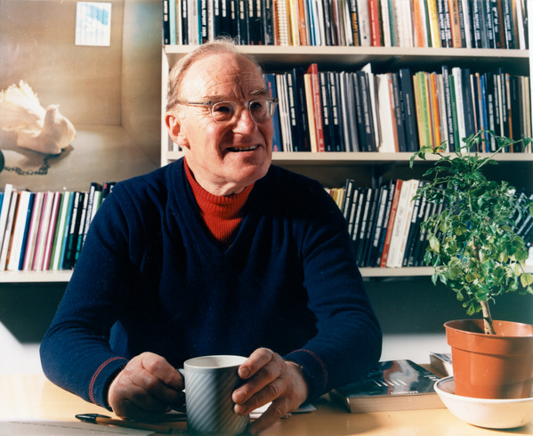
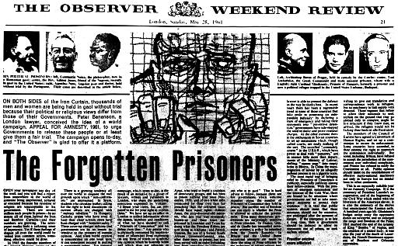
Where it all began?
We are ordinary people from across the world
standing up for humanity and human rights.
Notes:
Where it all began?
A detailed account of Amnesty’s history can be found here: http://www.amnesty.org/en/who-we-are/history
You may wish to show the following video. The video is less than two minutes long and shows the power of Amnesty as a global movement in taking urgent action.
Video: Use your Power. https://www.youtube.com/watch?v=wVYSNTVVxno&list=FLREPamP892LJnJfJNWYKfPQ
Amnesty International began with one man’s outrage and his determination to do something about it.
In 1961, after reading a short article about a couple of students in Portugal who had been imprisoned for seven years after raising their glasses in a toast to freedom; British lawyer, Peter Benenson, launched an Appeal for Amnesty with the publication of this article, “The Forgotten Prisoners” in The Observer newspaper, on 28 May 1961. His outrage at the imprisonment of the two men led to the birth of Amnesty International.
In the months to follow Benenson had set up an International meeting with delegates from Belgium, the UK, France, Germany, Ireland, Switzerland and the USA. They took the decision to establish "a permanent international movement in defence of freedom of opinion and religion“.
Their work focussed on releasing people they deemed prisoners of conscience. These are people who have been jailed because of their political, religious or other conscientiously-held beliefs, ethnic origin, sex, colour, language, national or social origin, economic status, birth, sexual orientation or other status, and have neither used nor advocated violence.
Within the first year, Amnesty worked on the release of 270 prisoners of conscience. Within five years 1,500 prisoners of conscience had been adopted and 1,000 prisoners had been released since Amnesty International was founded.
Amnesty grew from strength to strength, taking on more cases, engaging in its own field and research missions and acquiring consultative status from the UN.
Amnesty’s work had become internationally recognised and respected. This was further advanced in 1977 when Amnesty was awarded the Nobel Peace Prize for "having contributed to securing the ground for freedom, for justice, and thereby also for peace in the world".
Today Amnesty is made up of 7 million ordinary people across the world standing up for humanity and human rights. Our membership is our greatest strength.

Slide 7
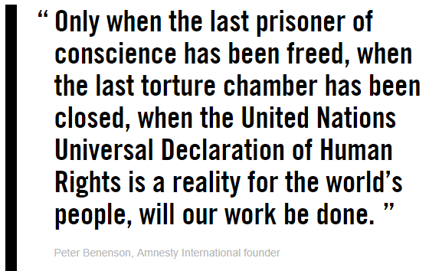
Notes:
Powerful Quote from Peter Benenson

Slide 8

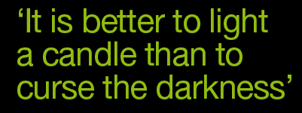
Notes:
The Amnesty Candle
This slide gives the background about Amnesty’s iconic logo: the Amnesty candle.
On Human Rights Day, 10 December 1961, the first Amnesty International candle was lit in the Church of St-Martin-in-the-Fields, London. Three years later, the first Amnesty International candle design was unveiled and became the organisation’s iconic logo.
[Ask the audience] What do you think the candle signifies?
[Inform the audience] The candle represents light and hope in the dark, and the barbed wire represents prison and persecution.
Amnesty’s motto comes from an ancient Chinese proverb: ‘It is better to light a single candle than to curse the darkness.’ Amnesty activists continue to light candles across the world.
The candle signifies Amnesty’s dedication to shining a light on human rights violations no matter where they are.

Slide 9
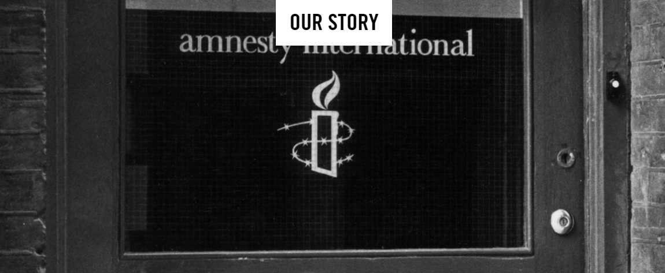
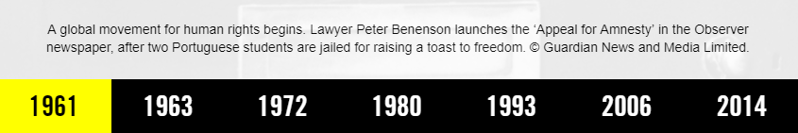
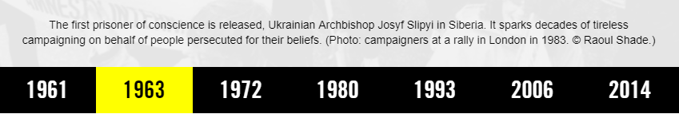
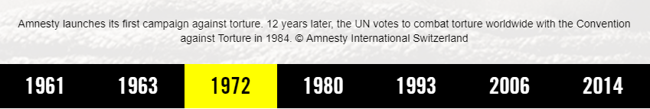
Notes:
Our Story
Amnesty has been around for nearly 60 years and in that time much has been achieved and much has changed.
From the birth of the movement in 1961 to the release of our first prisoner of conscience in 1963, Ukrainian Archbishop Josyf Slipyi in Siberia; to broadening the scope of our work by launching our first campaign against torture in 1972, which saw the UN adopt the Convention Against Torture, 12 years later.

Slide 10
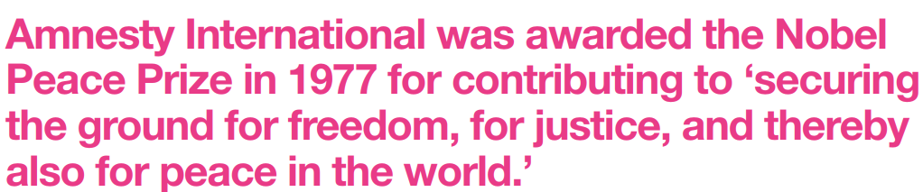
Notes:
Nobel Peace Prize
In 1977, Amnesty was awarded the Nobel Peace Prize for contributing to ‘securing the ground for freedom, for justice, and thereby also for peace in the world.’
Amnesty continues to do this work.

Slide 11
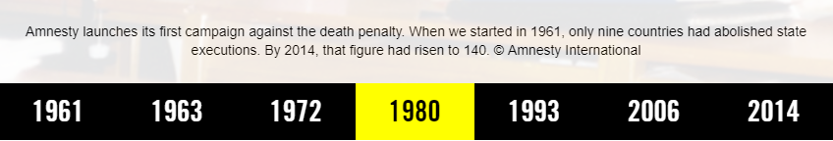
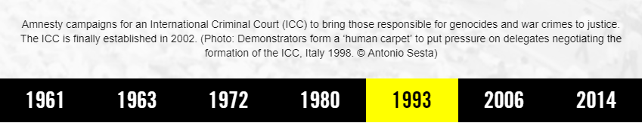
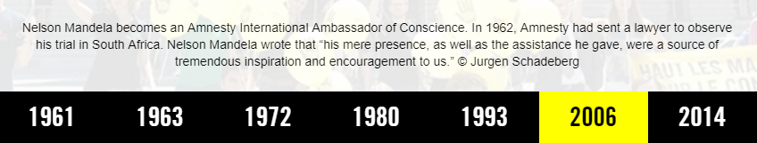
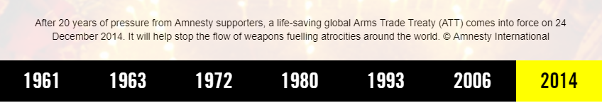
Notes:
Our Story (continued)
In 1980, Amnesty began one of it biggest campaign to end the death penalty. In 1961, when Amnesty was launched only nine countries had abolished the death penalty. That figure today stands at 141 countries where the death penalty is no longer used.
In 1993, Amnesty campaigning for an International Criminal Court (ICC) to bring to justice those responsible for genocide and war crimes. The ICC was finally established in 2002.
In 2006, Nelson Mandela became Amnesty’s Ambassador of Conscience. During Mandela’s trial, Amnesty sent lawyers to observe proceedings in South Africa. Mandela spoke very highly of the Amnesty lawyer, saying “his mere presence, as well as the assistance he gave, were a source of tremendous inspiration and encouragement to us”
Lastly, after 20 years of campaigning for an international Arms Trade Treaty, a treaty came into force in 2014, which aims to stop the flow of weapons which are fuelling atrocities around the world.
Over Amnesty’s nearly 60 year history, it is evident that our human rights focuses have broadened and our committed and ongoing campaigning has achieved many important human rights changes.

Slide 12
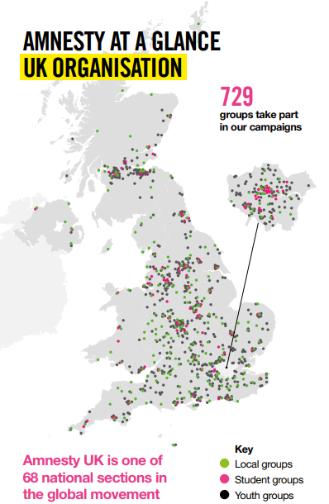
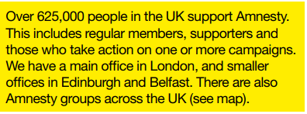

Notes:
Amnesty International UK Movement
More than 1 million people take action online with amnesty.org.uk a year and over 625,000 people in the UK support Amnesty in the UK, including members, supporters and those who have taken actions online.
Amnesty UK is one of 68 national sections in the global movement. We have offices in Edinburgh and Belfast and our main office is in London, with over 150 staff and volunteers overall.
One of Amnesty UK’s greatest strengths are our activist groups around the UK. We have 729 groups that take part in campaigns. Our local groups are made up of adult activists, often meeting in the evening once a month to come together to campaign on human rights issues that Amnesty focusses on. We also have amazing and active student groups based in Universities and Youth groups based in schools and colleges across the UK. Anyone can be a member of our activist groups and you can find your closest group on our website, www.amnesty.org.uk/groups.

Slide 13
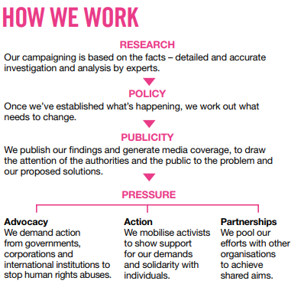
Notes:
How we work?
Amnesty International has come a long way since its inception in 1961.
Whilst campaigning and advocating on behalf of prisoners of conscience continues to be an important part of the work we do, the scope of Amnesty has greatly expanded.
Amnesty researchers carry out field research across the world, giving the movement facts straight from the ground.
This enables and informs our wide ranging campaigns and allows our members and activists to apply legal, political and moral pressure on governments and the public to act in support of human rights.
Our research enables us to build policy positions based on what needs to change and publishing our research and findings helps us to generate media coverage to shine a light on human rights abuses around the world. This gets the attention of authorities and the public to problem and to our proposed solutions.
All of this strengthens our campaigning and allows us to apply pressure through advocacy, action and partnerships, which helps to strengthen our call.

Slide 14
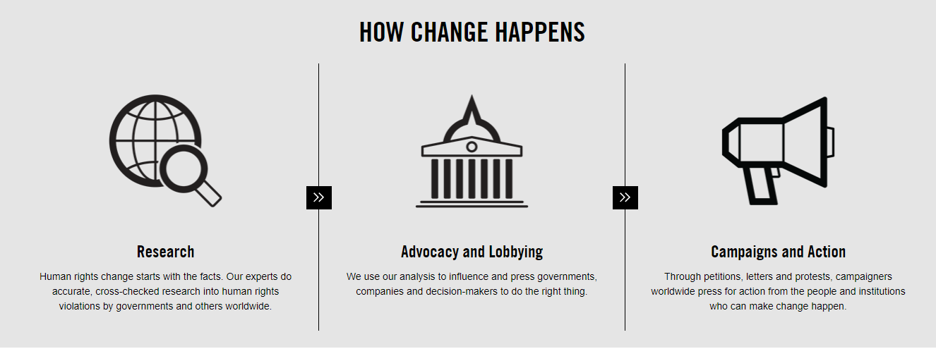
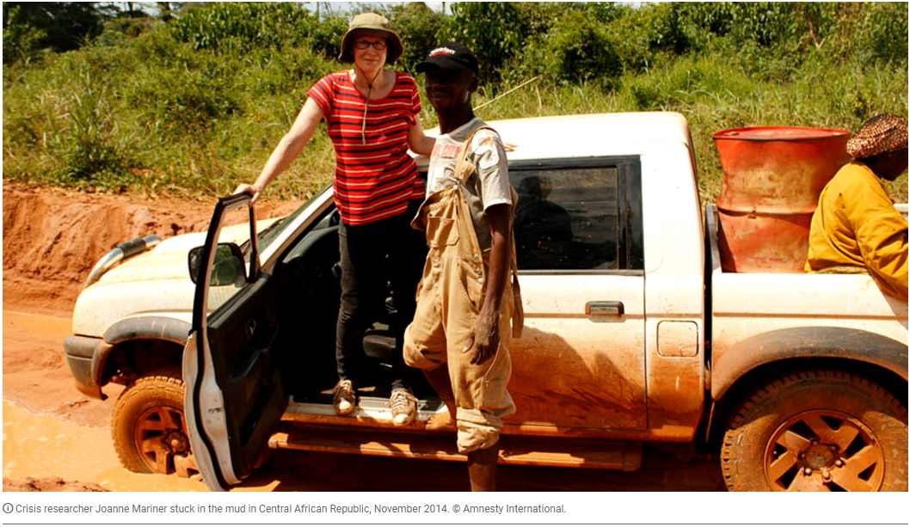
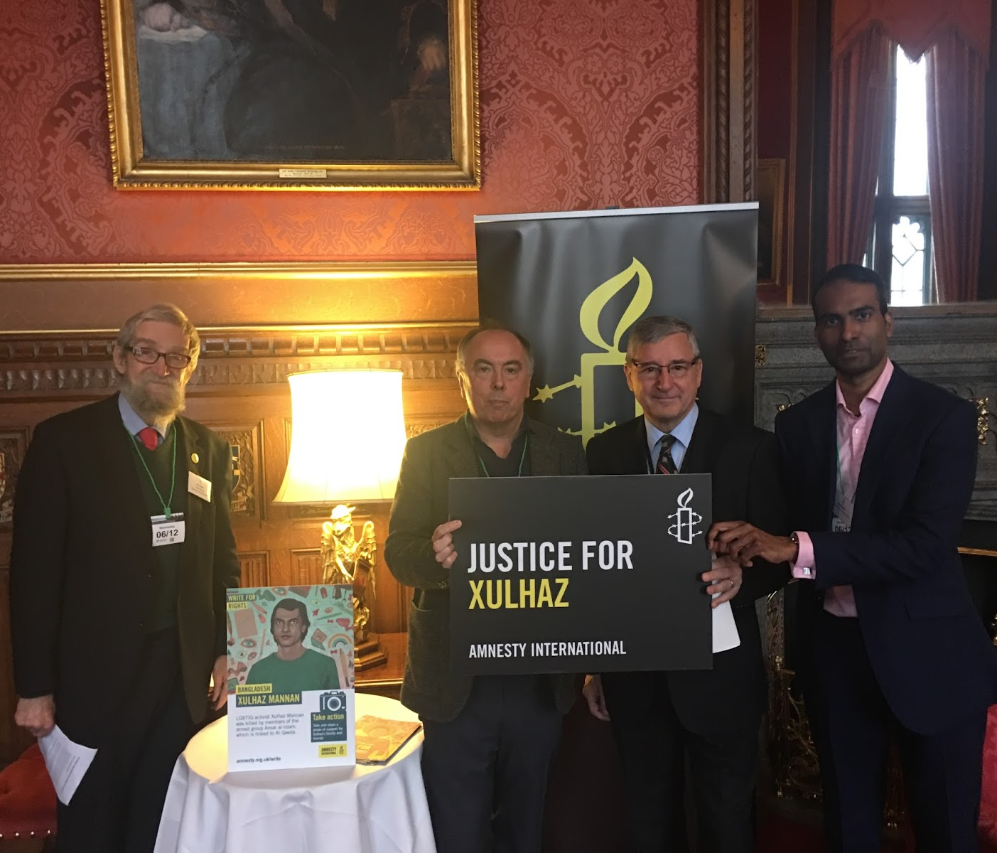
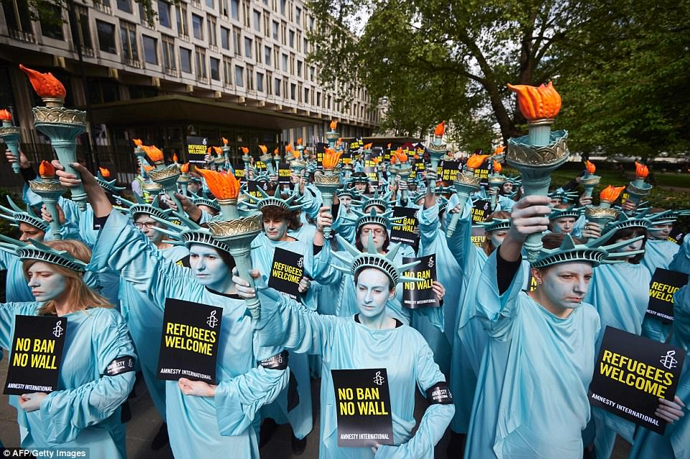
Notes:
How change happens?
This slide shows examples of the previous slide in action.
The image on the left shows Amnesty Researcher Joanne Mariner in Central African Republic in November 2014.
The image in the middle shows Amnesty activists at work doing advocacy and lobbying with MP Jim Fitzpatrick in Parliament.
The last image on the rights shows our powerful campaign action/stunt outside the US Embassy in London where 100 female activists dressed as the iconic Statue of Liberty carrying banners reading ‘Refugees Welcome’ and ‘No Ban, No Wall’, standing against the Trumps administration’s Executive Order proposing a ban on travel from 7 Muslim majority countries and their proposed border wall along the US Mexico border.

Slide 15
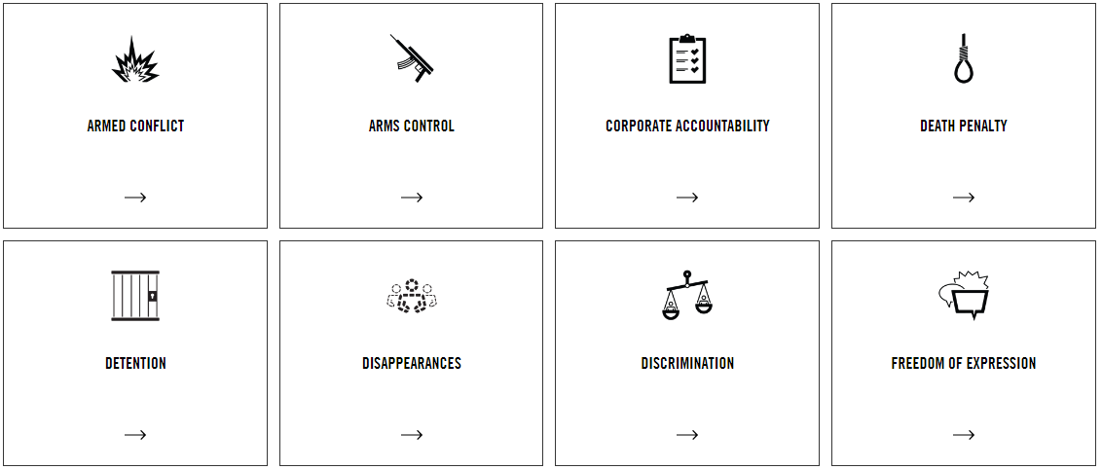
Notes:
What we work on?
Amnesty works on a broad range of human rights issues.
We work on armed conflict, arms control, corporate accountability and death penalty.

Slide 16
Notes:
What we work on?
1. We work on detention, disappearances, discrimination and freedom of expression.

Slide 17
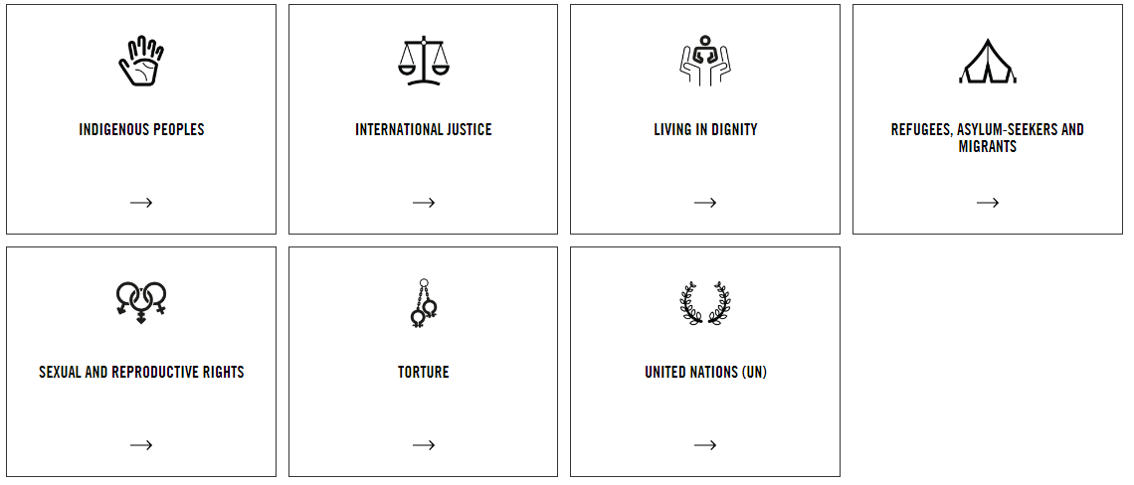
Notes:
What we work on?
1. We work on living in dignity, refugees, asylum-seekers and migrants, indigenous peoples and international justice.

Slide 18
Notes:
What we work on?
1. We work on sexual reproductive rights, torture and United Nations.

Slide 19
Notes:
Video: We can change the world?
Length: 1 minute 5 seconds.

Slide 20
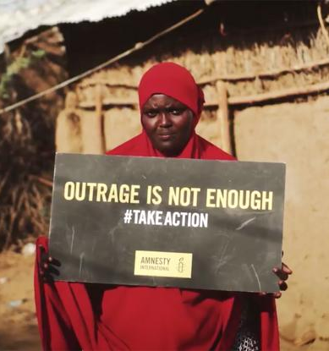
Take Action
1. Join Amnesty International
2. Sign petitions online
3. Send emails or letters to your elected officials
4. Send a tweet and share campaigns
5. Fund raise for Amnesty International
Notes:
Take Action
Amnesty’s work has impact because people around the world take action everyday.
You can take action too.
You become a member of Amnesty International, sign our online petitions, send emails, letters to officials, tweet and share our campaigns on social media and raise funds for Amnesty.

Slide 21

Notes:
Thank You!

