Slide 2
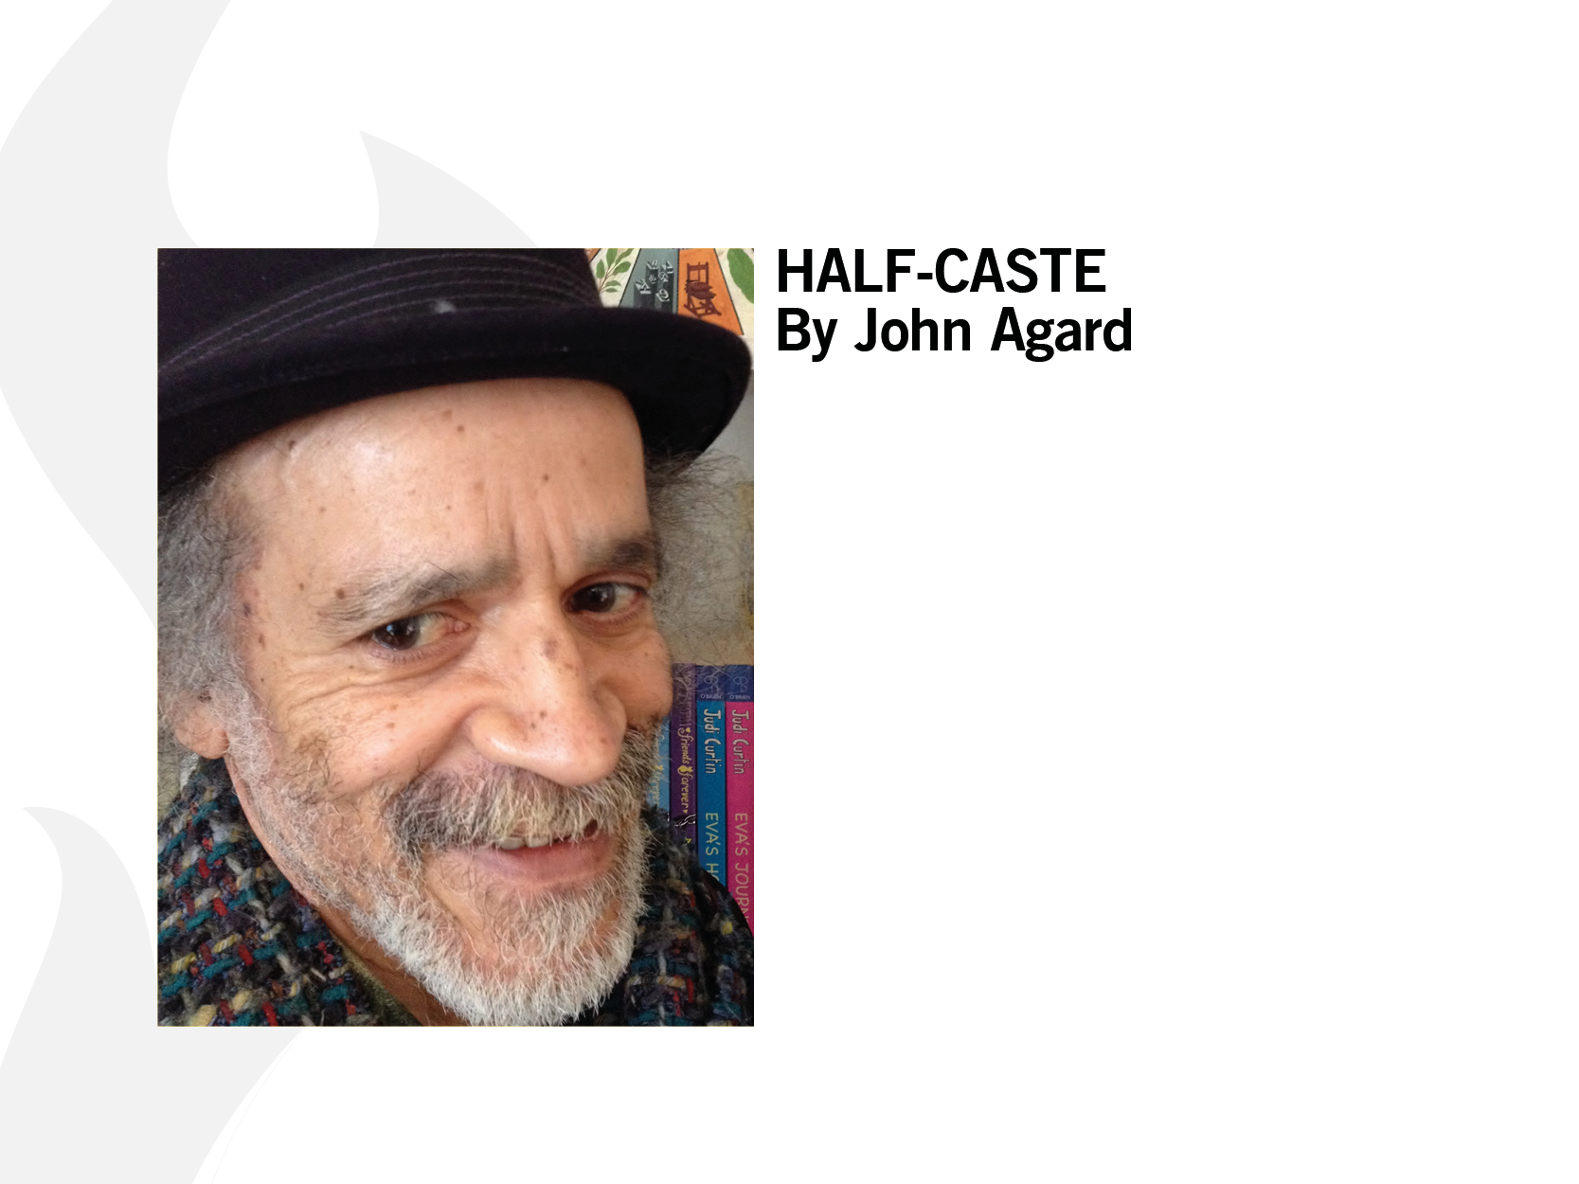
Notes:
The Guardian podcast that this audio is taken from is available here: https://www.theguardian.com/childrens-books-site/audio/2014/oct/13/john-agard-poetry-podcast-half-caste-diversity-race

