Slide 2
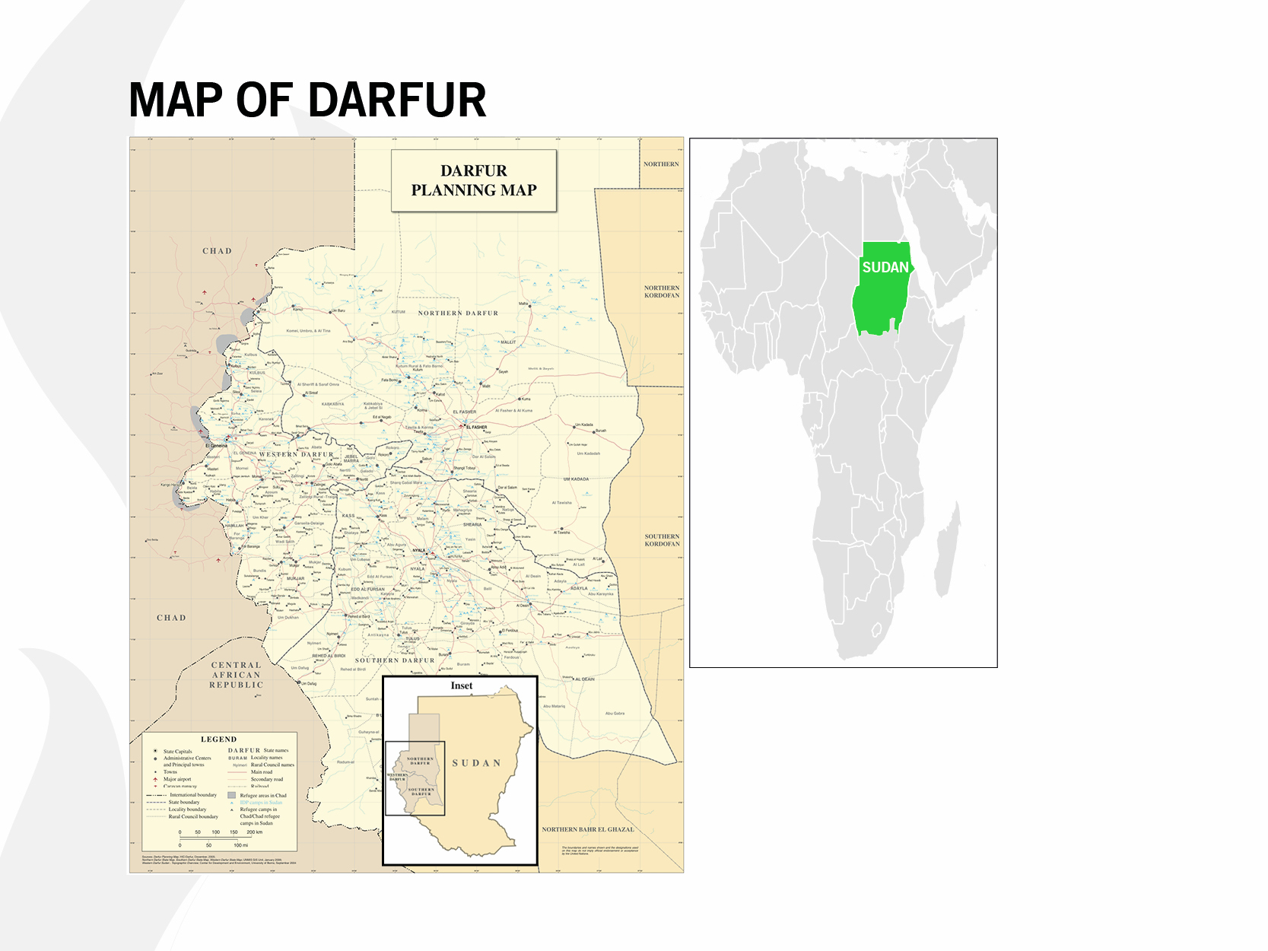

Slide 3
Notes:
Video also available here: https://www.ted.com/talks/emtithal_mahmoud_a_young_poet_tells_the_story_of_Darfur

