Slide 1


Slide 2
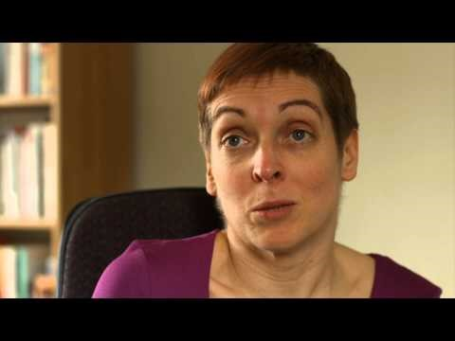


Source: Equally Ours
Notes:
Video also available on YouTube here: https://www.youtube.com/watch?v=dyH9TRQiijw

Slide 3


Slide 4


