Slide 2
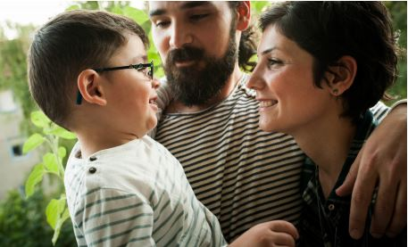
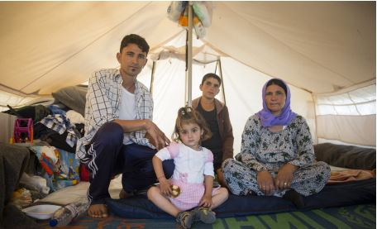
TRAINING OBJECTIVES
Understand the I Welcome global campaign and AIUK campaign priorities
Understand the issues surrounding the refugee crisis and be able to effectively communicate these to others
Gain skills, awareness and confidence to campaign on refugee issues
Explore local movement building ideas involved in Amnesty’s campaign.
Notes:
Training Objectives.
These are the objectives of the Trainer programme around Amnesty’s work on Refugees and the I Welcome campaign. It is likely a session or workshop would only focus on one or two of these goals.
Understand the I Welcome global campaign and AIUK campaign priorities
The participants will understand the objectives of the Amnesty I welcome campaign and some of the goals that feed into these. They will also understand the areas Amnesty does not work on (aid work etc).
Understand the issues surrounding the refugee crisis and be able to effectively communicate these to others
The participants will understand the key facts around the refugee crisis and Amnesty’s response. The refugee crisis specifically is covered in more depth in the presentation “I Welcome Refugees Training Presentation and Facilitation Notes”
Gain skills, awareness and confidence to campaign on refugee issues
The participants will understand Amnesty’s objectives and goals in a way that enables them to continue to research, explore or campaign on the issues independently or with a group.
Explore local movement building ideas involved in Amnesty’s campaign.
The participants will understand Amnesty’s movement building goals and how they can support them.
Activity - Refugees in numbers
Write the number 20 on the board. During activities or other breaks in the presentation change the number by 20x the number of minutes since the session started. Don’t draw any attention to this!
At the end of the session write the final number on the board and ask the participants what it means.
Explain that since we started this session 20 people per minute have been forced to flee their homes and are now displaced and as a result the final number shows how many people have been displaced in the time we have spent in this session.

Slide 3
The refugee crisis in numbers
UNHCR Global Report 2016
Notes:
The current refugee crisis in context
It is helpful to frame the current crisis, the scale of the issues faced and how this compares historically. Definitions for a number of the terms are included in another sheet.
These numbers are taken from UNHCR’S end of 2016 report.
Refugees and the developing world
In 2003, if we left out the Palestinian refugees and we looked just at the refugees that the UNHCR is responsible for, there were roughly about 10 million refugees in the world. The proportion of them hosted by the developing world was 70%. In 2017, the proportion hosted by the developing world was 84% while the total number of refugees had reached 17.2 million. Developing nations take on a disproportionate amount of the burden of hosting refugees.
The UNHCR assesses people for those in urgent need of being resettled. This can mean that their experiences, their family situation, their age, their physical or mental health, are so unsuitable for them that they are in urgent need of resettlement. During 2016, the total number of refugees admitted for resettlement stood at 189,300, according to government statistics. This is a 77 per cent increase from the 107,100 reported in 2015.

Slide 4
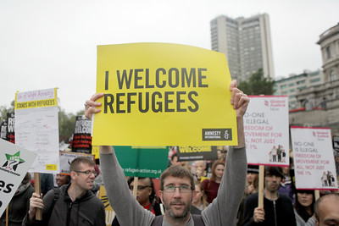
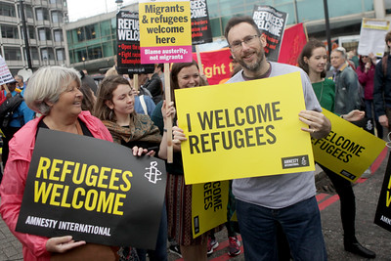
CAMPAIGN OVERVIEW
Refugees are protected,
welcomed and enjoy their
human rights, including
through strengthened
global responsibility-sharing
and international cooperation
Notes:
Campaign overview
The aim of the global campaign is that: Refugees are protected and enjoy their human rights through strengthened global responsibility-sharing and international cooperation.
Context
The UK context is particularly challenging right now, with strongly negative impressions of migrants and refugees. We are constantly facing the prospect of a more regressive asylum strategy, with a government obsessed with numbers and reducing the numbers of people coming to the UK.
But the need for this campaign now, and for us all to get behind it, couldn’t be clearer.
Approach
We want to think long term about the change we want to see in this country. A change of attitudes. A change in behaviour. The vision for us is the UK the best country in the world to be a refugee, an asylum seeker, or a migrant.
We can do this by breaking it down into component parts:
Tackling xenophobia, racism and hate crime.
Creating a more welcoming culture in communities
Running a high profile campaign, which is positive towards refugees
And we know that we can’t achieve this by ourselves. Have a top down national and international campaign yes – these are some of our strengths, but also work better in communities and partner with others to help strengthen our collective work to support and protect refugee rights. But we also know that together we are powerful. Together we can achieve great things.
Amnesty International is a campaigning organisation, not a government or aid agency, so we are unable to advise you on how to donate clothes and other items to refugees. Our mandate is to undertake research and to campaign/raise awareness to ensure that governments throughout the world do not forcibly return individuals to countries where they can reasonably be expected to experience a human rights abuse which Amnesty International actively opposes in its work.

Slide 5
CAMPAIGN OVERVIEW
Welcome strand
Positive experiences of and toward refugees nationally and in communities
2. movement building strand
A strong and sustainable movement of people and organisations working together for refugee rights
3. political change strand
The UK Government respects refugee rights through an improved asylum system and increases its share of responsibility for hosting refugees
4. responding to global events strand
AIUK contributes to ensuring that refugees’ rights are respected internationally
Notes:
Aims of the campaign
For AIUK, we have identified four long term outcomes, with each having a strand of work contributing to them. Below we have outlined some of Amnesty’s objectives and how we are planning to meet them. Depending on time or the interest of the group you may focus on a specific strand.
Outcome 1: Positive experience of and toward refugees nationally and in communities
Outcome 2: There is a wider, stronger and more sustainable movement of people and organisations working for refugee rights
Outcome 3: The UK Government respects refugee rights through an improved asylum system and increases its share of responsibility for hosting refugees
Outcome 4: AIUK contributes to ensuring that refugees’ rights are respected internationally
Activity
Materials:
Paper, pens
Organize the participants into 4 groups (if the groups are too large, more than 4 groups is fine with each strand being discussed by more than 1 group)
Give each group a strand and ask them to discuss:
What do they think the goals for the strands are, what do we hope to achieve?
How can this be achieved by Amnesty and its supporters?
What obstacles need to be overcome?

Slide 6
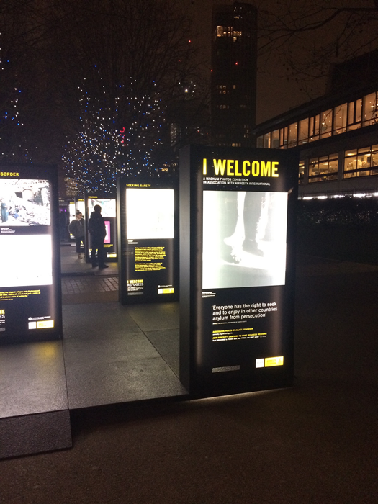
Welcome strand
Positive experiences of and toward refugees nationally and in communities
Create a more welcoming environment nationally and in communities for refugees and people seeking asylum.
Celebrating and adding to these acts of welcome.
Notes:
Communities Strand
Outcome 1: Positive experience of and toward refugees nationally and in communities
What we’re doing
We want to create a more welcoming environment national and in communities for refugees and people seeking asylum. It feels particularly egregious that people who have dropped everything and fled for their safety can be faced with hostility from the government, the media and on the streets. But we also know that across the country there are thousands of people doing amazing things to support refugees right now. We’re celebrating and adding to these acts of welcome.
Examples include:
Football Welcomes (See next slide)
Magnum photo exhibition

Slide 7
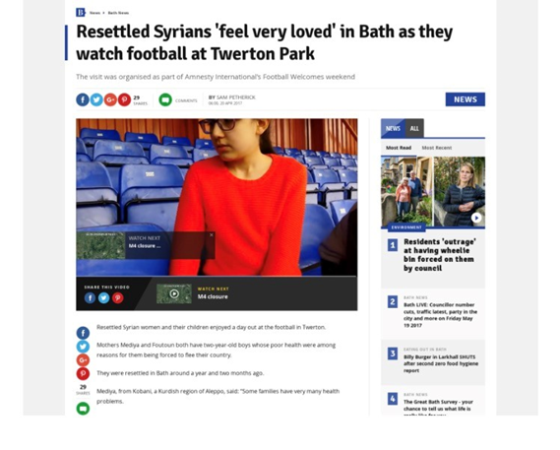
Welcome strand
FOOTBALL WELCOMES
Football clubs across the country celebrate the contribution of refugees to football
Free tickets to refugees, putting on stadium tours or doing outreach projects into the community
Thirty clubs took part
Notes:
Football Welcomes
For example, in April 2017 we encouraged football clubs across the country to celebrate the contribution of refugees to football and in doing so expressing welcome to refugees in their communities.
Clubs took part in a range of ways:
Giving away free tickets to refugees
Putting on stadium tours
Doing outreach projects into the community.
Thirty clubs took part, including eight Premier League teams and three refugee footballers playing in the Premier League. You could not get better advocates or messengers for this campaign to those audiences, than their favourite clubs and players.

Slide 8
2. movement building strand
A strong and sustainable movement of people and organisations working together for refugee rights
Sharing knowledge and effective practice to support refugees and host communities.
Campaigning with others to improve rights for refugees.
Building the capacity of other organisations.
Notes:
Movement building
Outcome 2: There is a wider, stronger and more sustainable movement of people and organisations working for refugee rights
What we’re doing
Examples include:
Partnering with a new initiative called Welcome Cinema to host monthly film screenings, where refuges and people seeking asylum attend for free and included in the event is a meal, where attendees can talk, integrate and feel welcome.
Hosting Solidarity with Refugees in our London office.

Slide 9
3. political change strand
The UK Government respects refugee rights through an improved asylum system and increases its share of responsibility for hosting refugees
UK government has expanded opportunities for more refugees to come to the UK through safe and legal routes
Extend family reunion to child refugees
Meet existing commitments and not reduce current standards
Notes:
Political Change
Outcome 3: The UK Government respects refugee rights through an improved asylum system and increases its share of responsibility for hosting refugees
What we’re doing
Our objective is that the UK has expanded opportunities for more refugees to come to the UK through safe and legal routes, including through extending family reunion to child refugees, but is also meet existing commitments and does not reduce current standards.
This includes:
Petitions
Letters and emails to politicians
Direct Amnesty advocacy/ relationship building with key MPs

Slide 10
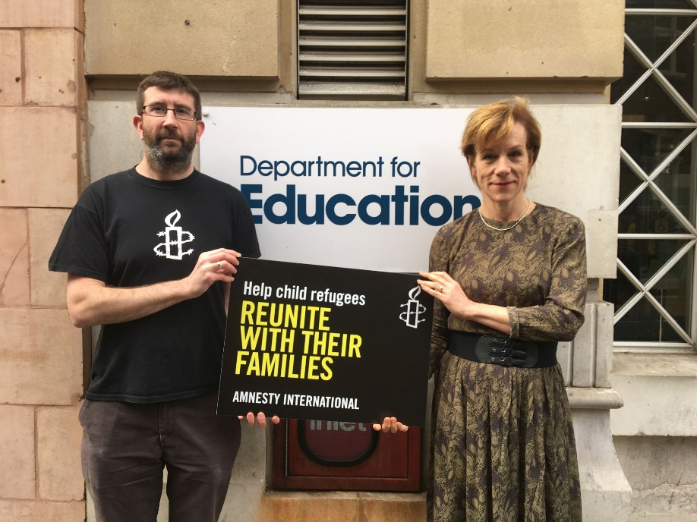
CHILD REUNIFICATION
3. political change strand
The right to maintain family unity is a vital right for children and for refugees.
In 2015 and 2016 the Home Office refused around 40 percent of refugee family reunion cases.
Notes:
Political Change: Child Reunification
Why are we focusing on this issue?
The right to maintain family unity is a vital right for children and for refugees. It is an appalling denial of their rights that separated child refugees are not permitted the opportunity for this in the UK. Family reunion is also a vital means by which refugees (including the parents and siblings of children here) should be able to safely reach safety. Denying this to these children’s parents either risks permanently separating child and her or his immediate family or encouraging those family members to attempt life-threatening journeys to be reunited.
The Numbers
In 2013 and 2014, the Home Office refused around 30 percent of refugee family reunion cases. In 2015 and 2016, this increased to closer to 40 percent. In 2016, that’s 3,678 people who were denied the possibility to live with their loved ones in safety.
Picture: We delivered a petition of 31k calling for change, helped by the Amnesty Ambassador Juliet Stevenson

Slide 11
3. political change strand
CHILD REUNIFICATION: NEXT STEPS
New minister for immigration: Brandon Lewis
Strategy for safeguarding unaccompanied minors delayed by election
Research to look at impact of policy on child refugees
Notes:
Political Change: Next steps
What we are asking for:
Amend the UK Immigration Rules by expanding the criteria for qualifying ‘family members’ for the purposes of refugee family reunion to include: young adults who were dependant on the family unit prior to flight, parents, siblings and in-laws and any dependent relative.
Allow an expanded group of extended family members, including adult siblings, aunts and uncles, and grandparents to sponsor child relatives to join them here under refugee family reunion policies, where it is deemed in the child’s best interests.
Allow children found to be in need of international protection in the UK to bring family members here under the refugee family reunion policy.
Reintroduce legal aid for refugee family reunion.
Next Steps
Since we handed in our petition to the Department for Education:
The joint Home Office /Dept for Education strategy in safeguarding unaccompanied minors, was delayed by election announcement. It's still coming, but we don't know a date yet.
There is a new minister for immigration (Brandon Lewis), which means starting afresh with relationship building with him.
The minister for children and vulnerable families (Edward Timpson) lost his seat in the election.
We are commissioning some joint research with Save the Children, in partnership with The Refugee Council and Young Roots, to look at strengthening are evidence base on the impact of the policy on child refugees (i.e. Their lived experience of not being able to be reunited with their families).

Slide 12
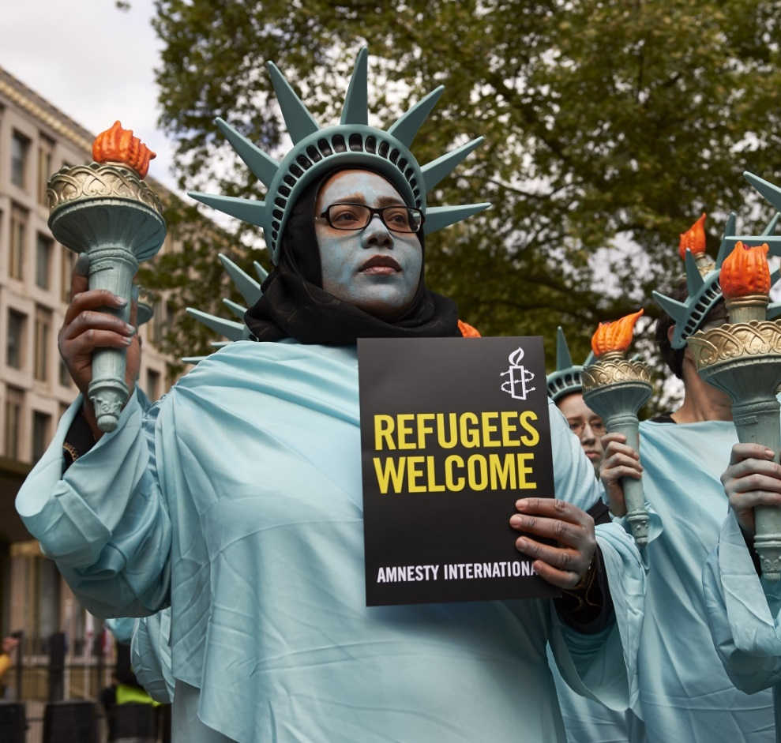
4. responding to global events strand
AIUK contributes to ensuring that refugees’ rights are respected internationally
Respond to current events and Amnesty global / regional wide calls to action
Examples:
USA Travel Ban
Freezing conditions in Greek refugee camps
Nauru
Notes:
Responding to global events
Outcome 4: AIUK contributes to ensuring that refugees’ rights are respected internationally
What we’re doing
Respond to current events and Amnesty global / regional wide calls to action –
USA Travel Ban – Protest outside of the US embassy on the 100th day of the Trump presidency. See picture.
Freezing conditions in Greek refugee camps
Nauru
Tom – Is there more detail of what Amnesty did on these examples? Just a line would be fine.

Slide 13
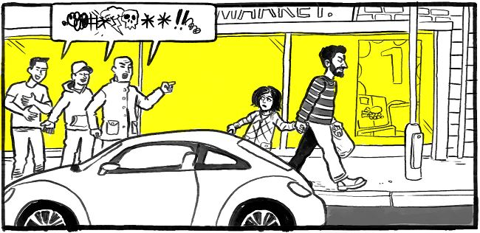
DIFFICULT QUESTIONS
Why can't they go to other Arab or African countries? Why do they have to come to the UK?
The NHS cannot handle more people. Won’t letting in more refugees break it?
How many is Amnesty suggesting we take? A million?
Notes:
Difficult Questions
This activity will not be appropriate for all groups, but for Amnesty supporters or campaigners it can give them the confidence to respond to difficult questions they may encounter.
Important – It’s worth reminding the group that it has been proven that “myth-busting” is not an effective campaigning tool as it makes people defensive and less likely to respond positively. Therefore these questions should only be used to build confidence in the workshop attendees.
Activity
Materials
Copies of “I Welcome Training FAQ”
In small groups, using the FAQ, try to formulate answers to some of the typical difficult questions above. 10 mins
Ask each group to share an answer to a question and ask the other groups to feedback and make suggestions 10 mins
Explain the Amnesty position on these questions, and reinforce the importance of being non-confrontational and objective.
Answers
Why can't they go to other Arab or African countries? Why do they have to come to the UK?
The overwhelming proportion of the world’s refugees are hosted by far poorer and less stable countries in the Near & Middle East and Africa. The refugee populations in Jordan and Lebanon (mostly Palestinian and Syrian) make up between a quarter and a third of these countries entire populations. Even countries in protracted conflicts or political crisis – Syria, Iraq, Yemen, South Sudan, Sudan, Democratic Republic of Congo, Afghanistan – host far more refugees (hundreds of thousands) from other conflicts and crises than do most European countries including the UK.
Very few of the world’s refugees even attempt to come to the UK. Last year, around 40,000 people sought asylum in the UK (around 3% of all asylum claims made in the European Union). Additionally, around 5,000 refugees (mostly Syrian) were resettled, most of whom came from refugees camps in the Syrian region (where their and their family’s prospects are extremely poor).
The NHS cannot handle more people. Won’t letting in more refugees break it?
You can think about this in various ways. Here’s two ways:
If these other countries – including countries with similar commitment to universal public health – can do so much more than the UK, can it really be the case that refugees who make up only a small number of the UK’s migrant population let alone its total population have any significant impact on the serious questions that confront our health services?
If the UK continues to bow out of sharing responsibility with countries elsewhere, more people fleeing from conflict and persecution will be compelled to travel further in the desperate search for somewhere safe and secure, while smugglers, traffickers and other abusers profit from the inevitably more disruptive and unmanaged migration this will entail.
How many is Amnesty suggesting we take? A million?
Amnesty has never fixed a number. Sharing responsibility isn’t about a fixed number. If conflict and persecution grows (as it has been), there will be more refugees in the world with greater responsibility for everyone; while if conflict and repression is reduced there will be less people in need of asylum.
We agree that assisting countries in the region of conflict to host the many refugees who want to stay closer to home is a vital element of any responsible response. But this can only work if the UK shows willing to share responsibility for hosting refugees with others.

Slide 14
Notes:
This video is from Amnesty’s online course on refugees. It can help to summarise and give people motivation to take action.
If the embedded video does not work the video can also be found here: https://www.youtube.com/watch?v=ZId4FlU4Sp0

Slide 15
NEXT STEPS
More Training – find out more about the refugee crisis
Take the Amnesty MOOC on refugees
Take Action! – on the Amnesty website, you can find the latest actions to support refugees
Notes:
Next Steps
This is an opportunity to discuss the training and for the group to plan what steps they might take next.
More Training – If appropriate you might like to remind the group that you’re able to come back and talk further on the refugee crisis.
Take the Amnesty MOOC (Massive Open Online Course) on refugees – This course online by Amnesty will cover some of the topics that have been explored in the training but possibly in more depth, it also offers voluntary opportunities to connect with other activists all over the world. This is the link if you want to show how to access it: https://www.amnesty.org/en/latest/education/2016/09/register-now-for-amnestys-free-online-course-on-refugee-rights/
Take Action! – There are a number of ways to take action to support refugees. They can explore the Amnesty UK website for calls to action, look at other organizations work such as the UNHCR and the Refugee Council, or take independent action. Information on the work of Amnesty around refugees will be here: https://www.amnesty.org.uk/issues/refugees-migrants-and-asylum

Slide 16
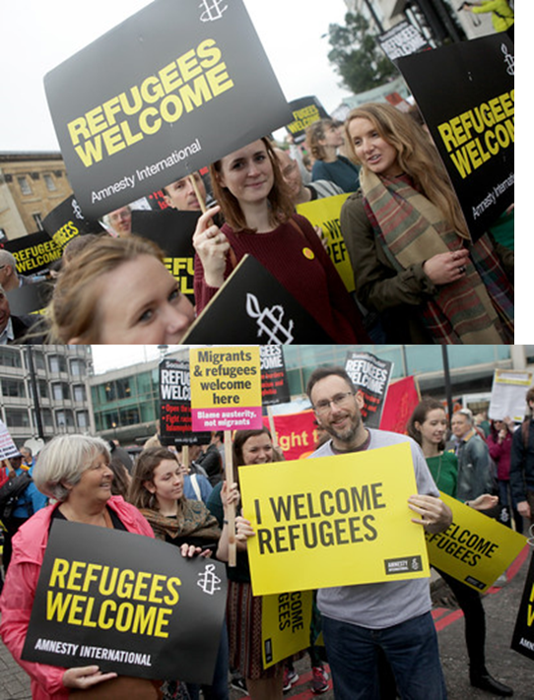
RESOURCES AND MATERIALS
We have lots of resources to support your campaigning:
Badges
Stickers
Placards
Contact:
sct@amnesty.org.uk
020 7033 1500
Notes:
Resources and Materials
In the next activity the groups will be planning what actions they would like to take to support the campaign, either individually or as a group. This is a good chance to remind them that Amnesty has a range of resources and materials that we can supply including badges, stickers and placards.

Slide 17
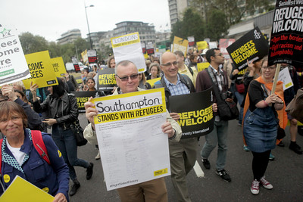
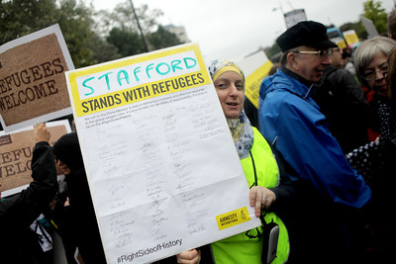
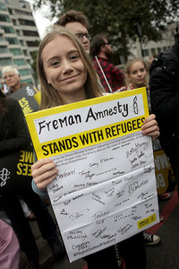
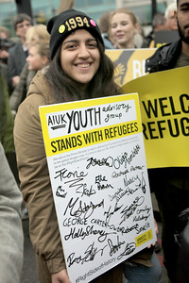
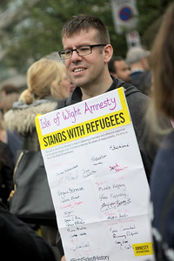
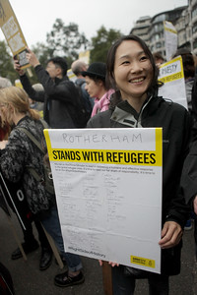
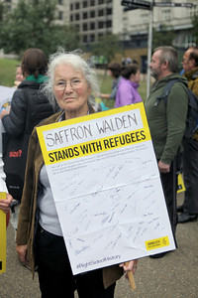
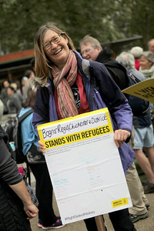
Educate – inspire – take action
Notes:
Activity – Discuss in small groups possible actions that they can take forward to support Amnesty’s campaign or the refugee crisis in general. Write down short ideas on post its and stick them on an “Action Wall” and ask the different groups to come up and explore other group’s suggestions.
If they are a local group they may want to decide one or two actions to take forward as a group.

