Slide 1
Notes:
I Welcome Refugees Training Presentation and Facilitation Notes
Content Warning
While the content of this presentation and supporting materials should be suitable for all audiences, it is important to be aware that participants may be either directly or indirectly affected by the issues discussed. If any of the participants share their personal stories with the group or asks to leave for all or part of the presentation this should be treated with sensitivity and respect.

Slide 2
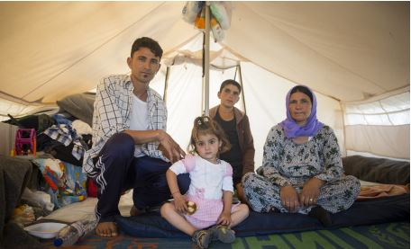
TRAINING OBJECTIVES
Understand the I Welcome global campaign and AIUK campaign priorities
Understand the issues surrounding the refugee crisis and be able to effectively communicate these to others
Gain skills, awareness and confidence to campaign on refugee issues
Explore local movement building ideas involved in Amnesty’s campaign
Notes:
Slide 1: Training Objectives.
These are the objectives of the Trainer programme around Amnesty’s work on Refugees and the I Welcome campaign. It is likely a session or workshop would only focus on one or two of these goals.
Understand the I Welcome global campaign and AIUK campaign priorities. This objective is not covered in this PowerPoint, please see the “I Welcome Campaign Training Presentation” which explores Amnesty’s work on Refugees and Migrants.
Understand the issues surrounding the refugee crisis and be able to effectively communicate these to others. The participants will understand the key facts, figures and definitions related to the refugee crisis and migrant issues so that they can feel more confident discussing the topic with other people.
Gain skills, awareness and confidence to campaign on refugee issues. While the refugee crisis is a vast and complex issue, the objective of this initial training is to help the participants to reach a level of understanding that enables them to continue to research, explore or campaign on the issues independently or with a group.
Explore local movement building ideas involved in Amnesty’s campaign. This objective is not covered in this PowerPoint, please see the “I Welcome Campaign Training Presentation” which explores Amnesty’s work on Refugees and Migrants.
Activity - Refugees in numbers
Write the number 20 on the board. During activities or other breaks in the presentation change the number by 20 x the number of minutes since the session started. Don’t draw any attention to this!
At the end of the session write the final number on the board and ask the participants what it means.
Explain that since we started this session 20 people per minute have been forced to flee their homes and are now displaced and as a result the final number shows how many people have been displaced in the time we have spent in this session.

Slide 3
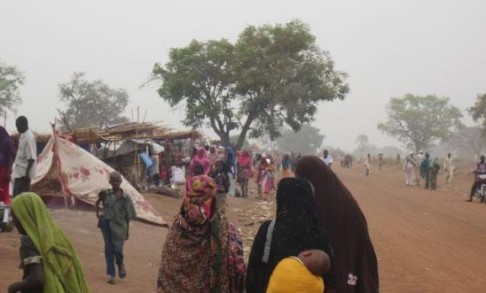
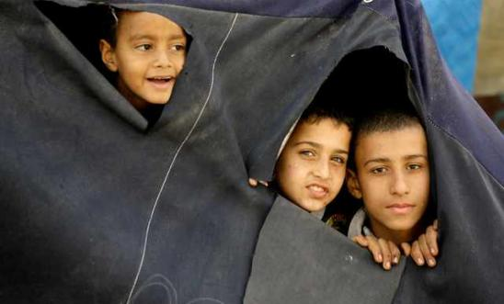
Ice breaker Fleeing from and fleeing to
Where do you think most refugees are fleeing from?
What countries do you think they are fleeing to?
Notes:
Slide 2: Icebreaker
This can be a useful activity to explore participants’ preconceptions of the refugee crisis. Flag with the participants that the statistics are based on the last complete information provided by UNHCR (United Nations High Commissioner for Refugees) in its 2016 report. This is the most recent data available.
Resources - Map, flip charts and pens
5 mins – In small groups discuss which five countries they believe the largest number of refugees are fleeing from? Which five countries are hosting the largest number of refugees?
This can be done with maps or without - without is harder.
5 mins – If time allows, collate answers from different groups and explore where there is overlap.
10 mins – Answers are on the following slides, is this what people expected? Where are the vast majority of refugees going? (to their neighbouring countries).

Slide 4
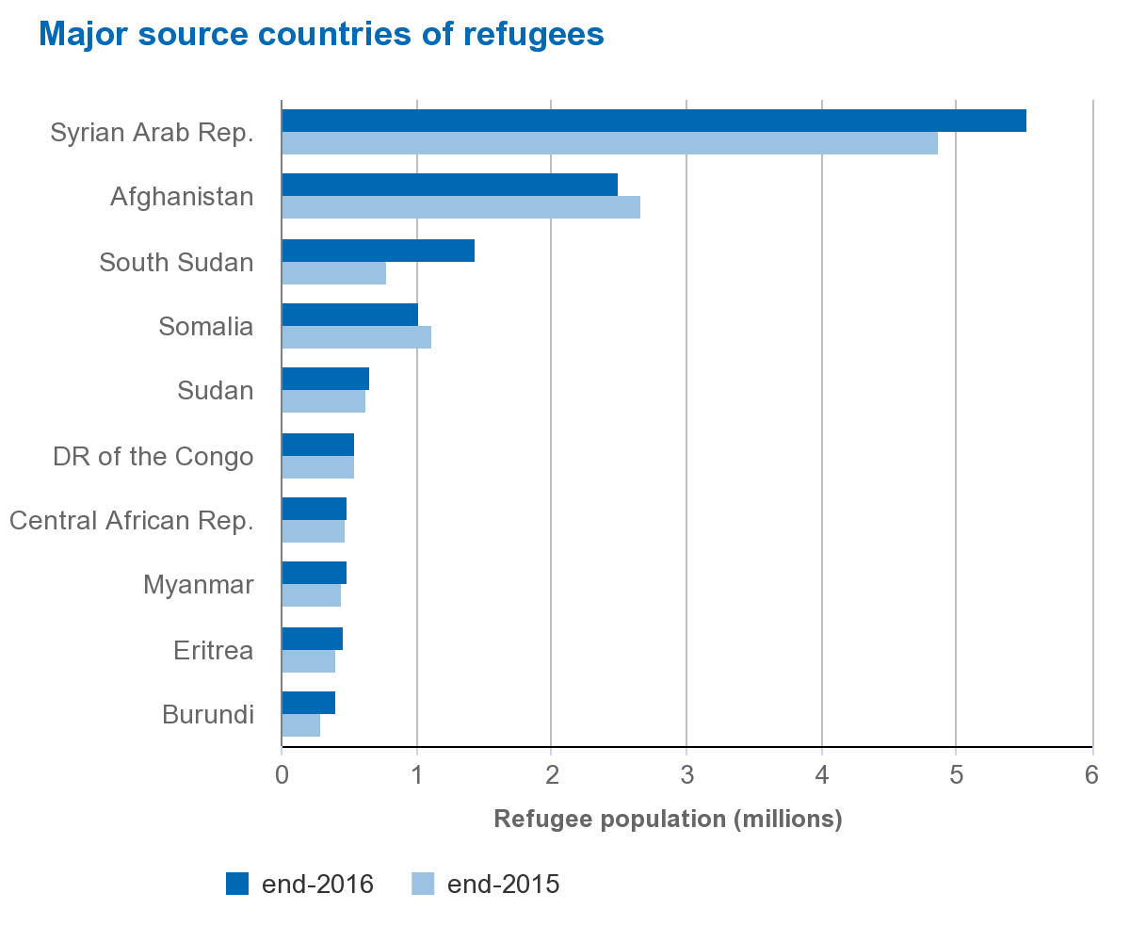
Source Countries
Source: UNHCR Global Trends Report 2016
Notes:
Slide 3: Source Countries
These are the main source countries of refugees in 2016.
Question - If this is a small group, you might want to ask which major group of refugees is missing? (Larger groups you may just want to point it out)
Answer – Palestinians
This is because Palestinian refugees do not fall within the remit of UNHCR (the UN refugee agency) and so are generally not recorded in their statistics. If they were included there would be nearly as many as the number of Syrian refugees (5.3 million Palestinian refugees, 5.5 million Syrian refugees).
Background on Palestinian refugees
When the Refugee Convention was being negotiated, Palestinians and their leaders argued that they wanted to be excluded and did not want to be in the UN Refugee Convention. They feared that if they signed up to the idea that the Convention was going to protect their displaced people, that this would create the idea that they could never go home. They thought it would be politically better to keep out of this agreement and to keep their attention on returning to their homes.
How Palestinian refugees factor into the Syrian crisis.
5.3 million Palestinians refugees are located in Syria, Jordan, Lebanon, West bank and Gaza Strip. Jordan alone is host to more than 2 million of these people. Before the conflict Syria was host to over 500,000 people. Many of them have been further displaced by that conflict.

Slide 5
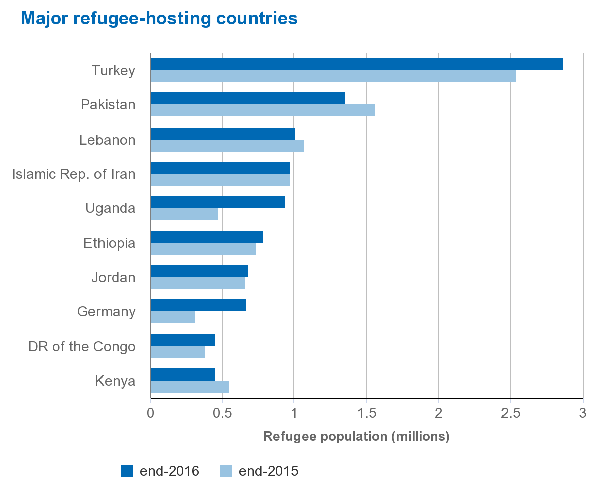
Host Countries
Source: UNHCR Global Trends Report 2016
Notes:
Slide 4: Host Countries
These are the main hosts of refugees in 2016.
Question – What do these countries have in common? Ask the teams for their answers.
Answer – 84% of refugees are hosted in developing regions, and only comparatively small numbers of refugees are hosted in the wealthiest nations including Europe, USA, Canada, Australia, New Zealand, and Japan. The only European county on this chart is Germany, who was not included in 2015. Despite popular belief, the number of refugees in Europe is very small compared to the number of refugees worldwide. The Europe situation is further clarified in a later slide.
Question – Where are most refugees seeking asylum?
Answer – Overwhelmingly (89%) to neighbouring countries, which in some cases have refugee crises of their own (Sudan and South Sudan). 11% of all refugees are hosted in countries in Europe, North America, Australia, etc. - demonstrating that the narrative that most refugees end up in wealthy nations is simply untrue.

Slide 6
The refugee crisis in numbers
UNHCR Global Report 2016
Notes:
The current refugee crisis in context
It is helpful to frame the current crisis, the scale of the issues faced and how this compares historically. If the sources and hosts activity have been completed before this they will have some sense of the numbers involved so you won’t need to dwell on the numbers in this slide. Definitions for a number of the terms are included later.
These numbers are taken from UNHCR’S end of 2016 report.
Refugees and the developing world
In 2003, if we left out the Palestinian refugees and we looked just at the refugees that the UNHCR is responsible for, there were roughly about 10 million refugees in the world. The proportion of them hosted by the developing world was 70%. In 2017, the proportion hosted by the developing world was 84% while the total number of refugees had reached 17.2 million. Developing nations take on a disproportionate amount of responsibility for hosting refugees.
The UNHCR assesses people for those in urgent need of being resettled. This can mean that their experiences, their family situation, their age, their physical or mental health, are so unsuitable for them that they are in urgent need of resettlement. During 2016, the total number of refugees admitted for resettlement stood at 189,300, according to government statistics. This is a 77 per cent increase from the 107,100 reported in 2015.

Slide 7
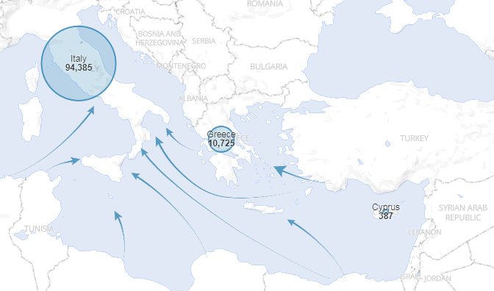
refugee crisis: The Mediterranean
Arrivals: January-July 2017
Source: UNHCR 2017
Notes:
The Mediterranean
The Mediterranean is only one route that refugees and asylum-seekers use to try and reach Europe. Since the start of the Syrian crisis, hundreds of thousands of refugees and asylum-seekers have tried to reach the EU using a range of other routes, including overland via Turkey into Bulgaria and via Turkey across the Aegean Sea to Greece.
Eastern Mediterranean Route
The Eastern Mediterranean Route refers to the routes refugees take through Turkey to Europe. In 2015, some 850,000 people, refugees fleeing conflict or persecution, made the dangerous crossing from Turkey to Greece. Greece’s already weak reception system failed – hundreds of thousands of refugees and asylum-seekers left the country and marched on through the Balkans, most of them aiming to reach Germany.
By the end of 2016 these numbers had dropped significantly to around 171,785 people due to a heavy policing effort by Turkey, during the period of January-July 2017 this had dropped further to around 10,725 people. This increased policing effort by Turkey is part of the new agreement with the EU to limit the number of refugees using this route to enter Europe. This is covered in more detail in the slide “Law in the EU”.
Central Mediterranean Route
The Central Mediterranean Route refers to the routes refugees take to Italy, usually from North African countries, particularly Libya.
In 2015 153,846 people used this route to flee conflict and persecution. With the stronger policing of the Turkish coast the numbers using crossing the central Mediterranean increased to 181,436 in 2016, and 94,385 in January to July 2017. This route carries more risk for refugees trying to cross, with 4,578 people dead or missing in 2017.
EU Capacity
In 2016, 1,204,300 first time asylum seekers applied for international protection in the Member States of the European Union. The population of the EU is just over 510 million. The population of Lebanon was approximately 6 million in 2016 yet the country currently hosts 1.1 million refugees (excluding its more than 400,000 Palestinian refugee population).
Source: UNHCR, Eurostat

Slide 8
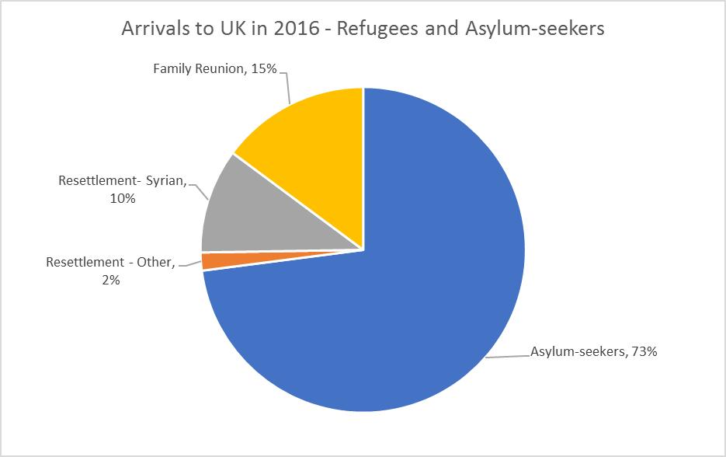
refugee crisis: Uk
Notes:
The UK’s response to the refugee crisis
It is important to note that these statistics are based on Home Office figures and only includes the primary claimant, not family dependents.
Asylum
In 2016, 30,603 people sought asylum in the UK (excluding dependents – i.e. partners and children who did not claim individually but registered themselves as dependent on their partner’s or parent’s claim). This compared to 32,733 in 2015. Around a third of all asylum claims decided by the Home Office resulted in leave to remain being granted, and in the great majority of these cases (8,407), the person was recognized to be a refugee. A further more than 5,000 people won their appeal against the Home Office initial decision to refuse asylum.
This UK received the 6th largest number of people seeking asylum in the EU in 2016, but this placed it only 14th in per capita terms.
Resettlement
On 7 September 2015 the UK government agreed to resettle 20,000 Syrian refugees in the UK by 2020. In 2016, the UK received 4,369 people under the scheme. By the end of 2016 the UK had received 5,706 people under the scheme in total since the scheme began.
It receives around 750 people per year under other schemes from different crises.
Yearly the number of refugees who are resettled in countries such as the UK, USA, Canada etc are in the tens of thousands, far from the numbers of people that are in urgent need.
Family Reunion
In 2016 the UK granted 6,224 visas in the Family: other category, the vast majority of which relate to family reunion. Of the 6,224 grants, the highest number came from Syrian nationals (2,005) seeking to join those with refugee status or humanitarian protection in the UK.
(Source: Home Office, UK - https://www.gov.uk/government/publications/immigration-statistics-october-to-december-2016/asylum#international-comparisons)

Slide 9
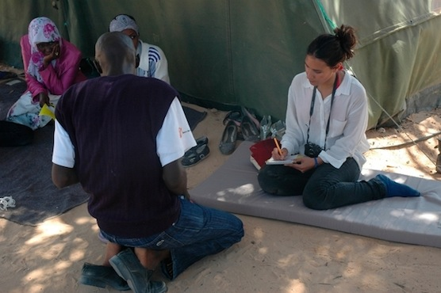
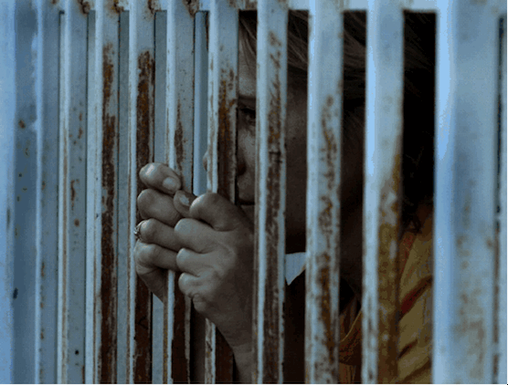
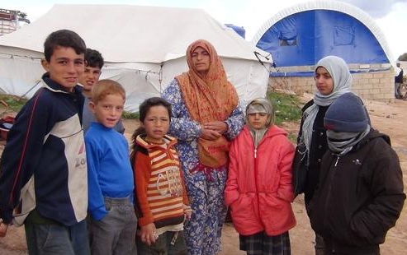
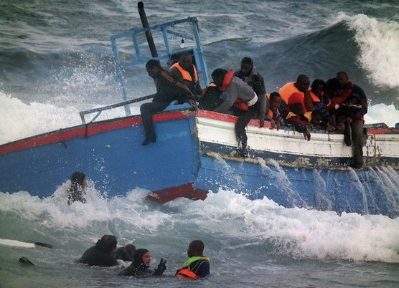
Activity
Defining People on the Move
Notes:
Activity - Defining Terms. Card sorting activity on key terms relating to migration and refugees.
Resources*
The cards in the activity ‘5. I Welcome Training Activity - Defining People on the Move’. If you have a large group you may want to have more than one set of cards
5 mins – In a group or groups ask the participants to match the term with it’s definition.
10 mins – Take feedback from groups and give answers. During answers emphasise that these terms are not mutually exclusive.
Alternative: Ask everyone to stand up and give everyone a card. They should move around and find the person who has the term or definition that matches their card
These terms are given in the cards and the following slides:
Refugee
Asylum Seeker
IDP
Migrant
Non-refoulment
Resettlement
These are not given definitions but might be raised by one of the participants:
From UNHCR:
Returned refugees are former refugees who have returned to their country of origin spontaneously or in an organised fashion but are yet to be fully integrated. Such return would normally only take place in conditions of safety and dignity.
Returned IDPs refer to those IDPs who were beneficiaries of UNHCR's protection and assistance activities and who returned to their areas of origin or habitual residence during the year.
Stateless persons are defined under international law as persons who are not considered as nationals by any State under the operation of its law. In other words, they do not possess the nationality of any State. UNHCR statistics refer to persons who fall under the agency’s statelessness mandate because they are stateless according to this international definition, but data from some countries may also include persons with undetermined nationality.
Others of concern refers to individuals who do not necessarily fall directly into any of the groups above, but to whom UNHCR extends its protection and/or assistance services, based on humanitarian or other special grounds.

Slide 10
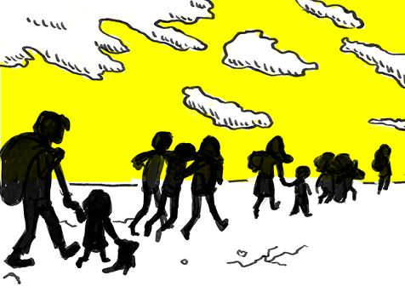
Refugee
A Refugee is somebody who:
Fears being persecuted;
Left their country;
Unable to safely return to their country.
Geneva Convention (1951 UN Convention relating to the Status of Refugees)
Notes:
Definition: Refugee
UNHCR definition: Refugees include individuals recognised under the 1951 Convention relating to the Status of Refugees; its 1967 Protocol; the 1969 OAU Convention Governing the Specific Aspects of Refugee Problems in Africa; those recognised in accordance with the UNHCR Statute; individuals granted complementary forms of protection; or those enjoying temporary protection. Since 2007, the refugee population also includes people in a refugee-like situation.
With refugees it’s important to clarify that people can be refugees whether they have requested asylum or not. If they have left their country due to a fear of being persecuted then they can be deemed a refugee.

Slide 11
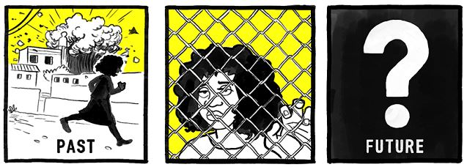
Asylum Seeker
An Asylum Seeker is somebody who:
Claims that they are a Refugee;
Wants to find safety somewhere else;
Has asked the Government of the country if they can stay.
Notes:
Definition: Asylum Seeker
UNHCR definition: Asylum-seekers are individuals who have sought international protection and whose claims for refugee status have not yet been determined, irrespective of when they may have been lodged.
Seeking asylum allows refugees to pursue protection by another state. They are seeking recognition as a refugee under relevant international and national laws. The government in question will seek to clarify if the individual is a genuine refugee and in need of protection, however even if asylum is denied this does not necessarily mean the individuals are not refugees - it can be due to lack of evidence etc.

Slide 12
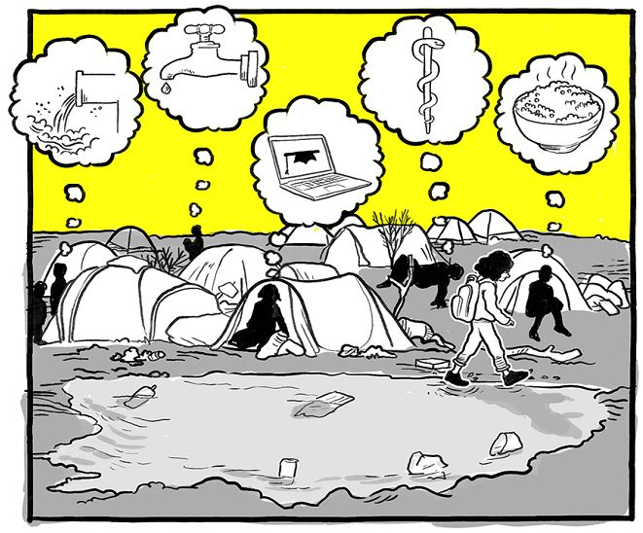
Internally Displaced Person (IDP)
An Internally Displaced Person is somebody who:
Has fled their home, e.g. due to civil war;
Has not crossed international borders;
Their protection remains the responsibility of their government.
Notes:
Definition: Internally Displaced Person
UNHCR Definition: Internally displaced persons (IDPs) are people or groups of individuals who have been forced to leave their homes or places of habitual residence, in particular as a result of, or in order to avoid the effects of armed conflict, situations of generalised violence, violations of human rights, or natural or man-made disasters, and who have not crossed an international border. For the purposes of UNHCR's statistics, this population only includes conflict-generated IDPs to whom the Office extends protection and/or assistance. Since 2007, the IDP population also includes people in an IDP-like situation.
The main point of difference between refugees and IDPs is that IDPs have not left their country despite fears of persecution. This might be that they cannot leave or do no want to due to family etc.
A IDP cannot be defined as a refugee until they leave their country.

Slide 13
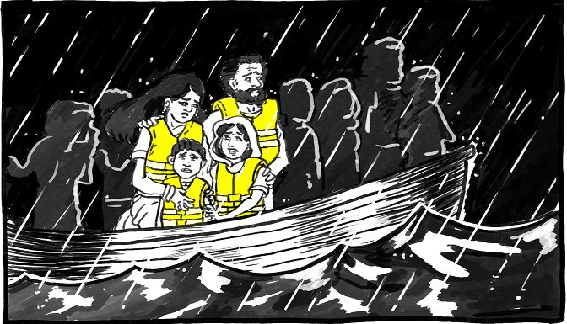
Migrant
A Migrant is somebody who:
Moves from one country to another, e.g. to find work
‘Regular’ migrant – with legal permission
‘Irregular’ migrant – without legal permission
Notes:
Definition: Migrant
A migrant is anyone who moves from their country to another, whatever the reasons. This can include ‘regular’ migrants who have legal permission, usually either a visa or as a European citizen within the EU, but it can also include ‘irregular’ migrants, which might include refugees who have entered the country without legal permission to gain asylum.
The term ‘illegal migrant’ should never be used. Judicially and ethically, an act can be legal or illegal but a person cannot. Moreover, entering a country in an irregular fashion, or staying with an irregular status, should not be considered a criminal activity but an infraction of administrative regulations. No human being can be illegal!
Refugee law recognises that refugees might have to move to countries without legal permission so as to escape persecution.

Slide 14
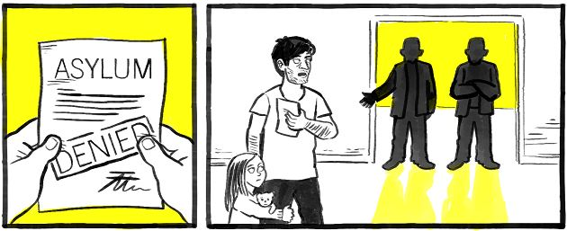
Non-refoulement
Non-refoulement means:
Not returning someone to a place where their life or liberty is threatened.
Notes:
Definition: Non-refoulment
The principle of non-refoulement is that no one should be returned to a place where they are at risk of persecution. It is a cornerstone of the protections for refugees in the Refugee Convention and will be explored in more detail later in this training.

Slide 15
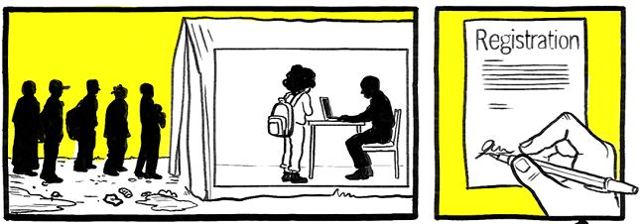
Resettlement
Resettlement is where someone:
is recognised as a refugee by UNHCR
is moved from one country to another, usually from a country in which the refugee is living in very difficult circumstances to a country with more resources.
Notes:
Definition: Resettlement
UNHCR runs resettlement programmes – identifying suitable candidates according to criteria and number given to UNHCR by those countries willing to receive refugees via this process.

Slide 16
REFUGEE Rights and international protections
Notes:
Refugees Rights and International Protection
This video is from Amnesty’s online course on refugees. It can help to summarise the complex international rights of refugees such as the 1951 Convention. It outlines what rights refugees have and how states should be expected to protect them.
If the embedded video does not work the video can also be found here: https://www.youtube.com/watch?v=Gx85kGQkeqQ
Depending on the group you might also like to provide some more in depth information provided in the following slides or refer them to the additional reading.

Slide 17
RIGHTS OF REFUGEES
1951 Convention | 1967 Protocol
Limited to people made refugees before 1951 | Not time limited.
Only concerned with refugees from Europe | Recognises that refugees can be from anywhere
Notes:
The 1951-Refugee Convention and the 1967 Protocol
The UN Refugee Convention was agreed after WW II in 1951. There were many people being displaced during this time, including almost 12 million German people being forcibly displaced, particularly from eastern Europe, and Palestinians, who were displaced after the 1948-conflict. There was an immediate need to think about how they were going to be protected.
The UN Refugee Convention is the first international agreement to outline the rights and protections for refugees. The Convention was limited to people who were made refugees before 1951, it didn’t assist anyone who was made a refugee after 1951, and it was only concerned with refugees from events in Europe.
In the Protocol, which came in 1967, States who signed the Convention agreed to drop those two stipulations and make the Convention a forward-looking document. There was no longer a cut-off date for when someone could have become a refugee and they could come from anywhere, not just Europe.

Slide 18
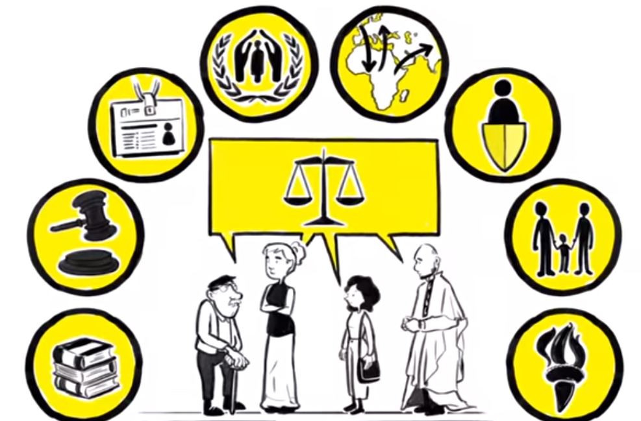
RIGHTS OF REFUGEES
Same rights as a citizen or national of that country.
A refugee cannot be penalized for how they arrive in the country.
International law recognizes that you might not get there immediately or by the most direct route.
Notes:
Rights laid out in the Convention / The Convention vs. International Law
The Convention sets out refugees’ access to work, access to education, rights to vote – rights that a national or citizen would expect. It outlines how and when the refugee should be entitled to those specific rights in the country where the refugee has found asylum.
A refugee must not be penalized for arriving ‘irregularly’ in the country where he/she is seeking asylum. The majority of refugees can’t get visas, can’t get permission to make the journeys they need to make – they are likely to come in breach of domestic immigration laws and they should not be penalized for that.
The Convention refers to making your claims as soon as possible and coming directly. In international law it is not the case that you are required to claim asylum in any particular country or in a neighbouring country, it is within your right to seek asylum where you wish to, where you can get to, where you think that would be sensible – which might well be because you might have a family somewhere else, because of a diaspora community somewhere else, you speak the language somewhere else, etc.

Slide 19
NON-REFOULEMENT
A refugee cannot be returned to a country where his/her life or freedom would be threatened on account of race, religion, nationality, membership of a particular social group or political opinion.
Notes:
Non-refoulement
The prohibition on refoulement is set out in Article 33(1) of the 1951 Convention in the following terms:
No Contracting State shall expel or return (‘refouler’) a refugee in any manner whatsoever to the frontier of territories where his life or freedom would be threatened on account of his race, religion, nationality, membership of a particular social group or political opinion.

Slide 20
LAW IN THE EU
Common asylum standard across the European Union
Responsibility largely determined from where someone first entered the EU
Notes:
Refugee Law in the EU
The European Union has a set of agreed rules about the protection that refugees should receive in the member states. Those rules agree a common asylum standard across the European Union so as to avoid the idea that some countries, rather than others, became the most favourite destinations for people seeking asylum. Though they are some way from this goal.
The Dublin Convention regulations
The Dublin Convention, or Dublin regulations, enshrined the idea that the member states would agree a system of determining amongst themselves which of them would be responsible for anyone seeking asylum in Europe and this is largely determined from where did someone first enter the European Union.
This conflicts with the principle that refugees are not required to claim in any particular country being under the Refugee Convention. A state who receives the claim of the asylum seeker, may, if agreed between those countries, request that the other country takes the person back if they have arrived there first. This has caused a huge amount of problems.
Turkey’s stand on the Convention
Turkey has not signed the Protocol
Does not officially recognise people from Syria as refugees
Turkey does not recognize the application of this Convention to people who are fleeing from Syria, or indeed anywhere else in the world, apart from Europe, because it hasn’t agreed in full to the 1967 Protocol. Turkey therefore does not follow the principle of non-refoulement, and may return a person to a place where their life is at risk. In 2013, Turkey introduced an asylum system – a system whereby at least Syrians could apply to be recognize as refugees and were granted most of the rights that they would get under the Convention.
Turkey as a processing agent
In order to break the business model of the smugglers and to offer migrants an alternative to putting their lives at risk, the EU and Turkey decided to end the irregular migration from Turkey to the EU. This included a number of provisions including:
All new irregular migrants crossing from Turkey into Greek islands as from 20 March 2016 will be returned to Turkey.
For every Syrian being returned to Turkey from Greek islands, another Syrian will be resettled from Turkey to the EU
Turkey will take any necessary measures to prevent new sea or land routes for illegal migration opening from Turkey to the EU
Source: EU Commission
The promise of a meaningful, safe and legal way out of Turkey largely remains unfulfilled.

Slide 21
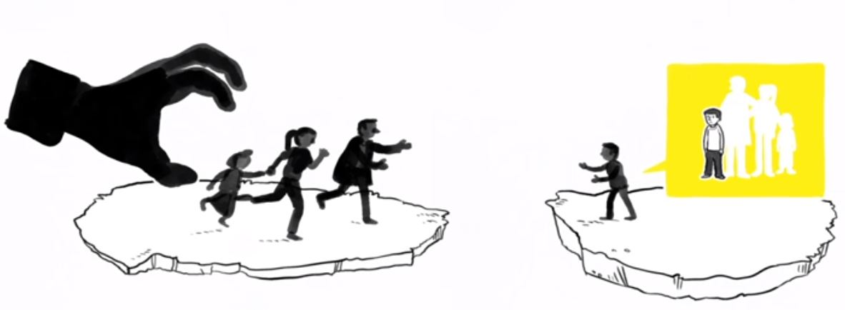
FAMILY REUNIFICATION
Right to reunification enshrined in treaties and EU law
Separation from family makes integration more difficult
In UK, unaccompanied children do not have this right
Notes:
Family Reunification
From UNHCR guidelines on Reunification Of Refugee Families (July 1983): “The circumstances in which refugees leave their country of origin frequently involve the separation of families. Such separation invariably leads to hardship and sometimes to tragic consequences. It may also create serious obstacles to a refugee's integration in a new homeland.”
EU
In international standards and in European Union law, key rights for refugees to family reunion are included. Family reunion offers an opportunity for a safe route by which some refugees can travel and get a visa. Reunification is an important aspect of the integration process – being separated from your family is a very powerful reason why many refugees find it difficult to settle into a new country.
UK
The UK allows family reunion from the moment they are recognized as a refugee. However unaccompanied children do not have the right to have their family join them. This is because the government believes that will deter them from coming in the first place. This failure to protect the rights of children is a focus of Amnesty’s campaign “I Welcome”.

Slide 22
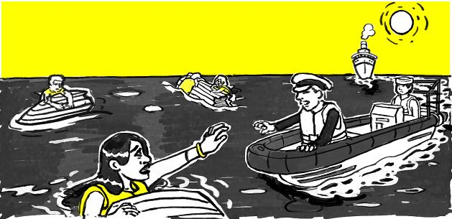
THE LAW OF THE SEAS
All ships are required to help those in distress immediately
Governments must establish search and rescue
Notes:
The law of the seas
The 1974 International Convention for the Safety of Life at Sea (SOLAS convention) and the 1982 UN Convention on the Law of the Sea (Unclos convention) provide that:
1. All shipmasters, State and merchant, are bound to render assistance;
2. The responsibilities of governments require, either individually or in co-operation with other States, to establish basic elements of a search and rescue service;
3. Any ships have to proceed instantly to the rescue of all persons in distress at sea without regard to circumstances in which they are found. No time may be wasted, even while the ship master is waiting for instructions.
4. Unless the rescue operation may endanger the lives of crew members or the ship itself, the fact that the cargo ship is not intended to carry a large crew is irrelevant. The top priority is to save lives.
EU-Turkey agreement concerning refugees
Since the EU agreement with Turkey, fewer refugees are crossing the Aegean to Greece. However, some still take the risk. Since Turkey has been patrolling it has become more difficult for the smugglers to operate on a large scale along that coastline, this means more refugees are taking the risk of travelling from North Africa to Italy, where 4,578 people lost their lives or went missing in 2016. See Law in the EU slide for more details of EU-Turkey agreement.

Slide 23
Notes:
This video is from Amnesty’s online course on refugees. It can help to summarise and give people motivation to take action.
If the embedded video does not work the video can also be found here: https://www.youtube.com/watch?v=ZId4FlU4Sp0

Slide 24
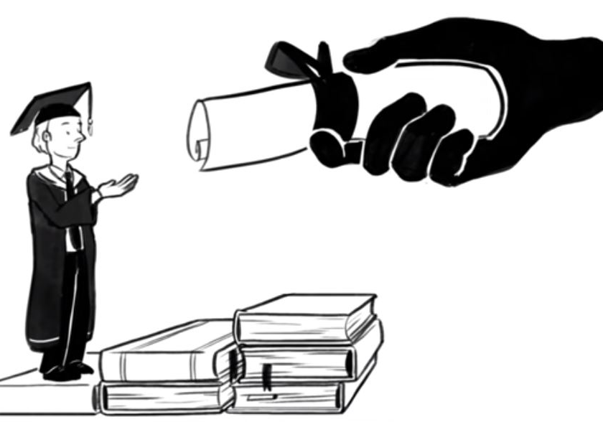
NEXT STEPS
More Training – find out more about the campaign and how to get involved
Take the Amnesty MOOC on refugees
Take Action! – on the Amnesty website, you can find the latest actions to support refugees
Notes:
Next Steps
This is an opportunity to discuss the training and for the group to plan what steps they might take next.
More Training – If appropriate you might like to remind the group that you’re able to come back and talk further on the refugee crisis and specifically on Amnesty’s campaign and how they can support it.
Take the Amnesty MOOC (Massive Open Online Course) on refugees – This course online by Amnesty will cover some of the topics that have been explored in the training but possibly in more depth, it also offers voluntary opportunities to connect with other activists all over the world. This is the link if you want to show how to access it: https://www.amnesty.org/en/latest/education/2016/09/register-now-for-amnestys-free-online-course-on-refugee-rights/
Take Action! – There are a number of ways to take action to support refugees. They can explore the Amnesty UK website for calls to action, look at other organizations work such as the UNHCR and the Refugee Council, or take independent action. Information on the work of Amnesty around refugees will be here: https://www.amnesty.org.uk/issues/refugees-migrants-and-asylum
Activity – Discuss in small groups possible actions that they can take forward to support Amnesty’s campaign or the refugee crisis in general. Write down short ideas on post its and stick them on an “Action Wall” and ask the different groups to come up and explore other group’s suggestions.
They may want to decide one or two actions to take forward as a group.

Slide 25
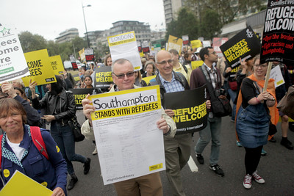
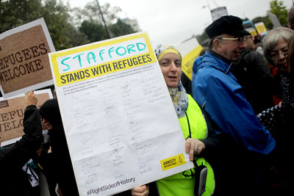
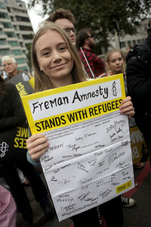
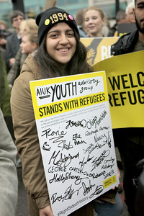
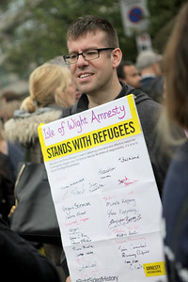
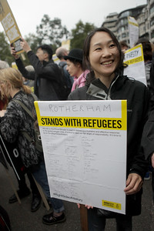
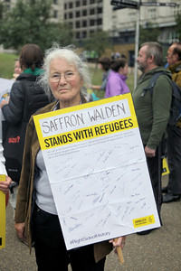
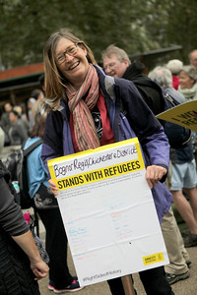
Educate – inspire – take action
Notes:
Reminder
This is your opportunity to present the final number from the refugees in numbers activity.

