Slide 1


Slide 2
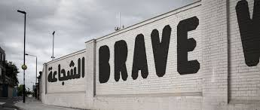
CONTENT WARNING
Notes:
Slide 1: Content Warning
This slide is an important part of setting the scene for this training. With the graphic nature of the abuse suffered by HRDs, which this training highlights, it is important to forewarn participants. Participants should be asked to speak to the trainer should they feel unable part take in all or some parts of the training.
1. Content warning for the following;
Sexual Assault
Rape
Torture
Intimidation and reprisals
Discrimination
Killings
Enforced disappearances
Stigmatisation
Smear campaigns
Trolling
You may include the following:
For activists; The nature of the work we do at Amnesty means that we often deal with issues which are upsetting or distressing. When working on HRD issues it is important to remember that many of the issues we address will have happened to people participating directly in our work. For example, in 2016 HRDs were threatened or attacked in 94 countries.
This means that whether you realise or not, you are likely to work with people who have had some direct experience of the issues we are discussing. Please remember this when participating in and facilitating discussions and take care in the type of language you use to ensure that others feel safe in spaces where we learn and campaign for human rights change.

Slide 3
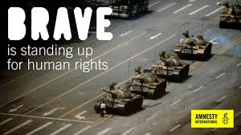
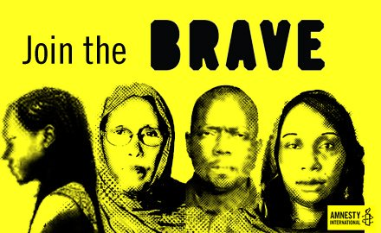
TRAINING OBJECTIVES
Understand the Brave global campaign and AIUK campaign priorities
Understand the issues surrounding Human Rights Defenders (HRDs) and be able to effectively communicate these to others
Gain skills, awareness and confidence to campaign on HRD issues
Explore ways to make HRD issues relevant to UK audiences and get more people involved in Amnesty’s Brave campaign
Notes:
Slide 2: Training Objectives.
These are the objectives of the Trainer Programme around Amnesty’s work on HRDs and the Brave campaign, which will run until the end of 2019. It is likely a session or workshop would only focus on one or two of these goals.
Understand the Brave global campaign and AIUK campaign priorities.
Understand the issues surrounding HRDs and be able to effectively communicate these to others. The participants will understand the key facts, figures and definitions related to the HRD campaign and the increasing risks HRDs take to champion human rights. This will help groups feel more confident discussing the topic with other people.
Gain skills, awareness and confidence to campaign on HRD issues. Whilst issues around HRDs can be complex, the objective of this initial training is to help the participants to reach a level of understanding that enables them to continue to research, explore or campaign on the issues independently or with a group.
Explore ways to make HRD issues relevant to UK audiences and get more people involved in Amnesty’s Brave campaign. Making this campaign relevant to the audiences we campaign to, will be essential in influencing change. This will be a chance to explore creative and innovative ways to campaign for HRDs.

Slide 4
WHO IS A HUMAN RIGHTS DEFENDER?
Notes:
Slide 3: Activity: Who is a human rights defender?
This activity is to gauge the understanding in the room. How do participants define HRDs? Is there definition close to the international legal framework definition? Why is it important to know what a HRD is, and what they are not?
Session objective: To personally reflect on what it means to be a HRD.
Length of session: 10 minutes
Resources: Post-it notes, marker pens, flip chart
In pairs or groups of three discuss how you would define what a HRD is? (3 minutes)
Write your definition on a post it note, ready to share with the wider group. (1 minute)
Each group share their definitions and discuss similarities and differences if there are any. (5 minutes)
Ask if anyone would like to share any personal reflections about this activity and whether this challenged them or opened their mind in any way? (1 minute)
Go into the next slide to find out the answer…

Slide 5

A HUMAN RIGHTS DEFENDER IS
a person who, individually or in association with others,
acts to defend, promote and protect human rights
at the local, national, regional or international levels.
Notes:
Slide 4: A Human Rights Defender is…
This slide will answer what a human rights defender is according to the international legal definition. We will explore the international legal framework which protects the rights of HRDs later on in this training.
You may say the following:
According to the international legal framework, a human rights defender is a person who, individually or in association with others, acts to defend, promote and protect human rights at the local, national, regional or international levels.
Human Rights Defenders are messengers or social change and crucial in upholding freedoms and human Rights for all. They are the ones holding political leaders, challenge racism, sexism and advocate for equality and justice for all.
Defenders come from all walks of life and can be journalists, lawyers, teachers, health professionals, trade unionists, whistle-blowers, or victims or relatives of victims of human rights violations and abuses. They can also be unpaid volunteers or activists - so yes our AIUK activists are HRD’s!
Human Rights Defenders are defined by what they do rather than who they are.
In addition, one of our key focuses will be working on and with Women Human Rights Defenders. WHRDs refers to both female HRDs (who may work on any human rights issue), or defenders, (who may not necessarily be women ), who work on women’s rights or on a range of gender-related issues.
How does this definition compare to your own definitions from the earlier activity?

Slide 6

WHO IS NOT AN HRD?
A person cannot claim to be an HRD if they;
Resort to or advocate violence,
Deny the universality of human rights or
Take action that undermines the rights of others.
Notes:
Slide 5: Who is not an HRD?
This slide outlines why some individuals and groups cannot be HRDs. This distinction is important as it may be the reason why organisations like Amnesty may not campaign on behalf of some individuals and groups.
Trainers may be interested in Amnesty’s history with Nelson Mandela’s case: https://www.amnesty.org.uk/nelson-mandela-and-amnesty-international. In 1962 Amnesty adopted Mandela as a prisoner of conscience, but later, as a global movement, took the decision to no longer consider Mandela a prisoner of conscience on the grounds of advocating violence. This core Amnesty principle for prisoners of conscience also prevails in our work with HRDs.
After his release, Nelson Mandela acknowledged that Amnesty made this decision in good faith and thanked Amnesty for working on behalf of thousands of other South African prisoners and detainees.
On being presented the Ambassador of Conscience Award in 2006, Mandela said
‘Like Amnesty International, I have been struggling for justice and human rights, for long years. I have retired from public life now. But as long as injustice and inequality persist in our world, none of us can truly rest. We must become stronger still.’
You may say the following:
It is important to understand why some individuals or groups are not deemed HRDs.
A person cannot claim to be an HRD if they;
Resort to or advocate violence,
Deny the universality of human rights or
Take action that undermines the rights of others.
This is an important distinction as it explains why Amnesty and other organisations may not campaign on behalf of certain individuals and groups.
You may be interested in Amnesty’s history with Nelson Mandela’s case. In 1962 Amnesty adopted Mandela as a prisoner of conscience, but later, as a global movement, took the decision to no longer consider Mandela a prisoner of conscience on the grounds of advocating violence. This core Amnesty principle for prisoners of conscience also prevails in our work with HRDs.
After his release, Nelson Mandela acknowledged that Amnesty made this decision in good faith and thanked Amnesty for working on behalf of thousands of other South African prisoners and detainees.
On being presented the Ambassador of Conscience Award in 2006, Mandela said
‘Like Amnesty International, I have been struggling for justice and human rights, for long years. I have retired from public life now. But as long as injustice and inequality persist in our world, none of us can truly rest. We must become stronger still.’

Slide 7
WHAT DO THEY DEFEND?
summary executions
discrimination
torture
arbitrary arrest and detention
women’s rights
female genital mutilation
employment issues
forced evictions
nationality
food and water
Any and all human rights concerns!
access to health care
adequate housing
life
toxic waste and its impact on the environment
the highest attainable standard of health
freedom of movement
refugees and IDPs
children’s rights
indigenous Rights
education
national, linguistic or sexual minorities
Notes:
Slide 6: What do they defend?
This slide gives the audience an idea of the vast area of human rights issues in which HRDs operate. It is safe to say that HRD’s and civil society organisations work across the full spectrum of human rights issues, making the work they do invaluable and vital to attaining a more just world. This is the message we must get across to audiences around the country, that HRDs defend us all and address any and all human rights concerns.
You may say the following:
As you can see, HRDs and civil society organisations operate and work on a vast area of human rights issues. It is safe to say that HRD’s and civil society organisations works across the full spectrum of human rights issues, making the work they do invaluable and vital to attaining a more just world.
Human rights defenders address any human rights concerns, which can be as varied as,
summary executions,
torture,
arbitrary arrest and detention,
female genital mutilation,
discrimination,
employment issues,
forced evictions,
access to health care,
and toxic waste and its impact on the environment.
3. Defenders are active in support of human rights as diverse as the rights
to life,
to food and water,
to the highest attainable standard of health,
to adequate housing,
to a name and a nationality,
to education,
to freedom of movement
and to non-discrimination.
4. They sometimes address the rights of categories of persons, including
women’s rights,
children’s rights,
the rights of indigenous persons,
the rights of refugees and internally displaced persons,
and the rights of national, linguistic or sexual minorities.
5. This is the message we must get across to audiences around the country, that HRDs defend us all and address any and all human rights concerns.

Slide 8
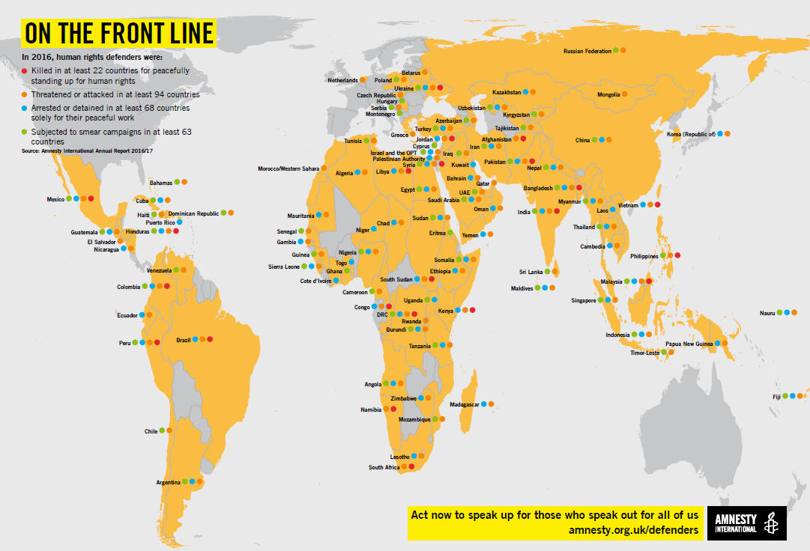
Countries where HRDs have been
killed, threatened, arrested or smeared
Notes:
Slide 7: On the Front Line
This slide shows the extent to which HRDs are at risk across the world.
Please refer to the “Human Rights Defenders Under Threat: A Shrinking Space for Civil Society” report for further information. Page references are given in the script below.
You may say the following
The space in which HRDs operate shows increased levels of risk, danger and harm, just for standing up for human rights. In 2016, HRDs in 63 countries faced smear campaigns designed to discredit, delegitimise and undermine the work they do. Typically, authorities and others in power make statements tarnishing their reputations. HRDs may be publicly (and falsely) accused of – among other things – being terrorists, defenders of criminals, unpatriotic, corrupt, “foreign agents”, “fifth column” spies, “enemies of the state” or of “picking quarrels and provoking trouble” and opposing national or moral values. (pg. 14)
In addition, Women HRDs (WHRDs) may be subjected to smear campaigns which portray them as sexually promiscuous as a means to ostracize them from their communities. (Pg. 35)
In 94 countries HRDs were threatened or attacked. This includes being threatened with death, rape, being beaten and harming family or those close to HRDs, in order to stop them from continuing with their human rights work.
HRDs were arrested or detained solely because of their peaceful work in 68 countries in 2016. This is known as persecution through prosecution. Authorities around the world are increasingly misusing criminal, civil and administrative laws to target and harass HRDs in order to delegitimise them and their causes and deter, limit or even prevent their human rights work. HRDs are frequently subjected to criminal proceedings on unfounded charges. Arbitrary detention and multiple other violations of the right to a fair trial are being employed as a way to interfere with their ability to defend and promote human rights. (pg. 11-14).

Slide 9
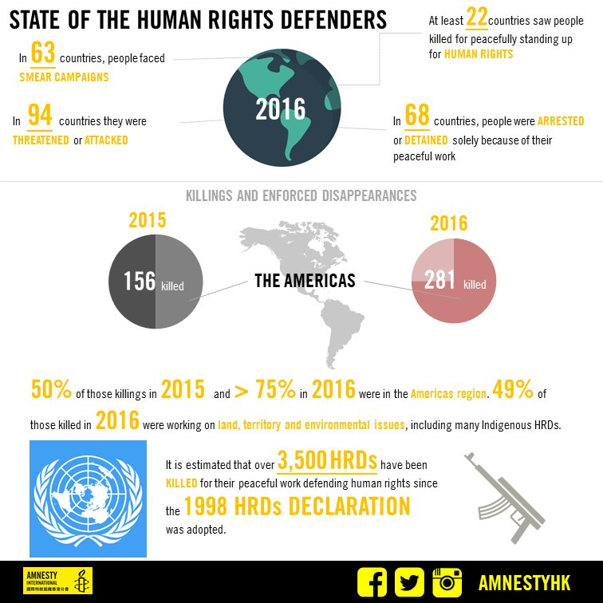
Notes:
Slide 8: State of Human Rights Defenders
This slide shows the extent to which HRDs are at risk across the world. The figures from 2015/16 reflects the increase in risk and danger that HRDs face year on year.
Please refer to the “Human Rights Defenders Under Threat: A Shrinking Space for Civil Society” report for further information. Page references are given in the script below.
You may say the following
Perhaps the most worrying all the figures is that at least 22 countries saw HRDs killed for peacefully standing up for human rights. According to Front Line Defenders, an NGO founded to protect HRDs at risk, 156 defenders were killed in 2015 and 281 in 2016. Over half of those killings in 2015 and more than three quarters in 2016 were in the Americas region. Forty-nine per cent of those killed in 2016 were working on land, territory and environmental issues, including many Indigenous HRDs.
Since the UN Declaration on Human Rights Defenders in 1998, it is estimated that 3500 HRDs have been killed for their peaceful work defending human rights.

Slide 10
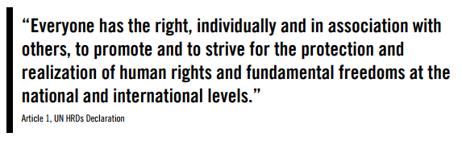
THE RIGHT TO DEFEND
HUMAN RIGHTS
Notes:
Slide 9: The Right to Defend Human Rights
In this slide we will be going into about the UN Declaration on Human Rights Defenders 1998. What it is? What it says? How it operates? This is important in understanding how the international legal framework protects HRDs and the work that they do.
Please refer to the “Human Rights Defenders Under Threat: A Shrinking Space for Civil Society” report for further information. Page references are given in the script below.
You may say the following:
International human rights law and standards establish and protect the right to defend human rights as an autonomous and independent right. The UN Declaration on Human Rights Defenders recognises the need to protect the rights of HRDs and develops existing provisions contained in international instruments such as the Universal Declaration of Human Rights, the International Covenant on Economic, Social and Cultural Rights and the International Covenant on Civil and Political Rights. (pg. 39)
Whilst the UN Declaration on Human Rights Defenders is not binding under international law, it is important to understand that it does not create new rights and obligations but instead articulates existing rights and applies them to the particular role and situation of HRDs. Therefore many of the existing rights it articulates are binding in other international legislation.
The Declaration recognises the crucial role played by HRDs in the defence and promotion of human rights which often exposes them to additional and specific risks, thus requiring measures explicitly for their protection.
The UN Declaration on Human Rights Defenders also establishes that states bear the ultimate responsibility to protect HRDs, to prevent and effectively address allegations of human rights violations and abuses committed against them and related to their human rights work, and to ensure that they can carry out their work in a safe and enabling environment. (pg. 39)
In the 20 years since the UN Declaration on Human Rights Defenders was adopted, a loose international regime for the protection of HRDs has been in formation. However, much remains to be done to ensure a safe and enabling environment for HRDs all over the world where recognition and protection is effectively implemented as specified under the UN Declaration on Human Rights Defenders. (pg. 41)
As a result, in June 2016, International Service for Human Rights (ISHR) launched The “Model Law for the Recognition and Protection of Human Rights Defenders”. This will provide authoritative guidance to states on how to implement the UN Declaration on Human Rights Defenders at the national level by giving technical guidance on developing appropriate laws, policies and institutions to support the work of defenders and protect them from reprisals and attacks.
The Model Law was developed in consultation with over 500 defenders from every region, and settled and adopted by leading human rights advocates, including by two UN Special Rapporteurs on the situation of human rights defenders. (pg. 41)

Slide 11
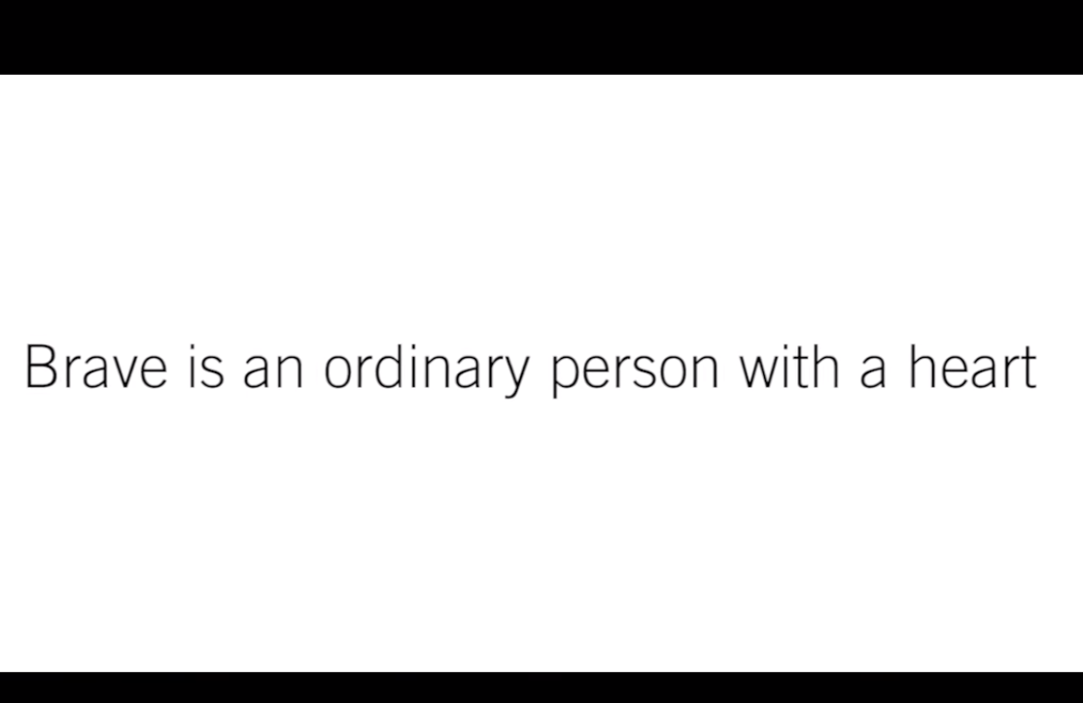

Notes:
Slide 10: Video: What does it mean to be brave?
Play this video before going into the campaign overview. You will need to ensure the training venue has Wi-Fi access if you want to play directly from YouTube, otherwise ensure you download and embed to slides prior to the training and make sure you test play the entire video, so there are no breaks in the playback.
The video URL is https://youtu.be/O-YoJOuLXG4

Slide 12


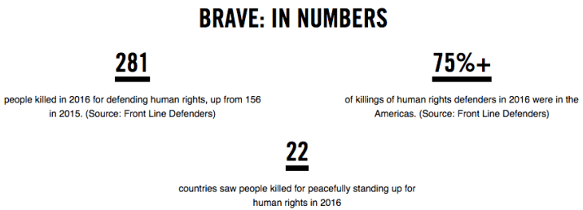
BRAVE: CAMPAIGN OVERVIEW
Notes:
Slide 11: BRAVE: Campaign Overview
This slide will delve into the aims of Amnesty’s global campaign on HRDs; BRAVE. It will discuss why Amnesty has launched this campaign and what is hopes to achieve by the end of 2019.
Please refer to the “Human Rights Defenders Under Threat: A Shrinking Space for Civil Society” report for further information. Page references are given in the script below.
You may say the following:
On 16 May 2017, Amnesty International launched a new global campaign, BRAVE, to strengthen the recognition and protection of human rights defenders around the world. The campaign is in response to the increased attacks and targeting of Human Rights Defenders (HRD), activists and civil society organisations around the world. The campaign will run until the end of 2019 and will also be a priority campaign at Amnesty UK (AIUK).
As we have already seen, over the past few years we have seen Human Rights Defenders (HRD’s) around the world increasingly face harassment, intimidation, smear campaigns, ill-treatment and unlawful detention; and some are even being killed.
In 2016, at least 281 HRD’s were killed in 22 countries, including defenders who challenged economic interests, protected the environment, defended minorities or opposed traditional barriers to women and LGBTI rights.
Right now, people across the world are risking everything to speak out against injustice. They are student leaders, political opponents, teachers, lawyers, journalists, women’s rights & environmental defenders and many others. They’re being harassed, tortured, jailed and even killed – just for daring to stand up for what’s right.
HRD’s are crucial to upholding freedoms and human rights across the world and supporting their rights and their space to live and operate in is one of the most important ways to ensure human rights for all.
Without them and you promoting people’s rights around the world, there'd be no human rights.
Amnesty is launching a campaign calling for HRD’s to be recognised, protected and able to operate in a safer environment.

Slide 13
BRAVE: CAMPAIGN AIM
Strengthen the recognition and protection of human rights defenders.
Actively respond to the increased attacks and target of Human Rights Defenders, Activists and civil society organisers around the world.
Enable and equip Human Right Defenders and give power to our women and young defenders by training and education.
Notes:
Slide 12: BRAVE: Campaign Aim
This slide will look into the aims of Amnesty’s global campaign on HRDs; BRAVE. It will discuss what the campaign hopes to achieve by the end of 2019.
Please refer to the “Human Rights Defenders Under Threat: A Shrinking Space for Civil Society” report for further information. Page references are given in the script below.
You may say the following:
The global campaign Aim:
To strengthen the recognition and protection of human rights defenders.
Actively respond to the increased attacks and target of Human Rights Defenders, Activists and civil society organisers around the world.
Enable and equip Human Right Defenders and give power to our young defenders by training and education.
The global campaign objectives:
By the end of 2019 more HRDs – with specific focus of young HRDs and WHRDs - are better connected, recognised, equipped and able to protect their rights and the rights of others in a safer and more enabled environment.
By the end of 2019 an increasing number of HRDs at risk are better protected by the state from attacks, intimidation and harassment through legislation, policy and change in practice.

Slide 14
BRAVE: KEY AREAS
There will be 4 priority areas in the campaign reflecting key issues and threats Human Rights Defenders face:
Women Human Rights Defenders includes LGBTIQ and inter-sectional discrimination
Killings, to include Enforced Disappearances
Misuse and Regressive use of criminal, civil and administrative law
Surveillance (online and offline)
Smear campaigns
Notes:
Slide 12: BRAVE: Key Areas
This slide will look at the key areas of focus for Amnesty’s global campaign on HRDs; BRAVE.
Please refer to the “Human Rights Defenders Under Threat: A Shrinking Space for Civil Society” report for further information. You may say the following:
Women HRDs, Killings, Enforced Disappearances, Misuse and Regressive use of criminal, civil and administrative law, Surveillance (online and offline) and smear campaigns will be the key areas that this campaign will focus on. Smear and stigmatisation are overarching issues which traverse all the other themes.
We need to make people care about the threats and attacks facing Human rights and those defending them around the world and to show people here in the UK that there is a role for them to play within this campaign.
The BRAVE campaign is all about showing why it’s important to stand up for and with Human Rights Defenders everywhere
We need to show that Human rights defenders are part of the fabric of making this world a fairer more just place to live.
It’s important that we who enjoy freedom won’t stay silent in the face of the injustice facing Human rights Defenders and the human rights community around the world!
Bravery comes in many forms and you do not have to put yourself in danger to live up to the word. It can show it’s face with a signature, a tweet, a letter, joining a peaceful protest, or any other gesture of solidarity

Slide 15
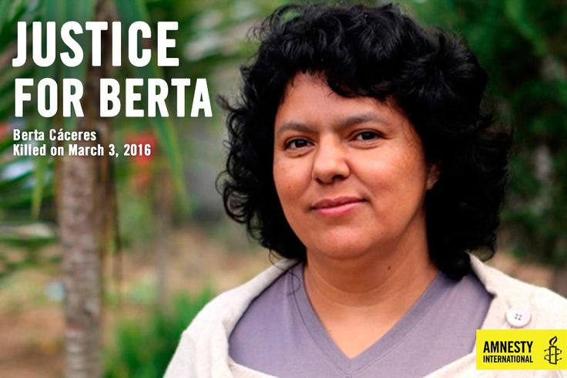
DOESN’T HAPPEN OVERNIGHT
Notes:
Slide 13: Doesn’t Happen Overnight
This slide will look at the case of Berta Cáceras. An HRD from Honduras who worked on indigenous and environmental issues. She was killed in her home in March 2016 because of the work she did as an HRD. Her killing was a part of ongoing threats and attempts to her life and the lives of her colleagues. It is important to know that the events that led up to Berta’s death as well as the toxic and dangerous environment that exists in Honduras for HRDs are ongoing.
You may say the following:
Berta was shot dead in her home in La Esperanza, western Honduras, after spending years campaigning on indigenous and environmental issues, including opposing the construction of a hydroelectric dam in the Agua Zarca region.
We believe she was killed because of the work she did as an HRD in Honduras, defending indigenous and environmental rights.
Berta’s work attracted international recognition when she was awarded the prestigious Goldman Environmental Prize in 2015 for her environmental work.
However this recognition also led to even more unwanted attention from those who wanted to silence her, and she endured a sustained campaign of harassment and threats in return for speaking out.
Even as far back as 2009, Berta was given protective status under the Inter-American Human Rights Commission. However, the death threats ensued.
In addition to attempts on her life she faced years of harassment from authorities. In September 2013, she and several other HRDs were charged with “usurpation, coercion and continued damages” for allegedly inciting others to commit these crimes.
On 20 September 2013 a judge ordered Bertha Cáceres to be placed in preventive detention.
From May 2013 to February 2014, Berta Cáceres also faced charges of carrying an unlicensed gun. She claimed that it was planted by the military officers at a checkpoint. The case was eventually dismissed at the Court of First Instance in Santa Barbara in February 2014.
During 2014 and 2015, Berta Cáceres received calls threatening her with disappearance or abduction, text messages which told her that she would be abducted and threats against her daughters and son.
On 6 November 2015, months before her murder, attempts were made on her life, resulting in 3 shots being fired at her whist driving to northwest Honduras.
On 16 February 2016, Berta Cáceres and other members of COPINH, the environmental group she campaigned for, were followed by armed men as they were returning from a visit to Río Blanco.
A month later, Berta was cruelly killed, shot dead, at home in her bedroom.
What is important to understand from cases like Berta’s is that the dangers and risks HRDs face around the world are systemic, ongoing and build gradually to the level of violence and death we see in Berta’s case.
She reported her instances of abuse and threats but these security incidents were never properly investigated by Honduran authorities.
Our campaign to strengthen the recognition and protection of HRDs around the world can protect other HRDs who face similar threats like Berta.

Slide 16
BRAVE: AIUK FOCUS
Ensure that AIUK campaign and contribution to the global campaign has led to more recognition, protection of HRD’s
HRD’s are better equipped and connected to carry out their work through specific training and capacity building projects.
Named HRDs at risk see positive developments in their cases
Inspire more people in the UK to take action with and on behalf of Human Rights Defenders
Inspire people to become Human Rights Defenders themselves.
Notes:
Slide 14: BRAVE: AIUK Focus
This slide will look at AIUK specific aims and the core approaches that will be used to achieve campaign objectives.
You may say the following:
AIUK will have specific focuses where we feel be can best deliver on this campaign and contribute to global campaign overall.
Our AIUK Campaign Aim is for more HRDs, particularly women and young people, being able to carry out their work more safely and effectively*, alongside thousands who are inspired to act against injustice with them. *Without obstacles, better recognised, equipped, connected.
We want to;
Ensure that AIUK campaign and contribution to the global campaign has led to more recognition and protection of HRD’s
HRD’s are better equipped and connected to carry out their work through specific training and capacity building projects.
Named HRDs at risk see positive development in their cases
Inspire more people in the UK to take action with and on behalf of Human Rights Defenders
Inspire people to become Human Rights Defenders themselves.
4. This is to be achieved through the core approaches of the AIUK BRAVE campaign, which are;
Human Rights Education
Active Participation
Youth involvement (including in advocacy & lobbying activities)
Capacity Building of individual HRDs, partner organisations and AIUK activists
Advocacy
Solidarity

Slide 17
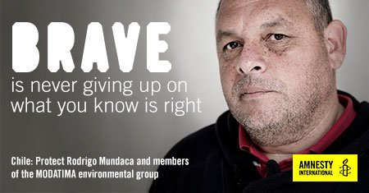
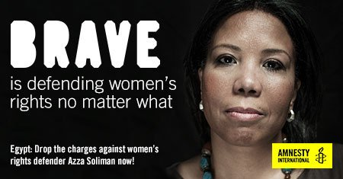
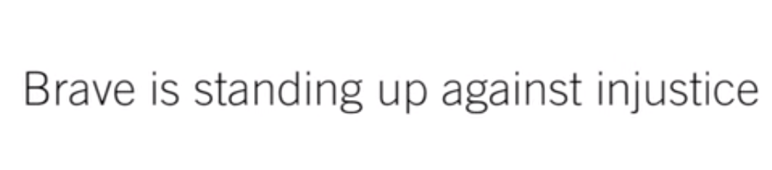
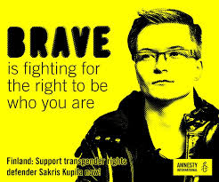
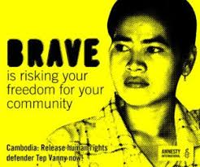
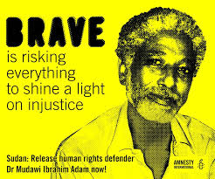
Notes:
Slide 15: Activity: Exploring Key Campaign Cases
The next few slides will focus on exploring the 5 key campaign cases that will be the focus of the two year priority campaign.
Depending on how much time trainers have been given for their session, they can either run through this section as a presentation or run it as an activity using the ‘Activity Case Sheet’.
Session objective:
Part 1: To explore each case in detail and share learnings. (10 minutes to explore and 10 minutes to feedback and reflect)
Part 2: To come up with creative and innovative ways to campaign on assigned cases. (20 minutes to plan creative campaign and 20 minutes to feedback and reflect)
Length of session: 60 minutes
Resources: Post-it notes, marker pens, flip chart, case activity sheets, Info Sheet – BRAVE Global Cases, Info Sheet – Case Country Profiles.
You may say the following:
Throughout the lifetime of the BRAVE Campaign, Amnesty UK will be working on 5 key cases. There will also be other HRDs that may feature as part of this campaign but these 5 will be the keys cases that the global movement will all work on.
These 5 individuals have all experienced the constraints, restrictions, threats and intimidation that Amnesty UK are looking to address within the Campaign.
Amnesty UK will be campaigning on these 5 cases in a sustained way for at least the next two years, and our aim is to galvanise as much support for these cases from the UK public.
You will now take the opportunity to explore these 5 cases.
Divide 5 cases between 5 groups, if group sizes exceed 4 then assign 1 case to more than group.
Part 1: Read the case sheet, make a note of key issues and concerns about the case. Share your case with the rest of the group. After all groups have fedback, discuss the similarities of the HRDs work, the tactics used to silence them and common themes. (20 minutes)
Part 2: Swap case sheet with other group. Come up with a creative and innovative way to campaign on your assigned case. Prepare a brief creative action or campaign plan to share with the rest of the group. (40 minutes)

Slide 18
CASE: TEP VANNY
Tep Vanny
Country: Cambodia
Land Rights Defender
Abuse faced: Persecution through prosecution, imprisonment, intimidation.
BRAVE Themes:
Women HRDs and LGBTI defenders
Misuse / regressive use of law
Notes:
Slide 16: Exploring Key Campaign Cases: Tep Vanny
The next few slides will focus on exploring the 5 campaign cases that will be the focus of the two year priority campaign.
The global objectives on Tep Vanny’s case are:
The appeal court overturns the conviction and orders the immediate and unconditional release of Tep Vanny
Increased visiting rights for family and friends
You may say the following:
Tep Vanny is a land rights defender, human rights defender and community representative.
Tap Vanny, has become a symbol of peaceful resistance in Cambodia.
She helped mobilise the communities of Boeung Kak Lake to protest against the forced eviction of thousands of families to make way for a tourist development by a private company granted a 99-year lease on the land by Phnom Penh Municipality.
Because of their peaceful protests, she and 13 fellow women human rights defenders, were sentenced to 2.5 years in prison on 24 May 2012.
The authorities are now reviving old cases against Tep Vanny in an apparent attempt to silence her and as a warning to other defenders.
In March 2013 she participated in a protest against the lake development, held outside Prime Minister Hun Sen’s house in Phnom Penh.
Because of this, on 23 February 2017 she was convicted on charges of “intentional violence with aggravated circumstances” and again given a 2.5 year prison sentence.
During the trial the prosecution presented no credible evidence to back up their charges.
She has been in prison since 16 August 2016 for her land protest work, and the authorities are going to extraordinary lengths to ensure that she remains in prison.
They hope to send a chilling message to other human rights defenders and activists.

Slide 19
CASE: RODRIGO MUNDACA
Rodrigo Mundaca
and members of
MODATIMA
Country: Chile
Environmental
Defenders
Abuse faced: Persecution through prosecution, threatened and attacked.
BRAVE Themes:
Physical attacks / killings / enforced disappearances
Notes:
Slide 17: Exploring Key Campaign Cases: Rodrigo Mundaca and members of MODATIMA
The next few slides will focus on exploring the 5 campaign cases that will be the focus of the two year priority campaign.
The global objectives on Rodrigo’s case are:
By 2018, the authorities provide effective protection measures to Rodrigo Mundaca and other members of MODATIMA, in consultation with them and in accordance with their wishes;
By 2018, the authorities initiate prompt, thorough and impartial investigations into the threats and attacks against members of MODATIMA, make the results public and bring those responsible to justice.
Rodrigo Mundaca and other members of MODATIMA receive international solidarity, which encourages them to continue their important human rights work.
You may say the following:
Rodrigo Mundaca is a member of the Defence Movement of Earth, Environmental Protection and for the Access to Water, (Movimiento de Defensa por el Acceso al Agua, la Tierra y la Protección del Medio ambiente (MODATIMA).
Rodrigo lives in Central Chile, in the Petorca Province and in 2012, he began to denounce the illegal extraction of water by politicians and enterprises in the zone.
As a consequence, 4 criminal cases against the defender were initiated.
One of them ended with a sentence of 61 days in prison suspended under the condition that Rodrigo would present himself monthly to the Chilean Policy, for a year.
In March 2015, Rodrigo was physically attacked from the back by unidentified people.
In the recent years, he and other community leaders have received threats via cell phone calls, and by people in the street.

Slide 20
CASE: SAKRIS KUPILA
Sakris Kupila
Country: Finland
Trans Rights Defender
Abuse faced: Harassment, threats of violence, intimidation, open hostility.
BRAVE Themes:
Women HRDs and LGBTI defenders
Smear and stigmatisation
Notes:
Slide 18: Exploring Key Campaign Cases: Sakris Kupila
The next few slides will focus on exploring the 5 campaign cases that will be the focus of the two year priority campaign.
The global objectives on Sakris’ case are:
The Government of Finland to develop a gender recognition procedure that is quick, transparent, based on self-determination, and available irrespective of age, medical or financial status;
The Ministry of Social Affairs and Health to introduce a legislative proposal by the end of 2017 to change the current law on legal gender recognition – the Trans Act – allowing transgender people to obtain legal recognition of their gender through a timely and transparent procedure on the basis of self-identification;
The Government of Finland to revise the Trans Act by the end of 2018, abolishing the need for sterilization, other medical treatment, and a mental health diagnosis, as requirements for a person’s legal recognition of their gender identity. Judicial and medical issues are to be separated and gender diversity is depathologized.
Sakris is recognized and supported by the authorities in his fight for transgender rights in Finland.
You may say the following:
Sakris Kupila is a 20 year-old medical student, youth activist and a defender of transgender rights, from Finland.
Sakris is being denied legal gender recognition because he refuses to fulfil the requirements of the current process – which requires a diagnosis of mental disorder and enforced sterilisation.
It is not easy to use the traditionally male name Sakris. Rectrictive laws means Sakris has to continue using old photos and names on his ID and passport.
In Finland you cannot give children names of the “opposite” gender and you cannot change your name as an adult to one that suits your gender identity, without a mental disorder diagnosis.
Because of his work advocating for the rights of Trans people, Sakris has faced harassment, intimidation, threats of violent beatings, and open hostility, forcing him to take a year away from his education.
Despite this, Sakris is determined to continue his work, so that all transgender persons may enjoy their rights.

Slide 21
CASE: AZZA SOLIMAN
Azza Soliman Country:
Egypt
Women’s Rights Defender
Abuse faced: Smear
campaigns, surveillance,
harassment, arrested.
BRAVE Themes:
Misuse / regressive use of law, Women HRDs and LGBTI defenders, Smear and stigmatisation
Notes:
Slide 19: Exploring Key Campaign Cases: Azza Soliman
The next few slides will focus on exploring the 5 campaign cases that will be the focus of the two year priority campaign.
The global objectives on Azza’s case are:
The Egyptian authorities to drop the charges against Azza and Case 173
The Egyptian authorities must drop the travel bans and asset freezes against Azza and Case 173
The Egyptian authorities amend the NGO Law to eliminate restrictions on civil society work including limitations on registration, funding, operations, and to eliminate harsh criminal penalties.
You may say the following:
Azza Soliman works to defend women victims of torture and arbitrary detention.
Azza Soliman founded the Centre for Egyptian Women's Legal Assistance (CEWLA) in Boulaq el-Dakror, a working class neighbourhood in greater Cairo.
The organisation provides legal aid, support and literacy lessons for women, especially those who have experienced domestic abuse and rape.
She has been targeted with smear campaigns, government surveillance and faces constant harassment by security forces and pro-government media.
Recently Azza was arrested, interrogated and charged with tax evasion, operating a civil society organization without proper registration, and with slandering Egypt’s image by claiming that women in the country face rape.
She has been banned from travelling and her assets and those of her organization have been frozen.
She could be sentenced to 25 years in prison.

Slide 22
CASE: DR MUDAWI IBRAHIM ADAM
Dr Mudawi Ibrahim Adam
Country: Sudan
HRD in Sudan
Abuse faced: prolonged detention without charge, limited access to lawyer in detention.
BRAVE Themes:
Misuse / regressive use of law
Surveillance
Stigmatisation
Notes:
Slide 20: Exploring Key Campaign Cases: Dr Mudawi Ibrahim Adam
The next few slides will focus on exploring the 5 campaign cases that will be the focus of the two year priority campaign.
The global objectives on Mudawi’s case are:
The Sudanese authorities release Dr Mudawi Ibrahim Adam immediately and unconditionally
The Sudanese authorities investigate allegations that Dr Mudawi Ibrahim Adam has been otherwise ill-treated while in detention and prosecute those suspected of responsibility in proceedings that meet international fair trial standards
You may say the following:
Dr Mudawi Ibrahim Adam is a Sudanese human rights defender known Organisation, Sudan Social Development Organisation (SUDO), working to shine a spotlight on human rights violations in Sudan.
He is a Professor of Engineering at the University of Khartoum
Dr Mudawi has been arrested several times because of his human rights work, most recently on 7 December 2016 by the Sudanese National Intelligence and Security Services (NISS) while he was at the University.
He was first detained at Kober prison in Khartoum, Sudan, where he went on hunger strike on 21 January 2017 for bringing attention to human rights violations in Sudan, in particular Darfur.
Around mid-February 2017, he was transferred to the office of the Sudanese State Security Prosecutor, after he agreed to end his hunger strike.
He remains in detention but has still not been charged or brought before a court.
He was only allowed to speak to his lawyer for the first time on 22 February.
Dr Mudawi suffers from chronic respiratory and heart complications.

Slide 23
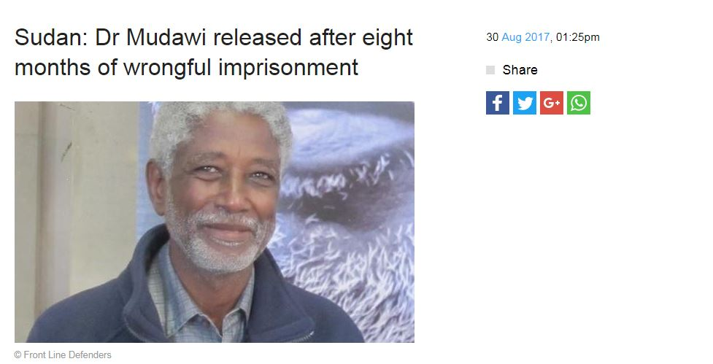
DR MUDAWI RELEASED
Notes:
Slide 21: Dr Mudawi Released
Please see the press release with details of Dr Mudawi’s release.
https://www.amnesty.org.uk/press-releases/sudan-dr-mudawi-released-after-eight-months-wrongful-imprisonment
You may include the following:
Dr Mudawi was released, along with five other human rights defenders, late on 29 August. He faced six trumped-up charges, including 'undermining the constitutional system’ and ‘waging war against the state', both of which carry either the death penalty or life imprisonment. All charges against him have been dropped.
Sarah Jackson, Amnesty International’s Deputy Regional Director for East Africa, the Horn and the Great Lakes, said: “It is a great relief that this awful chapter has drawn to a close. Dr Mudawi, a prisoner of conscience, has been reunited with his family and is once again a free man.
“Dr Mudawi’s eight months in prison represent a grave miscarriage of justice and his release must serve as a first step towards ending the criminalisation of human rights work in Sudan. The authorities’ relentless assault on any form of criticism endangers anyone who dares to speak out, and it must stop.”
Dr Mudawi Ibrahim Adam has been released from prison and all charges against him dropped and he is now home with his family.

Slide 24
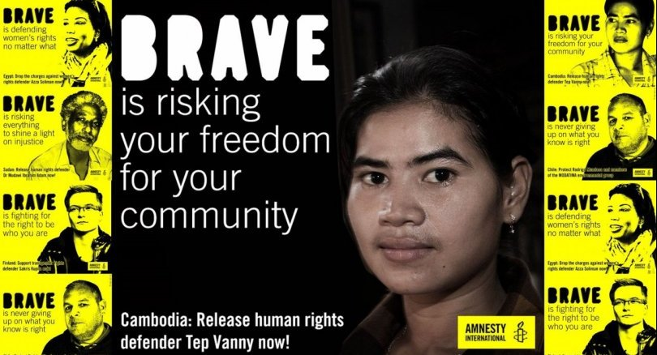
AIUK Campaign Materials
AIUK Campaign Materials available to order from MDA from 31st August.
HRDs Action Cards
V1 (Azza Soliman) HRD001
V2 (Dr Ibrahim Adam) HRD002
V3 (Sakris Kupila) HRD003
V4 (Tep Vanny) HRD004
V5 (Rodrigo Mundaca) HRD005
Campaign Leaflet HRD6TEMP
Notes:
Slide 21: AIUK Campaign Materials
AIUK Campaign Materials available to order from MDA from 31st August.
HRDs Action Cards
V1 (Azza Soliman) HRD001
V2 (Dr Ibrahim Adam) HRD002
V3 (Sakris Kupila) HRD003
V4 (Tep Vanny) HRD004
V5 (Rodrigo Mundaca) HRD005
Campaign Leaflet HRD6TEMP

Slide 25
NEXT STEPS
31st August – AIUK Campaign Materials available to order from MDA
30 September– HRE Conference in Manchester
7th October 2017 - AIUK Skillshare on BRAVE Campaign in Manchester
1st November – Write for Rights 2017 – featuring 10 Human Rights Defender cases
Notes:
Slide 22: Next steps
31st August – AIUK Campaign Materials available to order from MDA
30 September– HRE Conference in Manchester
7th October 2017 - AIUK Skillshare on BRAVE Campaign in Manchester
1st November – Write for Rights 2017 – featuring 10 Human Rights Defender cases

Slide 26
NEXT STEPS
Available now! International Secretariat’s online learning package on HRDs and MOOC to come
10th to 13th November – Sakris visits the UK.
29th November - International Women’s Human Rights Defenders Day
9th December – International Human Rights Defenders Day
Feb 2018 – Women’s Human Rights Defenders Wikipedia Project
Notes:
Slide 23: Next steps
1. The International Secretariat’s online learning package is available now and covers:
The Importance of Defending Human Rights;
Who is a Human Rights Defender?;
The Importance of Defending Human Rights.
You do need to create an account to access this: www.humanrightseducation.amnesty.org
The MOOC on the HRDS is due to be launched in November.
2. November marks the beginning of Write for Rights 2017 and will feature several Human Rights Defender cases
3. Also in November, Sakris visits the UK and will be attending Amnesty’s Student Conference on Saturday/ Sunday.
4. 29th November will be International Women’s Human Rights Defenders Day followed by International Human Rights Defenders Day on 9th December.
5. Lastly, in February 2018 we are launching a Women’s Human Rights Defenders Wikipedia project. This will be a global edit-a-thon to generate and improve the WHRD content on Wikipedia.

Slide 27
THANK YOU

