Slide 1
Asylum Seekers and Refugees in Books
Presentation by Karen Argent
The Letterpress Project Director
www.letterpressproject.co.uk

Slide 2
Why do we need to talk about this today?
Most people don’t know very much about this subject
Knowledge and information can help to make things much better
As a human being – you need to think about how to welcome asylum seekers and refugees
Through reading stories we can experience the world through the eyes of others
Inspiration for writing your own stories

Slide 4
When Hitler Stole Pink Rabbit by Judith Kerr
A true story
Germany to England via Switzerland and France
1930s
Political reasons
Judith and her brother

Slide 8
What is an asylum seeker?
Someone who is fleeing persecution in their homeland, has arrived in another country, made themselves known to the authorities and exercised their legal right to apply for asylum under the terms of the 1951 United Nations Refugee Convention
Many will choose to return home once the situation has improved sufficiently for them to feel safe

Slide 9
Why leave?

Slide 10
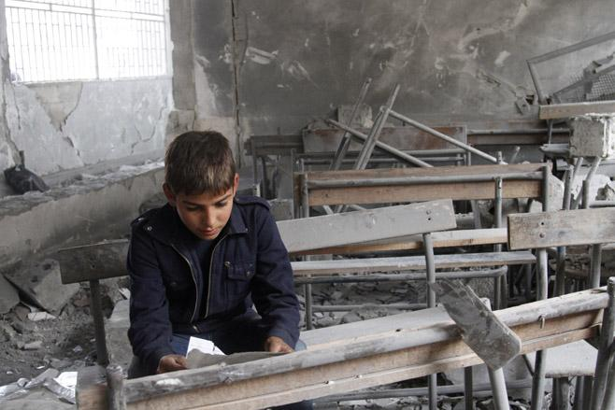

Slide 11
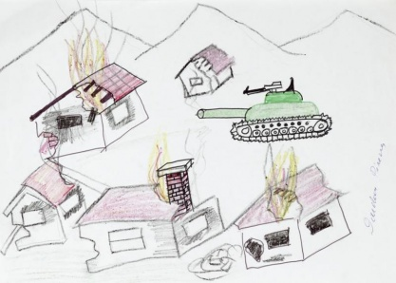
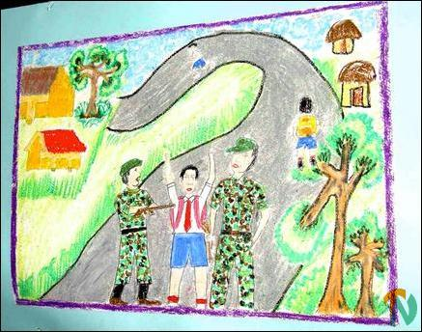
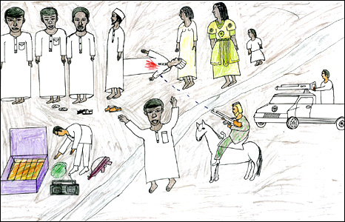

Slide 12
You have the right to claim asylum
Could you stay in your country if these were the new rules?
Any disabilities are forbidden
Women driving cars is forbidden
All people must follow the strict Crocogod religion
The state must be obeyed at all times
Activity: You have three days to decide – what do you need to do?

Slide 13
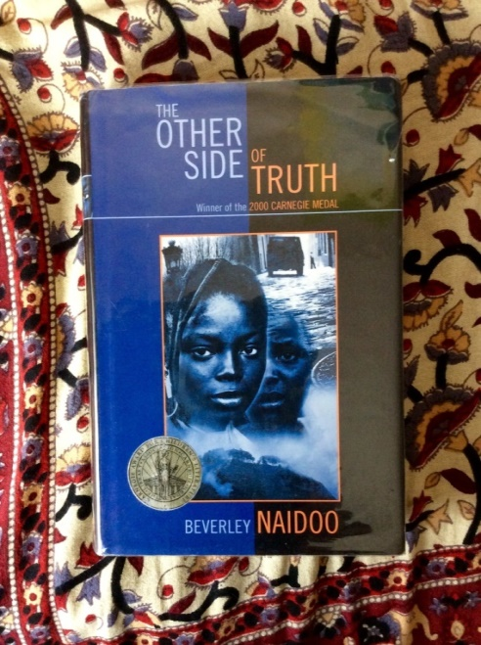
The Other Side of Truth by Beverley Naidoo
A fictional story based on true accounts
Nigeria to UK
Late 20th century
Politics
Sade and Femi
Read the book review
http://www.letterpressproject.co.uk/inspiring-young-readers/2015-12-11/the-other-side-of-truth

Slide 14
Shadow by Michael Morpurgo
A fictional story inspired by true accounts
Afghanistan to Manchester
21st century
War
Shadow ( a Springer Spaniel), Matt,
his grandfather and Aman

Slide 15
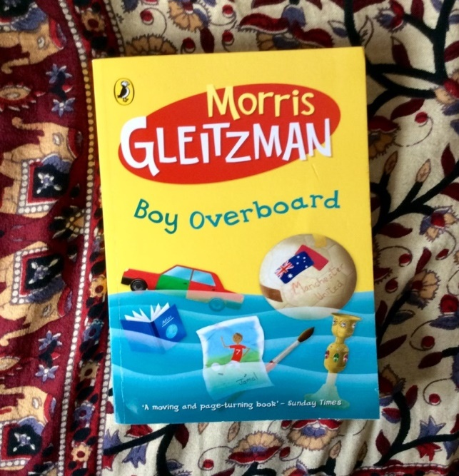
Boy Overboard by Morris Gleitzman
A fictional story inspired by true accounts
Afghanistan to Australia
21st century
War
Jamal
‘ I wrote this story to express my sympathy for children everywhere who have to flee to survive , and my admiration for the adults who embrace them at the end of the journey’

Slide 16
The Journey is never easy and is often very dangerous …

Slide 17
So what is a refugee?
Someone whose asylum application has been successful and who is allowed to stay in another country having proved that it is tooo dangerous to stay in their home country
The UK is home to less than 2% of the world refugees out of more than 15 million worldwide ( UNHCR GlobalTrends, 2011)
At the moment refugees from Syria are in the news because of the war there which has been going on for 5 years …

Slide 18
Where is Syria?

Slide 19
Adjacent countries

Slide 20
Za’atari camp in Jordan) is home to more than 83,000 refugees

Slide 21
What is it like living in a refugee camp?
https://www.theguardian.com/global/video/2016/dec/09/kids-refugees-questions-whats-it-like-to-have-no-home-video

Slide 23
What is it like moving to a new country when you have nothing and know nobody?

Slide 24
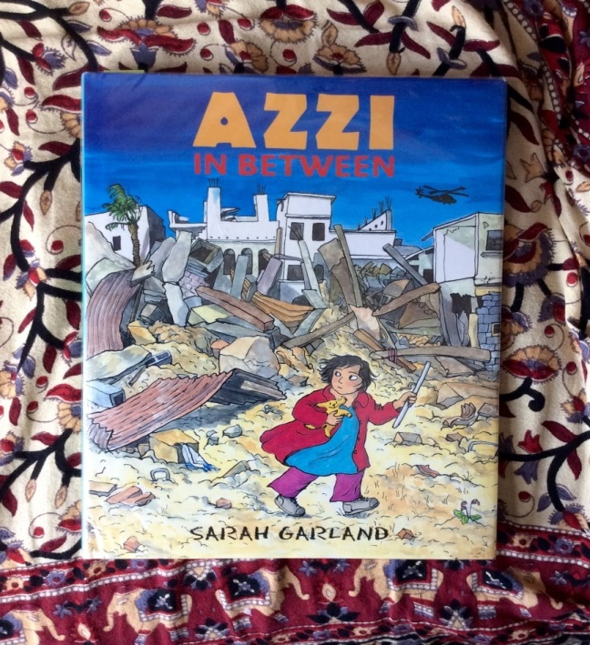
Azzi in Between by Sarah Garland
A fictional story inspired by true accounts
Somewhere in the Middle East to UK
20th / 21st century
War
Azzi

Slide 26
Two Syrian children just are coming to live in Stourbridge …
Nadia (10)
She is a very lively, talkative girl who likes playing with her brothers and sisters. She is very close to her mother and grandmother and enjoys helping with cooking etc.
She was too young to attend school before the war in Syria. She has enjoyed going to some classes in the refugee camp and loves doing maths problems. She enjoys drawing and listening to stories in Arabic. She is very good at running and doing somersaults and would really love to try swimming because she has never had the chance.
Omar (10)
He is a quiet boy who has a good imagination and likes making things with his father and younger brothers.
He was too young to attend the school before the war in Syria. He has attended some classes in the refugee camp but has often been too ill to go because of his war injuries. He likes playing football and listening to music. He would love to join a football team and learn to play an instrument.
Activity: How can you make them feel welcome?

Slide 27
Thank you for listening
Please spread the word about the importance of these books
Imagine what it would be like to be an asylum seeker and write about it
Contact me if you would like to write a book review to be published on our website – teachers and parents too!
Karen Argent
The Letterpress Project
www.letterpressproject.co.uk
Karen.argent@btinternet.com

