Slide 1


Slide 2
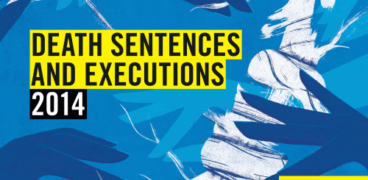
The Death Penalty
Notes:
Slide 1: The Death Penalty
This presentations on the death penalty is for adult audiences to bring about awareness on the global state of the death penalty in 2014. It will take the audience through Amnesty’s 2014 report on death sentences and executions, cases and Amnesty’s long term commitment to abolishing the death penalty across the world.
The 2014 report on the death penalty can be found here: https://www.amnesty.org.uk/sites/default/files/death_sentences_and_executions_2014_en.pdf
You may include the following:
Amnesty International is one of the leading organisations to report on the use of the death penalty across the world.
This presentation will take you through Amnesty’s 2014 report on death sentences and executions, death penalty cases and the impact of Amnesty’s work in this area.
Amnesty’s opposition to the death penalty began as far back as 1965, when it sponsored a UN resolution to suspend and abolish the death penalty for peacetime political offences.
In 1968 Amnesty announced its opposition to the death penalty for political prisoners.
Calls for a total abolition of the death penalty began in 1977, the same year Amnesty was awarded the Nobel Peace Prize.
Amnesty has called on all governments to “bring about the immediate and total abolition of the death penalty”.
Amnesty activists continue to campaign for total abolition of the death penalty in countries across the world.

Slide 3

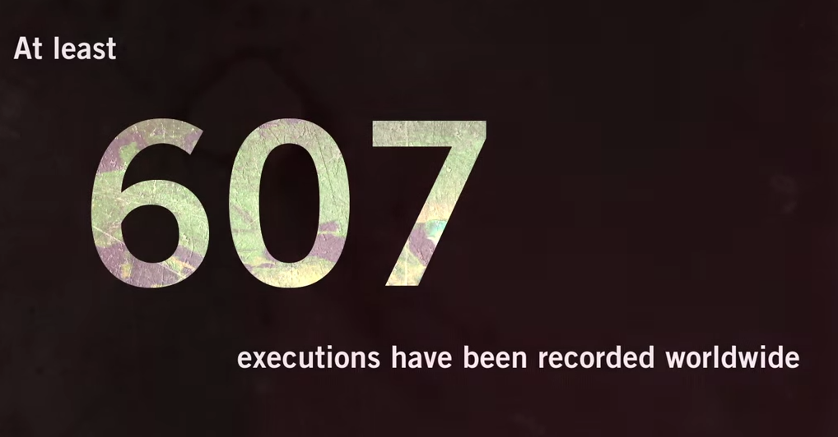
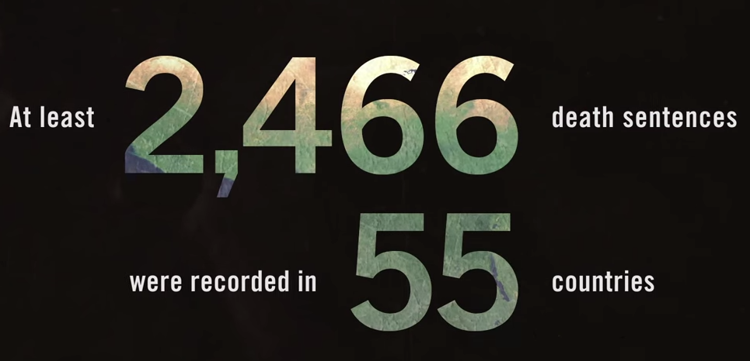
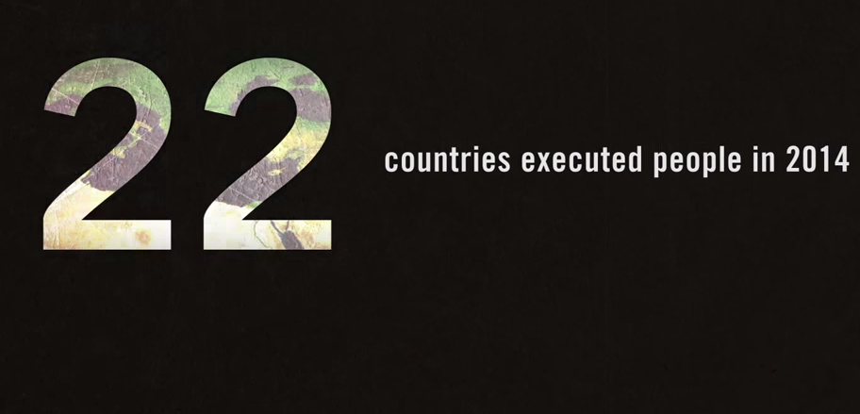
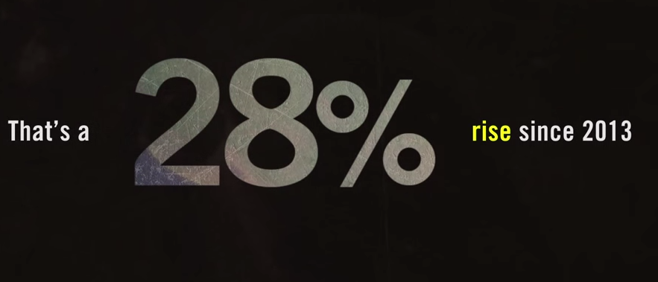
Content Warning
© AI
Notes:
Slide 2: Content warning
Before the full presentation begins, it is worth providing a content warning as the nature of the topic may be upsetting or distressing.
Content warning for the following:
Death
Executions (including methods of execution and descriptions of executions)
Imprisonment
Inhumane conditions (including descriptions of death row cells and regimes)
Torture (includes references to torture being used to obtain confessions and “botched” executions)
You may include the following:
The nature of the work we do at Amnesty means that we often deal with issues which are upsetting or distressing. As you can see from the statistics the number of executions that were recorded by Amnesty and death sentences handed. Behind each death sentence is a story of human suffering.
If at any time a member of the audience does find any of the content distressing or it makes them uncomfortable, do check whether it would be possible to explain that section in a different way. It may be possible for audience members to remove themselves for upsetting sections and then return.
The content of this presentation will include details about death, methods and descriptions of executions and other violations of human rights including, torture and inhumane treatment.
The presentation will also include the types of crimes that could lead to being sentenced to death in different countries, which you may also find alarming.

Slide 4
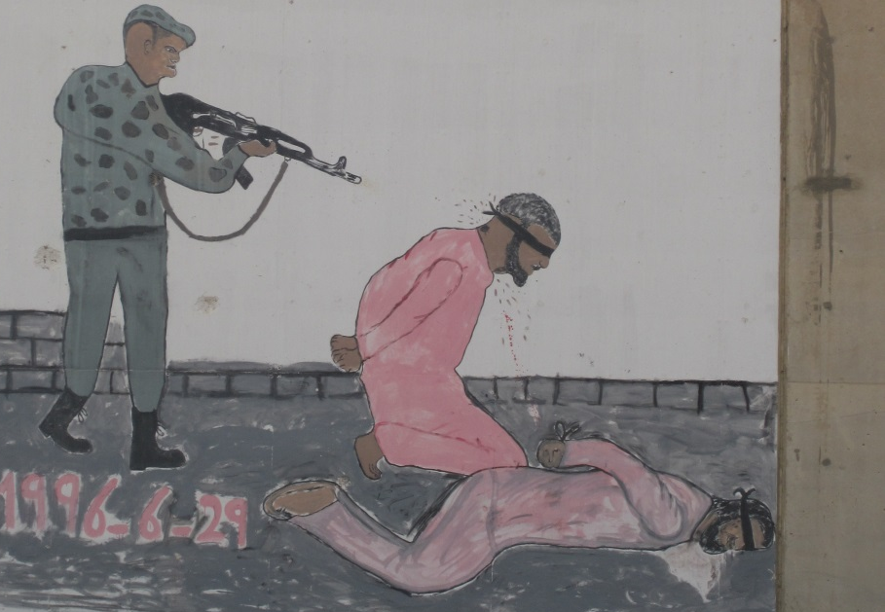
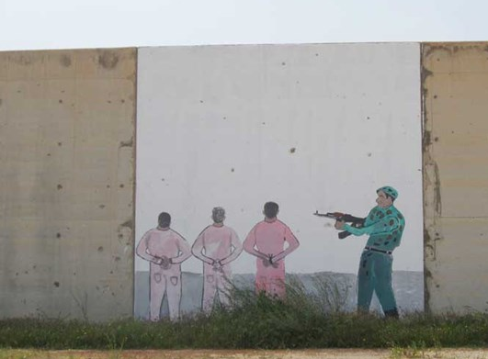
What is the Death Penalty?
Artwork on the wall of Abu Salim Prison in Tripoli, Libya. 15 March, 2014. © Amnesty International
Notes:
Slide 3: “What is the Death Penalty?” - Death Penalty Definition
This slide will engage the audience to put forward their ideas of what is meant by the death penalty.
You could engage the audience by discussing the pictures in this slide. They are from Abu Salim Prison in Libya. Thousands were executed here under the Gaddafi regime. It can be a useful catalyst for beginning the discussion on the death penalty. It can also help outline the difficult, upsetting and distressing nature of this topic.
You may wish to play this short video: Death Penalty Facts and Statistics 2014
https://www.youtube.com/watch?t=12&v=BYmNt-bDefM
You may include:
The images you see are from are from Abu Salim Prison in Libya. Thousands were executed here under the Gaddafi regime. Let’s use these images to begin our discussion on the death penalty.
Activity: Ask the participants to discuss the images and what they understand by the death penalty? (5 minutes)
The phrase “capital punishment” may also be given (originating from the Latin “caput” and so affecting the head or life).
After some discussions you can offer the following definition.
The death penalty (aka capital punishment) is the premeditated, judicially sanctioned killing of an individual by the state.
It is essential to emphasise that we are referring only to executions by a state in accordance with the laws of that state.
Whilst executions are also carried out by non-state actors (e.g. ISIS), it should be understood that whilst Amnesty categorically condemns such acts, Amnesty’s work on the death penalty aims to abolish state sanctioned killing.
Every day, people are executed by the state as punishment for a variety of crimes – sometimes for acts that should not be criminalised. In some countries it can be for who you sleep with, in others it is reserved for acts of terror and murder.
Some countries execute people who were under 18 years old when the crime was committed, others use the death penalty against people who suffer mental problems. Before people die they are often imprisoned for years on “death row”. Not knowing when their time is up, or whether they will see their families one last time.
The death penalty is cruel, inhuman and degrading. Amnesty opposes the death penalty at all times - regardless of who is accused, the crime, guilt or innocence or method of execution.

Slide 5
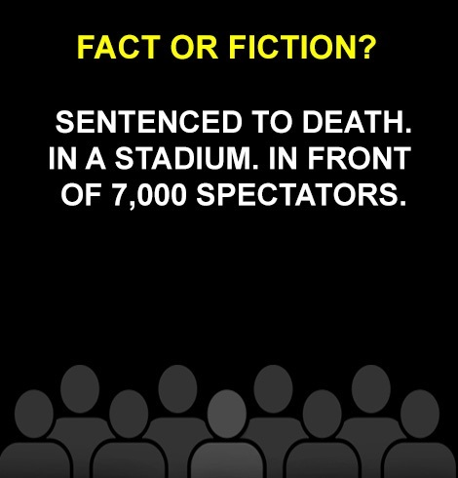
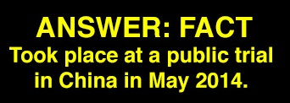
Sentenced to Death
Notes:
Slide 4: Sentenced to Death
This slide begins the discussion on the death penalty sentence. It is useful to draw attention to the fact that a number of countries such as China and Taiwan use death penalty sentences for political reasons, such as China sentencing alleged terrorists in a stadium in front of thousands.
It is also useful to ask the audience what crimes they think may prompt the death penalty? Are they surprised that a number of countries have the death penalty as a sentence for crimes that don’t include intentional killing?
You may start with the following activity:
Activity: Can the audience suggest what crimes and in what countries might be punished with the death penalty?
Not all those executed have been convicted of intentional killing.
Some countries have mandatory death sentences for certain crimes.
Offenses attracting the death penalty include:
- Adultery (Saudi Arabia)
- Blasphemy (Pakistan)
- Rape (e.g. Somalia)
- Economic Crimes (e.g. China, Vietnam)
- Drugs-related offences (e.g. Indonesia, Iran, Yemen)
- Crimes against the state (e.g. North Korea, Iran)
4. Many of those sentenced have:
- Not been afforded a fair trial, been present for their sentencing or given the opportunity to appeal.
- Are based on confessions obtained under torture.
5. Some countries also have mandatory sentences, which require the death penalty for all instances of that crime.
6. This does not allow any possibility of taking into account a defendant’s personal circumstances or the circumstances of the particular offence such as mental incapacity and illness, which will be discuss later.
7. Activity
Before the next slide you may want to ask who do they think the world’s top executioners are? They can discuss this in pairs or small groups for a couple of minutes or you can take feedback directly from the audience. The 2014 top executioners are presented on the next page.

Slide 6
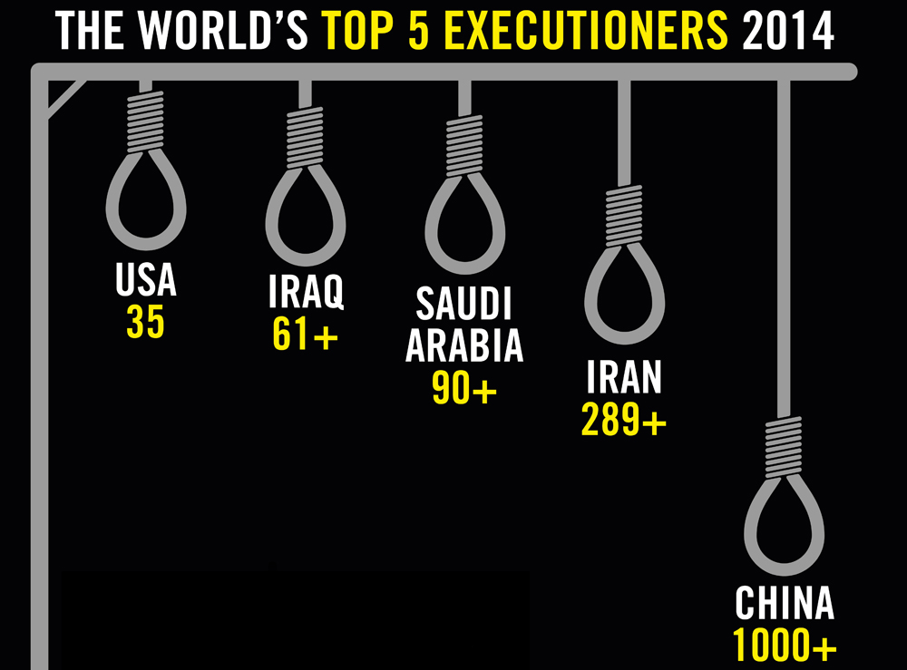
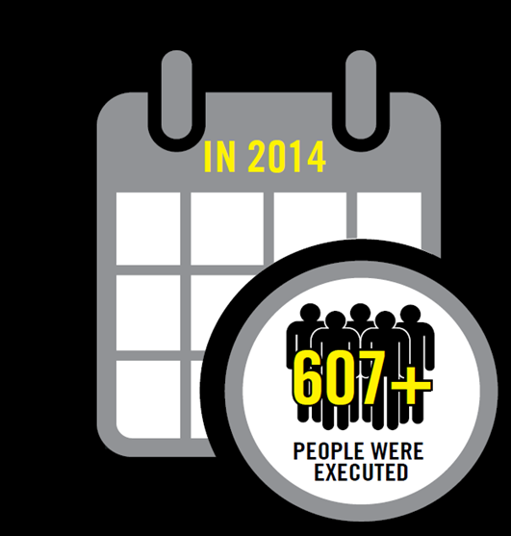
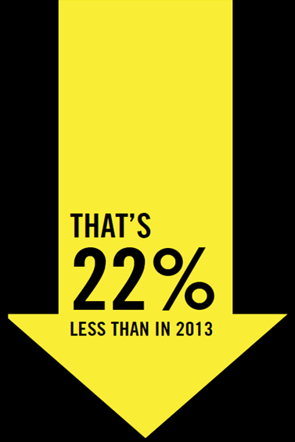
Notes:
Slide 6: The World’s Top 5 Executioners 2014
This slide demonstrates findings from Amnesty’s 2014 report. There is a huge gap between the top two executioners and the rest. It also demonstrates the prevalence of the death penalty in the USA who continue to remain in the top five executioners in 2014.
You may include:
These are some of the findings from Amnesty’s 2014 report on death sentences and executions. It shows the top five executioner countries.
We are not able to verify the true number of executions in China because the government does not provide us with any numbers. However, conservatively it is in the 1000’s.
Iran, Saudi Arabia and Iraq account for 72% (2014) of the 607 recorded executions, though likely there were hundreds more unreported in Iran.
Amnesty’s report found that the number of recorded executions have gone down by 22% from the previous year. However the picture is still grim as the number of deaths sentences have risen. (Next slide)

Slide 7
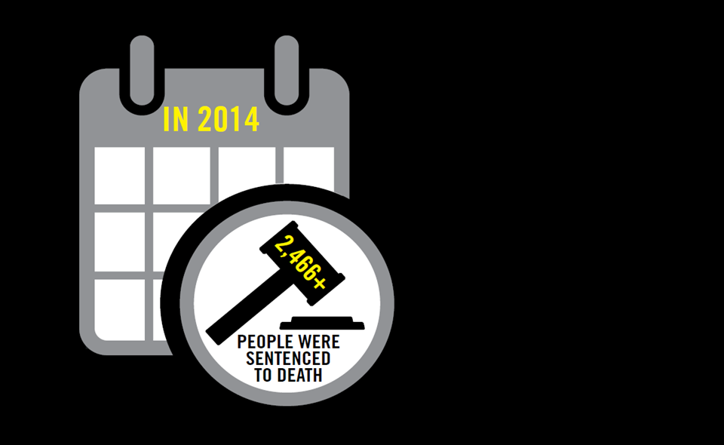
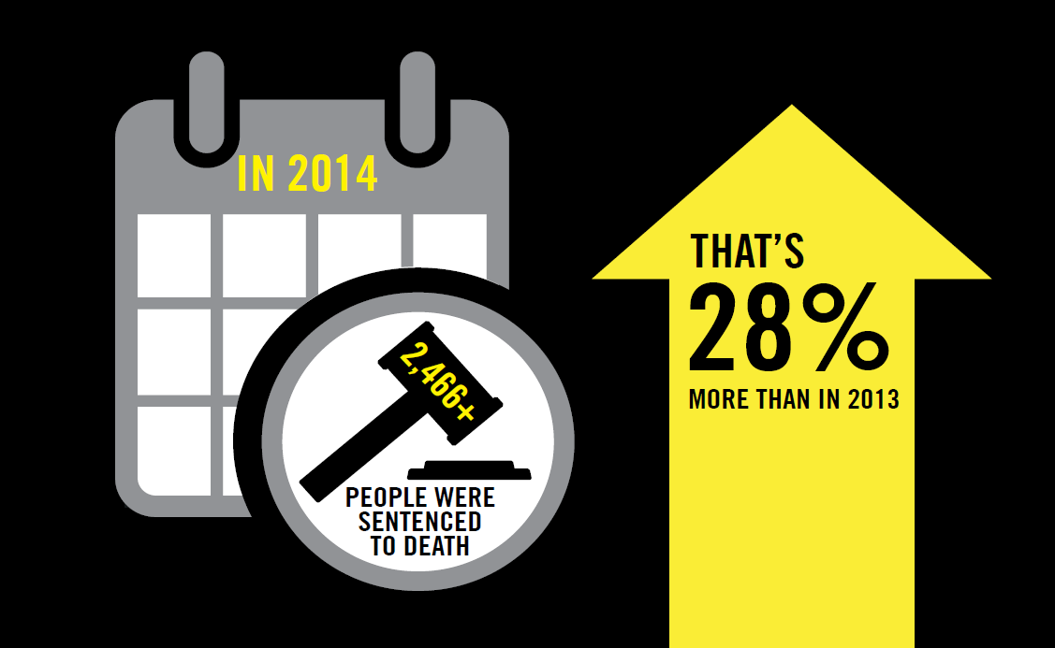
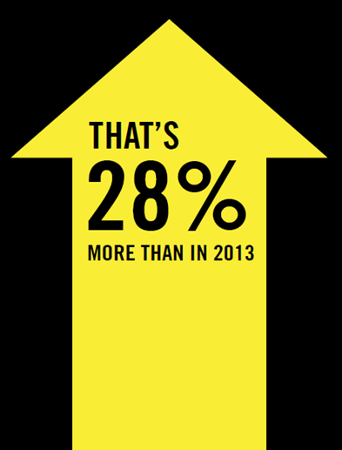
Death Sentences 2014
Notes:
Slide 5: Death Penalty Sentences
This slide looks at the findings of Amnesty’s 2014 report on death sentences and executions. It looks at the number of death sentences reported in 2014.
You may include the following:
Whilst the number of executions went down by 22%, the number of death sentences went up by 28% with more that 2,466 death sentences being handed out in 2014.
However, the total number of people on death row awaiting execution has declined. This includes 112 exonerations in 2013.
This is partly due to the unusually high number of 220 people being sentenced to death in Bangladesh in 2013 which included 172 people who were sentenced for mutiny. The number being sentenced to death in Bangladesh was much lower in 2014.
Some countries such as Vietnam continue to not provide us statistics on the number of sentencings.
Some of the countries executing the most people have deeply unfair legal systems. The ‘top’ three executing countries – China, Iran and Iraq – have issued death sentences after unfair trials. Many death sentences are issued after ‘confessions’ that have been obtained through torture.
In addition, you are more likely to be sentenced to death if you are poor or belong to a racial, ethnic or religious minority because of discrimination in the justice systems of many countries. Also, vulnerable and marginalised groups have less access to the legal resources needed to defend themselves.
The authorities in some countries, for example Iran and Sudan use the death penalty to punish political opponents.

Slide 8
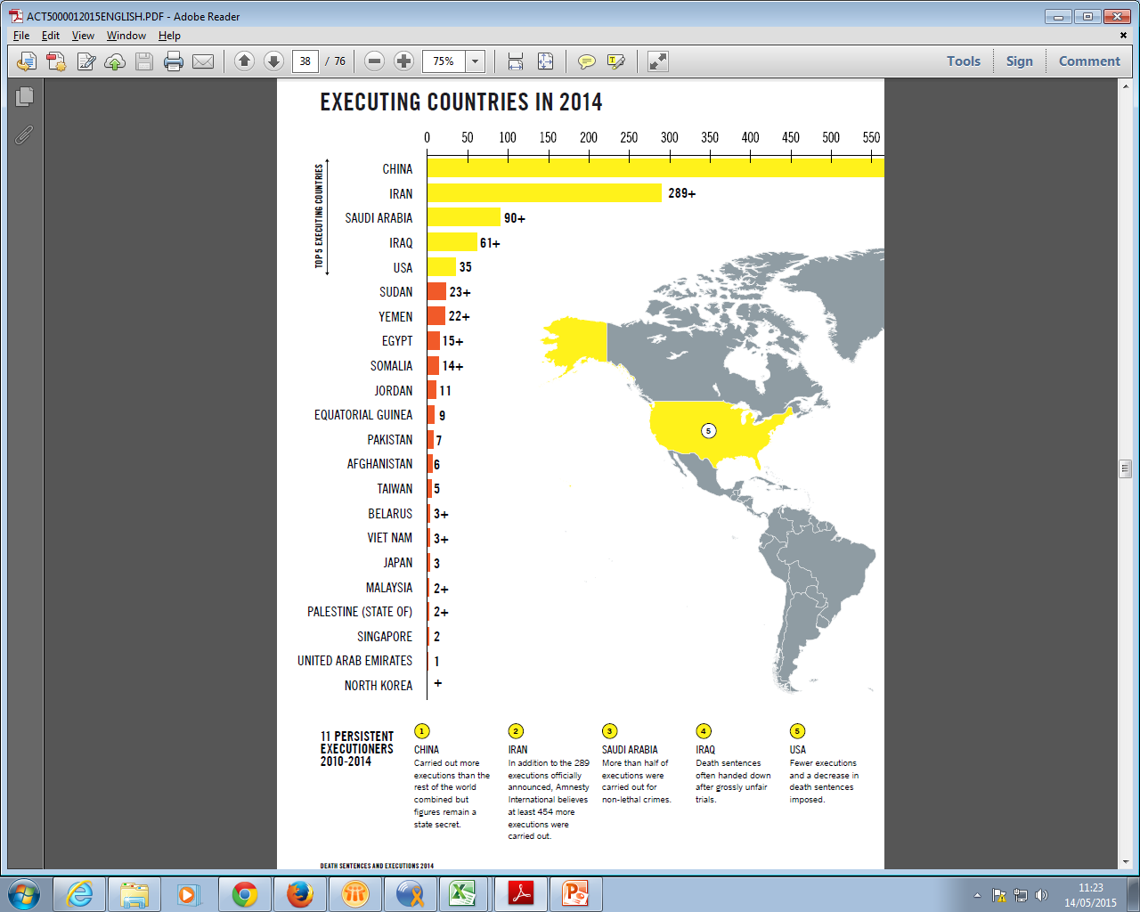
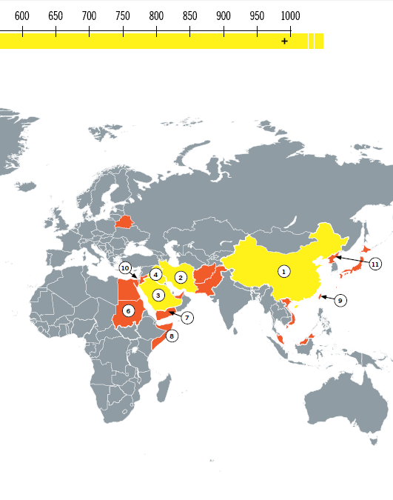
Where?
Notes:
Slide 7: Where?
This map breaks down where all the executions took place in 2014.
You may include the following:
This map shows where all the reported executions took place in 2014.
There were 607 known executions in the countries listed above in 2014.
Though as pointed out before there were likely thousands more specifically in China (where there were no official numbers) and Iran (where likely the full number of executions was not reported).
There is one country in Europe that still carries out the death penalty. That is Belarus, where there were 3 executions in 2014.
Activity - Prompt a discussion, is this what people expected? Are there any countries listed that they didn’t expect?

Slide 9
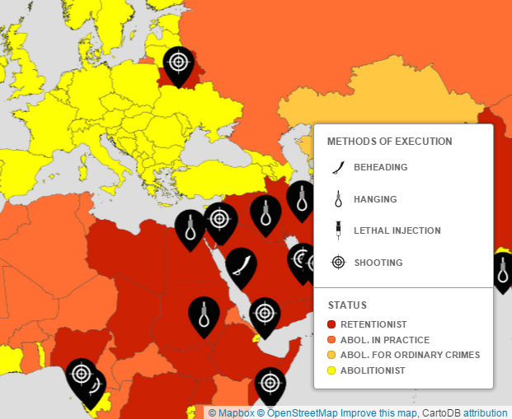
Methods of Execution
What are the most frequent methods of execution? Is there a humane way to take a life?
Notes:
Slide 8: Methods of Execution
This slide discusses means and methods of execution.
You may want to include:
The most common methods of execution are: Beheading (Saudi Arabia), Shooting (e.g. China, Yemen, Taiwan), Lethal injection (e.g. USA, China), Hanging (e.g. Afghanistan, India), Electrocution (some US states)
Ask the audience, if this is what they expected? Do some of these methods seem more or less humane?
Amnesty’s position is that none of these methods are in any way “humane”. There is no right way to take someone’s life.
The above are not the only means of execution, in past years stoning and firing squads have also been used.
While there have been no executions by stoning for a number of years, in 2014 the United Arab Emirates sentenced a woman to death by stoning for allegedly committing adultery.
On the 5 June 2015, 6 men were executed in 4 different prisons in Taiwan by shooting (this is slightly different from a firing squad in that it only involves a single gunman) for the crime of murder. Amnesty International condemned the executions as politically motivated.
This challenges possible views on humane forms of executions. It is worth pointing out that despite arguments to the contrary, none of the methods of execution can be considered humane. They all involve anticipation, often for many years. Some involve public humiliation. Families and friends suffer long term effects. In some cases (e.g. in Indonesia, Malaysia, South Sudan) families and lawyers are often not told execution is taking place.

Slide 10
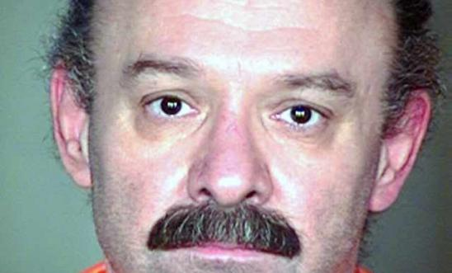
In focus: Lethal Injection
© EPA/Arizona Department of Correction
Notes:
Slide 9: In focus: Lethal Injection
This slide will discuss the use of the lethal injection and why this method of execution is far from humane.
You may include the following:
The lethal injection, which is adopted by the majority of death penalty states in the US is often considered a “humane” method of execution. However, it is a form of cruel and unusual punishment and is often excruciatingly painful.
While a “normal” lethal injection takes about 10 minutes for death to occur, it has sometimes resulted in prolonged suffering even taking hours for an individuals life to end.
One such case was the execution of Joseph Wood (pictured). Wood, who was convicted of the 1989 murder of his former girlfriend and her father, was executed in July 2014. His death illustrates just how cruel the use of the lethal injection can be.
At his execution the lethal injection was administered at 1.52pm, however the process took so long that his lawyers had time to file an emergency motion in a federal court in an attempt to have it stopped while the prisoner was still alive. Wood was pronounced dead around 3.49pm, meaning it took nearly two hours for him to die.
Amnesty International USA Researcher Rob Freer said: “How many more times do officials need to be reminded of the myth of the ‘humane execution’ before they give up on their experiment with judicial killing?”
“However the state chooses to kill the prisoner - and whether the execution goes according to plan or not - does not change the fact that this is a punishment incompatible with fundamental human rights principles.”
Amnesty does not believe that there is any such thing as a humane execution, or that the cruelty of the death penalty is confined to what goes on in the death chamber (for example see the next slide on “death row”).
Activity
Which of Joseph Wood’s human rights do you think were violated? Discuss in small groups or pairs and report back. (10 minutes)
You can print off and provide a copy of the Universal Declaration of Human Rights to help them (simplified version by Amnesty International available here: http://www.amnesty.org.uk/resources/document-universal-declaration-human-rights-simplified).

Slide 11
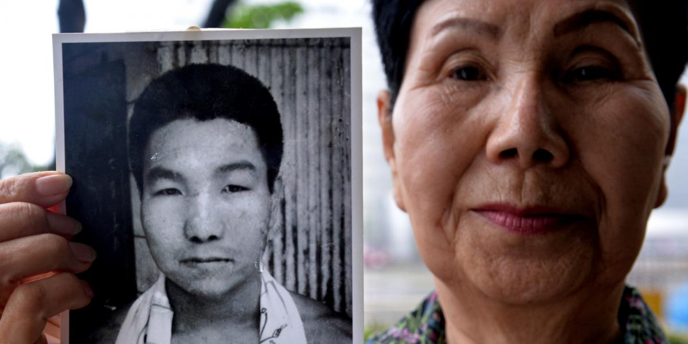
Death Row
Spending years on death row is a cruel and inhuman punishment.
Hideko Hakamada, sister of Iwao Hakamada, campaigned on her brother's behalf for decades. (c)Kazuhiro/AFP/Getty Images
Notes:
Slide 10: Death Row
This slide looks at how the conditions of being on death row can amount to cruel and inhuman punishment.
You may include the following:
In 2014, around 19,094 people are thought to be on death row worldwide, down from 23,392
It is important when discussing the death penalty to consider the conditions of inmates on death row. Inmates often face much harsher regimens than regular prisoners, as well as the constant stress and isolation from facing death. In some cases they have no knowledge of when it might happen and are only told on the morning of their execution.
This is Hideko Hakamada, whose brother Iwao Hakamada was on death row in Japan.
In Japan, death row inmates are in almost total isolation in a 5 sq. m cell with:
Limited family contact.
Lights on 24/7.
Forced to sit upright at all times in cell apart from at bedtime.
No speaking to other prisoners or even making extended eye contact with guards.
Monitored 24/7.
Hakamada (pictured) was sentenced to death in Japan in 1968, it was finally agreed that he had been forced to confess and he was finally released in 2014 pending a retrial.
He spent 46 years on death row and his years on death row have caused a severe decline in his mental health.

Slide 12

Juveniles
© Private
Notes:
Slide 11: Juveniles
This slide gives a brief overview on the international law around sentencing juvenile (under 18’s) to death. In international law those under 18 at the time of an alleged crime must not be executed.
This is a picture of Moses Akatugba who was accused and tried for armed robbery in Nigeria in 2005, when he was 16. Moses was shot in his hand and was beaten with a machete and batons in the head and back by soldiers and police officers at the time of arrest, and later at the Police Station. He told a human rights defender that he was tied and hanged in the interrogation room for several hours.
In 2013 he was sentenced to death by hanging. After 10 years in jail with the help of Amnesty and its supporters he was pardoned. However because he was under 18 at the time of the crime he never should have been sentenced to death.
You may include the following:
International law requires that no state execute people for crimes committed when they were a minor, e.g. Under 18 years of age. Despite this a number of countries continue to execute minors in violation of this law.
At least 14 minors in Iran were executed in 2014 in violation of this law.
Juvenile offenders were sentenced to death in Egypt, Iran and Sri Lanka.
In addition, Iran, Maldives, Nigeria, Pakistan, Saudi Arabia, Sri Lanka and Yemen, gave death sentences to people who were juveniles at the time of their alleged crimes.
In one case, Pakistan executed a man on 10 June 2015 for crimes committed when he was 15, largely based on a confession that was allegedly given under torture.
Often the actual age of the offender is in dispute because no clear proof of age, such as a certificate of registration at birth, exists.
Amnesty argues that governments should apply a full range of appropriate criteria in cases where age is in dispute. Good practice in assessing age includes drawing on knowledge of physical, psychological and social development.
The benefit of doubt should be given in disputed cases so that the individual is treated as a juvenile offender, and accordingly should ensure that the death penalty is not applied.
There are several international laws against the use of capital punishment for crimes committed when someone is under the age of the 18, but one of the most widely recognised, the UN Convention on the Rights of the Child, states in Article 37:
States Parties shall ensure that:
No child shall be subjected to torture or other cruel, inhuman or degrading treatment or punishment. Neither capital punishment nor life imprisonment without possibility of release shall be imposed for offences committed by persons below eighteen years of age;

Slide 13
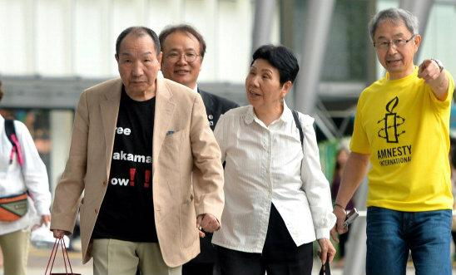
Mental Incapacity and Illness
‘Living each day knowing that you may be sent to your death at any given month, day or moment is torture. Being on death row dehumanises and has a massive psychological effect on a person. It’s an awful penalty to inflict on anyone, and is even more devastating for someone who is innocent.’
Sakae Menda, first Japanese prisoner to be released from death row, speaking in 2007 to the United Nations
Former Japanese death row inmate Hamakada returns to his hometown, 27 May 2014 © The Asahi Shimbun
Notes:
Slide 12: Mental Incapacity and Illness
This slide looks at the role mental health plays in death penalty cases and what the international human rights framework says about the human rights of people suffering from mental health issues.
You may include the following:
Mental incapacity or illness is often not taken into account in sentencing and carrying out the death penalty or when keeping people on death row.
The UN Commission on Human Rights in 2000 urged all countries with the death penalty “not to impose it on a person suffering from any form of mental disorder and not to execute any such person.”
People with mental or intellectual disabilities were under sentence of death in countries including Indonesia, Japan, Malaysia, Pakistan, Trinidad and Tobago and the USA.
Although this is a major concern we have very little data as most governments refuse to do tests and those that do not provide data to Amnesty. We do know that people in the USA have been sentenced and executed despite mental health issues. This was the case in April 2014, when Ramiro Hernandez Llanes, a Mexican national, was executed in Texas despite having an intellectual disability.
In addition, extended periods on death row can also cause incredible strain and lead to severe mental health issues. Hakamada (pictured) spent 46 years in isolation and was finally released in 2014 pending a retrial. He has suffered severe mental health issues.
Amnesty’s movement is vital in stopping such executions taking place. One such case was Osariakhi Ernest Obyangbon, a Nigerian national, who was due to be executed in Malaysia on 14 March 2014. He had not received a fair trial and had been diagnosed as having schizophrenia, for which he had been receiving treatment before his appeal in 2007. Amnesty International was notified of the imminent execution 36 hours before it was due to be carried out and issued urgent appeals to the Malaysian authorities. His execution was commuted.

Slide 14
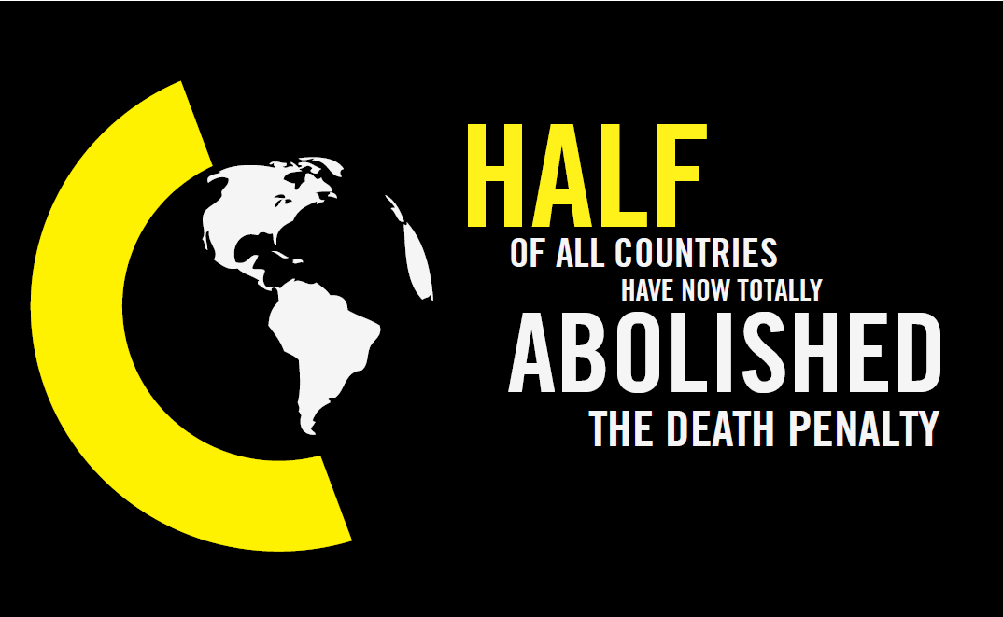
Notes:
Slide 13: Abolition and the history of Amnesty’s Campaigning
This slide will briefly discuss the success of our campaign against the death penalty so far.
You may include the following:
When Amnesty started in 1961 only 9 countries had abolished the death penalty. When we began campaigning against the death penalty in 1977, only 16 countries had abolished the death penalty in law or practice. Today, the number has risen to 141.
This slide shows the positive trend as more states continue to abolish the death penalty for all crimes. A number of others have abolished it either in practice (if not in law) or have abolished it for “ordinary crimes” (everything excluding the military or exceptional cases).
99 countries have abolished the death penalty for all crimes. 7 have abolished it for ordinary crimes, and 35 are abolitionist in practise. In total this is 141 countries (of 193 UN member states).
In addition 18 States in the USA have abolished the death penalty and 32 still retain it.
A bill to abolish the death penalty remained pending in Mongolia. Legislators in Fiji, Republic of Korea (South Korea) and Thailand began debates on abolition of the death penalty, with debates in Fiji leading to the abolition of the death penalty for all crimes in February 2015.
These are some of the positive developments that Amnesty has been campaigning on for nearly 40 years.

Slide 15
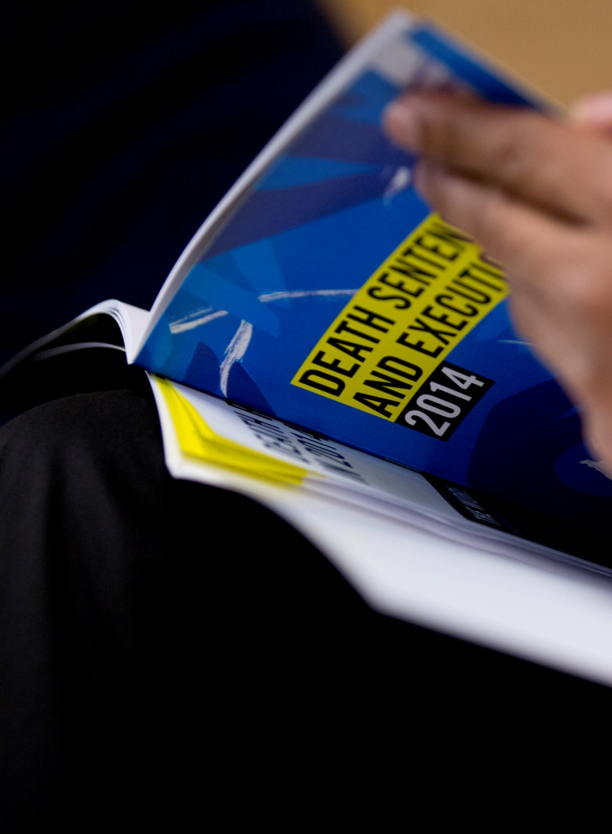
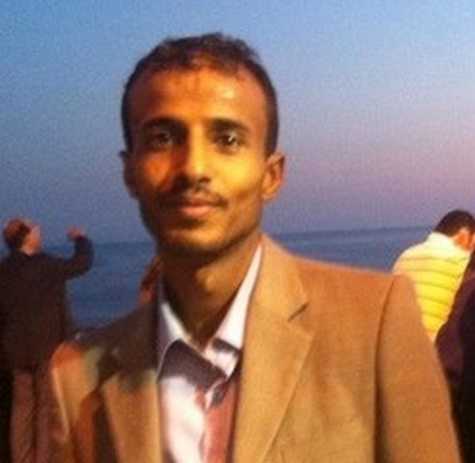
Conclusion
“I owe my life to Amnesty. Now I dedicate that life to campaigning against the death penalty.”
Hafez Ibrahim, Yemen
Notes:
Slide 14: Conclusion
This concluding slide will reiterate Amnesty’s commitment to abolishing the death penalty and how it has helped individuals like Hafez Ibrahim, who was sentenced to death in Yemen in 2007.
You may include the following:
We still have a long way to go and will continue to campaign until the death penalty is abolished in all countries.
Amnesty’s message on the issue is very clear:
Amnesty International opposes the death penalty in all cases without exception; it violates the right to life and is the ultimate cruel, inhuman and degrading punishment.
We know that, together, we can end the death penalty everywhere.
Hafez Ibrahim (pictured), was about to be executed in Yemen in 2007 when he sent a mobile text message to Amnesty. It was a message that saved his life. He has said, “I owe my life to Amnesty. Now I dedicate that life to campaigning against the death penalty.”
Amnesty International campaigns for:
An immediate halt to executions
Abolition of the death penalty as a form of punishment in every country.
Countries that still use the death penalty must immediately halt all executions.
Countries that have already stopped executing people need to take this punishment off their legal books for all crimes, permanently.
All death sentences should be commuted to prison sentences.
Information and opportunities to take action:
http://www.amnesty.org.uk/issues/Death-penalty
https://www.amnesty.org/en/what-we-do/death-penalty/

